Slide 1

Data Exploration of NYC Taxi Trip Durations

Slide 2
PROJECT GOALS
Perform Exploratory Data Analysis (EDA) to understand underlying trends, distributions, and potential correlations in the NYC taxi dataset.
Identify which vendor is most preferred by passengers based on key trip patterns and fare data through univariate and bivariate analysis.

Slide 3
DATA SOURCE
NYC Taxi and Limousine Commission
The data comes from several vendors who manage the meter/gps systems in the cabs

Slide 4
RELEVANT FEATURES
Trip Fields
pickup_datetime
dropoff_datetime
trip_time
trip_distance
pickup_latitude
pickup_longitude
dropoff_latitude
dropoff_longitude
passenger_count

Slide 5
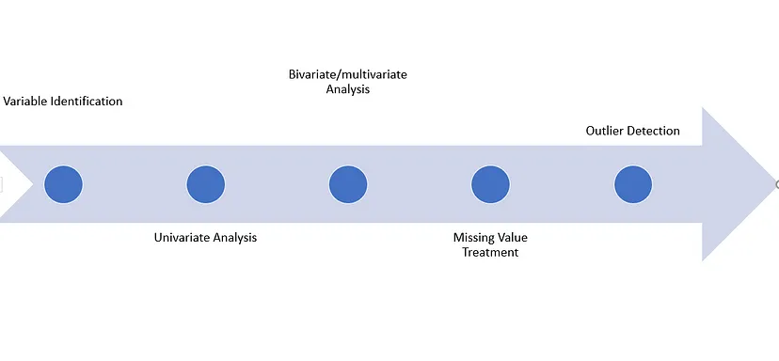
DATA EXPLORATION APPROACH

Slide 6
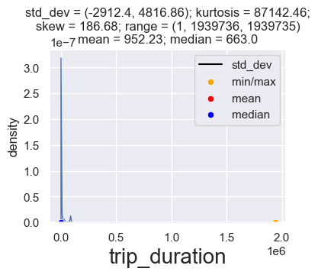
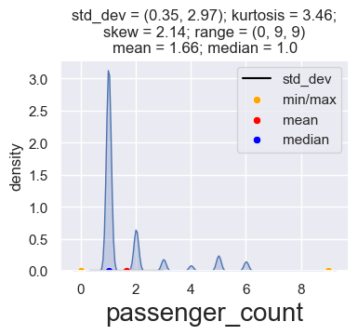
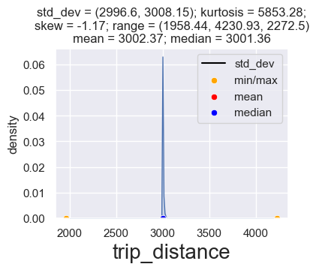
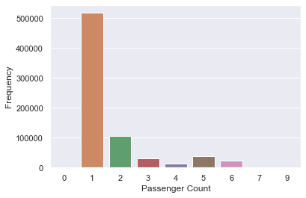
VISUALIZATIONS Normal Distribution Plots

Slide 7
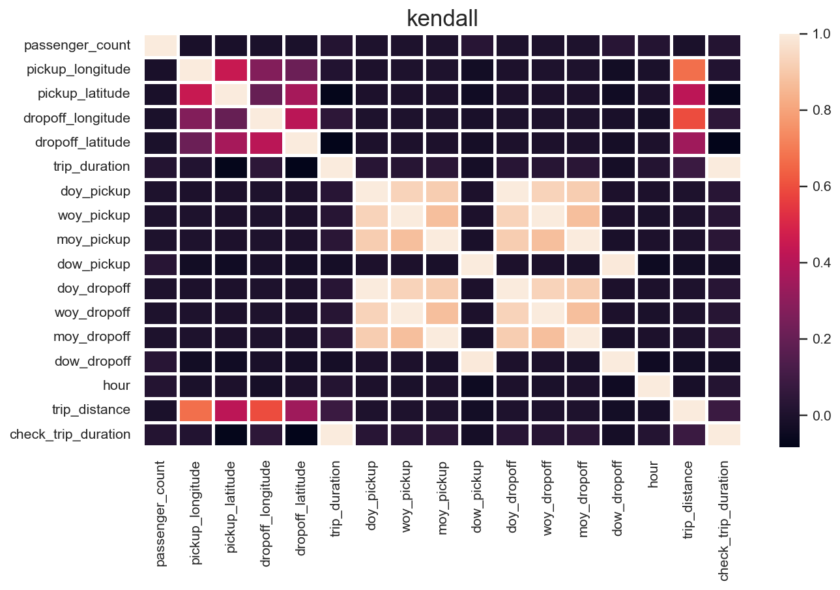
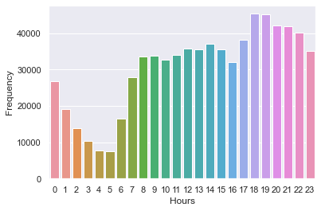
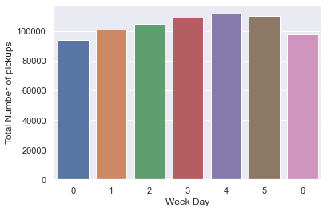
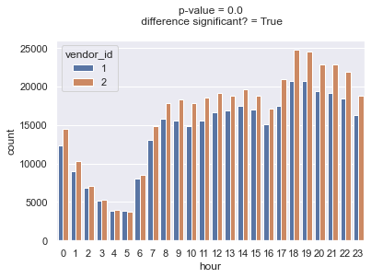
VISUALIZATIONS
Correlation, Temporal & Trip Charteristics Plots

Slide 8
INFERENCE
Trip Characteristics: Most trips involve only one passenger, with higher passenger counts (7-9) being very rare. Data shows minimal storing of trip information.
Temporal Patterns: Thursdays are the busiest days, while weekends see the fewest trips. The peak time for trips is between 6-7 p.m., and March is the busiest month.
Vendor Preferences: Vendor 2 has more trips compared to Vendor 1 throughout the day, indicating a preference for Vendor 2

Slide 9
QUESTIONS?
Thanks!

