Slide 1

HR ANALYTICS DASHBORDS
USING POWERBI
DIVYA KUMAR

Slide 2


Introduction
The HR Analytics Dashboard provides an in-depth analysis of employee data, focusing on key metrics such as attrition, salary distribution, education background, and job roles. This data-driven approach helps identify trends and areas for improvement in employee retention, satisfaction, and overall organizational efficiency.
The primary goal of this analysis is to uncover actionable insights that can guide strategic decisions, enhance workforce management, and reduce attrition rates.
By exploring these visuals, we aim to highlight:
The departments and roles with the highest turnover.
The impact of education, salary, and experience on attrition.
Opportunities to improve employee satisfaction and engagement.
This dashboard is a step towards fostering a thriving and sustainable workforce.

Slide 3
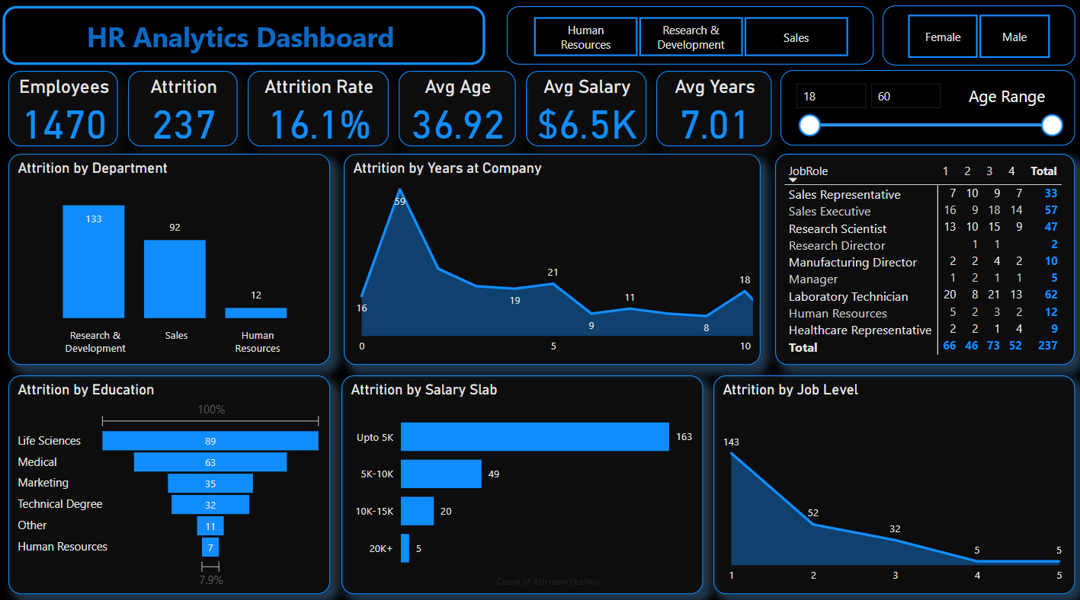
Dashboard

Slide 4
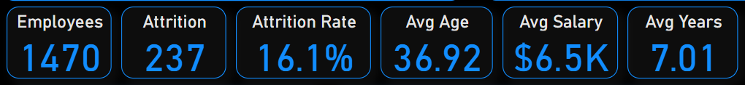
Key Metrics
Overview of Key Metrics
Employees: 1,470
Attrition: 237 employees (16.1% attrition rate)
Average Age: 36.92 years
Average Salary: $6.5K
Average Years at Company: 7.01 years

Slide 5
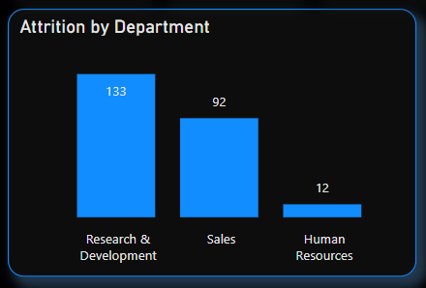
Attrition by Department
Visualization: Bar Chart
Key Points:
Research & Development: Highest attrition (133 employees).
Sales: 92 employees.
Human Resources: Least attrition (12 employees)
Insight: Attrition is significantly higher in the Research & Development department. This could indicate issues like job satisfaction, management, or growth opportunities.

Slide 6
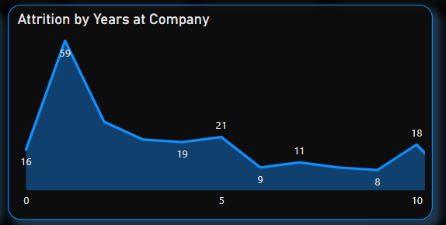
Attrition by Years at Company
Visualization: Line Graph
Key Points:
Peak at 1 Year: 59 employees leave within the first year.
Decrease with Time: Attrition decreases as employees stay longer at the company, except for a slight spike at 5 years.
Insight: The first year sees the highest turnover. Improving onboarding, initial training, and career path clarity can help reduce this early attrition.

Slide 7
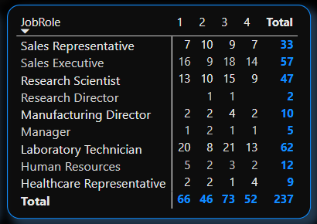
Attrition by Job Role
Visualization: Table/Bar ChartTop Attrition Roles:
Sales Executive: 57 employees.
Laboratory Technician: 62 employees.
Research Scientist: 47 employees.
Low Attrition Roles: Manufacturing Director (10), Research Director (2).
Insight: Employee turnover is higher in operational roles (Sales, Laboratory, Research). Investigate the workload and career growth opportunities in these roles.

Slide 8
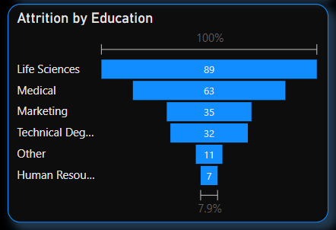
Attrition by Education
Visualization: Stacked Bar Chart
Key Points:
Life Sciences: Highest attrition (89 employees).
Medical Field: 63 employees.
Technical Degrees and Other Fields: Lower attrition rates.
Insight: Higher attrition among employees with Life Sciences and Medical backgrounds. Investigate how job satisfaction and career progression could be improved for these groups.

Slide 9
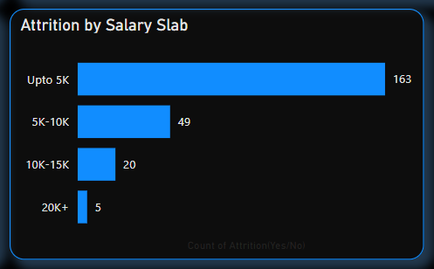
Attrition by Salary Slab
Visualization: Bar Chart
Key Points:
Upto $5K Salary: Majority of attrition (163 employees).
5K-10K Salary: 49 employees.
10K-15K Salary: 20 employees.
20K+: 5 employees.
Insight: Employees earning lower salaries (Upto $5K) are leaving at a higher rate. Consider salary benchmarking and introducing retention strategies for lower-paid employees.

Slide 10
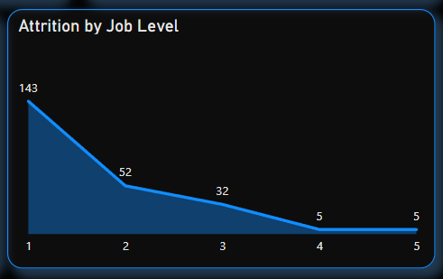
Attrition by Job Level
Visualization: Bar Chart
Key Points:
Level 1: Highest attrition (143 employees).
Level 2-3: Decreasing attrition rates.
Level 4-5: Low attrition (5 employees).
Insight: New and entry-level employees (Level 1) experience the highest attrition. Providing better onboarding and engagement can improve retention for these employees.

Slide 11
Conclusion
Insights
The average age of employees who left the company is 37 years.
The Research & Development department witnessed the highest attrition, accounting for 133 of the total.
The majority of employees who left the company belonged to the salary range below $5000 per month, comprising 163 individuals.
Among employees who left, the highest attrition rate was observed among those who spent 1 year at the company (25%), followed by 2 years (11%) and 5 years (9%).
The educational background of employees who left the company indicates that 89 individuals had a Life Science background, 63 had a Medical background, and 35 had a Marketing background.
Male employees experienced an attrition rate of 17%, while female employees had a slightly lower attrition rate of 14.8%.
The attrition rate in the Research & Development department was the highest at 56%, followed by Sales at 39% and the HR Department at 5%.
Approximately 69% of employees who left the company fell under the salary range below $5000, while 21% fell under the $5000-$10,000 range, 8% under the $10,000-$15,000 range, and 2% under the $20,000 range.
Recommendations
• Recommendations: Implement retention strategies for employees around 40 years old.
• Address attrition in the Research & Development department.
• Enhance compensation and benefits for employees in lower salary ranges.
• Develop employee engagement initiatives for early career employees.
• Provide opportunities for career growth and learning based on educational backgrounds.
• Pay attention to gender disparities in attrition and promote diversity and inclusion.
• Mitigate attrition in the Research & Development and Sales departments with department-specific strategies.
• Regularly review and adjust salary ranges to ensure competitiveness.

Slide 12


