Slide 1

Project1
You tube data analysis
Using
Hadoop

Slide 2
Purpose and Scope
“YOU Tube has over a billion users and every day people watch hundreds of millions of hours on You Tube and generate billions of views”.
“Every day, people across the world are uploading 1.2 million videos to You Tube, or over 100 hours per minute and this number is ever increasing[3].To analyze and understand the activity occurring on such a massive scale, a relational SQL database is not enough. Such kind of data is well suited to a massively parallel and distributed system like Hadoop.

Slide 3
This project using following concepts and tools:-
Hadoop
Hive
Pig
Sqoop

Slide 4
Description:-
In this,project I took youtube dataset .
Using the gui of ambari I have uploaded the file into hdfs.
Then I wrote the file into a table which can created in hive.
After importing file into the table in hive I performed some queries through which I want to do the analysis.

Slide 5

Data analysis using Hive:-

Slide 6
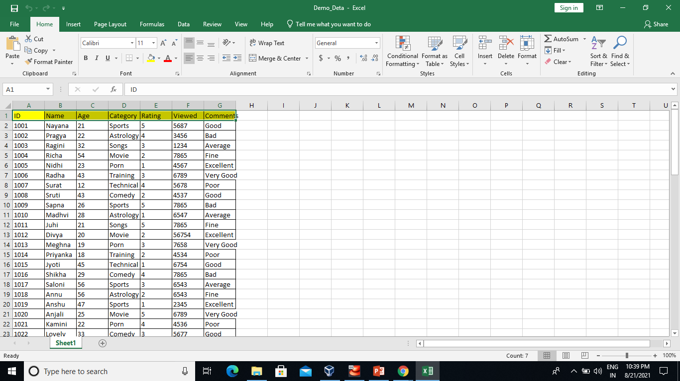
Input file

Slide 7
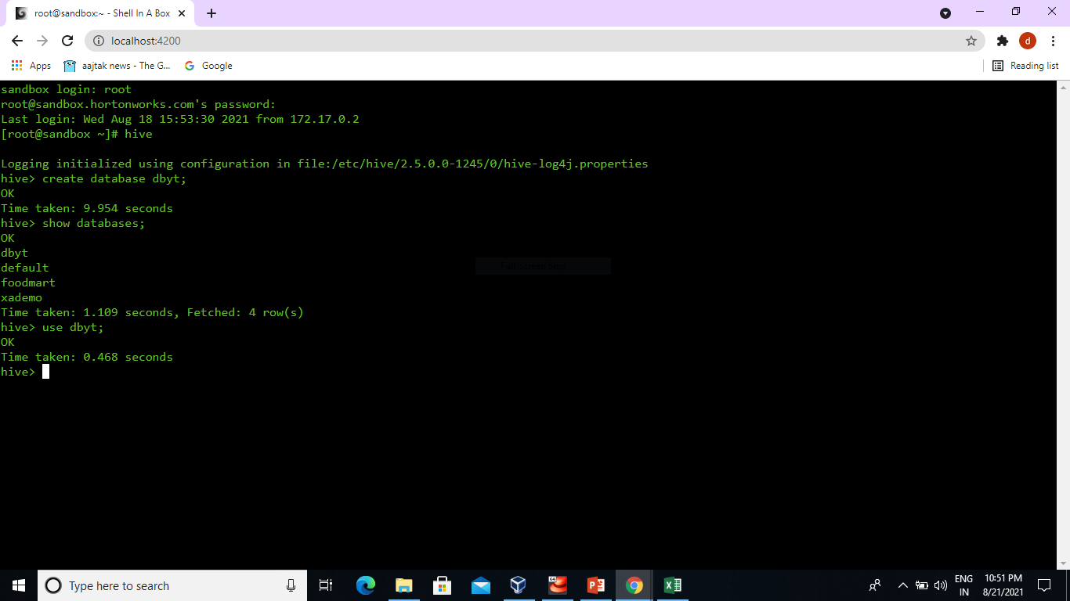
Step1: create database in hive. Command:create database dbyt;

Slide 8
Step 2: Create a table in hive and Load the You Tube data file into the Hive table. Command: create table tbyt(Id int,Name string,Age int,Category string,Rating int,Viewed int,Comment string) row format delimited fields terminated by ‘,’ stored as textfile location ‘/youtube’; step 3:display all the data in hive table. Command: select * from tbyt;

Slide 9
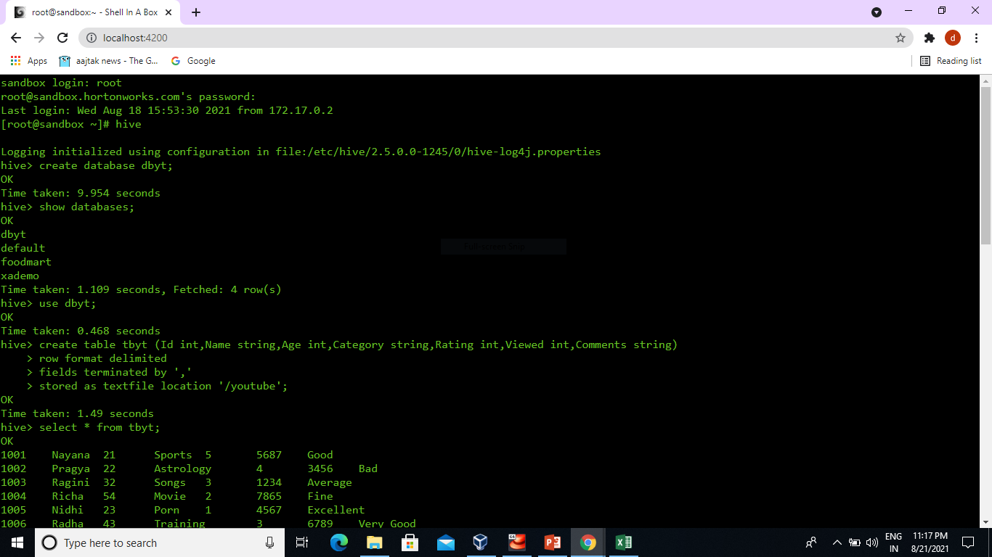

Slide 10
Query 1:-Identifies Top 5 catagories in which most of the videos are upload .
Command: select Category,count(viewed) as cnt FROM tbyt group by Category ORDER BY cnt DESC LIMIT 5;

Slide 11
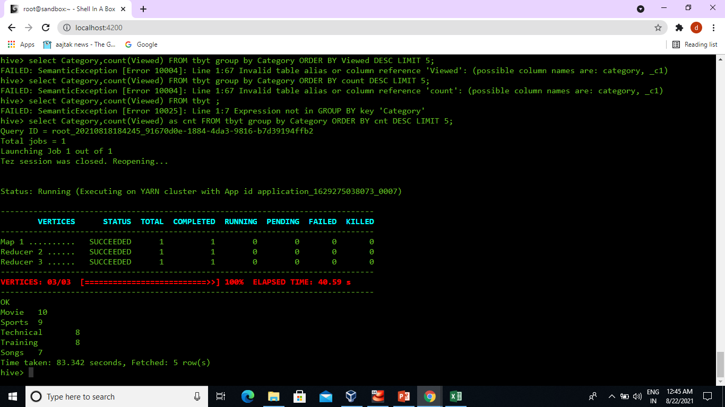

Slide 12
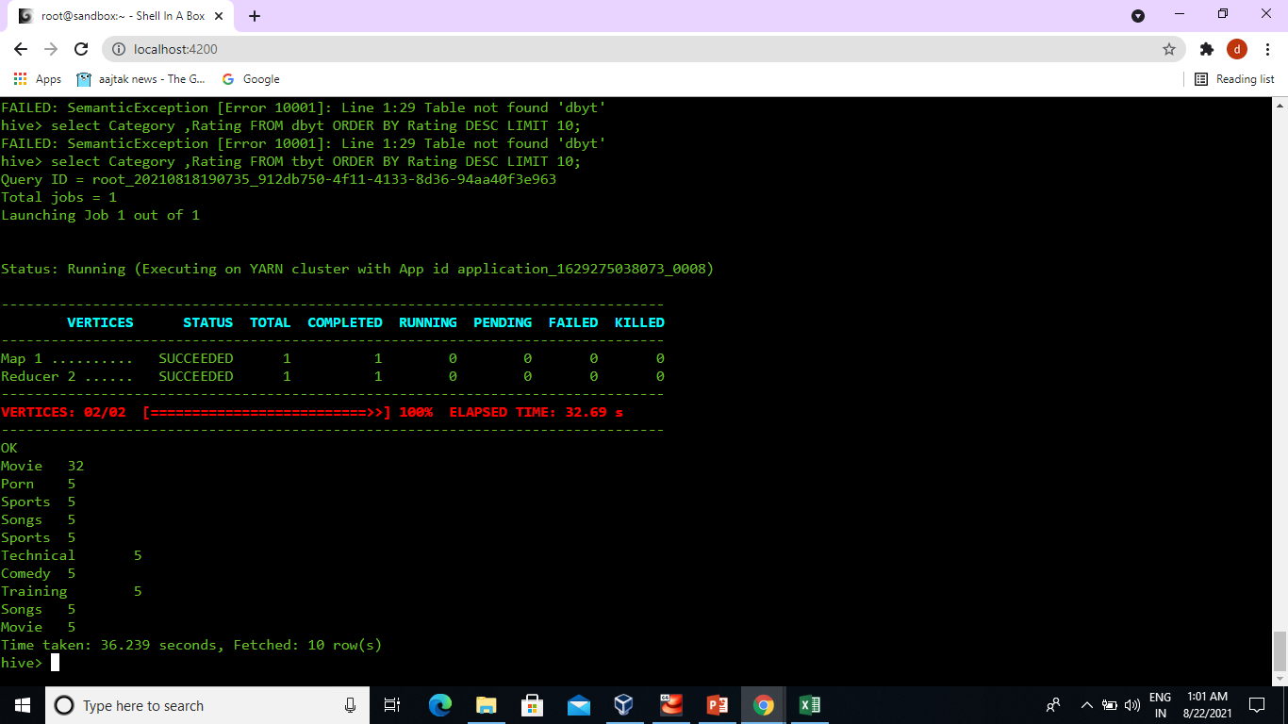
Query 2: Top ten highest rated videos Command: select Category,Rating FROM tbyt ORDER BY Rating DESC LIMIT 10;

Slide 13
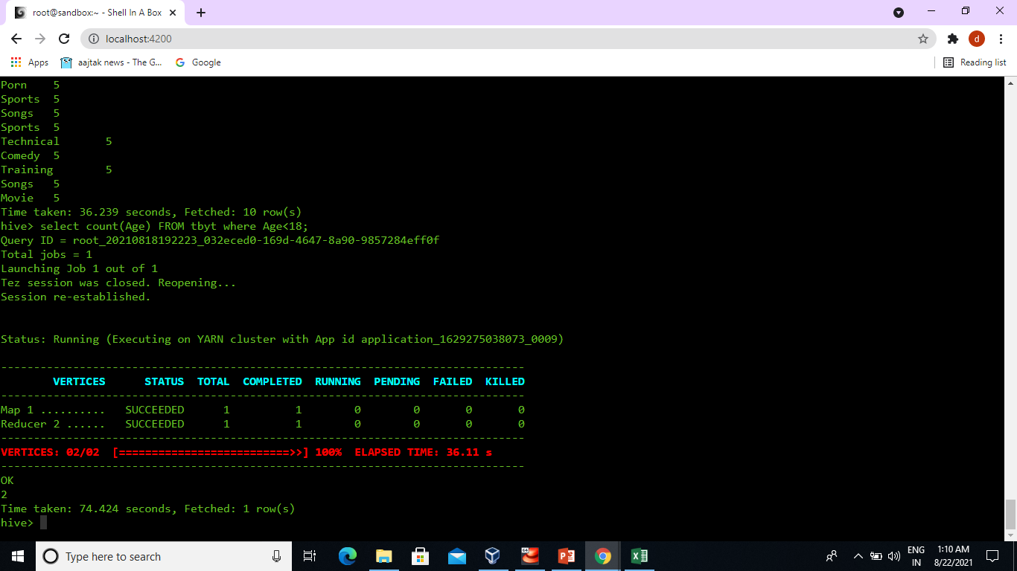
Query 3:How many peoples are less than 18 years old and uploaded videos Command:select count(Age) from tbyt where Age<18;

Slide 14
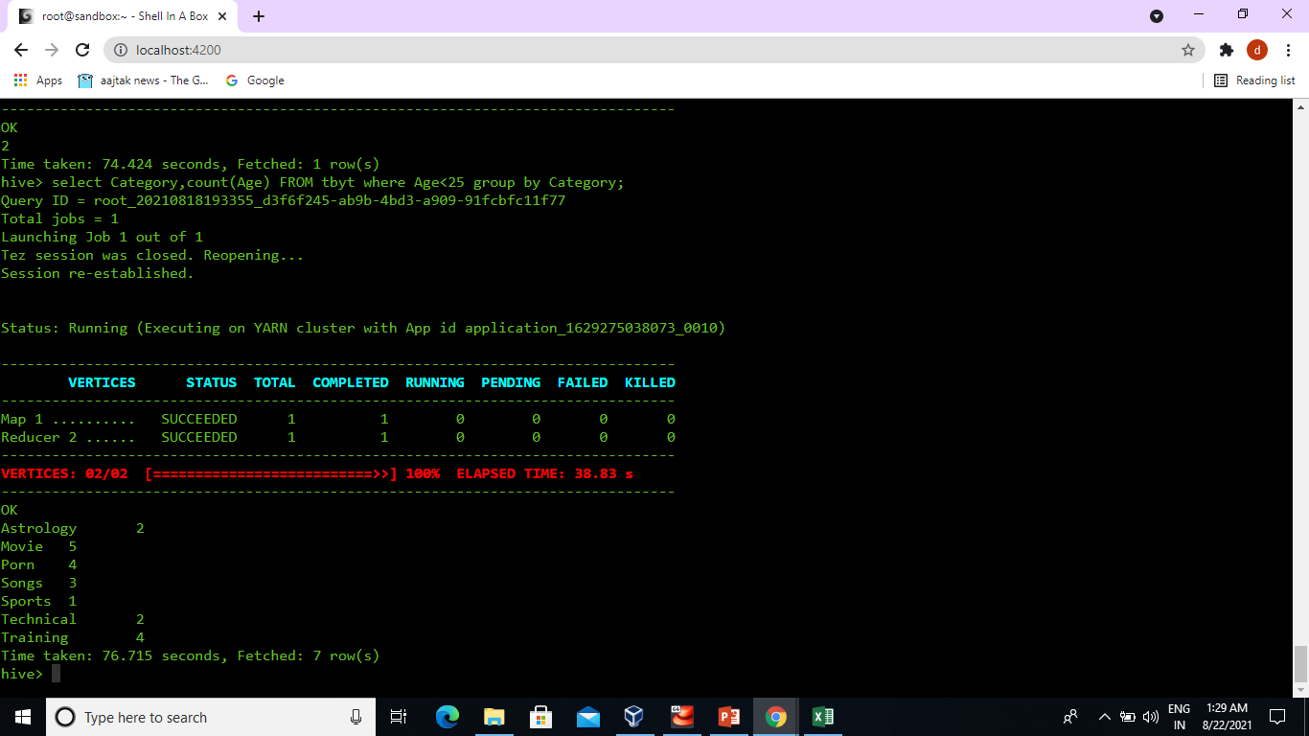
Query4: how many people in which category uploaded videos are less than 25 year. Command: select Category,count(Age) From tbyt where Age<25 group by category;

Slide 15
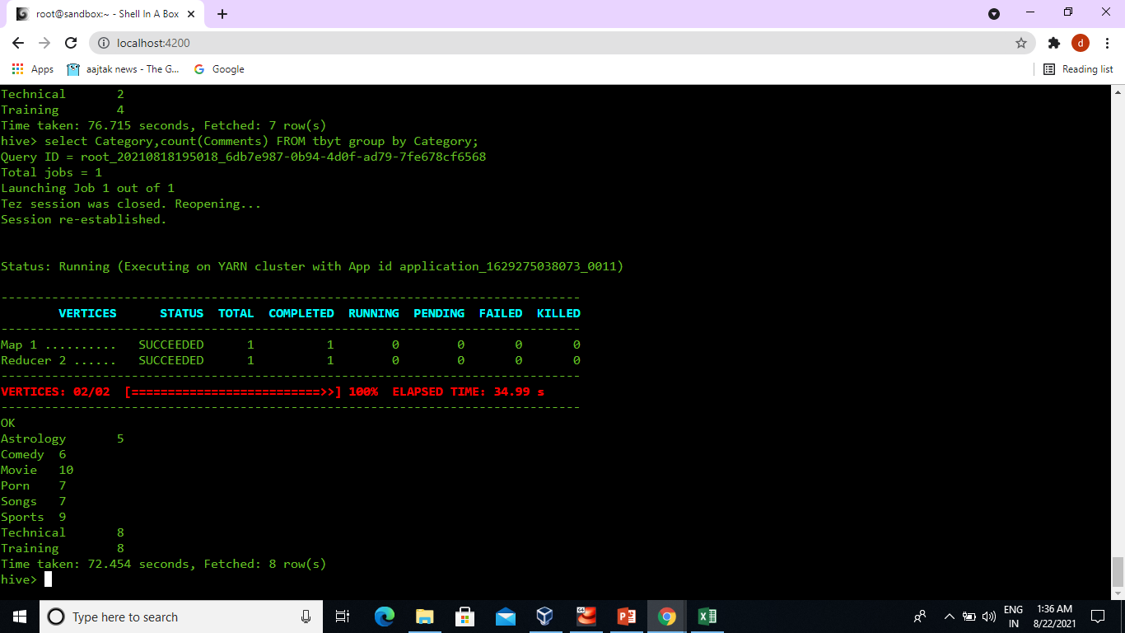
Query 5:Number of comment per videos. Command: select Category,count(Comments)from tbyt group by Category;

Slide 16
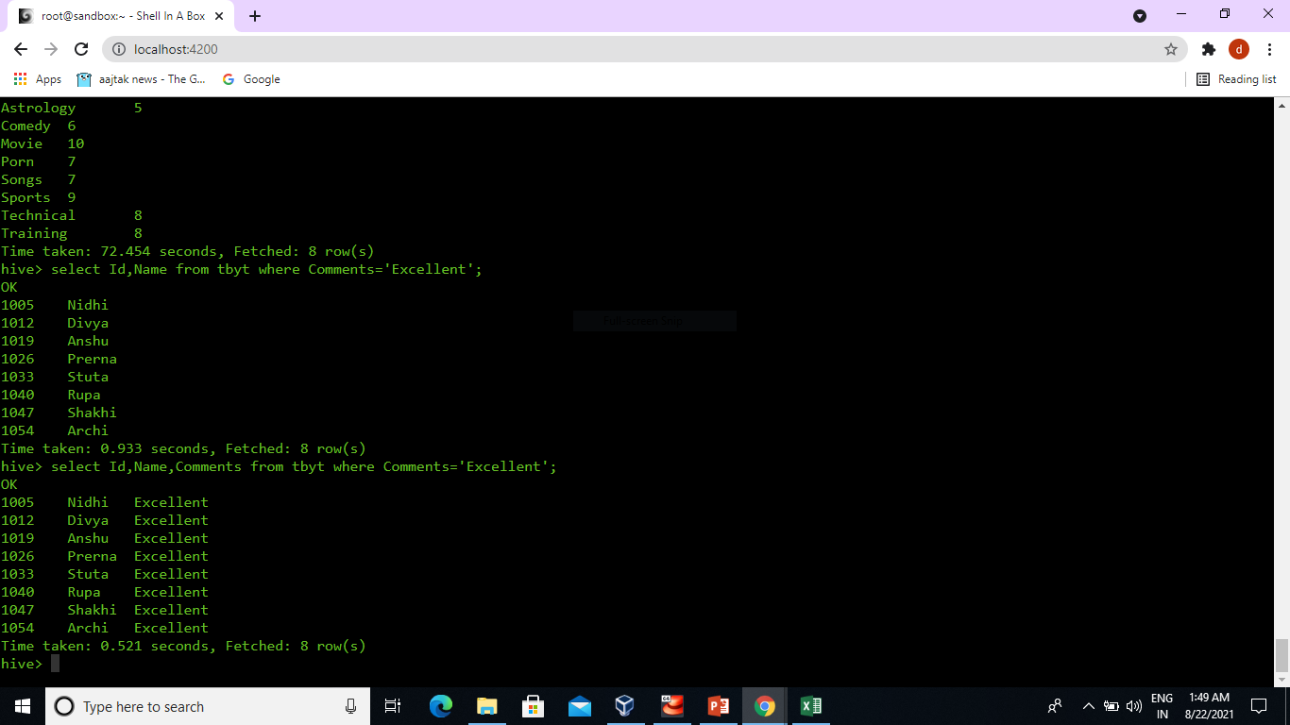
Query 6: Name and id of people who got the excellent Command:select Id,Name,Comments from tbyt where Comments=‘Excellent’;

Slide 17
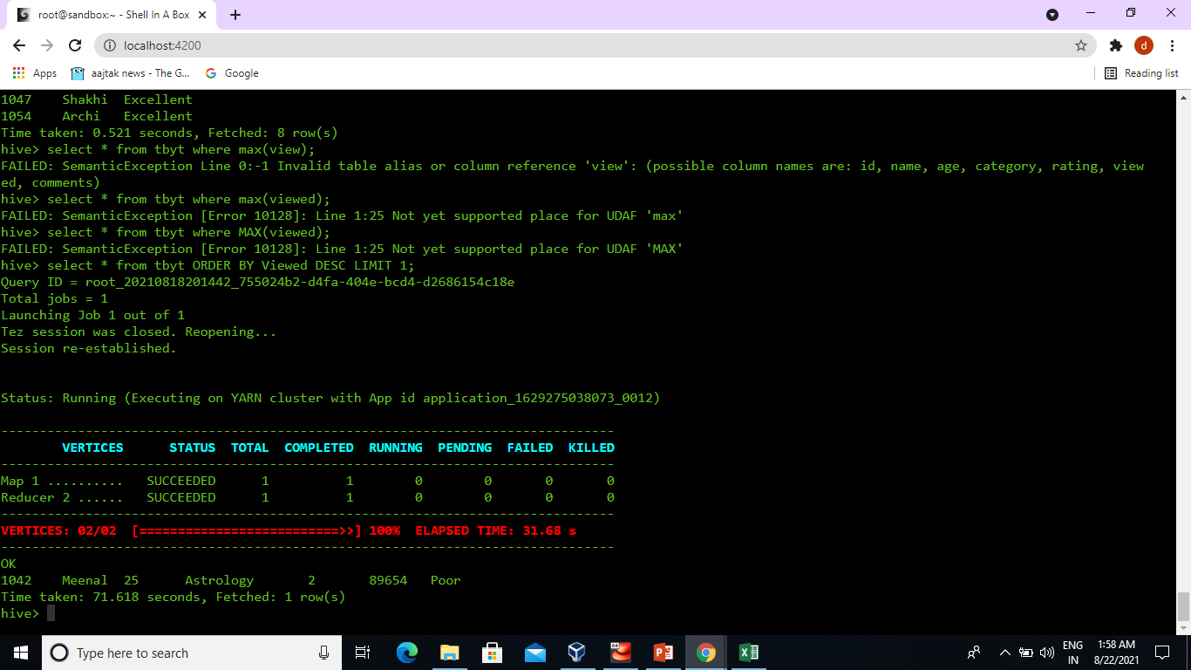
Query 7: select daetails of video which is maximum viewed Command: select * fromtbyt ORDER BY Viewed DESC LIMIT 1;

Slide 18

Data analysis using Pig:-

Slide 19
Step 1: Load the file in pig Command: A = LOAD ‘/user/root/DemoData.txt’ using PigStorage(‘,’) as (Id:int,Name:chararray,Age:int,Category:chararray,Rating:int,Viewed int,Comments:chararray); # dump A;

Slide 20
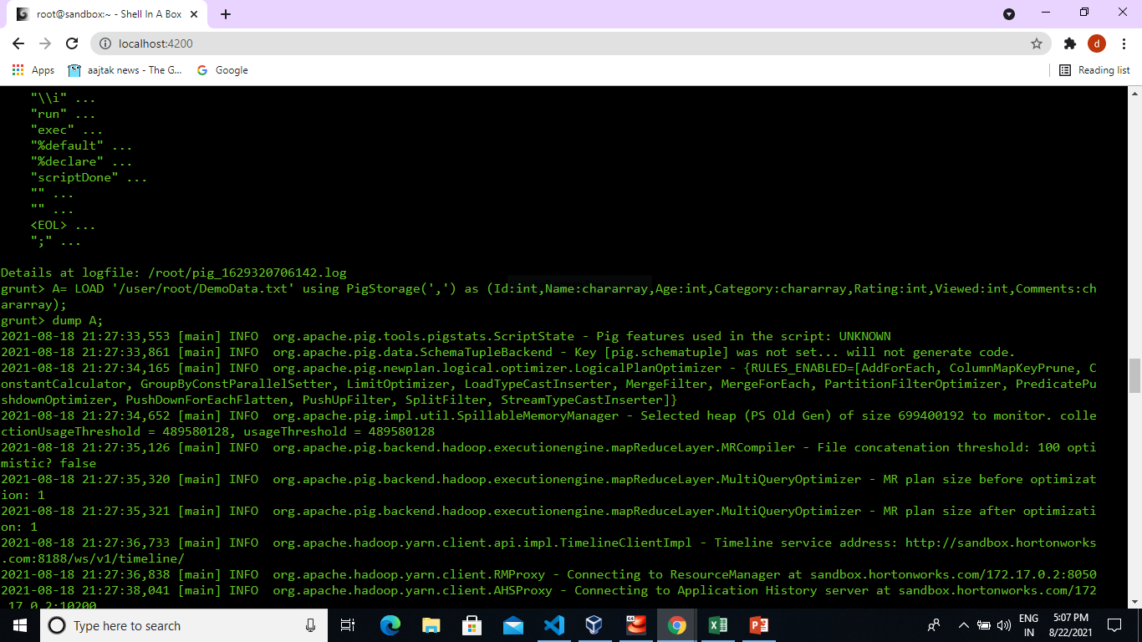

Slide 21
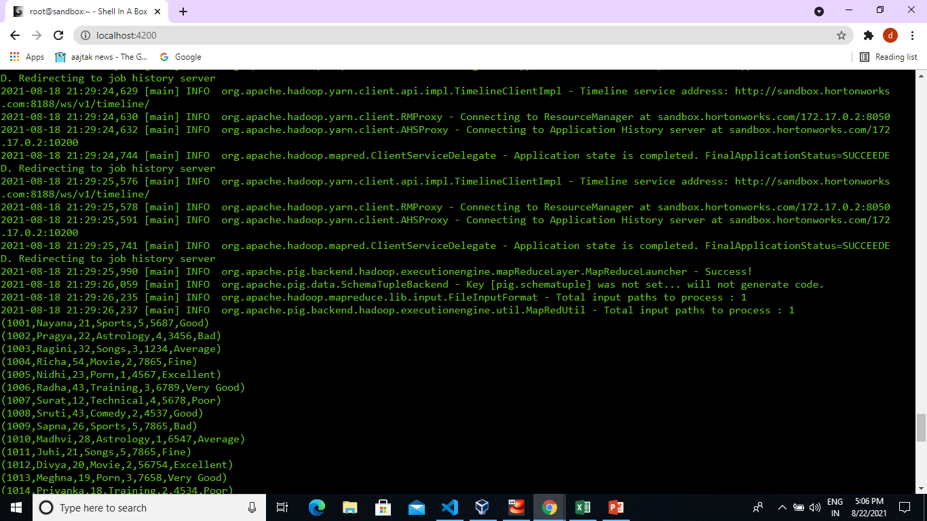

Slide 22
# Identify top 5 categories in which most of the videos are uploaded .
Command:-
A= LOAD ‘/user/root/DemoData.txt’ using PigStorage(‘,’);
B= group A by $3;
C=foreach B generate group,COUNT(A);
D=order C by $1 DESC;
E=limit D 5;
dump E;

Slide 23
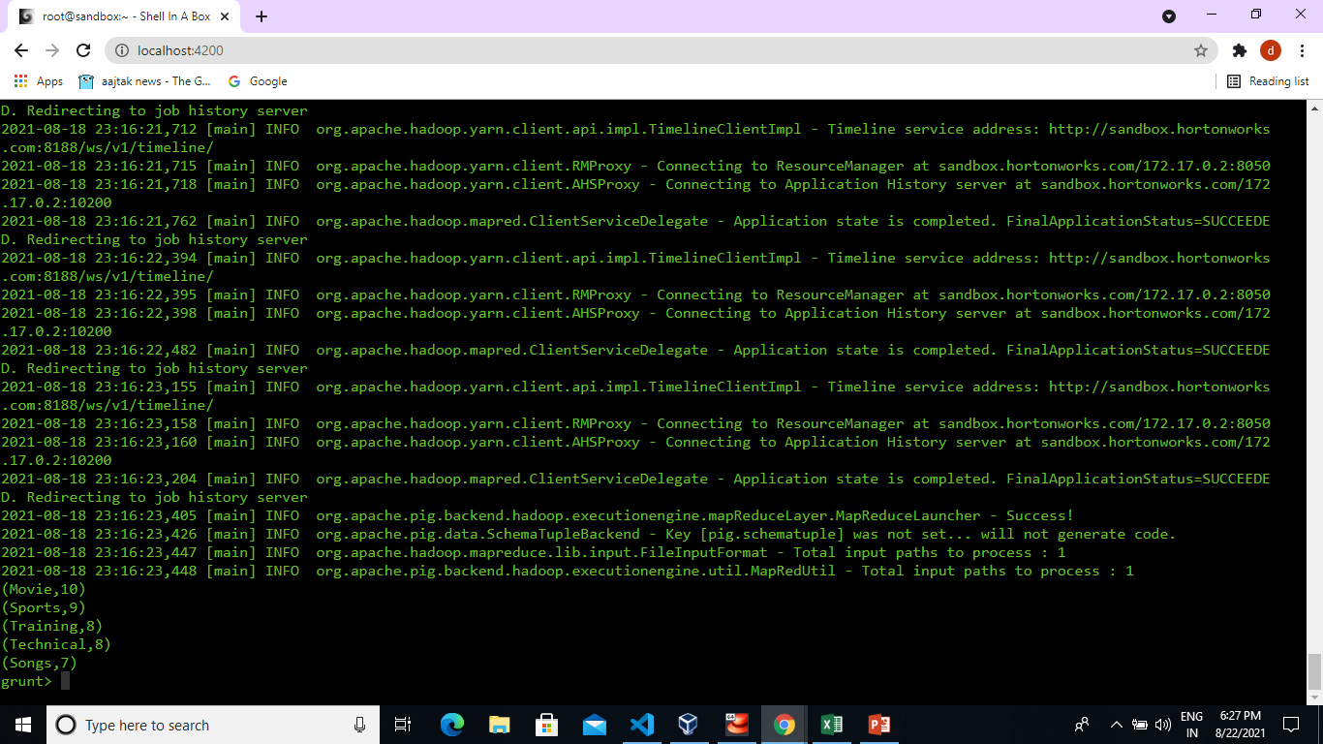

Slide 24
Top five highest rated videos
Command:
A= LOAD ‘/user/root/DemoData.txt’ using PigStorage(‘,’);
X=filter A by $0 !=‘ID’;
B=foreach X generate $0,$4;
C=order B by $1 DESC;
D=limit C 5;
dump D;

Slide 25
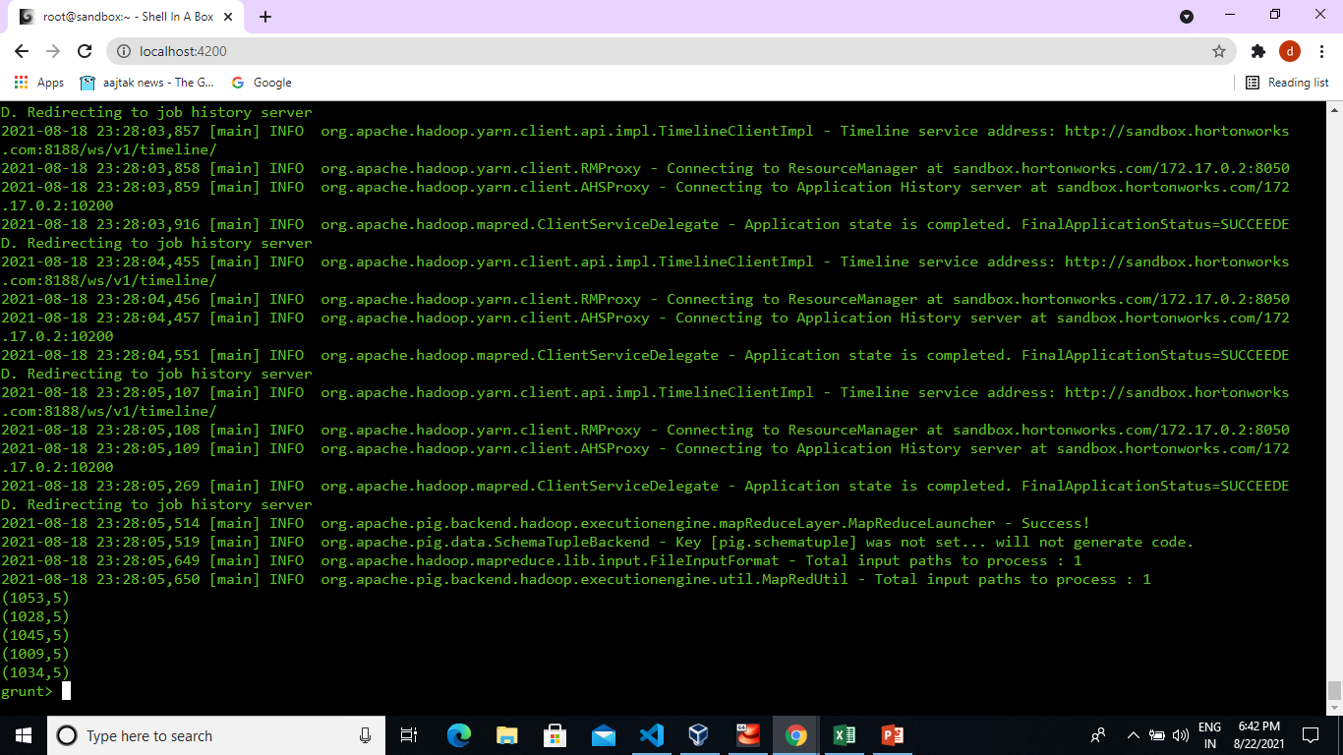

Slide 26
Top ten most viewed
Command:
A= LOAD ‘/user/root/DemoData.txt’ using PigStorage(‘,’);
X=filter A by$0 !=‘ID’;
B=foreach generate $0,$3,(int)$5;
C= order B by $2 DESC;
D= limit C 10;
dump D;

Slide 27
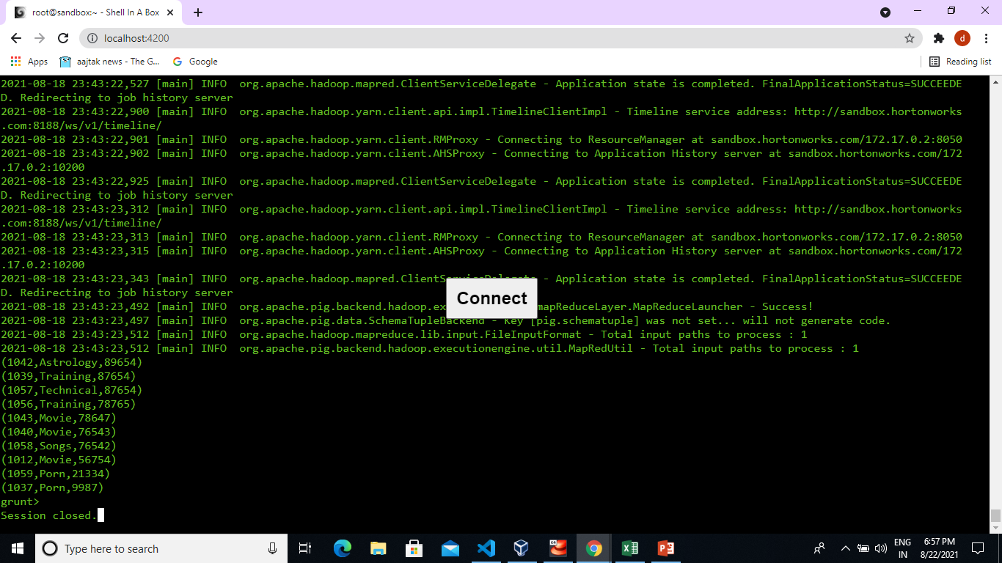

Slide 28
How many peoples are less than 18 years old and uploaded video ?
Command:
A= load ‘/user/root/DemoData.txt’ using PigStorage(‘,’);
X= filter A by $0!=‘ID’;
B= foreach X generate $1,(int)$2,$5;
C=filter B by $1<18 and $2!=0;
D= group C by $0;
E= foreach D generate COUNT(C);
F= group E by $0;
G= foreach F generate COUNT(E);
dump G;

Slide 29
