Slide 1
STACKS

Slide 2
Concept of Stacks
A stack is defined as a restricted list where all insertions and deletions are made only at one end, the top.
Each stack abstract data type (ADT) has a data member, commonly named as top, which points to the topmost element in the stack.
There are two basic operations push and pop that can be performed on a stack.
insertion of an element in the stack is called push
deletion of an element from the stack is called pop.

Slide 3
Operations of Stack
Push—inserts an element on the top of the stack.
Pop—deletes an element from the top of the stack
GetTop—reads (only reading, not deleting) an element from the top of the stack.
Empty—checks whether the stack is empty.
Full—checks whether the stack is full
Stack_initialization—sets up the stack in an empty condition.

Slide 4
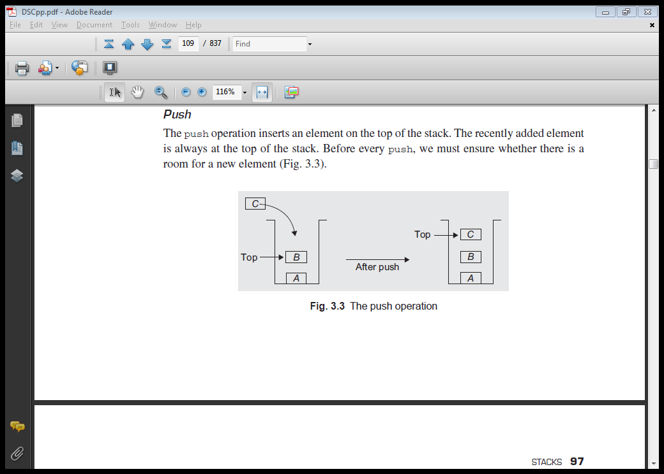
Push
The push operation inserts an element on the top of the stack.
The recently added element is always at the top of the stack.
Before every push, we must ensure whether there is a room for a new element.
When there is no space to accommodate the new element on the stack, the stack is said to be full

Slide 5
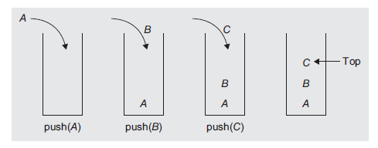
Stack and push operations

Slide 6
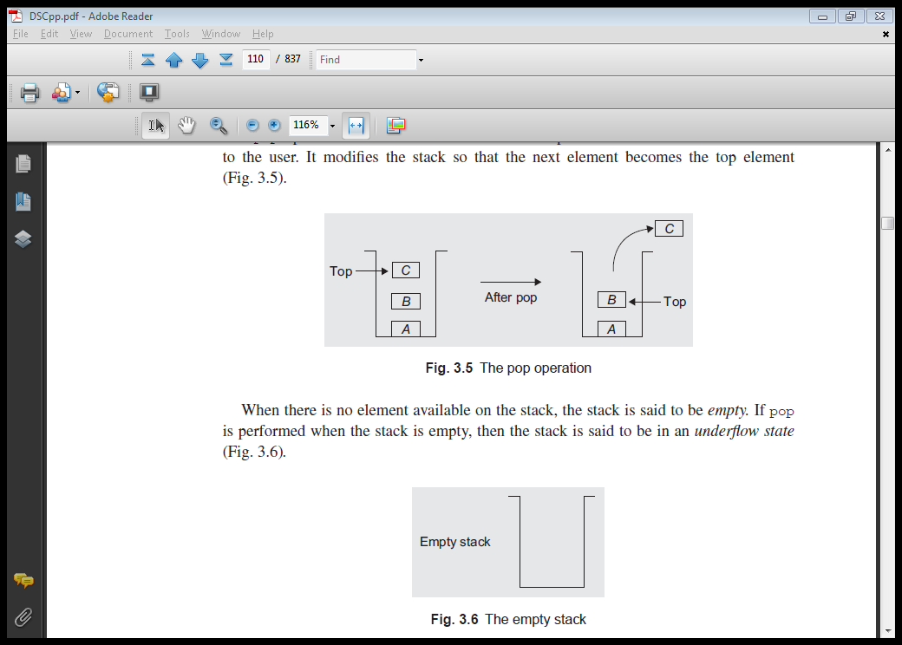
Pop
The pop operation deletes an element from the top of the stack and returns the same to the user.
It modifies the stack so that the next element becomes the top element.
When there is no element available on the stack, the stack is said to be empty.

Slide 7
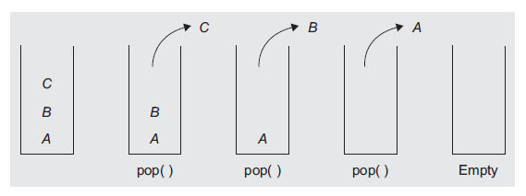
Stack and pop operations

Slide 8
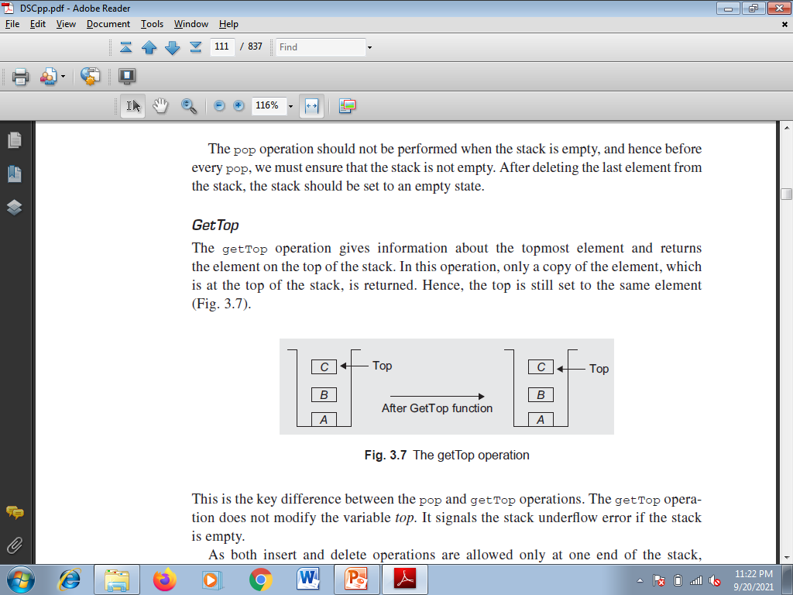
GetTop
The getTop operation gives information about the topmost element and returns the element on the top of the stack.
In this operation, only a copy of the element, which is at the top of the stack, is returned

Slide 9
STACK ABSTRACT DATA TYPE
Create(S)—creates an empty stack
Push(i, S)—inserts the element i on the stack S and returns the modified stack
Pop(S)—removes the topmost element from the stack S and returns the modified stack
GetTop(S)—returns the topmost element of stack S
Is_Empty(S)—returns true if S is empty, otherwise returns false
Is_Full(S)- returns true if S is Full, otherwise returns false

Slide 10
APPLICATIONS OF STACK
Converting infix expression to postfix and prefix expressions
Evaluating the postfix expression
Checking well-formed (nested) parenthesis
Reversing a string
Processing function calls
Parsing ( analyse the structure) of computer programs
Simulating recursion
In computations such as decimal to binary conversion
In backtracking algorithms (often used in optimizations and in games)

Slide 11
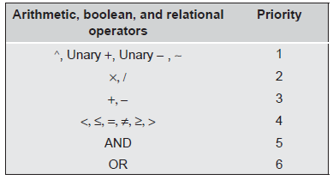
EXPRESSION EVALUATI ON AND CONVERSION
The following operators are written in descending order of their precedence:
Exponentiation (^), Unary (+), Unary (-), and not (~)
Multiplication (\) and division (/)
Addition (+) and subtraction (-)
Relational operators <, ￡ , =, π, ≥, >
Logical AND
Logical OR

Slide 12
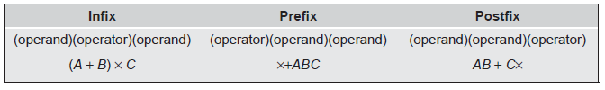
Polish Notation and Expression Conversion
The Polish Mathematician Han Lukasiewicz suggested a notation called Polish notation, which gives two alternatives to represent an arithmetic expression, namely the postfix and prefix notations.
Example expression in various forms—infix, prefix, and postfix

Slide 13
Need for Prefix and Postfix Expressions
The infix expression using a computer needs proper code generation by the compiler without any ambiguity and is difficult because of various aspects such as the operator’s priority and associativity. This problem can be overcome by writing or converting the infix expression to an alternate notation such as the prefix or the postfix.
The postfix and prefix expressions possess many advantages as follows:
The need for parenthesis as in an infix expression is overcome in postfix and prefix notations.
The priority of operators is no longer relevant.
The order of evaluation depends on the position of the operator but not on priority and associativity.
The expression evaluation process is much simpler than attempting a direct evaluation from the infix notation.

Slide 14
Infix to postfix conversion

Slide 15
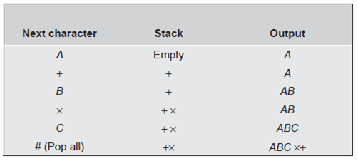
expression E = A + B × C

Slide 16
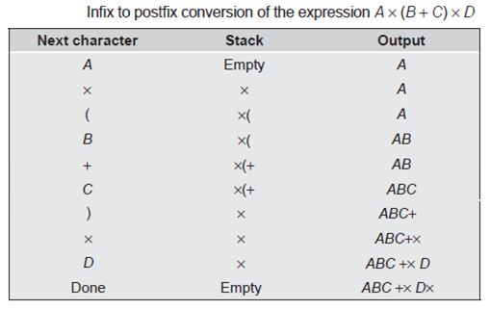

Slide 17
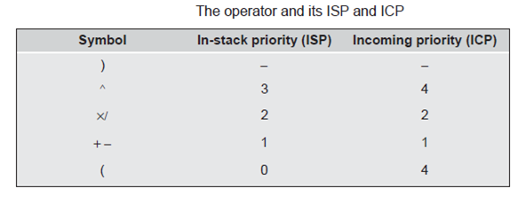

Slide 18
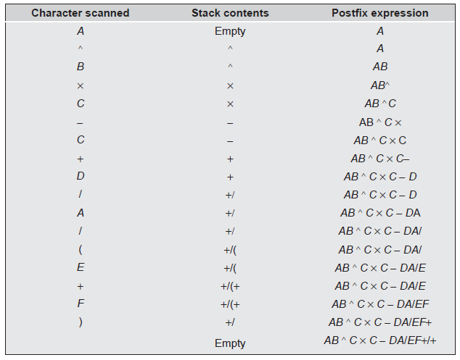
Convert the following infix expression to its postfix form: A ^ B × C - C + D/A/(E + F)

Slide 19
Steps needed for infix to postfix conversion using stack
1. Scene the Infix string from left to right.
2. Initialize a vacant stack.
3. If the scanned character is an operand add it to the Postfix string.
4. When the scanned character is an operator and if the stack is empty push the character to stack.
5. If a scanned character is an Operator and the stack is not empty, compare the precedence of the character with element on top of the stack.
6. When top Stack has higher precedence over the scanned character pop the stack else push the scanned character to stack. Repeat this procedure till the stack is not empty and top Stack has precedence over the character.
7. Reiterate 4 and 5 steps till all characters are scanned.
8. After all characters are scanned, we have to add any character that the stack may have to the Postfix string.
9. When stack is not empty add top Stack to Postfix string and Pop the stack.
10. Repeat the process as long as stack is not vacant.

Slide 20
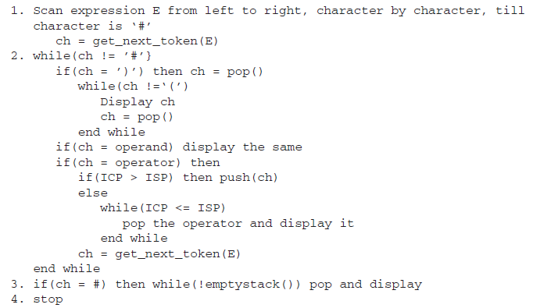
Infix to Postfix Conversion

Slide 21
Postfix Expression Evaluation
The postfix expression may be evaluated by making a left-to-right scan, stacking operands, and evaluating operators using the correct number from the stack as operands and again placing the result onto the stack.
This evaluation process is much simpler than attempting a direct evaluation from the infix notation.
This process continues till the stack is not empty or on occurrence of the character #, which denotes the end of the expression.

Slide 22
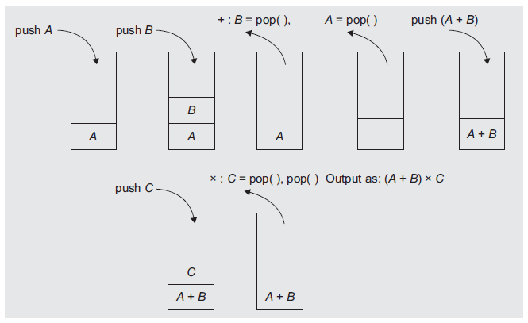
Postfix Expression Evaluation
Infix: (A + B) × C
Postfix : AB + C ×

Slide 23
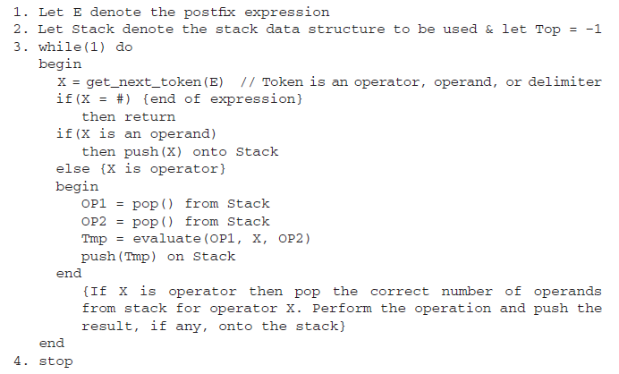
Algorithm

Slide 24
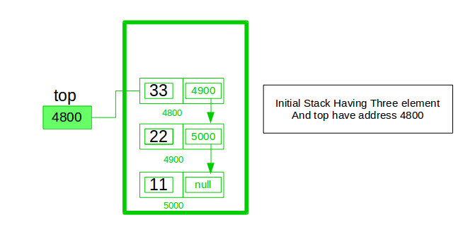
Implement a stack using singly linked list
Implement a stack using single linked list concept. all the single linked list operations perform based on Stack operations LIFO(last in first out) and with the help of that knowledge we are going to implement a stack using single linked list.

Slide 25
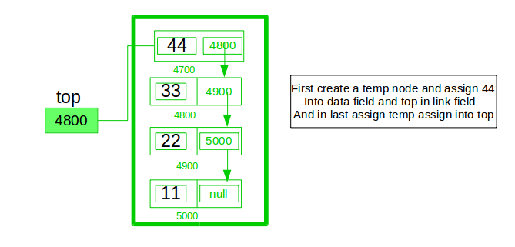
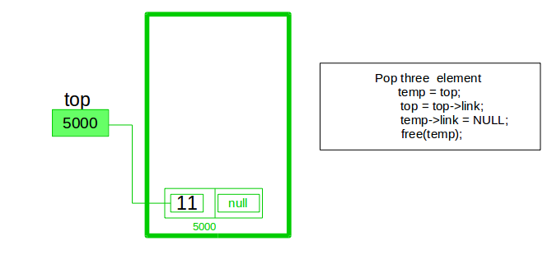

Slide 26
A stack can be easily implemented through the linked list. In stack Implementation, a stack contains a top pointer. which is “head” of the stack where pushing and popping items happens at the head of the list.
First node have null in link field and second node link have first node address in link field and so on and last node address in “top” pointer.
The main advantage of using linked list over an arrays is that it is possible to implements a stack that can shrink or grow as much as needed.
In using array will put a restriction to the maximum capacity of the array which can lead to stack overflow. Here each new node will be dynamically allocate. so overflow is not possible. Stack Operations:
push()- Insert the element into linked list nothing but which is the top node of Stack.
Pop()- Return top element from the Stack and move the top pointer to the second node of linked list or Stack.
Peek()-Return the top element.
display(): Print all element of Stack.

Slide 27
The infix priorities of +, \, ^, / could be
(a) 5, 1, 2, 7
(b) 7, 5, 2, 1
(c) 1, 2, 5, 7
(d) 5, 2, 2, 4

