Slide 1
Space Complexity

Slide 2
Space Complexity
Order to growth memory (RAM) space in term of Input size.

Slide 3
int getsum( int n)
{
return n*(n-1)/2;
}
int getsum( int n)
{
int sum=0;
for( int i=0; i<=n; i++)
sum=sum + i;
return sum;
}
Θ(1) or O(1)
Θ(1) or O(1)

Slide 4
Auxiliary Space
Order of growth of extra space or temporary space in term of Input size.
int getsum( int a[], int n)
{
int sum=0;
for( int i=0; i<=n; i++)
sum=sum + a[i];
return sum;
}
When in term of Input size =n
Time Complexity = Θ(1) or O(1) and Auxiliary space Θ(1)

Slide 5
Example: Insertion, bubble ,selection sort does not use any extra memory
Merge sort need extra space of size n.
All the sorting algorithm need θ(n) space complexity but in auxiliary space are different based types of algorithm's.
Insertion, bubble ,selection sort take θ(1)
Merge sort need θ(n).
Quick sort need θ(log n)in best case.

Slide 6
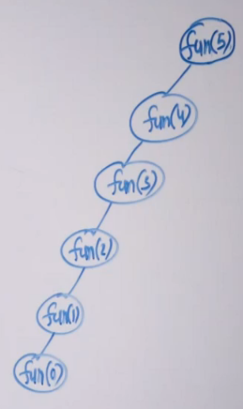
Space Complexity for Recursive Function
int fun(int n)
{
if(n<= 0)
return 0;
return n + fun(n-1);
}
Space Complexity = θ(n)
Auxiliary Space = θ(n)

Slide 7
int fib(int n)
{
if(n==0 || n==1)
return n;
return fib(n-1) + fib(n-2);
}
Space Complexity = θ(n)
Auxiliary Space = θ(n)

Slide 8
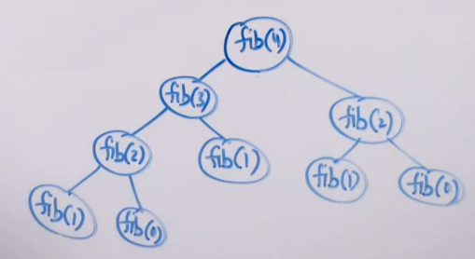

Slide 9
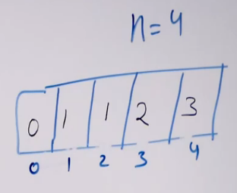
int fib(int n)
{
int f[n+1];
f[0]=0 ; f[1]=1;
for(int i=2; i<=n; i++)
f[i]=f[i-1]+ f[i-2];
return f[n];
}
Space Complexity = θ(n)
Auxiliary Space = θ(n)

Slide 10
int fib(int n)
{
if(n==0 || n==1)
return n;
int a=0, b=1;
for(int i=2; i<=n; i++)
{
c=a+b;
a=b;
b=c;
}
return c;
}
Space Complexity = θ(1)
Auxiliary Space = θ(1)
Time Complexity = θ(n)

Slide 11
o (Little Oh) Notation
The function f(n)=o(g(n)) [read as f of n is big oh of g of n] if and only if there exist positive constants c and n₀ Such that f(n) <c*g(n) for all n, n ≥ n_{0.}
In other words, f (n)=o(g(n)) if and only if there exist positive constants c, and n₀. , such that for all n ≥ n₀, the inequality 0≤f(n)<c*g(n) is satisfied.
The statement f(n)= o(g(n)) states only that g(n) is an Loose Upper bound for f (n) .

Slide 12
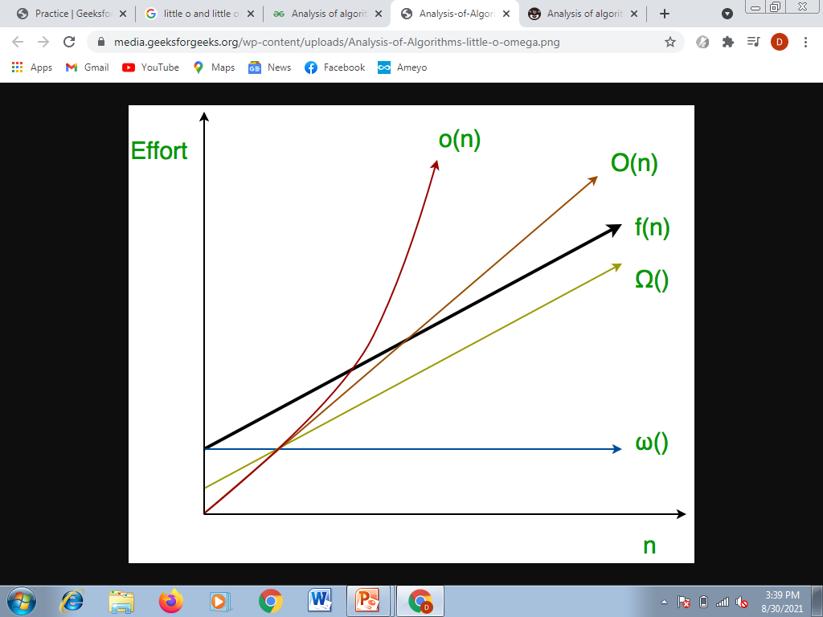

Slide 13
ω (Little Omega) Notation
The function f(n)=ω(g(n)) (read as “f of n is omega of g of n”) iff there exist positive constants c and n₀ such that f(n) > c*g(n) for all n, n≥ n_{0.}
we use ω notation to denote a lower bound that is not asymptotically tight.

