Slide 1
DBMS Basic Concepts
1

Slide 2
DBMS
Database Management System
Term Database requires understanding of data and information
Data: It can be anything like name, place or number, etc. Data usually refers to raw data, or unprocessed data.
Information: It is organized or classified data so that it has some meaningful values to the receiver.
– Information is the processed data on which decisions and actions are based.
2

Slide 3
Difference between Data and Information?
3

Slide 4
Data | Information
Data is raw facts and figures | Information is a processed form of data
For example: 12 is data | For example: When 12 is stored in row column form as shown it is information. Age 12
Data are atomic level pieces of information | Information is a collection of data
Data does not help in decision making | Information helps in decision making
4

Slide 5
Database
A database is a shared collection of logically related data designed to meet the information needs of an organization
The related information when placed is an organized form makes a database.
The organization of data/information is necessary because unorganized information has no meaning.
5

Slide 6
Purpose of DBMS
An example
University Database:
Data about students, faculty, courses, research- laboratories, course registration/enrollment etc. Reflects the state of affairs of the academic aspects of the university.
Purpose: To keep an accurate track of the academic activities of the university.
6
Notes:
UMS is enterprise Resource Planning- Enterprise resource planning (ERP) is business process management software that allows an organization to use a system of integrated applications to manage the business and automate many back office functions related to technology, services and human resources

Slide 7
Purpose of DBMS
Before DBMSs were introduced, organizations usually stored information in file processing system which has a number of disadvantages:
Data redundancy and inconsistency
Difficulty in accessing data
Data isolation
Integrity problems
Atomicity problems
Concurrent-access anomalies
Security problems
7

Slide 9
Database Management System
DBMS A database management system is the software system that allows users to define, create and maintain a database and provides controlled access to the data.
A database management system (DBMS) is basically a collection of programs that enables users to store, modify, and extract information from a database as per the requirements.
9

Slide 10
Operations on databases
To add new information
To view or retrieve the stored information
To modify or edit the existing
To remove or delete the unwanted information
Arranging the information in a desired order etc.
10

Slide 11
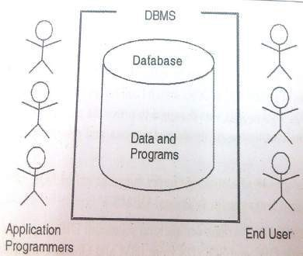
Components of Database
Five major components in database system environment:
Hardware
Software
Data
Users
Procedures
11

Slide 12
Components of Database System
Hardware: It is the actual computer system used for keeping and accessing the database. DBMS hardware consists of secondary storage devices like hard disks.
Software: It is the actual DBMS. Between the physical database itself and the users of system is a layer of software, called DBMS.
Data: Data acts as the bridge between the machine components and user components.
12

Slide 13
Components of Database System
Users: There are number of users who can access or retrieve data on demand using the applications and the interfaces provided by DBMS. The users can be:
Naïve users
Application Programmers
Sophisticated Users
Data base Administrator ( DBA)
13

Slide 14
Components of Database System
Procedures: It refers to the instructions and rules that govern the design and the use of the database. The users of the system and the staff that manage the database requires documented procedures on how to use or run the system.
14

Slide 15
Applications of DBMS
Banking: all transactions
Airlines: reservations, schedules
Universities: registration, grades
Sales: customers, products, purchases
Online retailers: order tracking, recommendations
customized
Manufacturing: production, inventory, orders, supply chain
Human resources: employee records, salaries, tax deductions
15

Slide 16
Data models, Schemas, and Instances
Data model:-A set of concepts to describe the structure of a database, and certain constraints that the database should obey.
Schema:- The overall description of the database is called the Database Schema.
– A schema is defined as an outline or a plan that describes the records and relationships existing at the particular level.
Instance:- Data in the database at a particular moment in time.
16
Notes:
ER model, relational model

Slide 17
Data abstraction
A major purpose of database system is to provide user with an abstract view of data. That is, system hides certain details of how the data are stored and maintained.
17

Slide 18

Levels of Abstraction(view of data)
Physical level: describes how a record (e.g., customer) is stored.
Logical level: describes what data stored in database, and the relationships among the data. DBA, who decides what information to keep in the database, use the logical level of abstraction.
View level: describe only part of database. application programs hide details of data types. Complexity remain due to variety of information stored. Views can also hide information (such as an employee’s salary) for security purposes.
18

Slide 19

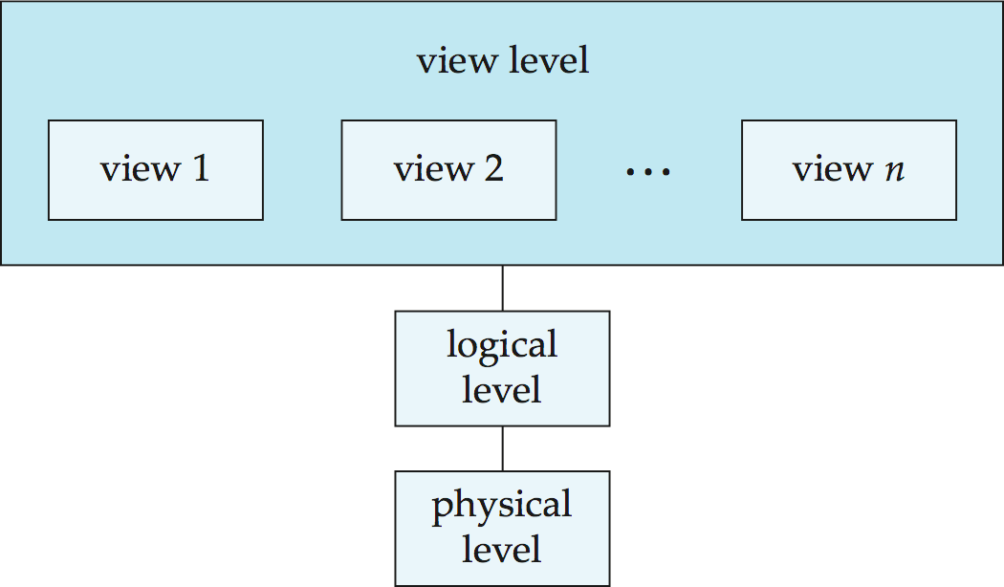
View of Data
An architecture for a database system
19

Slide 20
Database Languages
Database languages are used to create and maintain database on computer.
Data Definition Language(DDL): It is a language that allows user to define data and their relationship to other types of data.
CREATE
ALTER
DROP
TRUNCATE
RENAME
Data Manipulation Language(DML):It provides a set of operations to support the basic data manipulation operations on the data held in databases. It allows user to insert, update, delete and retrieve data from the database.
DELETE
INSERT
SELECT
UPDATE
20
Notes:
Truncate removes all rows from a table. The operation cannot be rolled back and no triggers will be fired. Drop will remove a table from the database.

Slide 21
Database Languages
Data Control Language(DCL): DCL statements control access to data and the database
GRANT
REVOKE
Transaction Control Language(TCL): TCL statements manage the change made by DML statements, and group DML statements into transactions
COMMIT
ROLLBACK
SAVEPOINT
21
Notes:
DCL is used to create roles, permissions
Grant is used to give user access privileges to a database
Revoke is used to take back permissions from the user.
Set transactin is used for placing a name on the transaction. We can specify a transaction to be read only or read write. Used to inititate database transaction.

Slide 23
Thank You

