Slide 1
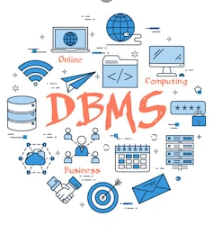
Welcome
To
INT306
DATABASE MANAGEMENT SYSTEM
By- Shivali Chopra
Assistant Professor
LPU

Slide 2
Lecture 0
‘ Let’s move toward the better way to store and manage the data’

Slide 3
Course Details
Lecture Tutorial Practical
0 0 5
Text Book –
DATABASE SYSTEM CONCEPTS by HENRY F. KORTH, ABRAHAM SILBERSCHATZ, S. SUDARSHAN, TATA MCGRAW -HILL EDUCATION.
Link for Book:- https://tinyurl.com/korthbook

Slide 4
COURSE OUTCOMES
Through this course, Student will be able to:
CO1 :: develop skills and understanding in the database design and make use of database management systems for applications
CO2 :: develop understanding about relational algebra, relational model and SQL for implementing and maintaining databases
CO3 :: develop understanding about the different issues involved in the design and implementation of a database system
CO4 :: develop skills and understanding about the real time transaction management systems and the concurrency control techniques
CO5 :: compose programming constructs such as functions, stored procedures and triggers that can be shared by multiple forms, reports and data management applications

Slide 5
Marks criteria
Contributor | Marks
Attendance | 5
CA(2 out of 3) | 20
MTE | 25
ETE | 50

Slide 6


Slide 7
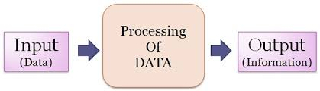
Data and information
Raw material that can be processed by any computing machine is data.
Images, words, numbers , sounds etc. all forms different representations of the data.

Slide 8
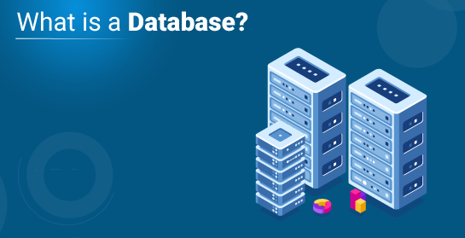
Notes:
A database is actually a place where related piece of information is stored and various operations can be performed on it.
Or we can say database is a shared collection of logically related data in a systematic manner that is stored to meet the requirements of different users of an organization that can be easily accessed.
Database can be maintained manually or through electronic devices such as digital diaries, mobile phones, computers etc.

Slide 9
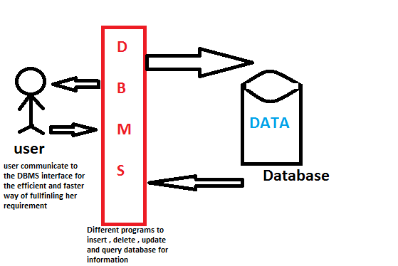
Database Management Systems

Slide 10
Software for installation
https://tinyurl.com/oraclesetup

Slide 11
Unit 1: Introduction to Databases
purpose of database systems
components of dbms
applications of dbms
three tier dbms architecture
data independence
Database Schema, instance
data modeling
entity relationship model
relational model

Slide 12
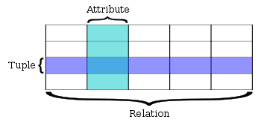
Relational Databases

Slide 13
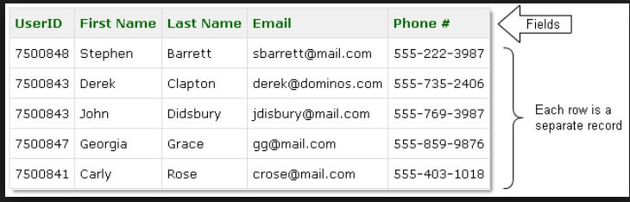
Relational Databases

Slide 14
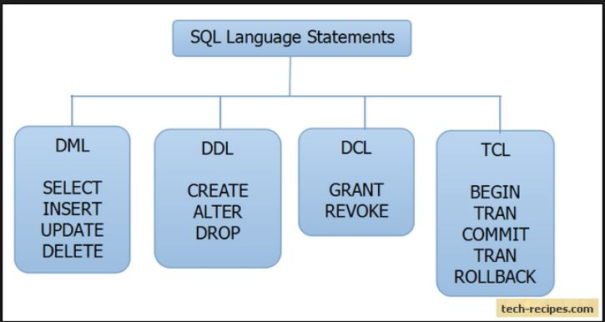
Unit 2: Relational Query Languages

Slide 15
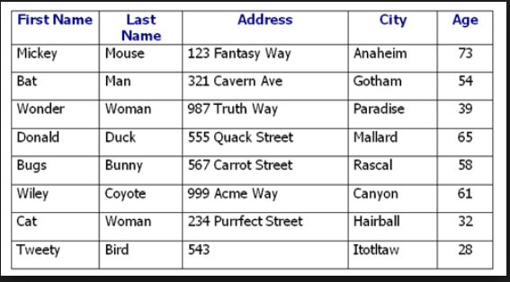
Unit 3: Relational Database Design

Slide 16
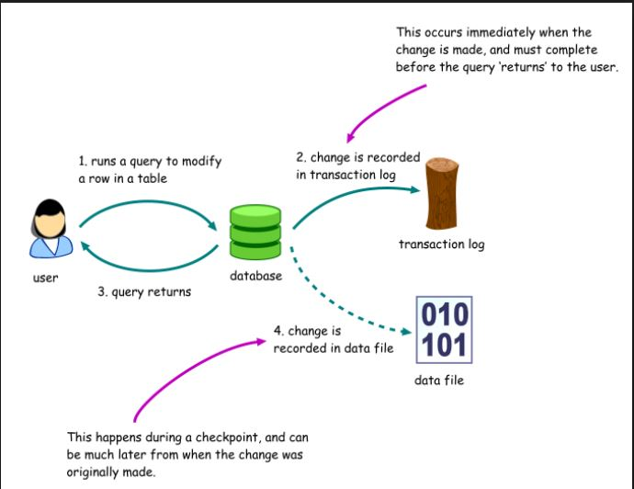
Unit 4: Database Transaction Processing

Slide 17
Unit 5:Programming Constructs in Databases
Cursors
Triggers
exception handling

Slide 18
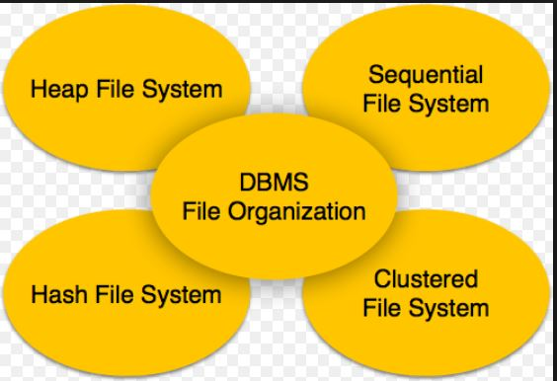
Unit 6: File Organization and Trends in Databases

Slide 19
Lets Begin…

