Slide 1
Data Models
1

Slide 2
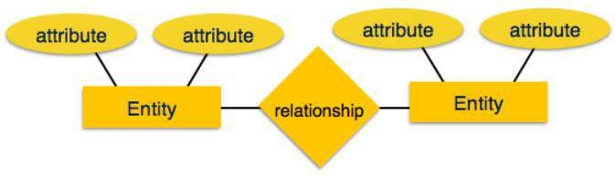
E-R Model
ER Model is based on:
Entities and their attributes
Relationships among entities
2

Slide 3
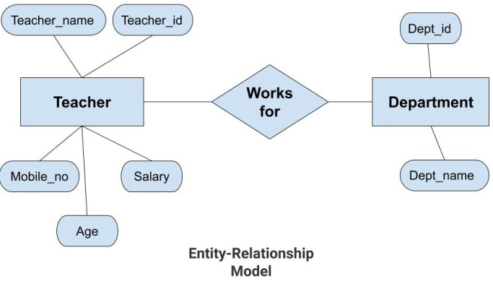
Notes:
In the above diagram, the entities are Teacher and Department. The attributes of Teacher entity are Teacher_Name, Teacher_id, Age, Salary, Mobile_Number. The attributes of entity Department entity are Dept_id, Dept_name. The two entities are connected using the relationship. Here, each teacher works for a department.

Slide 4
Features of ER Model
Graphical Representation for Better Understanding
ER Diagram as Visual tool
Database Design
Notes:
Graphical Representation for Better Understanding: It is very easy and simple to understand so it can be used by the developers to communicate with the stakeholders.
ER Diagram: ER diagram is used as a visual tool for representing the model.
Database Design: This model helps the database designers to build the database and is widely used in database design.
Advantages of ER Model
Simple: Conceptually ER Model is very easy to build. If we know the relationship between the attributes and the entities we can easily build the ER Diagram for the model.
Effective Communication Tool: This model is used widely by the database designers for communicating their ideas.
Easy Conversion to any Model: This model maps well to the relational model and can be easily converted relational model by converting the ER model to the table. This model can also be converted to any other model like network model, hierarchical model etc.
Disadvatages of ER Model
No industry standard for notation: There is no industry standard for developing an ER model. So one developer might use notations which are not understood by other developers.
Hidden information: Some information might be lost or hidden in the ER model. As it is a high-level view so there are chances that some details of information might be hidden.

Slide 5
E-R Model components
Entity: An entity in ER Model is real world entity, which has some properties called attributes. Every attribute is defined by its set of values, called domain. For example, in a school database, a student is considered as an entity. Student has various attributes like name, age and class etc.
An entity set is a collection of similar types of entities. For example, Students set may contain all the student of a school.
5
Notes:
A weak entity is one that can only exist when owned by another one. For example: a ROOM can only exist in a BUILDING. On the other hand, a TIRE might be considered as a strong entity because it also can exist without being attached to a CAR.
Represented by double rectangle

Slide 6
Attribute(s):
Attributes are the properties which define the entity type. For example, Roll_No, Name, DOB, Age, Address, Mobile_No are the attributes which defines entity type Student. In ER diagram, attribute is represented by an oval.

Slide 7
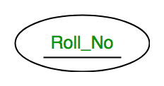
Types of Attributes
Key Attribute –
The attribute which uniquely identifies each entity in the entity set is called key attribute. For example, Roll_No will be unique for each student. In ER diagram, key attribute is represented by an oval with underlying lines.

Slide 8
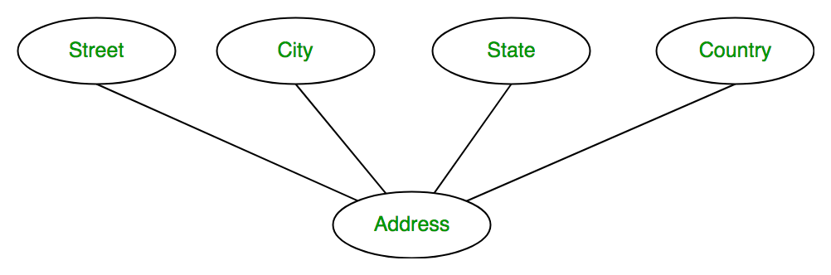
2. Composite Attribute-
An attribute composed of many other attribute is called as composite attribute. For example, Address attribute of student Entity type consists of Street, City, State, and Country. In ER diagram, composite attribute is represented by an oval comprising of ovals.

Slide 9
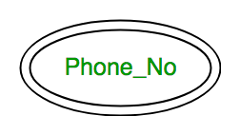
3. Multivalued Attribute- An attribute consisting more than one value for a given entity. For example, Phone_No (can be more than one for a given student). In ER diagram, multivalued attribute is represented by double oval.

Slide 10
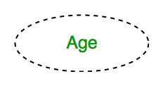
4. Derived Attribute
An attribute which can be derived from other attributes of the entity type is known as derived attribute. e.g.; Age (can be derived from DOB). In ER diagram, derived attribute is represented by dashed oval.

Slide 11
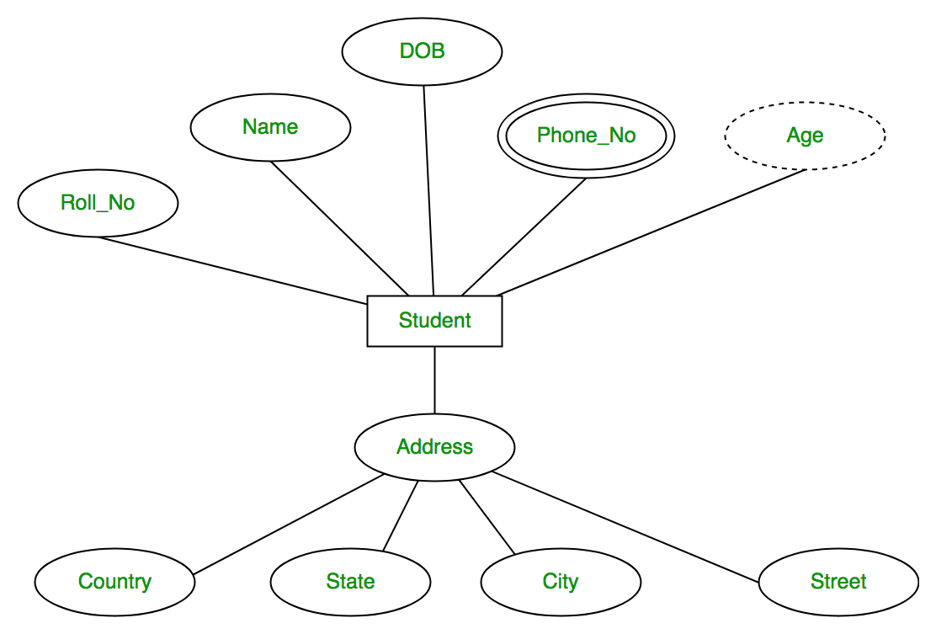
Notes:
The complete entity type Student with its attributes can be represented as:

Slide 12
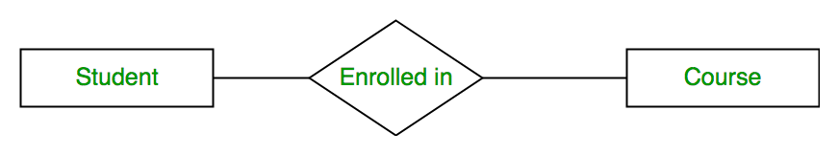
Relationship Type and Relationship Set:
A relationship type represents the association between entity types. For example, 'Enrolled in’ is a relationship type that exists between entity type Student and Course. In ER diagram, relationship type is represented by a diamond and connecting the entities with lines.

Slide 13
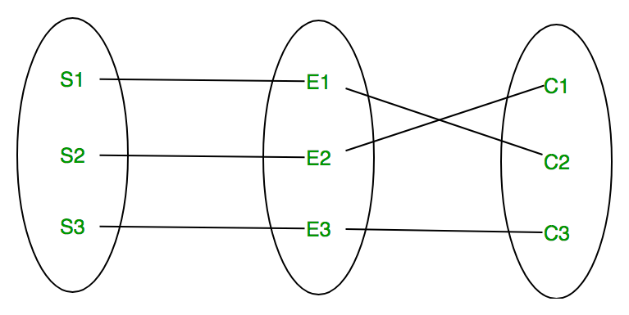
Notes:
A set of relationships of same type is known as relationship set. The following relationship set depicts S1 is enrolled in C2, S2 is enrolled in C1 and S3 is enrolled in C3.

Slide 14
Degree of a relationship set:
The number of different entity sets participating in a relationship set is called as degree of a relationship set.

Slide 15
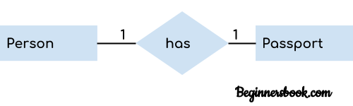
One to One Relationship
When a single instance of an entity is associated with a single instance of another entity then it is called one to one relationship. For example, a person has only one passport and a passport is given to one person.

Slide 16
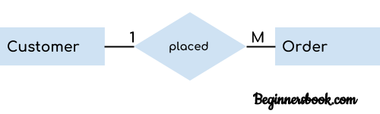
One to Many Relationship:-
When a single instance of an entity is associated with more than one instances of another entity then it is called one to many relationship. For example – a customer can place many orders but a order cannot be placed by many customers.

Slide 17
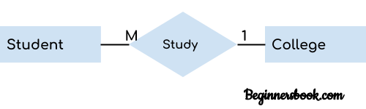
Many to One Relationship
When more than one instances of an entity is associated with a single instance of another entity then it is called many to one relationship. For example – many students can study in a single college but a student cannot study in many colleges at the same time.

Slide 18
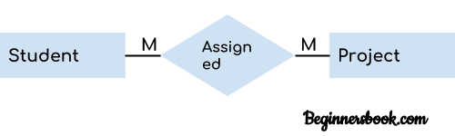
Many to Many Relationship
When more than one instances of an entity is associated with more than one instances of another entity then it is called many to many relationship. For example, a can be assigned to many projects and a project can be assigned to many students.

Slide 19
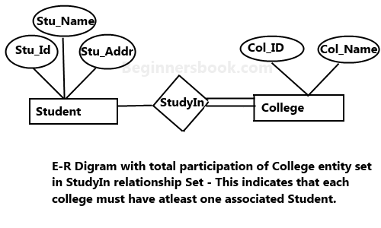
Total Participation of an Entity set
Notes:
A Total participation of an entity set represents that each entity in entity set must have at least one relationship in a relationship set. For example: In the below diagram each college must have at-least one associated Student.

Slide 20
Participation Constraints
The participation of an entity set E in a relationship set R is said to be total if every entity in E participates in at least one relationship in R.
If only some entities in E participate in relationships in R, the participation is said to be partial.
20

Slide 21
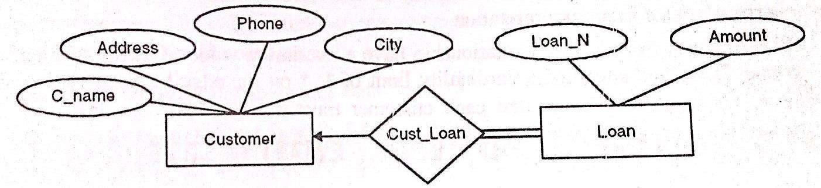

Example
Total participation of Loan entity
21

Slide 22
Keys
The key is defined as the column or attribute of the database table.
They are used to establish and identify relation between tables.
They also ensure that each record within a
table can be uniquely identified by
a
combination of one or more fields within table.
22

Slide 23
Types of Keys
Superkey: An attribute (or combination of attributes) that uniquely identifies each row in a table. It is a super set of candidate key.
Candidate key : An attribute (or set of attributes) that uniquely identifies a row. Let K be a set of attributes of relation R. Then K is a candidate key for R if it possess the following properties:
Uniqueness – No legal value of R ever contains two distinct tuples with the same value of K
Irreducibility- No proper subset of K has the uniqueness property
23

Slide 24
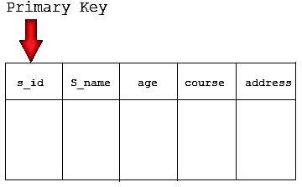
Types of Keys
3. Primary key : is the candidate key which is selected as the principal unique identifier. It is a key that uniquely identify each record in the table. Cannot contain null entries.
24

Slide 25
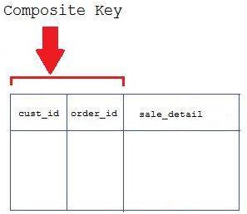
Types of Keys
4. Composite Key: Key that consist of two or more attributes that uniquely identifies an entity occurrence is called composite key.
Reg_no
Crs_id
subjects
25

Slide 26
Types of Keys
5. Foreign Key: A foreign key is generally a primary key from one table that appears as a field in another where the first table has a relationship to the second.
In other words, if we had a table A with a primary key X that linked to a table B where X was a field in B, then X would be a foreign key in B.
26

Slide 27
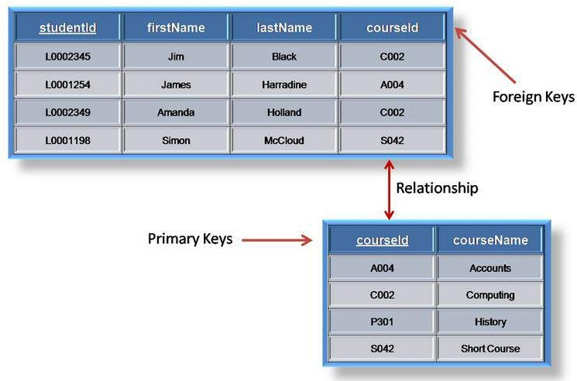
Example
27

Slide 28
Steps in designing E-R Diagram
There are following steps:
Identify the entities from the requirement sheets
Find relationships among those entities
Identify the key attributes for every entity
Identify other relevant attributes
Draw complete E-R diagram with all attributes including Primary key
Review your results with your Business users
28

Slide 29
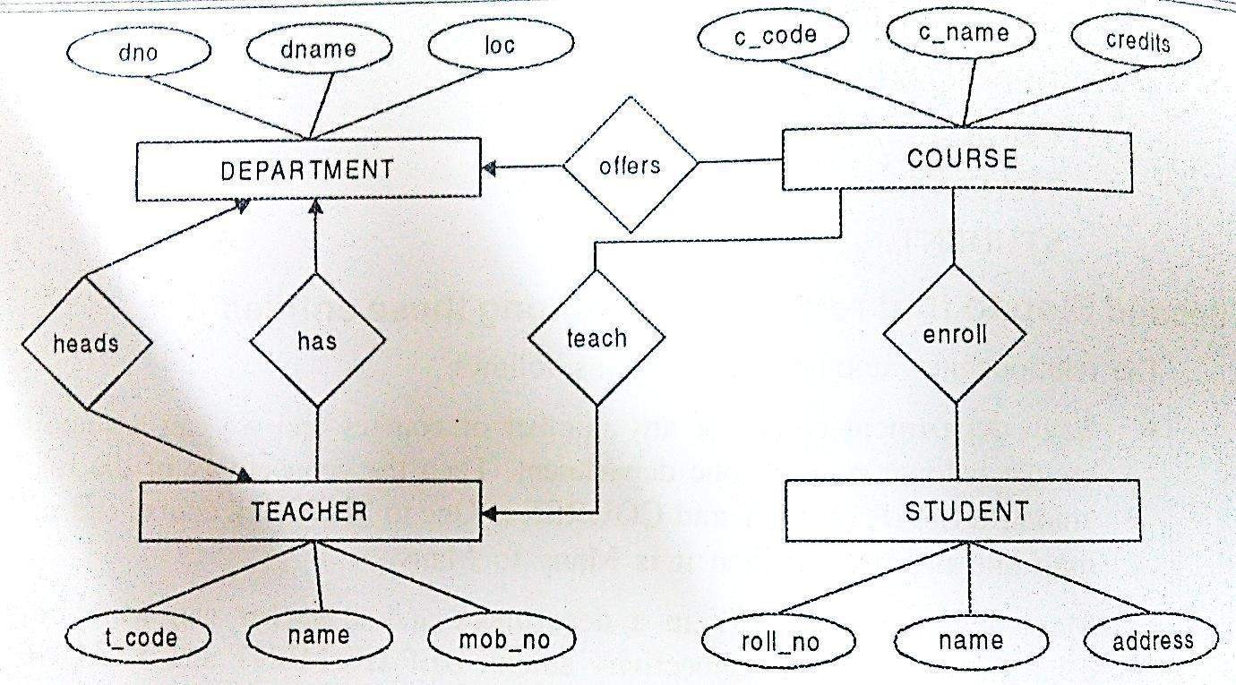
Example: University Management System
29

Slide 30
Task for you:-
Create an ER diagram for Bank Database
Notes:
ER diagram of Bank has the following description :
Bank have Customer.
Banks are identified by a name, code, address of main office.
Banks have branches.
Branches are identified by a branch_no., branch_name, address.
Customers are identified by name, cust-id, phone number, address.
Customer can have one or more accounts.
Accounts are identified by acc_no., acc_type, balance.
Customer can avail loans.
Loans are identified by loan_id, loan_type and amount.
Account and loans are related to bank’s branch.

Slide 31
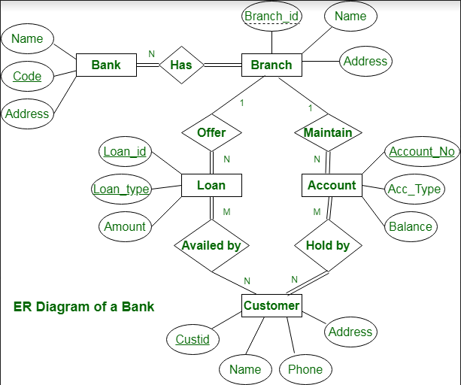
Notes:
ER diagram of Bank has the following description :
Bank have Customer.
Banks are identified by a name, code, address of main office.
Banks have branches.
Branches are identified by a branch_no., branch_name, address.
Customers are identified by name, cust-id, phone number, address.
Customer can have one or more accounts.
Accounts are identified by acc_no., acc_type, balance.
Customer can avail loans.
Loans are identified by loan_id, loan_type and amount.
Account and loans are related to bank’s branch.

Slide 32
Strong and Weak entity sets
Strong Entity:
A strong entity is not dependent of any other entity in the schema. A strong entity will always have a primary key. Strong entities are represented by a single rectangle. The relationship of two strong entities is represented by a single diamond.
Various strong entities, when combined together, create a strong entity set.
32

Slide 33
Weak Entity: A weak entity is dependent on a strong entity to ensure the its existence. Unlike a strong entity, a weak entity does not have any primary key. It instead has a partial discriminator key. A weak entity is represented by a double rectangle. The relation between one strong and one weak entity is represented by a double diamond.
Notes:
The entity set which does not have sufficient attributes to form a primary key is called a Weak entity set.
The entity set which has the primary key is called as Strong entity set.
A member of a strong entity set is called dominant entity and member of a weak entity set is called subordinate entity.
Weak entity does not have a primary key but we need a mean to distinguish among other entities. The discriminator of a weak entity set is a set of attributes that allows this distinction to be made. Ex: payment_number.

Slide 34
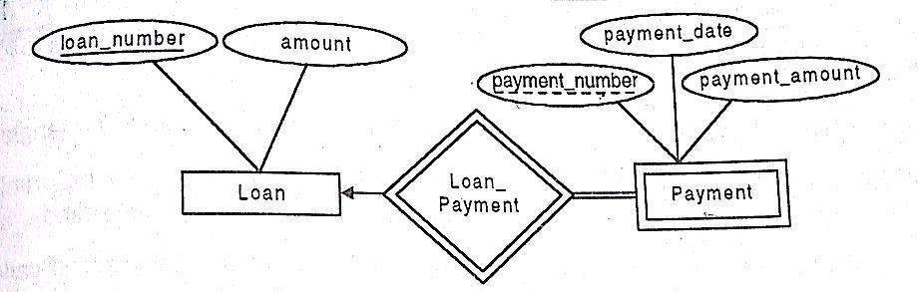
Example
34

Slide 35
Conversion of E-R Diagram into Relational Model
In general conversion of E-R diagram into a relational model involves the following:
Mapping of an entity set into relation (tables) of the database.
The attributes of a table include the attributes of an entity
The key attribute of an entity becomes the primary key of the relation
Notes:
Conversion of an E-R diagram into a relational model is required because E-R diagrams represent the conceptual level of the database design while the relational model represents the logical level. The relational models can be easily implemented using RDBMS like Oracle, MySQL, etc.

Slide 36
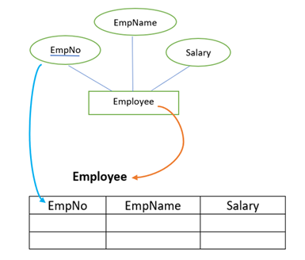
For example,
Consider the following E-R diagram in the figure below.
Notes:
The E-R diagram consists of Employee as an entity set and EmpNo, EmpName, and Salary as its attributes. Here we map entity set into a relation Employee and attributes of an entity set will become the attributes inside the table. The key attribute will become the primary key of the table.

Slide 37
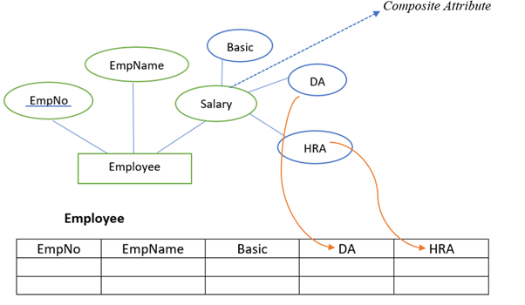
Entity set with a composite attribute
Notes:
While converting an E-R diagram consisting of a composite attribute we do not include the composite attribute in the relational model. The compositions of the composite attribute will become the attributes in the relational model. For example in the figure given below, Salary is the composite attribute, and Basic, DA, and HRA are its compositions.

Slide 38
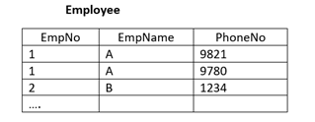
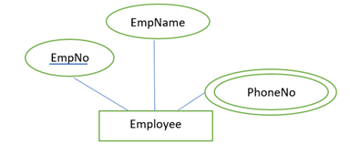
Entity set with multivalued attributes
Duplicate values with multivalued attribute
Notes:
If an entity contains a multivalued attribute, we split the attributes into two relations in the relational model. One with key attribute and all simple attributes and other with key attribute and all multivalued attributes. For example, in the figure given , PhoneNo is the multivalued attribute.
If we include the PhoneNo in the table with all other attributes, then for a single-valued tuple we may have multiple entries as shown in the table

Slide 39
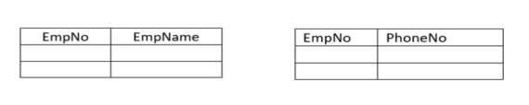
Conversion of multivalued attributes into relation
Notes:
However, to avoid duplicate values in the table, we split the attributes into two different relations as shown in the figure

Slide 40
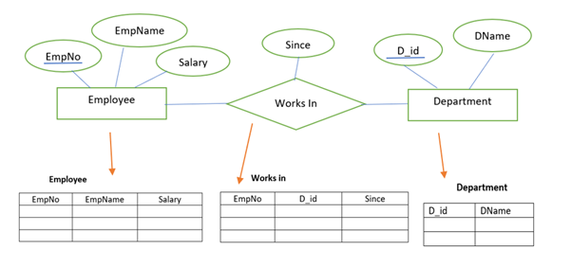
Translation of a relationship into a relation
Translation of a relationship into a relation
Notes:
Likewise, we map the entity set into the relation in a relational model, we can also map a relationship set into a relation. The attribute of such a relation includes key attributes of the participating relations. The attributes are will become a foreign key.
For example, in the figure given, there are two entity sets Employee and Department. These entity sets are participating in a relationship works in. The relationship set is converted into relation with attributes EmpNo from Employee relation, D_id from Department relation and Since, the attribute of the relationship set itself.

Slide 41
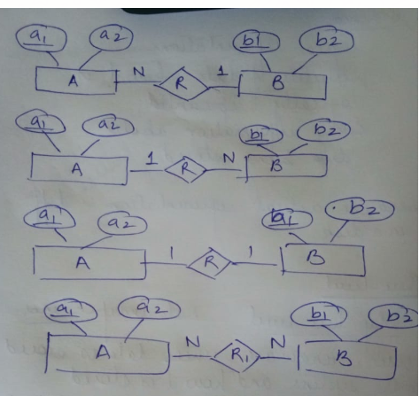
Notes:
Combine in n side relation for 1-n or n-1

Slide 42


