Slide 1

Project Title – AQI TRACKER
Group members with Student Id
Pallavi Tambe - 21204001
Vaishnavi Bhalerao - 21204007
Mayuresh Kalkar - 21204010
Sahil Jadhav - 21204013
Project Guide - Prof. Ganesh Gourshete

Slide 2
Contents
Introduction
Objectives
Scope
Key features
Technology Stack
Project Design

Slide 3
1. Introduction
The air quality index is an index for reporting air quality on a daily basis.
The AQI is calculated based on the average concentration of a particular pollutant measured over a standard time interval. Generally, the time interval is 24 hours for most pollutants, 8 hours for carbon monoxide and ozone.
It is a measure of how air pollution affects one's health within a short time period .The purpose of the AQI is to help people know how the local air quality impacts their health.

Slide 4
2. Objectives
To compare air quality conditions at different locations/cities.
To develop a system that will allow user to get information regarding weather
Content of different gases present in air or area around us

Slide 5
3. Scope
In future the project can be upgraded in more ways than one.
Interface more number of sensors to know detailed content of all gases present in air.
Design Webpage and upload data o webpage with date and time.

Slide 6
4. Key Features
Continuous update of change in percentage of quality.
Simple compact and easy to handle.
System is real time.
Detecting a wide range of gases .
User friendly
Button, images, api key, labels ,date & time etc. used in this project

Slide 7
Data Collection
Collection Methods:- During this stage data may be collected by
Mail survey
Plant inspection
Field surveys
Data from literature:-
Industrial files
Government files.-
Trade journals-
scientific publications

Slide 8
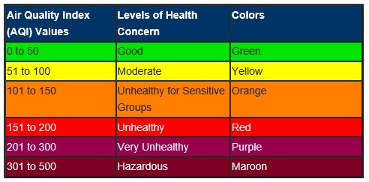
Consider the analysis of the air quality index as a criterion ranging from 0 to 500. The higher the value of the AQI, the higher the level of air pollution and the greater the problem of air quality.

Slide 9


6. Technology Stack
FRONT END - Python
BACK END – Python, Database
Concept Used – Api ,Tkinter
IDE Used –IDLE, Vscode, Xampp server
Operating System – Windows 10,Windows 11

Slide 10
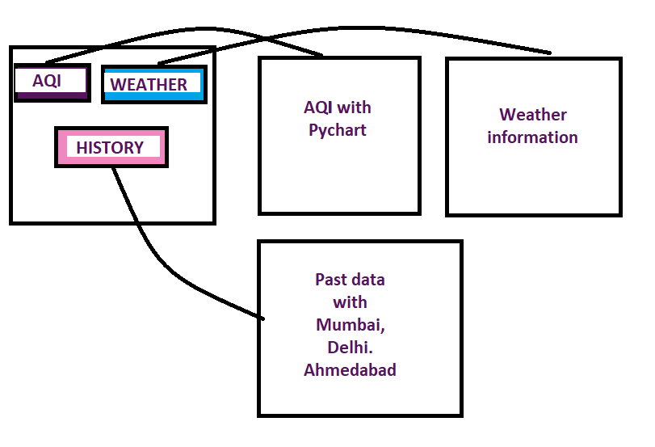
7. Project Design

Slide 11
Thank You...!!

