Slide 1

Project Title:-Seasonal Agriculture Performance Analysis
Student Name:-Divya Lakhtariya
College Name:-Government engineering college,rajkot
AICTE STU ID : STU695baa12de5761767614994

Slide 2

PROBLEM STATEMENT
Agricultural performance is shaped by seasonal variations in environmental conditions, farming practices, resource availability and market conditions.
Raw agricultural data alone does not clearly explain how performance changes across seasons or what patterns exist within different seasonal conditions.
Problem: analyze the seasonal agriculture dataset to identify meaningful patterns, trends, relationships and differences in agricultural performance across the Kharif, Rabi and Zaid seasons.

Slide 3
Project Description
This project analyzes 4,000 farm records spanning 3 seasons, 8 states and 8 crops to understand how seasonal factors affect agricultural performance.
Using Python (Pandas, Matplotlib, Seaborn) in Jupyter Notebook, the analysis covers data cleaning, exploratory data analysis, seasonal comparison of yield, production and profit, resource-usage patterns, environmental correlations, and region/crop-level consistency checks.
The project concludes with evidence-based insights and recommendations to support better seasonal agricultural planning.

Slide 4

WHO ARE THE END USERS?
Farmers & agricultural cooperatives — choosing the right crop and season
Government & agricultural policy makers — evidence-based seasonal planning
Agri-business & supply chain companies — forecasting production and procurement
Researchers & academic institutions — studying seasonal performance trends
Banks & crop insurance providers — assessing seasonal risk
Irrigation & resource planning agencies — optimizing water and input allocation

Slide 5

Technology Used
Python 3 — core programming language for data analysis
Pandas & NumPy — data cleaning, transformation and aggregation
Matplotlib & Seaborn — visualization (bar charts, heatmaps, boxplots, regression plots)
Jupyter Notebook — end-to-end analysis and documentation
Dataset — seasonal_agriculture_performance_dataset.csv (4,000 records, 28 features)
Techniques — descriptive statistics, correlation analysis, group-wise comparison, IQR-based outlier detection, pivot tables

Slide 6
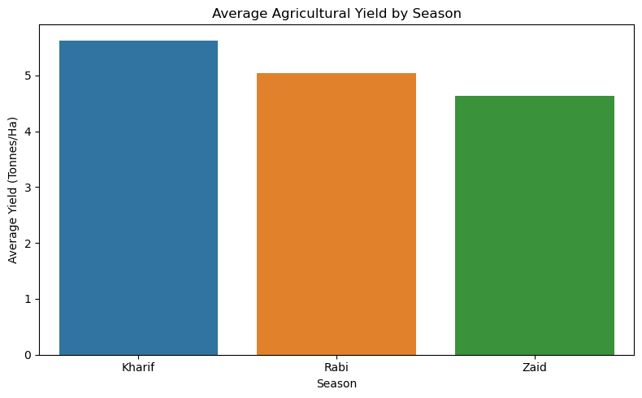
RESULTS
Kharif delivers the highest average yield (5.63 t/ha) of all three seasons.
5.63 t/ha
Kharif avg. yield

Slide 7
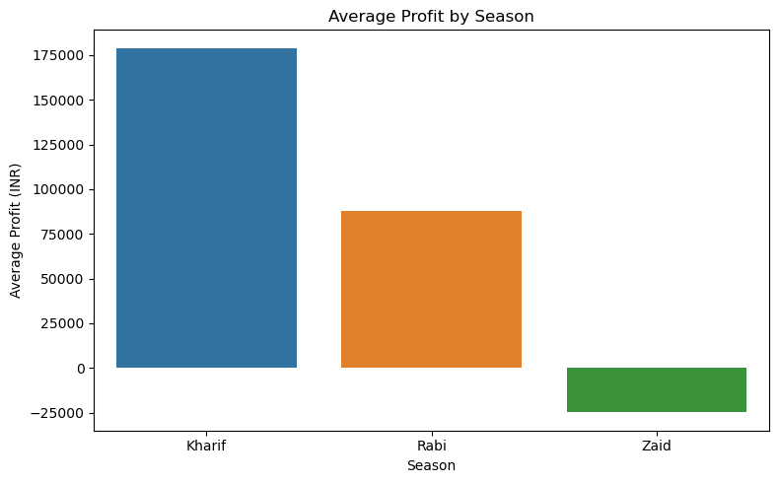
RESULTS
Kharif is the only season with strong profitability; Zaid runs at an average loss.
−₹24.8K
Zaid avg. profit

Slide 8
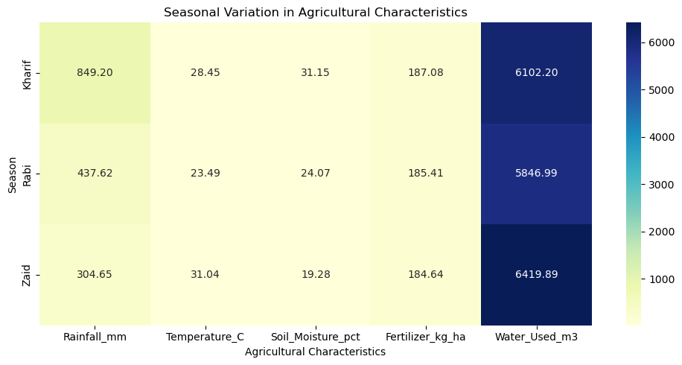
RESULTS
Rainfall, temperature, soil moisture and water use all shift markedly by season.
849 mm
Kharif avg. rainfall

Slide 9
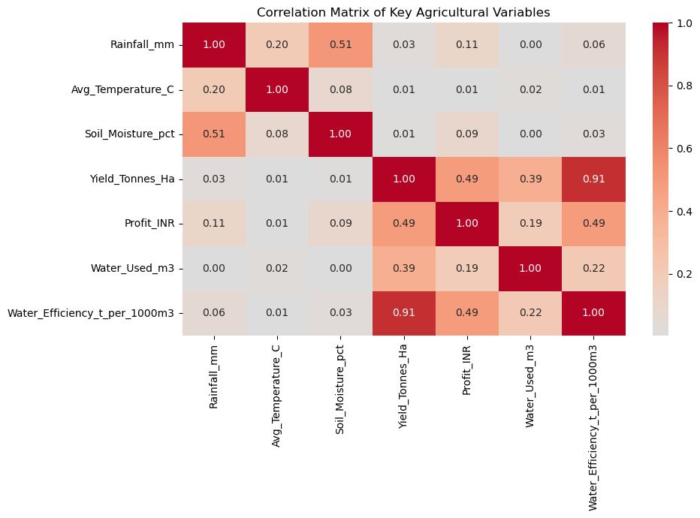
RESULTS
Environmental and resource variables show varying association with yield and profit.
7
variables analyzed

Slide 10
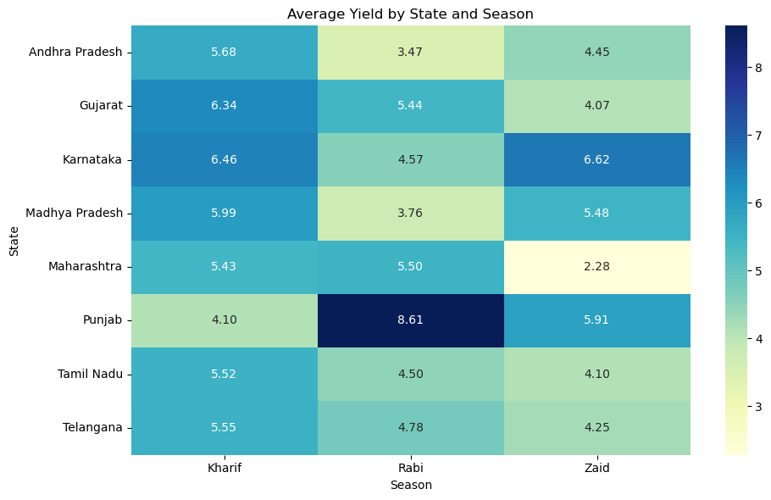
RESULTS
Kharif is the best-performing season for 5 of 8 states and for every crop studied.
5 of 8
states peak in Kharif

Slide 11
Future scope
• Extend the analysis with statistical significance testing (ANOVA / t-tests) across seasons
• Build a predictive model to forecast yield and profit from seasonal & environmental inputs
• Incorporate real-time weather and market-price data for dynamic seasonal planning
• Develop an interactive dashboard (Power BI / Streamlit) for farmers and policy makers
• Expand dataset coverage to more states, districts and crop varieties for finer-grained insights

Slide 12
GitHub Link
Notebook, dataset and this presentation are available in the project repository:
https://github.com/divyalakhtariya/Seasonal-Agriculture-Performance-Analysis.git

Slide 13
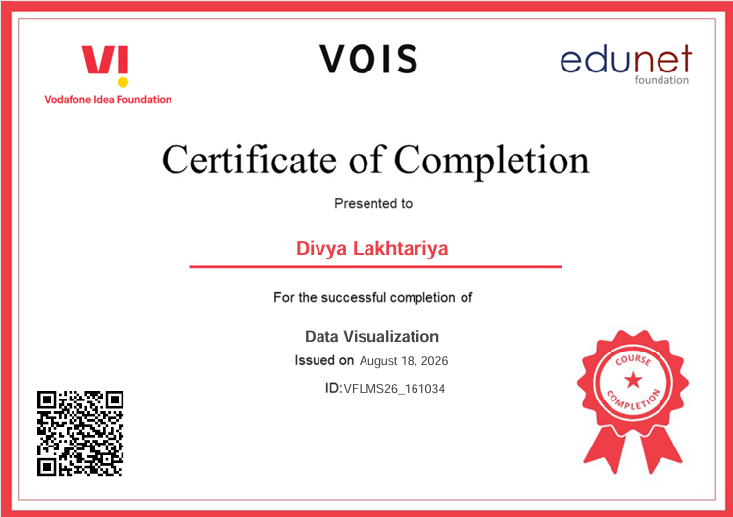
VOIS Course completion certificate - Course name- Data Visualization

Slide 14
Thank you
.
.

