Slide 1


Design and Realization of a Virtual Circuit Network Through Frame Relay Technology
Presented by:
B Santhosh Kumar [192511053]
Avinash V S [192512017]
Divyalakshmi B [192524204]
[CSA0764] [Computer Networks For a Game server]
Date: [26/12/2025]
Guided By:
Dr SENTHIL K
Dr RAJARAM P

Slide 2
Introduction
Overview of the Project
Simulated wide-area network (WAN) using Frame Relay and Permanent Virtual Circuits (PVCs)
Demonstrates how multiple branch locations can be interconnected cost-effectively through a single service-provider cloud
Problem Statement
Traditional WANs with leased lines are costly and inflexible.
Multi-branch organizations need reliable, scalable communication.
Challenge: Implement efficient virtual circuits at low cost while simulating real WAN behavior.
Purpose of the Project
Build and configure a simulated Frame Relay WAN with routers, PVCs, and DLCIs to replicate real ISP network behavior.
Test and optimize network performance to ensure stable communication, efficient traffic management, and proper handling of congestion.

Slide 3
Objectives
Clear Goals
Design an efficient Frame Relay virtual circuit network
Configure routers, PVCs & DLCIs for realistic WAN behavior
Optimize performance: low latency, high throughput, reliable
Address the Problem Statement
Reduce dependency on costly leased lines
Enable seamless multi-branch communication
Ensure scalability, fault tolerance, and easy management
Expected Outcomes
Functional WAN simulation with real ISP behavior
Performance metrics: throughput, latency, packet delivery
Guidelines for cost-effective, reliable Frame Relay networks

Slide 4
Literature Review / Background
S.No | Title | Authors & Year | Methodology Used | Key Findings
1 | Taming Imbalance and Complexity in WAN Traffic Engineering | Xin et al., 2024 | Optimization-based WAN traffic engineering with analytical modeling and simulation | Improved traffic balance and reduced routing complexity
2 | Teal: Learning-Accelerated Optimization of WAN Traffic Engineering | Xu et al., 2022 | Machine learning integrated with traditional traffic engineering solvers | Faster path computation and improved throughput
3 | Auto-Scaling Network Resources using Machine Learning to Improve QoS and Reduce Cost | Rahman et al., 2018 | Supervised ML models for traffic prediction and dynamic resource scaling | Enhanced QoS with reduced delay and packet loss
4 | On Deep Reinforcement Learning for Traffic Engineering in SD-WAN | Troia et al., 2021 | Deep reinforcement learning for adaptive traffic routing decisions | Reduced congestion through intelligent path selection
5 | Reliable Path Prediction using Intelligent Reinforcement Learning in Software-Defined Networks | Alharbi et al., 2024 | Reinforcement learning using network state feedback | Increased path reliability and failure reduction

Slide 5
Theoretical Foundation
Virtual Circuit Theory – explains how logical communication paths (PVCs) are created.
Frame Relay Technology – explains frames, DLCIs, and permanent virtual circuits.
Routing Theory – explains how data selects the best path across the WAN.
QoS Principles – explains how delay, jitter, and throughput are measured.
Research Gap
Most studies focus on modern SD-WAN and overlay networks, not classic Frame Relay WANs.
Limited practical simulation that integrates virtual circuit configuration, adaptive routing, and real-time monitoring.
Our project fills this gap by implementing a complete virtual-circuit WAN with design, configuration, and testing modules.

Slide 6
Methodology
1. Tools & Frameworks Used
Cisco Packet Tracer for designing and simulating the virtual circuit network.
Cisco IOS CLI for router configuration and Frame Relay setup.
Frame Relay Cloud Module for PVC/DLCI assignment and WAN emulation.
PC End Devices for testing LAN-to-WAN communication.
2. Development Approach
Followed a step-by-step modular approach:
Designed topology for R1–R2–R3.
Assigned DLCIs and built PVCs inside the Frame Relay cloud.
Configured router interfaces with Frame Relay encapsulation, IPs, and routes.
Connected PCs and configured gateways for end-to-end communication.
Used an iterative test-and-validate cycle to ensure each module worked before integration.
3. Data Collection Recorded connectivity results using ping.
Verified PVC status with show frame-relay map/pvc.
Checked interface status using show ip interface brief.
Captured key screenshots from Packet Tracer for documentation.

Slide 7
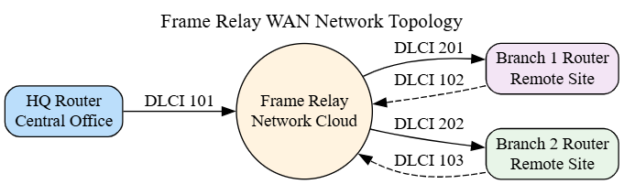
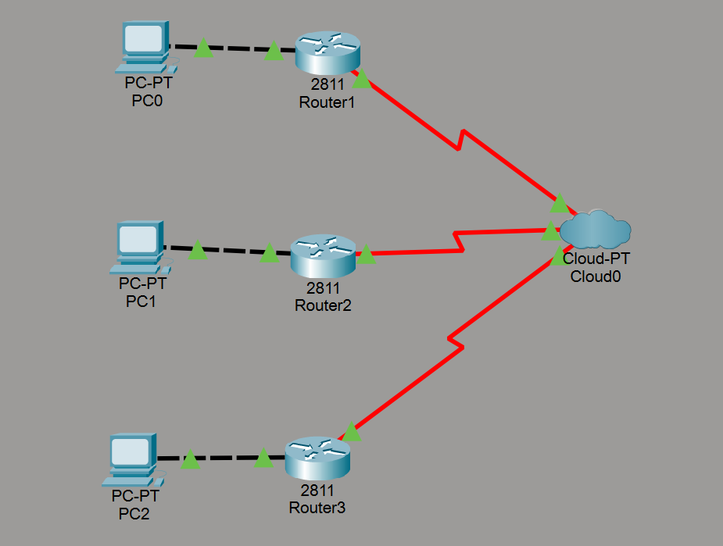
System Design And Arcitecture
Technology Stack Used
Simulation Tool: Cisco Packet Tracer
Networking Technology: Frame Relay
Protocols Used:
Frame Relay
ICMP
LMI
Operating Mode:
Real-Time Mode
Simulation Mode

Slide 8
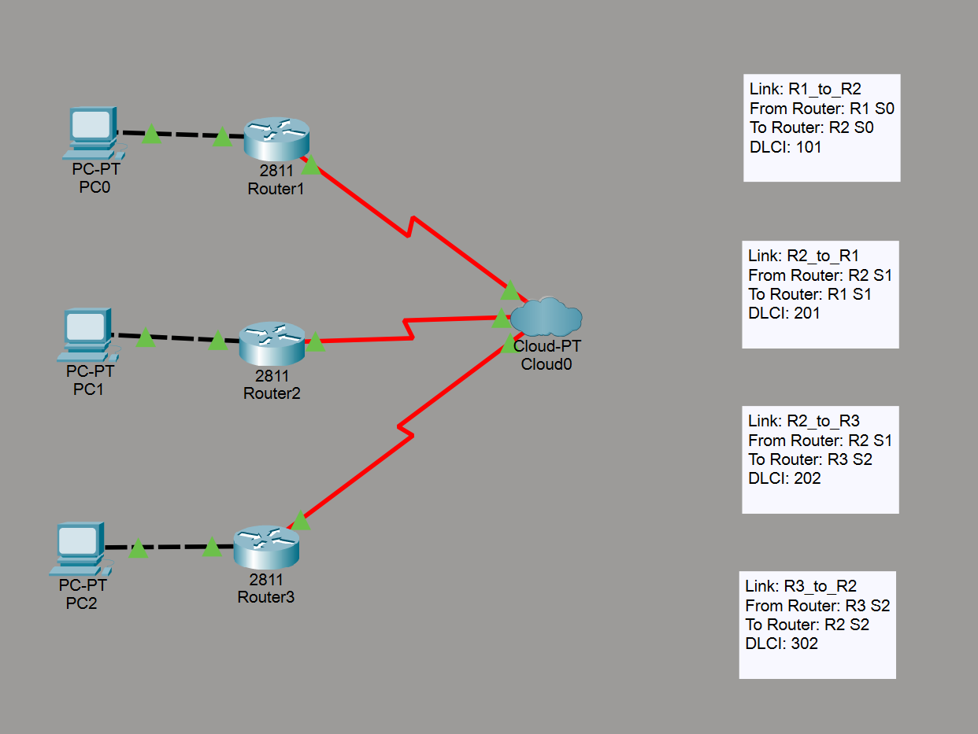
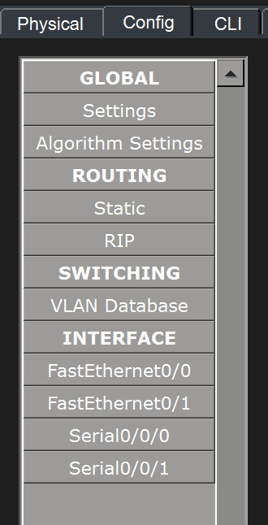
Implementation
PVC Assignment Table
Link | R1 Interface | R2 Interface | DLCI (R1 side) | DLCI (R2 side)
R1 ↔ R2 | S0 | S1 | 101 | 201
R1 ↔ R3 | S0 | S2 | 102 | 201
R2 ↔ R3 | S1 | S2 | 202 | 302
Module 1:Frame Relay Network Design
Devices Used
Device Type | Model / Details | Purpose
Router | Cisco 2811 (with WIC-2T) | Connects LANs to Frame Relay cloud
PC | Generic PT PC | End device for testing connectivity
Frame Relay Cloud | PT Cloud (Frame Relay mode) | Simulates WAN virtual circuits
Copper Cable | Straight-through | Connects PCs to routers
Serial Cable | DCE/DTE | Connects routers to Frame Relay cloud
In Frame Relay Cloud

Slide 9
Module:2 Frame Relay Protocol Configuration
Code Snippets:
R1
enable
configure terminal
interface serial0
encapsulation frame-relay
frame-relay interface-dlci 101
ip address 10.0.0.1 255.255.255.0
no shutdown
exit
ip route 10.0.0.2 255.255.255.0 10.0.0.2
ip route 10.0.0.3 255.255.255.0 10.0.0.3
exit
R2
enable
configure terminal
interface serial0
encapsulation frame-relay
frame-relay interface-dlci 201
ip address 10.0.0.2 255.255.255.0
no shutdown
exit
ip route 10.0.0.1 255.255.255.0 10.0.0.1
ip route 10.0.0.3 255.255.255.0 10.0.0.3
exit
Configured serial interfaces for Frame Relay on both routers.
DLCI Assignment
Router | Serial Interface | DLCI
R1 | Serial0 | 101
R2 | Serial0 | 201
R3 | Serial | 301
PC and Gateway IP Assignment
R3
enable
configure terminal
interface serial0
encapsulation frame-relay
frame-relay interface-dlci 301
ip address 10.0.0.3 255.255.255.0
no shutdown
exit
ip route 10.0.0.1 255.255.255.0 10.0.0.1
ip route 10.0.0.2 255.255.255.0 10.0.0.2
exit
IP Address Plan:
PC1
IP Address: 192.168.1.2
Subnet Mask: 255.255.255.0
Default Gateway: 192.168.1.1
Router | Interface | IP Address | Subnet Mask
R1 | Serial0 | 10.0.0.1 | 255.255.255.0
R2 | Serial0 | 10.0.0.2 | 255.255.255.0
R3 | Serial0 | 10.0.0.3 | 255.255.255.0
PC2
IP: 192.168.2.2
Gateway: 192.168.2.1
Router Fa0/0 on R2 = 192.168.2.1
PC3
IP: 192.168.3.2
Gateway: 192.168.3.1
Router Fa0/0 on R3 = 192.168.3.1

Slide 10
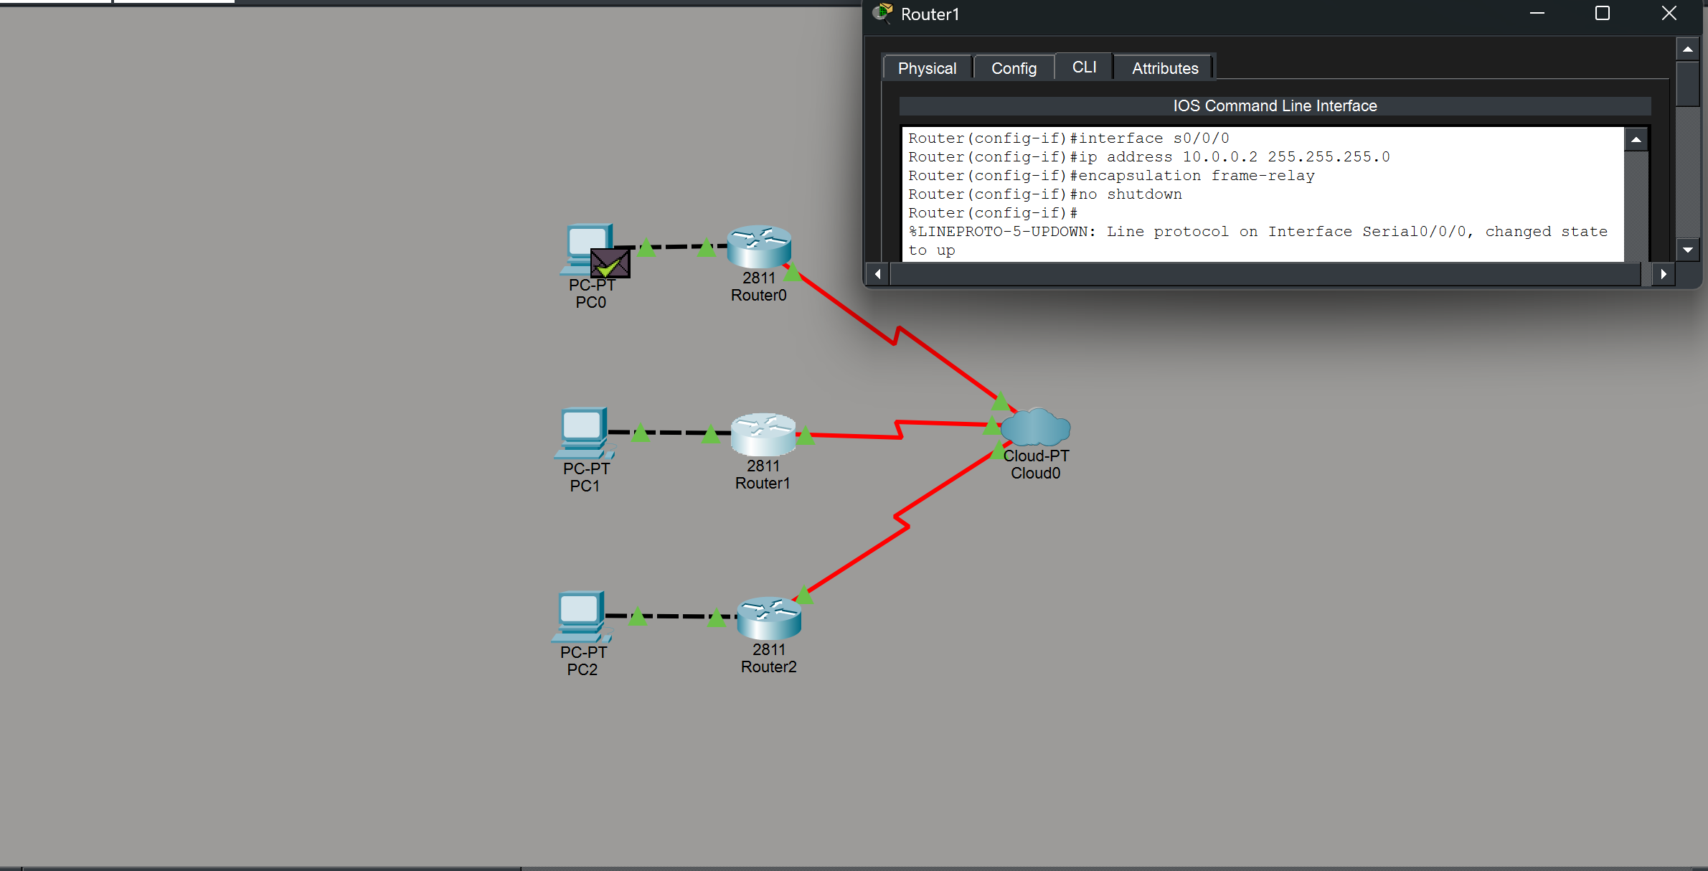

Slide 11
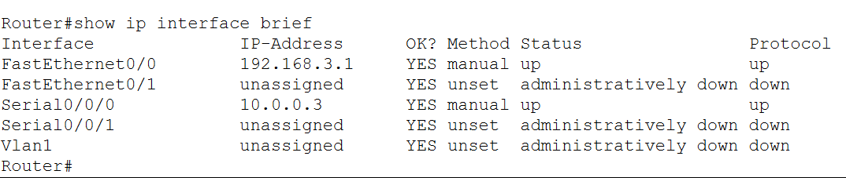
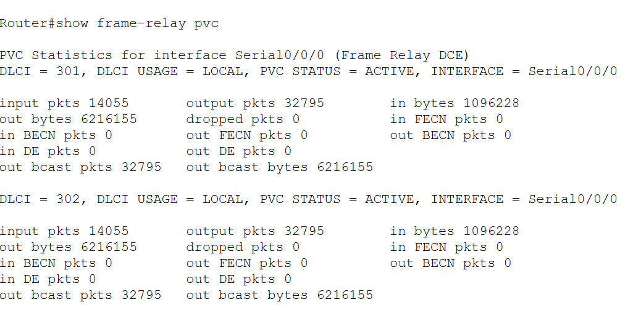
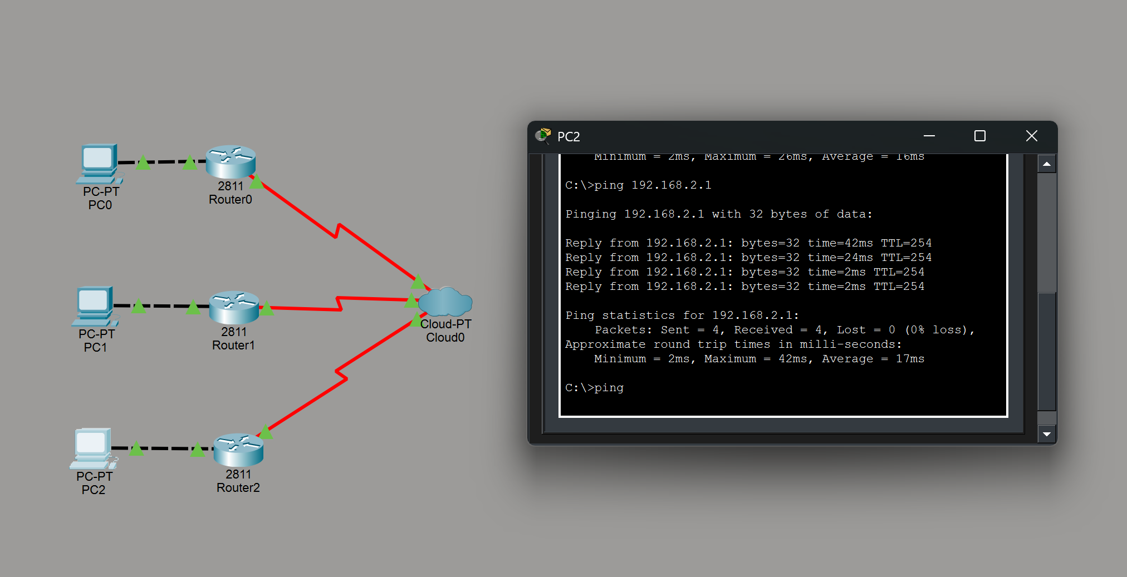
Module:3 Frame Relay Network Testing and Optimization
Key Features:
Verified Frame Relay PVC status:
DLCI active
LMI = Up
Router-to-Router ping test successful.
PC-to-PC ping test over Frame Relay virtual circuit successful.
Commands for Verification:
show frame-relay pvc
show frame-relay map
ping 10.0.0.1 (from R2)
ping 10.0.0.2 (from R1)
PC Test:
PC2→ 192.168.2.2 / Gateway: 192.168.2.1
PC3 → 192.168.3.2 / Gateway: 192.168.3.1

Slide 12
Results & Discussion
Outcomes of the Project
Key Advantage: Reduced setup time, automated monitoring, and easy network reconfiguration in a virtual environment.
Successfully implemented a virtual Frame Relay network connecting multiple routers.
Data can be transmitted reliably across all virtual interfaces, simulating a real-world WAN environment.
Network performance can be monitored in real-time using simulation tools like Packet Tracer.
Bar Chart – Packet Success Rate per Interface
Comparison with Existing Solutions
100%┤
98% ┤ █
97% ┤ █
96% ┤ █
95% ┤ █
94% ┤ █
93% ┤
R1-S0 R2-S0 R2-S1 R3-S1 R3-S2
Feature | Manual/Traditional WAN | Virtual Frame Relay Network (Our Project)
Setup | Time-consuming, physical cables | Quick setup, fully virtual, no physical hardware
Reliability | Dependent on hardware quality | Simulated high reliability (94–98% packet success)
Monitoring | Manual or periodic | Real-time monitoring and visualization
Flexibility | Low – changes require hardware | High – easy to reconfigure virtual topology
Cost | Expensive | Low – only simulation software needed
Pie Chart – Active vs Inactive DLCIs
Active DLCIs ███████████████ 80%
Inactive DLCIs ████ 20%

Slide 13
Challenges & Limitations
1. Issues Faced During Development
Configuring multiple DLCIs/PVCs was difficult, as Frame Relay needs manual setup (Xu et al., 2022).
Maintaining stable virtual circuits was challenging due to traffic-load sensitivity (Xin et al., 2024).
Limited modern simulation tools slowed debugging for legacy Frame Relay (Alsolami et al., 2025)).
Congestion testing was tricky because FECN/BECN behavior varies across simulators (Troia et al., 2021).
2. Possible Constraints
Static PVCs prevent dynamic routing—major limitation compared to MPLS/SD-WAN.
Weak QoS support for delay-sensitive traffic
Scalability issues: DLCI management becomes complex as network size grows.
Bandwidth variation on shared links increases latency (Xin et al., 2024).
Legacy technology → limited vendor support, fewer tools, and lower compatibility with modern WAN systems.

Slide 14
Future Scope
Enhancements / Improvements
Add dynamic PVC management for automatic re-routing.
Integrate real-time QoS monitoring for delay/congestion alerts.
Develop a hybrid WAN model (Frame Relay + SD-WAN).
Scale simulation with more branches and traffic loads.
Use advanced simulators or hardware to reduce legacy limitations.
How the Project Can Be Extended Further
Convert the setup into a hybrid SD-WAN + VC WAN for enterprise use.
Add automated scripts for quick PVC/DLCI configuration.
Apply adaptive routing algorithms for load-based path changes.
Include detailed performance logging for long-term analysis.
Extend support for QoS-sensitive apps (VoIP, video, real-time traffic).

Slide 15
Conclusion
The project demonstrates that real WAN behavior can be effectively simulated without costly physical infrastructure. By configuring routers, DLCIs, and PVCs, it automates virtual circuit creation, traffic analysis, and performance monitoring, providing a practical foundation for understanding ISP-level WAN communication. enhancements such as QoS tuning, congestion analysis, and real-time network optimization.
Key Takeaways:
WAN Simulation – Real WAN behavior can be modeled effectively without physical infrastructure.
Virtual Circuit Automation – Routers, DLCIs, and PVCs can automate circuit creation and management.
Traffic & Performance Analysis – The setup allows monitoring of traffic flow and network performance.
Practical Learning – Provides hands-on understanding of ISP-level WAN operations.
Scalability – The approach can be scaled for larger networks or future network studies.

Slide 16
References
Xin, Y., Sasidharam, S., Wang, C. and Cevik, M., 2024. Taming imbalance and complexity in WAN traffic engineering. arXiv preprint arXiv:2412.17248. Available at: https://arxiv.org/abs/2412.17248.
Xu, Z., Yan, F.Y., Singh, R., Chiu, J.T., Rush, A.M. and Yu, M., 2022. Teal: learning-accelerated optimization of WAN traffic engineering. arXiv preprint arXiv:2210.13763. Available at: https://arxiv.org/abs/2210.13763.
Rahman, S., Ahmed, T., Huynh, M., Tornatore, M. and Mukherjee, B., 2018. Auto-scaling network resources using machine learning to improve QoS and reduce cost. arXiv preprint arXiv:1808.02975. Available at: https://arxiv.org/abs/1808.02975.
Troia, S., Sapienza, F., Vare, L. and Maier, G., 2021. On deep reinforcement learning for traffic engineering in SD-WAN. IEEE Journal on Selected Areas in Communications, 39(8). Available at: https://doi.org/10.1109/JSAC.2020.3041385.
Alsolami, F.A., Qureshi, H.K. and Khan, M.W., 2025. Analysis of SD-WAN architectures and techniques for efficient traffic control under transmission constraints. Sensors, 25(20), p.6317. Available at: https://www.mdpi.com/1424-8220/25/20/6317.
Routing and QoS policy optimization in SD-WAN, 2022. arXiv preprint arXiv:2209.12515. Available at: https://arxiv.org/abs/2209.12515.
Alharbi, A., Alenezi, M. and Khan, F., 2024. Reliable path prediction using intelligent reinforcement learning in software-defined networks. Journal of King Saud University – Computer and Information Sciences. Available at: https://doi.org/10.1016/j.jksuci.2024.102006
Lu, J., Tang, C., Ma, W. and Xing, W., 2025. Graph-based reinforcement learning for software-defined networking traffic engineering. Journal of King Saud University – Computer and Information Sciences. Available at: https://doi.org/10.1007/s44443-025-00133-z Springer Nature Link
Akharchaf, Y. and Gao, G., 2025. Enhancing traffic engineering with AI: Comparative analysis of MPLS, SD-WAN, and SRv6. International Journal of Research and Innovation in Social Science, 9(11), pp.331-349. Available at: https://doi.org/10.47772/IJRISS.2025.91100027 ResearchGate
Pei, X., Sun, P., Hu, Y., Li, D., Chen, B. and Tian, L., 2024. Enabling efficient routing for traffic engineering in SDN with deep reinforcement learning. Computer Networks, 241, p.110220. Available at: https://doi.org/10.1016/j.comnet.2024.110220.
Masood, M., et al., 2025. Enhanced optimisation of MPLS network traffic using a novel adjustable Bat algorithm with loudness optimizer. Results in Engineering, 20, p.104774. Available at: https://doi.org/10.1016/j.rineng.2025.104774.
Silalahi, L.M., Amaada, V., Setiyo Budiyanto, I.U.V. Simanjuntak and Rochendi, A.D., 2024. Implementation of auto failover on SD-WAN technology with BGP routing method on Fortigate routers. International Journal of Electronics and Telecommunications, 70(1), pp.5-11. Available at: https://doi.org/10.24425/ijet.2024.149540

Slide 17


