Slide 1
Coursera Capstone IBM Applied Datascience
Restaurants types in Toronto compared to New York
By: Divya Lakshmi Narasimhan

Slide 2
Business problem
Locating the restaurants in the city of Toronto Canada and comparing them with New york USA.
Finding the Cuisines that are available in New york by missing in the Toronto.
Which of the city has most number of cuisines and the restaurants.
Business Questions:
Which type of cuisine are not available in Toronto but already running successfully in New york?
Which type of cuisine can attract more customers as no other restaurants in the neighbourhood offers?

Slide 3
Data
Data Required
Latitude and Longitudes of the cities Toronto and New york.
Number of restaurants available in both the cities.
Restaurants available in the city and their respective cuisine which they are serving the food.
Source of Data
Geocoder package for latitude and longitude coordinates
Foursquare data for fetching the restaurants
Folium map to show the location of the restaurants.

Slide 4
Methodology
Get the latitude and longitude of both the cities using Geocoder.
Use Foursquare api to get the list of resturants along with their food category.
Map the output using Folium so that on click of blue dot restaurants type will be displayed.
Group the data according to their categories.
User outer join the join the data of both the cities and compare it
Use barh to display the result for the user to easily understand.

Slide 5
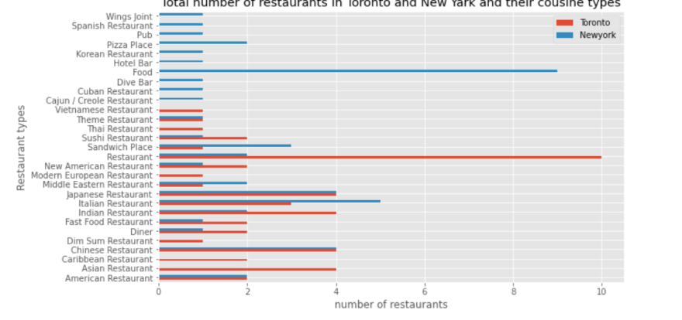
RESULT
New york has wide variety of cuisines and restaurants.
New york attracts more tourist and immigrants as it contains almost major number of cuisines compared to Toronto.

Slide 6
Recommendation and conclusion
Toronto has very less or no available cuisines like Spanish or Cuban etc. restaurants. Opening such restaurants in Toronto can attract more number of customers for their different variety of cuisines.
Opening more cuisines will attracts more immigrants and tourists as food is important aspects for everyone.

Slide 7
Thank You !!!

