Slide 1


Pattern Classification of Stock Price Moving
MSc Data Science, The University of Manchester, 2026
Student ID : 14261808
Name: Divyalakshmi Rama

Slide 2

Can we find hidden groups in noisy stock prices?
The Problem and Approach: Stock prices are noisy time series with no predefined labels, so this study compares three unsupervised clustering algorithms to identify stocks that move in similar ways and assess the meaningfulness and stability of the resulting clusters.
Why It Matters: Identifying natural groups of stock can be used to build portfolios, finding stocks to invest or trade and describing market conditions.

Slide 3
To study this, we apply three clustering algorithms to the FTSE data.
FTSE 100 & FTSE 250 - Daily Adjusted Closing Prices, Z-score Standardised
K-Means Clustering
K-Medoids Clustering with Dynamic Time Warping
Gaussian Mixture Model with Expectation-Maximisation
Period | Stocks | Days
11 years | 103 | 2,779
4.5 years | 241 | 1,153
1 year | 248 | 273

Slide 4
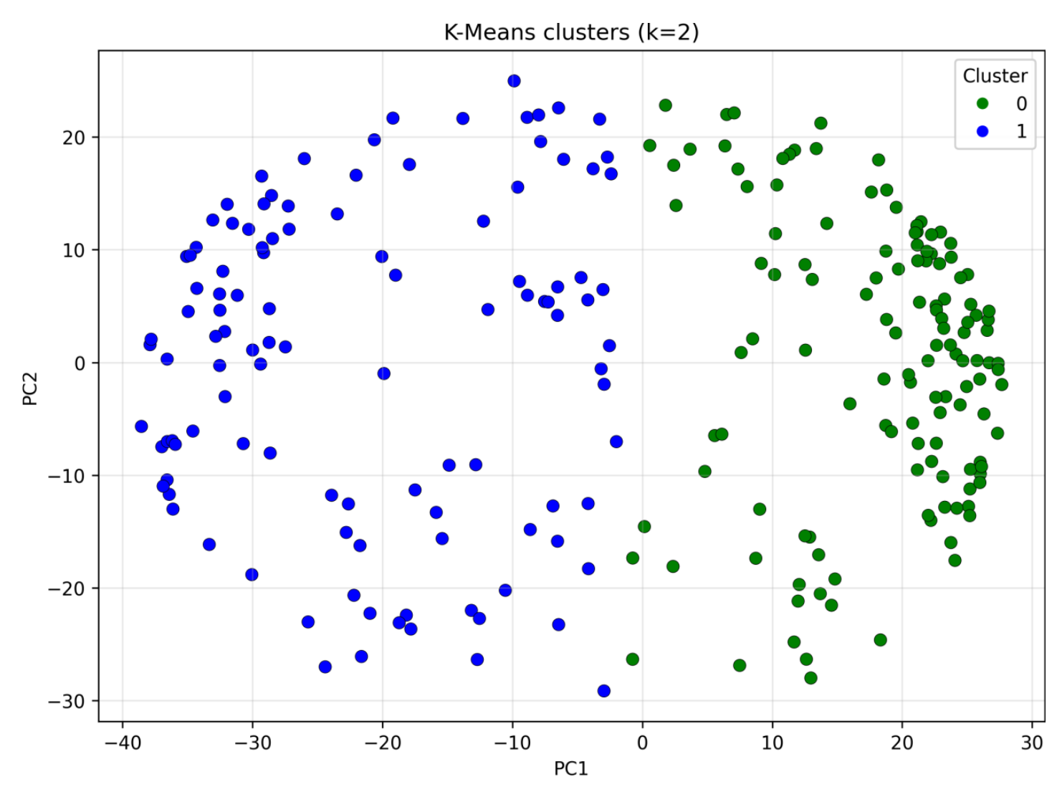
K-Means
1. Reduce the data: PCA was used to reduce the dimensionality of the price series..
2. Assign: Every stock joins the cluster with the nearest centre.
3. Update: Each centre moves to the mean of the stocks in its cluster.
4. Repeat: Steps 2 and 3 repeat until no stock changes cluster.
5. Choose k: I tried k from 2 to 10 and judged each value with four validity indices: Silhouette, Calinski-Harabasz, Davies-Bouldin and Dunn.
PCA view of the 241 stocks, split into two
K-Means groups (k = 2).

Slide 5
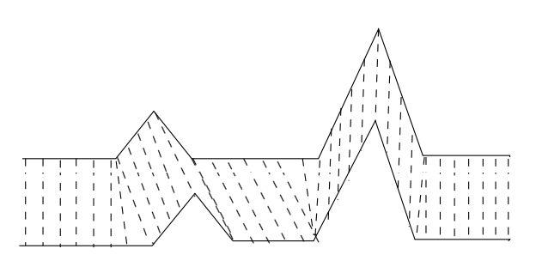
K-Medoids with Dynamic time wraping
1. Measure similarity: Dynamic Time Warping compares the full price series of every pair of stocks. It stretches or squeezes the time axis, so the same shape still matches if it happens a few days earlier or later. This gives a table of distances between all stocks.
2. BUILD: Choose k real stocks as the starting medoids: first the stock closest to all the others, then each stock that reduces the total distance the most.
3. Assign: Every stock joins the medoid that is closest to it by DTW distance.
4. SWAP: Try replacing a medoid with another stock, and keep the swap that lowers the total distance the most.
5. Repeat: Assigning and swapping repeat until no swap lowers the total distance.
6. Result: Each cluster is led by a real stock, called its medoid whereas a K-Means centre is only an average.
DTW stretches the time axis so that similar shapes
still match.

Slide 6
Gaussian mixture model with Expectation Maximisation
GMM groups stocks into overlapping clusters, assigning each a membership probability. EM fits the clusters to the data.
How EM fits the model
Start: Use K-Means to choose initial centres, repeating 20 times to find a good starting point.
E-step: Calculate each stock’s probability of belonging to each cluster.
M-step: Update each cluster’s centre, spread and size, weighting stocks by their membership probabilities.
Repeat: Alternate between the E-step and M-step until the likelihood stops improving, up to 500 iterations.
Choose the model: Compare models with different cluster numbers and covariance shapes, selecting the one with the lowest BIC.
Assign clusters: Assign each stock to its most probable cluster and flag stocks with a maximum probability below 70% as uncertain.

Slide 7
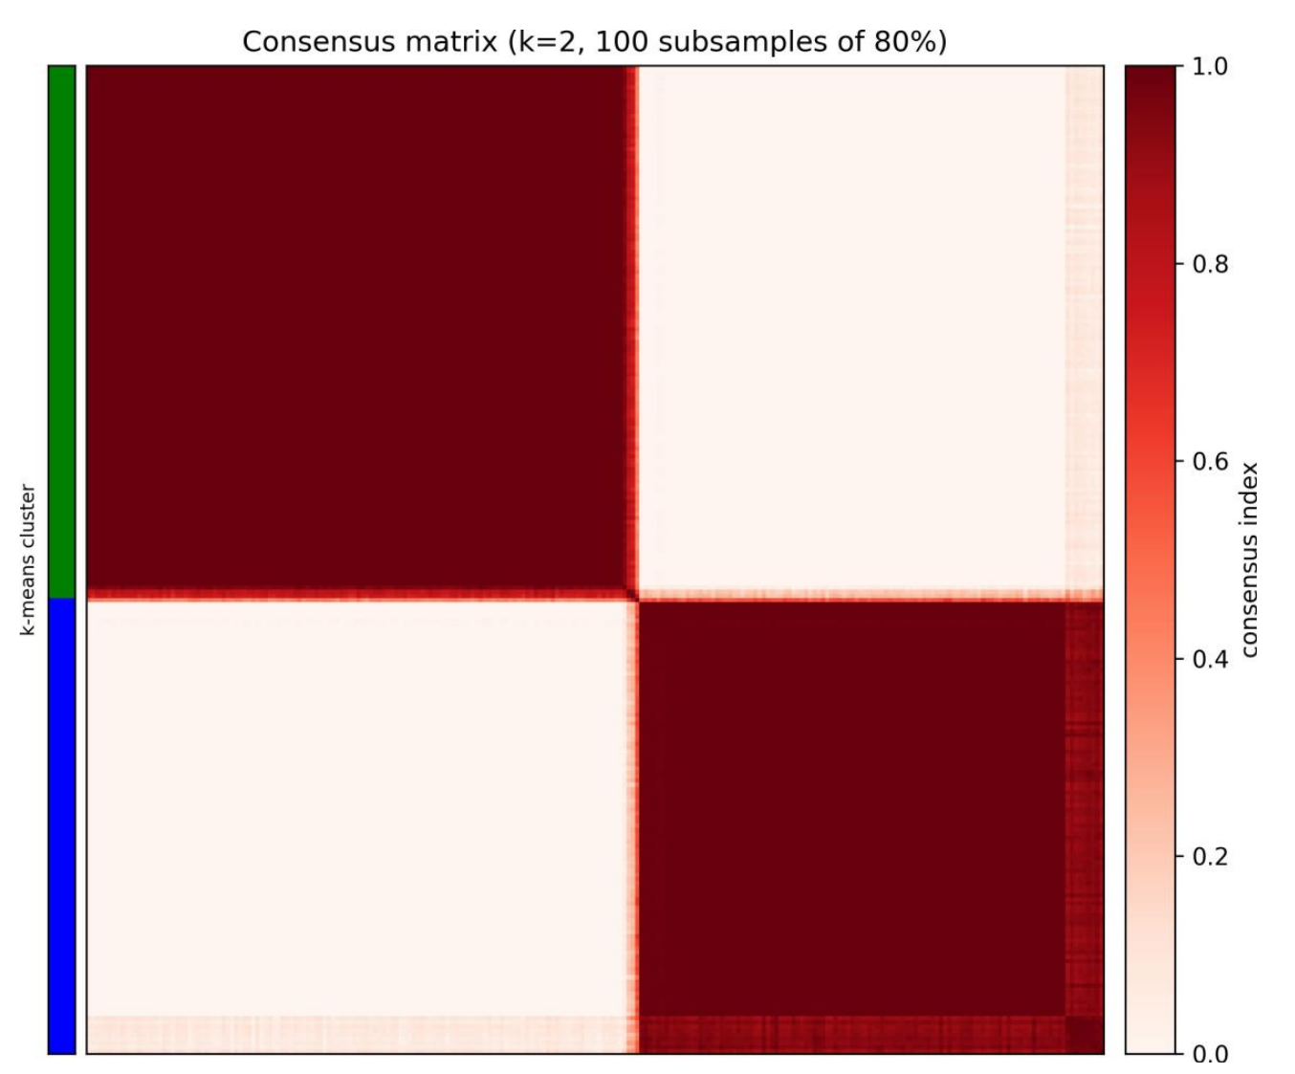
Consensus clustering: are the groups stable?
What it tests. Consensus clustering checks whether the groups stay the same when the data changes slightly.
1. Subsample. Draw 100 random samples, each containing 80% of the stocks.
2. Cluster. Run the same algorithm on every sample.
3. Count. Record how often each pair of stocks ends up in the same cluster.
4. Read the matrix. A value of 1 (dark red) means a pair is always together, and 0 (white) means it is never together.
Result. Dark blocks along the diagonal mean stable groups. I use this to test stability, not to choose k.

Slide 8
RESULTS

Slide 9
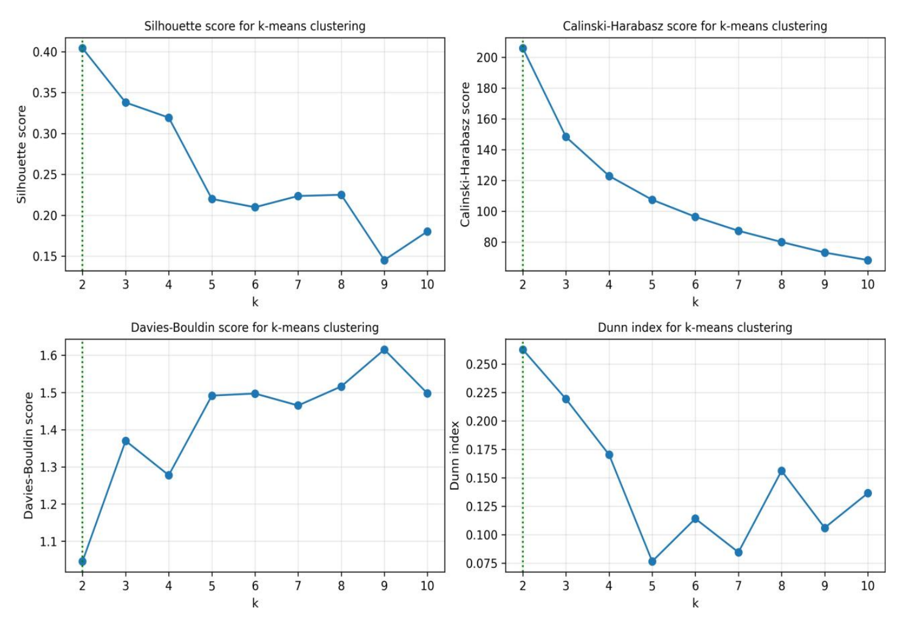
K-Means finds two stable groups
All four validity indices choose k = 2.

Slide 10
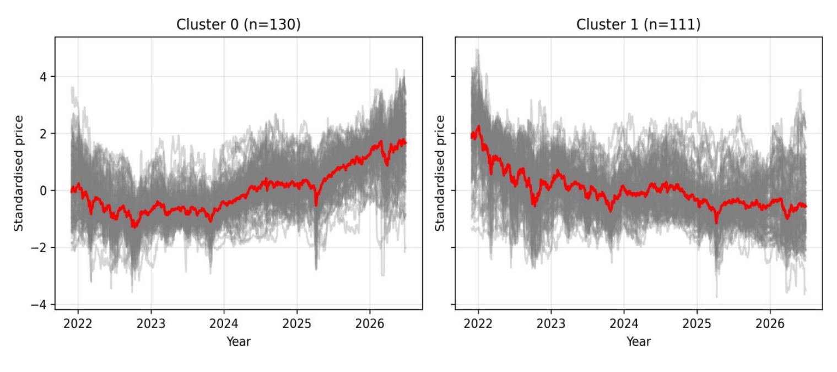
The two clusters contain 130 and 111 stocks
Standardised prices: Cluster 0 rises and Cluster 1 falls (the red line is the cluster mean).
Cluster 0 (rising, 130 stocks): BlackRock World Mining Trust, JPMorgan Global Growth & Income, AJ Bell, HgCapital Trust, 3i Infrastructure and Rotork.
Cluster 1 (falling, 111 stocks): Spire Healthcare, easyJet, Frasers Group, J D Wetherspoon, Greggs and Taylor Wimpey.

Slide 11
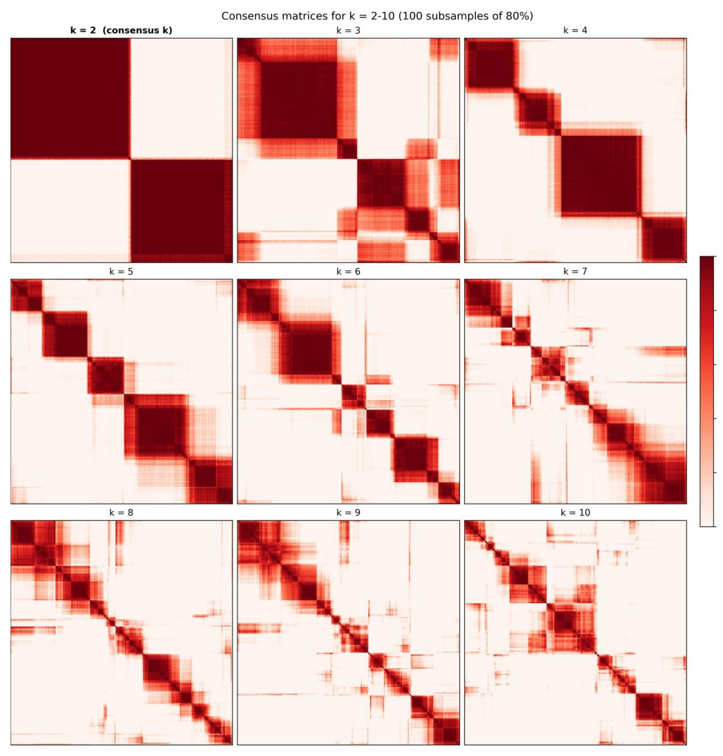
K-Means consensus: chosen k against all k
All values of k from 2 to 10: the blocks blur as k grows.
Chosen k = 2: two clean dark blocks.
Conclusion. At k = 2 the cluster consensus is 0.992 and 0.980 and is stable

Slide 12
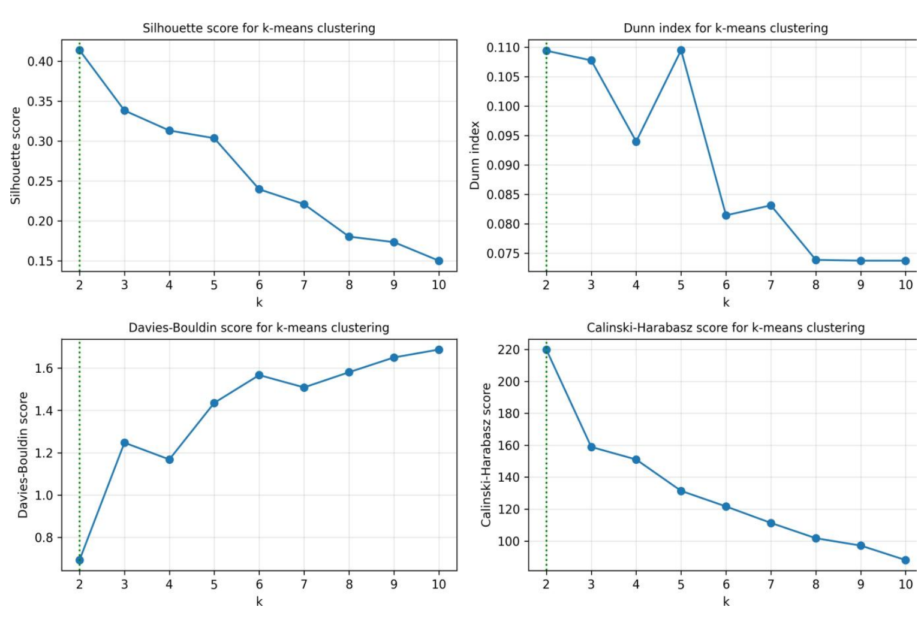
K-Medoids agrees: rising and falling
Three indices selected K = 2, while the Dunn index selected K = 3. Therefore, K = 2 was chosen by majority vote.

Slide 13
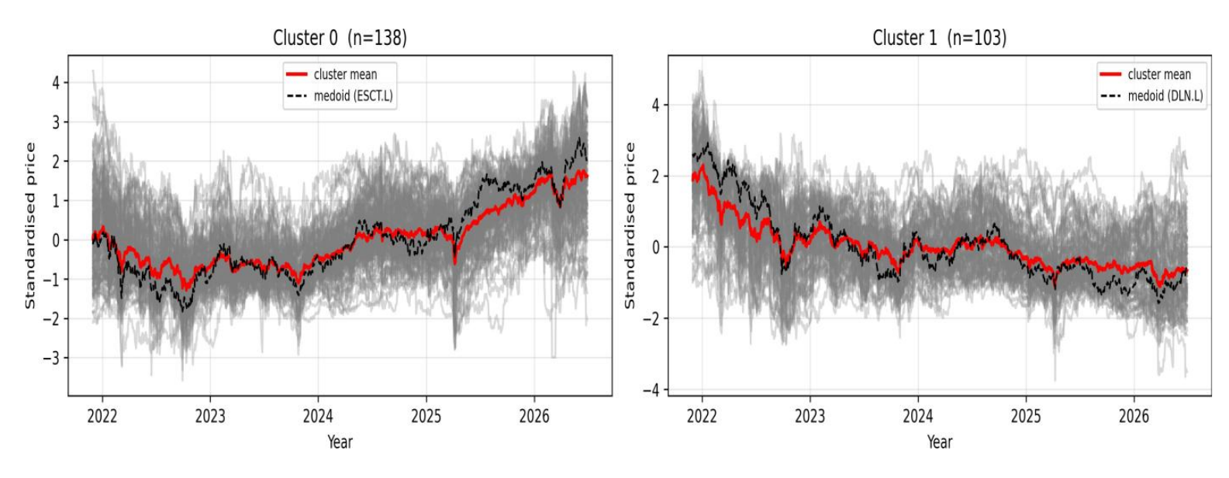
The two clusters contain 138 and 103 stocks
Standardised prices in each cluster (the dashed black line is the medoid stock).
Cluster 0 (rising, 138 stocks, medoid ESCT.L): BlackRock World Mining Trust, JPMorgan Global Growth & Income, AJ Bell, HgCapital Trust and Rotork.
Cluster 1 (falling, 103 stocks, medoid DLN.L): Spire Healthcare, easyJet, Frasers Group, J D Wetherspoon and Greggs.

Slide 14
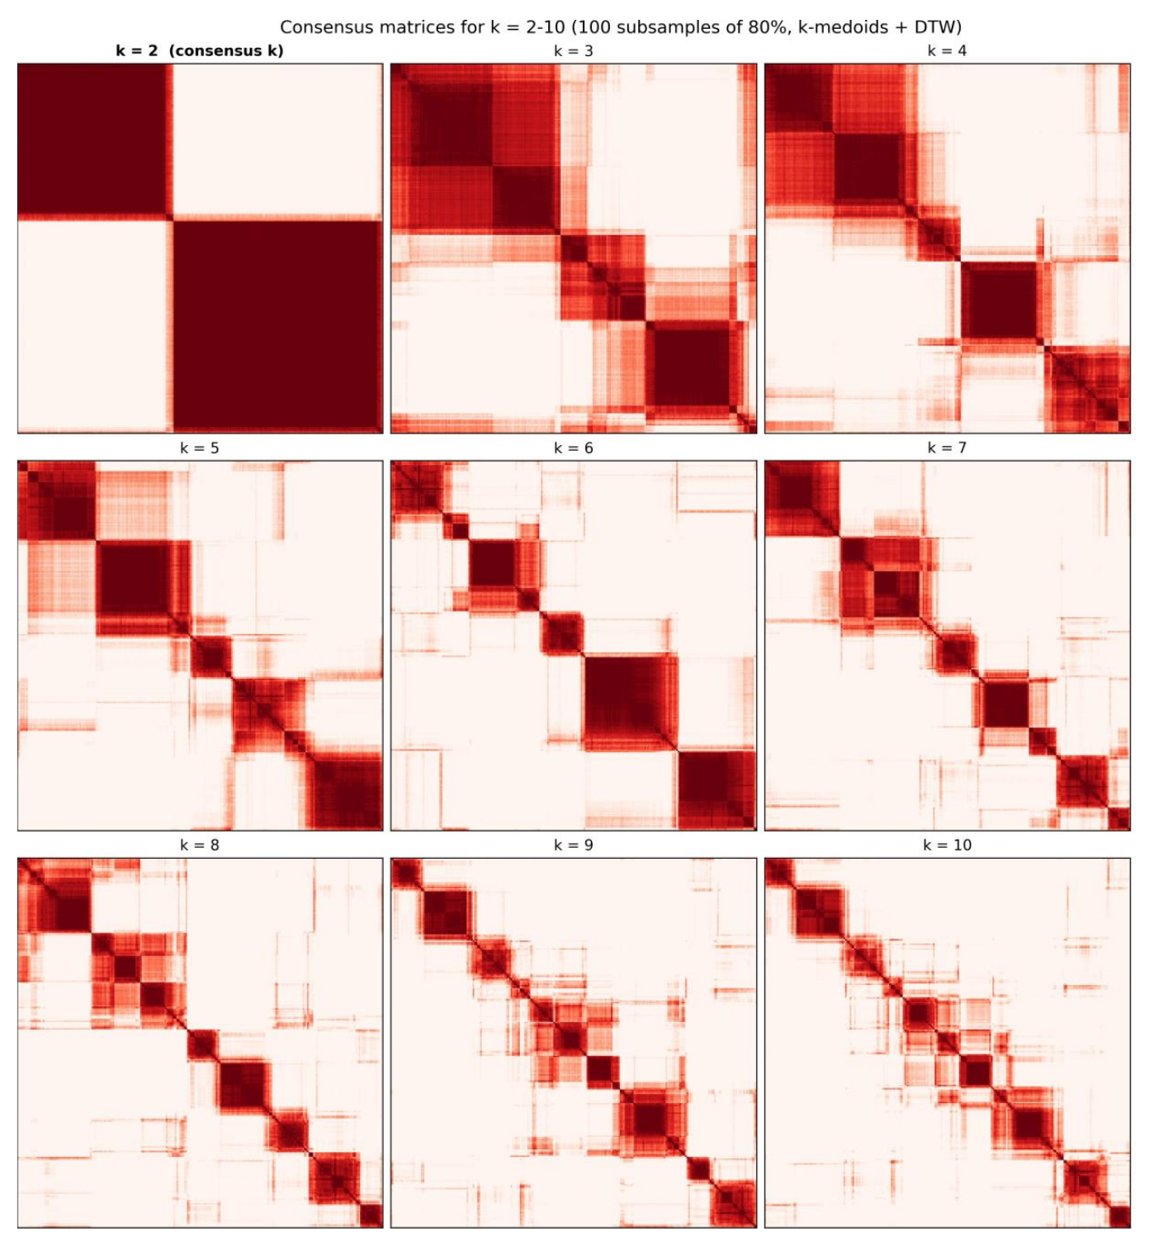
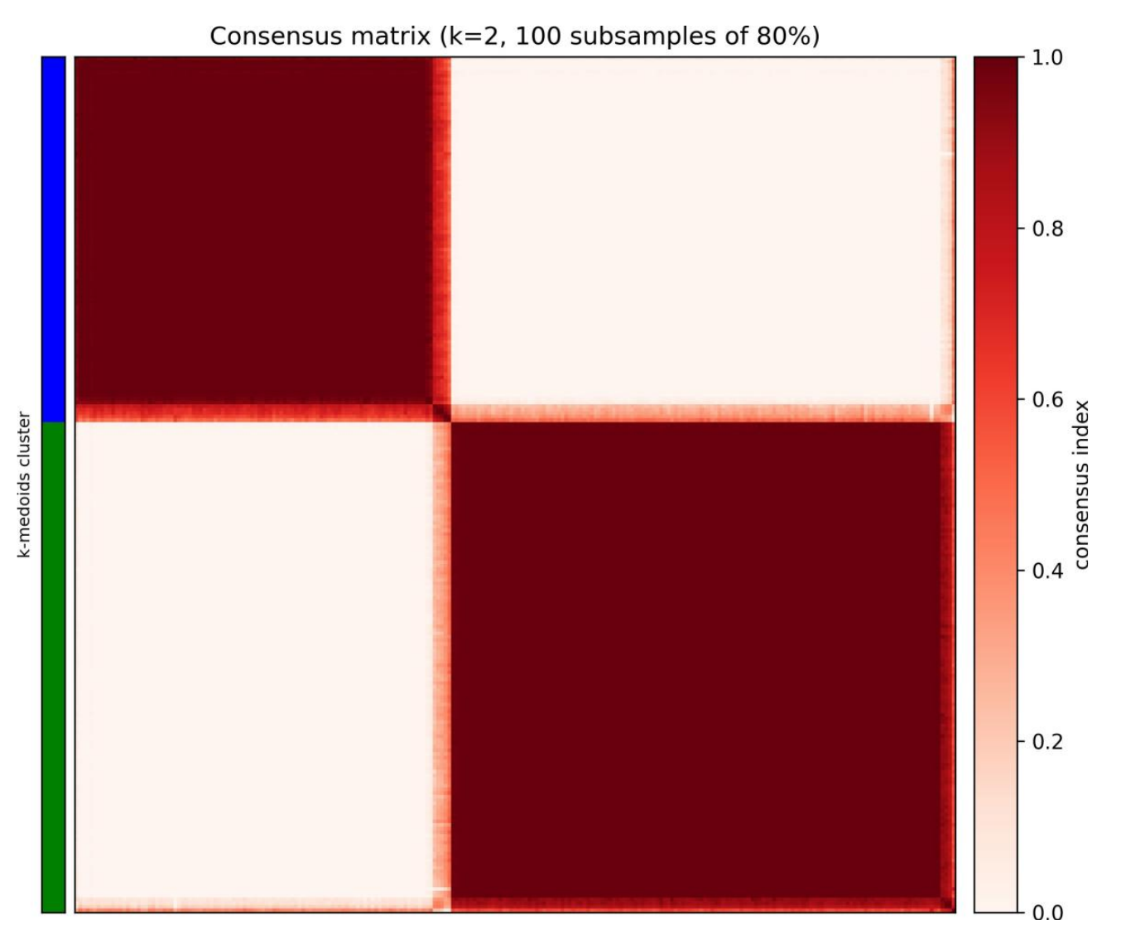
K-Medoids consensus: chosen k against all k
All values of k from 2 to 10 with DTW: the blocks blur as k grows.
Chosen k = 2: two clean dark blocks.
Conclusion. At k = 2 the cluster consensus is 0.989 and 0.965 and is stable

Slide 15
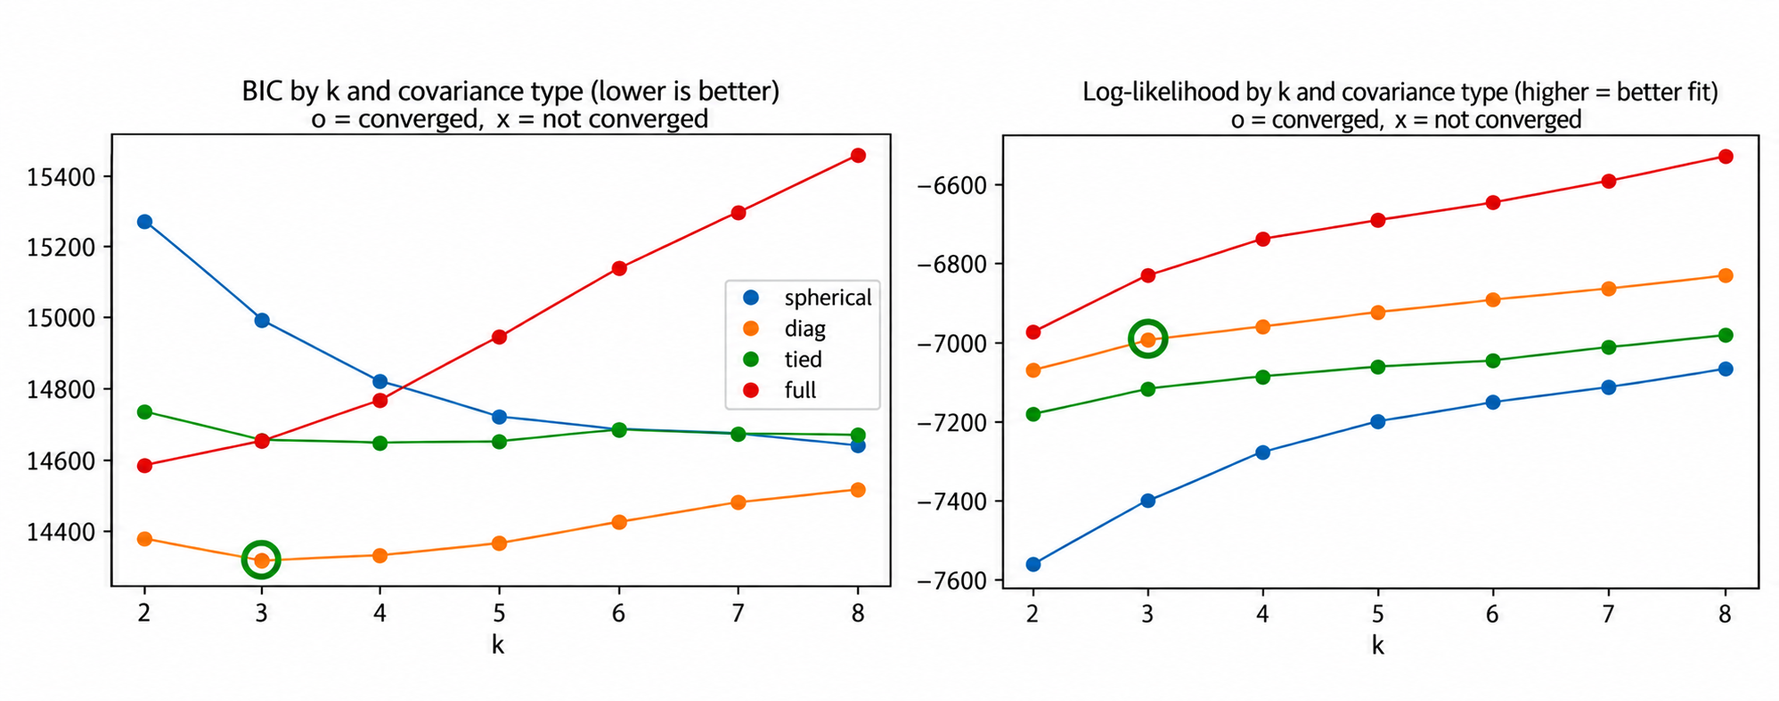
GMM adds a third, mixed group
We chose k = 3 with diagonal covariance because it has the lowest BIC, meaning it gives the best balance between fitting the data well and keeping the model simple, even though other models have a higher log-likelihood.

Slide 16
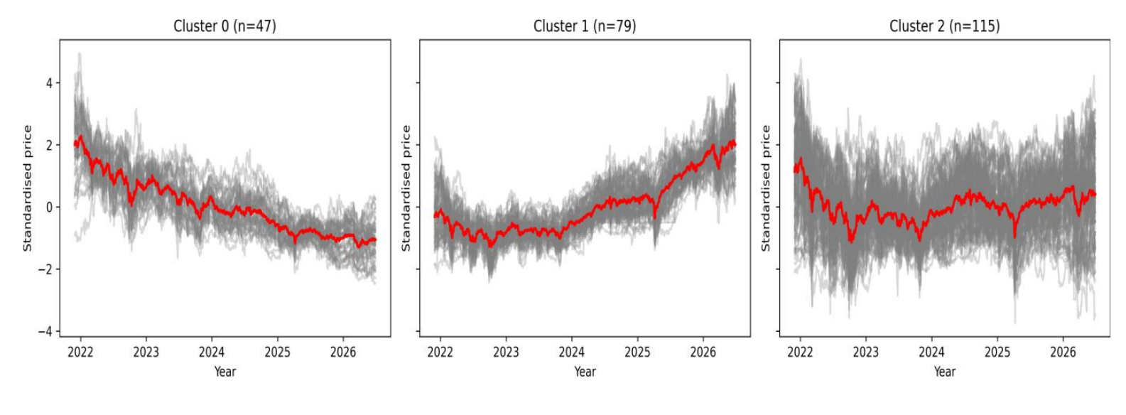
The GMM finds three groups: 47 falling, 79 rising and 115 mixed stocks
Standardised prices in the falling, rising and mixed groups (the red line is the cluster mean).
Cluster 0 (falling, 47 stocks): Aston Martin, Ocado, WH Smith and Unite Group.
Cluster 1 (rising, 79 stocks): AJ Bell, JPMorgan Global Growth & Income, Serco and Plus500.
Cluster 2 (mixed, 115 stocks): Spire Healthcare, BlackRock World Mining Trust, easyJet and Frasers Group.

Slide 17
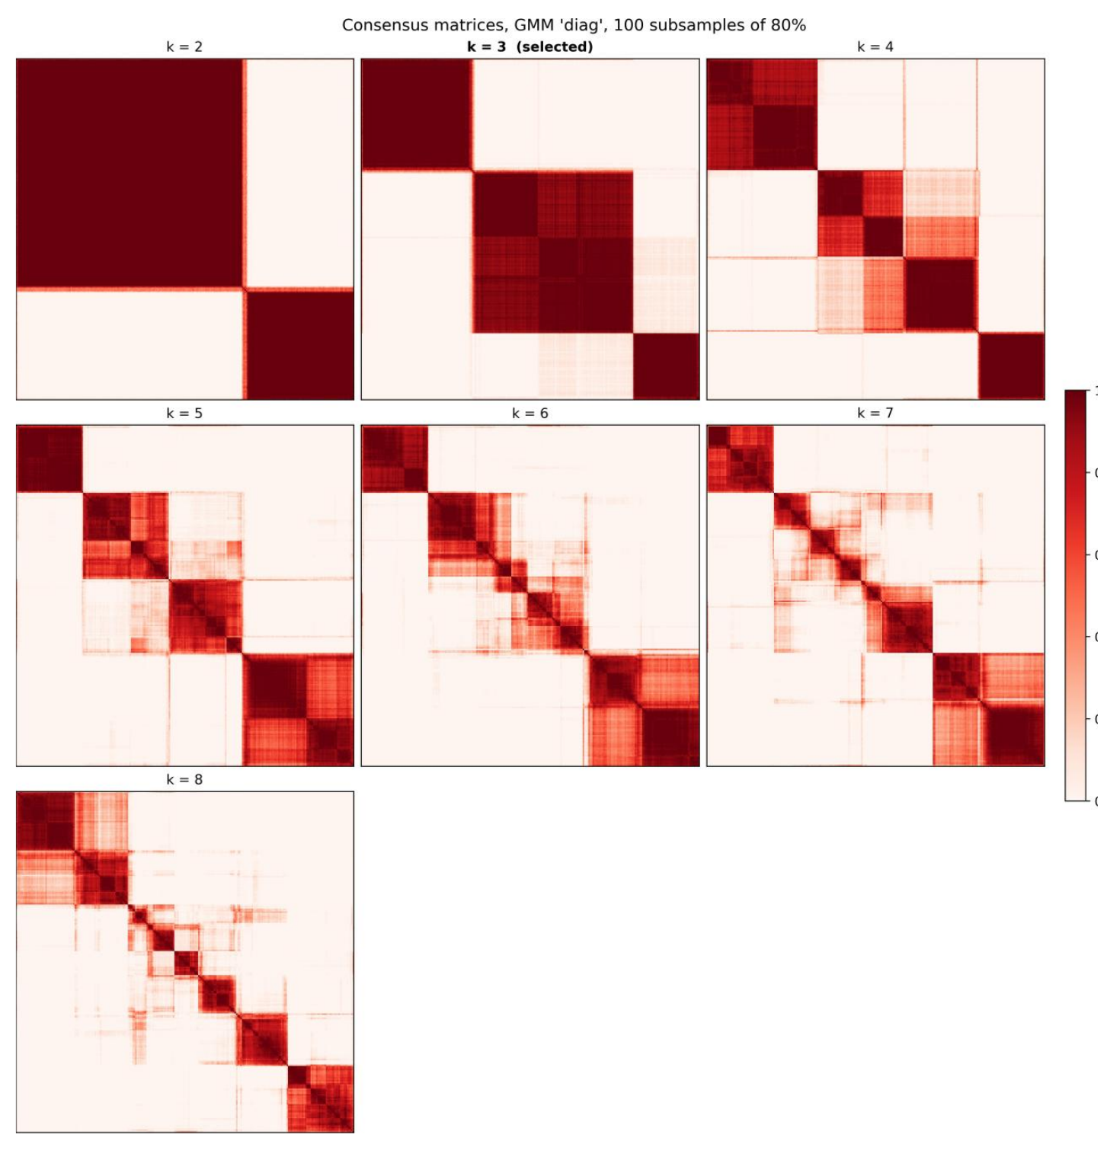
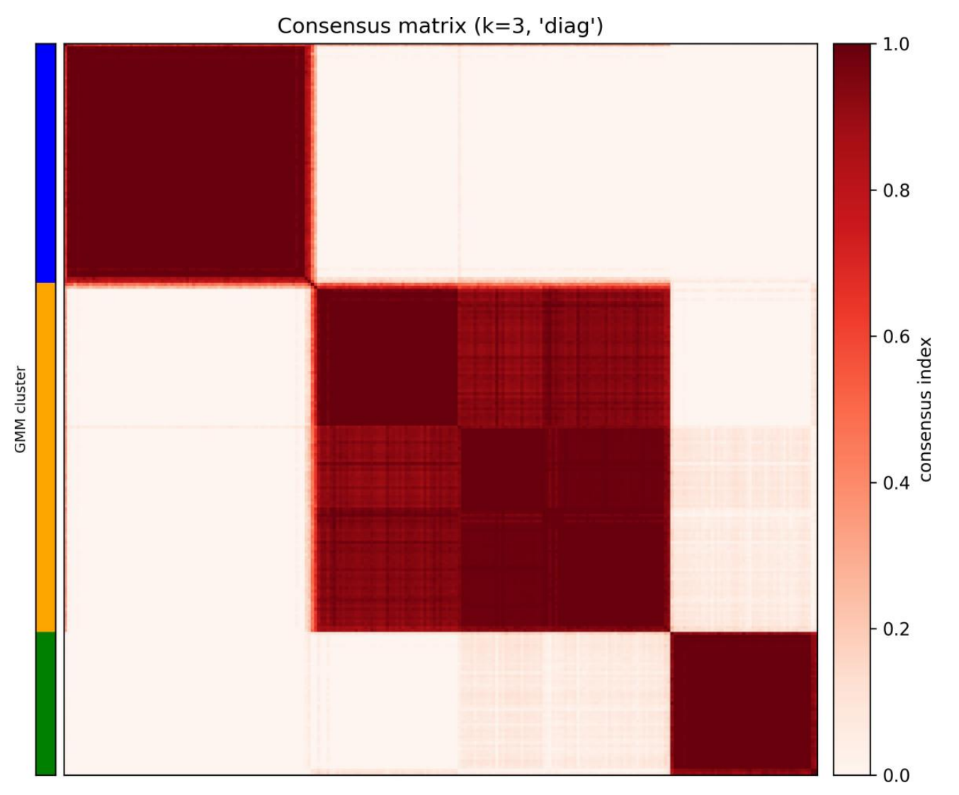
GMM consensus: chosen k = 3 against all k
All values of k from 2 to 10 with DTW: the blocks blur as k grows.
Chosen k = 3: three dark blocks.
Conclusion. At k = 3 the cluster consensus is 0.989, 0.981 and 0.949. The model with k = 2 is slightly more stable, but BIC chooses k = 3.

Slide 18
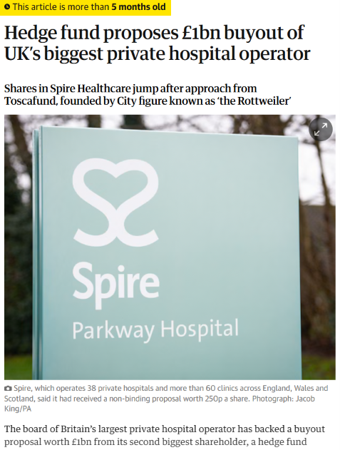

Spire Healthcare: grouped as falling.
Spire Healthcare Group (SPI.L)
Method | Group for Spire
K-Means | Falling
K-Medoids with DTW | Falling
GMM | Mixed
Price trend: K-Means and K-Medoids classify Spire as falling, while GMM places it in a mixed group, potentially capturing more nuance after the 2026 takeover and price rise. However, one example does not prove GMM is better.

Slide 19
More companies across the three methods
Company | K-Means | K-Medoids | GMM
Taylor Wimpey | Falling | Falling | Mixed
Greggs | Falling | Falling | Mixed
ITV | Falling | Falling | Mixed
Rightmove | Falling | Falling | Mixed
Ocado | Falling | Falling | Falling
Aston Martin | Falling | Falling | Falling
WH Smith | Falling | Falling | Falling
Wizz Air | Falling | Falling | Falling
Company | K-Means | K-Medoids | GMM
Serco | Rising | Rising | Rising
Currys | Rising | Rising | Rising
Cranswick | Rising | Rising | Rising
Premier Foods | Rising | Rising | Rising
Drax | Rising | Rising | Mixed
Saga | Rising | Rising | Mixed
Man Group | Falling | Rising | Mixed
Johnson Matthey | Falling | Rising | Mixed
Where the methods differ. Among these companies, K-Means and K-Medoids disagree only on Man Group and Johnson Matthey. GMM moves several other companies, such as Taylor Wimpey and Drax, into its mixed group.

Slide 20
Comparison: the same story with different detail
Agreement: K-Means and K-Medoids classify 96% of stocks (231 out of 241) into the same groups.
GMM: Around 48% of stocks fall into its additional mixed group using 4.5 years of data.
Stability over time: 70% of stocks keep the same group with K-Means and K-Medoids, compared with 52% for GMM, when comparing 4.5-year and 1-year data.
So far, we can see that the algorithms group stocks based on similarities in their price movements, rather than their business sectors. As a result, companies from different industries can end up in the same cluster.
Overall: All three methods produce stable clusters within each period, but stock groups can change over time as prices change.

Slide 21
CONCLUSION
Groups exist, but they mostly reflect price direction
K-Means and K-Medoids: Both identify two groups of stocks rising and falling with approximately 96% agreement between their classifications.
Gaussian Mixture Model (GMM): Identifies a third, mixed group, providing a more detailed picture and highlighting stocks with uncertain group membership.
Stable but Not Permanent: Stock groupings remain relatively stable within each period, but stocks can move between groups over time.
Future Work: Incorporate additional features, such as stock returns and volatility; test the models across other markets and include delisted stocks; and develop a news pipeline to explore the impact of news on stock groupings.

Slide 22
THANK YOU

