Slide 1
VERSION CONTROL SYSTEMS

Slide 2
ABOUT ME
A Sophomore from UIET
Open source enthusiast || Traveller || Turns coffee into code
Software Developer at KDE
Season of KDE developer with GCompris
Contributing to GCompris from the past 9 months.

Slide 3
INTRODUCTION
Version control systems are a category of software tools that help a software team manage changes to source code over time. Version control software keeps track of every modification to the code in a special kind of database.If a mistake is made, developers can turn back the clock and compare earlier versions of the code to help fix the mistake while minimizing disruption to all team members.

Slide 4


Slide 5
YOU CAN TRAVEL BACK IN TIME. I am not joking :p
Helps you collaborate and contribute
Want to do GSoc? You need it.
Working in a team is better…...

Slide 6
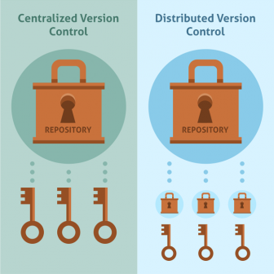

Slide 7

CENTRAL VCS

Slide 8
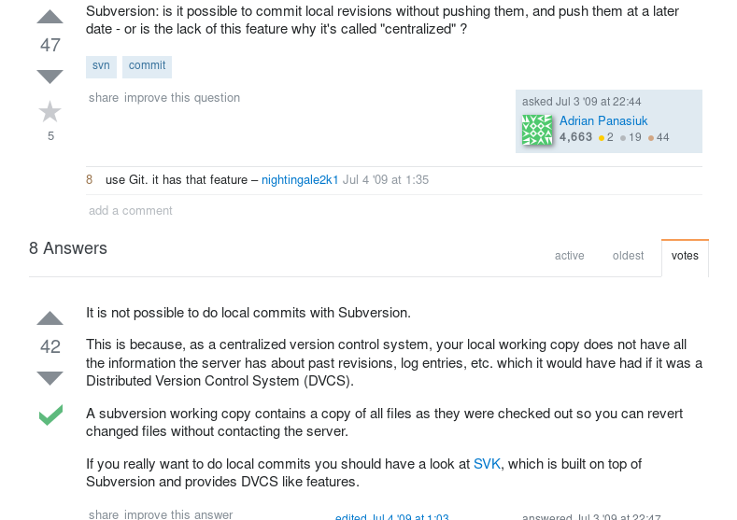

Slide 9

DISTRIBUTED VCS

Slide 10


Slide 11
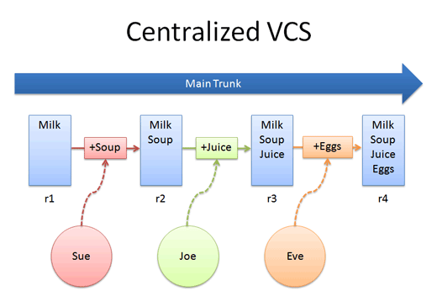

Slide 12
DISADVA-NTAGES
What if server goes down?
What if data on server gets deleted?
You need to give commit rights
Space: SVN = 30 * space required for git for history

Slide 13
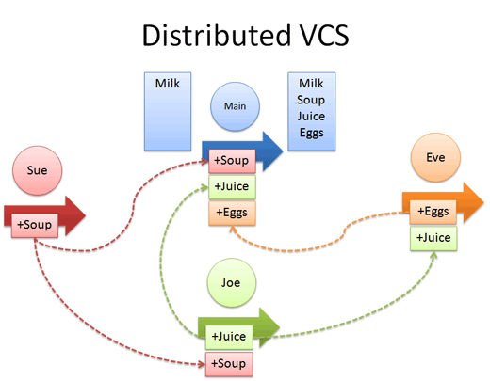

Slide 14


Slide 15
Installing GIT
For Windows:
Download git http://bit.ly/git_vcs, run the setup and do the next next finish.
For Linux:
sudo apt-get install git
For more reference:
http://bit.ly/gitTutorial

Slide 16
DONT’S IN VCS
Don’t add temporary files
Don’t add executables
Don’t add large bundles of files

Slide 17


