Slide 1
GIT
Let’s Dive In

Slide 2


Slide 3

Git is a revision control system, a tool to manage your source code history.
GitHub is a hosting service for Git repositories.
Git the tool, GitHub the service for projects that use Git.

Slide 4
REPOSITORY ???
Repository: A directory or storage space where your projects can live. Sometimes GitHub users shorten this to “repo.” It can be local to a folder on your computer, or it can be a storage space on GitHub or another online host. You can keep code files, text files, image files, you name it, inside a repository.

Slide 5


Slide 6
CREATING A REPOSITORY
git init: Git repository or initialize a new empty repository. Most of the other Git commands are not available outside of an initialized repository, so this is usually the first command you’ll run in a new project.

Slide 7
Your Introduction
git config --global user.name “Your name”
git config --global user.email “Your email”
That’s all Git knows now who you are know.
Congartulations :)
TELL GIT ABOUT YOURSELF

Slide 8

THE THREE STAGES
Commit means data is safe in repository, snapshot taken
Staged means that you have marked a modified file in its current version to go to next snapshot

Slide 9
COMMIT
Commit: This is the command that gives Git its power. When you commit, you are taking a “snapshot” of your repository at that point in time, giving you a checkpoint to which you can reevaluate or restore your project to any previous state.

Slide 10


Slide 11


Slide 12
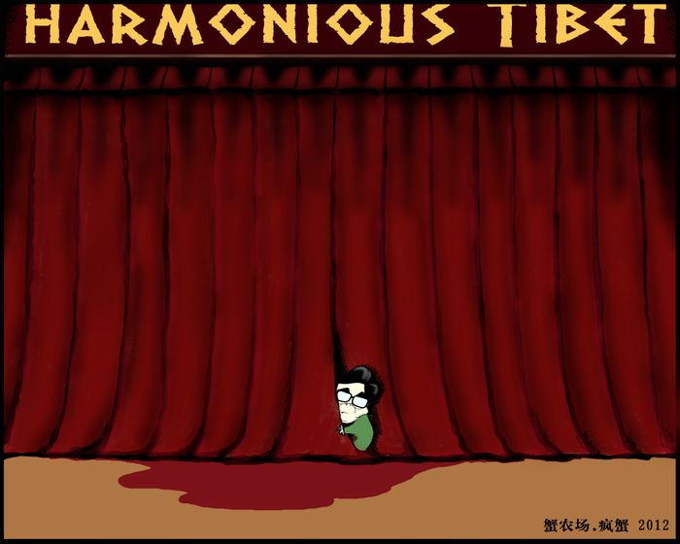

Slide 13


Slide 14
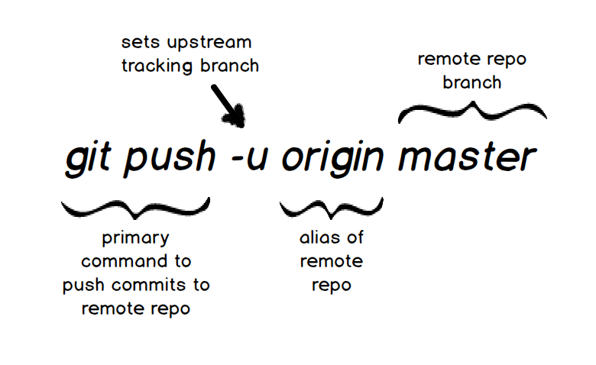

Slide 15

INSPECTING A REPOSITORY
git status
git log
git diff

Slide 16


Slide 17


Slide 18

That’s all for today,
See you day after tomorrow for making your first contribution in open source ;)
Thank you ;)

