Slide 1
Your FIRSt contribution

Slide 2
FORK AND CLONE
Forked project is on your online repository (repo).
Cloned project is on your local machine

Slide 3
PULL MY CHANGES
git pull

Slide 4


Slide 5


Slide 6
Git branch
A branch represents an independent line of development. Branches serve as an abstraction for the edit/stage/commit process discussed in Git Basics, the first module of this series. You can think of them as a way to request a brand new working directory, staging area, and project history. New commits are recorded in the history for the current branch, which results in a fork in the history of the project.

Slide 7
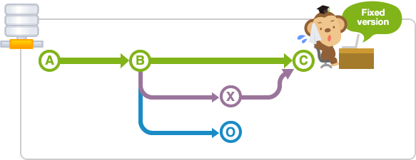

Slide 8


Slide 9
WHY BRANCHES?
In real-world projects, work always happens in multiple of these contexts in parallel:
While you're preparing 2 new variations of your website's design (context 1 & 2)...
you're also trying to fix an annoying bug (context 3).
Besides, you also update some content on your FAQ pages (context 4), while...
your teammate is working on a new feature for your shopping cart (context 5),...
and another colleague is experimenting with a whole new login functionality (context 6).

Slide 10
Making a branch
git branch branchName
git checkout branchName
git checkout -b branchName

Slide 13
Switch branch
git checkout branchName

Slide 14
TRavel back in time
git log
git reset --hard commitID
git reset --soft commitID

Slide 15
REWRITING HISTORY
git commit --amend -m “Message”

Slide 16
FUture
REferences
https://www.atlassian.com/git
https://git-scm.com/doc

Slide 17


Slide 18


