Slide 1
Capstone project
Predicting House Price Based on School and Venues Vicinity
- Divya Mahesh

Slide 2
PROBLEM STATEMENT
The vicinity of schools in a neighborhood is widely believed to be a key determinant of housing prices. However, the strength of the consensus is puzzling, given the formidable empirical challenges facing any homeowner or empirical researcher seeking to answer the question carefully.
Good schools usually come bundled with other neighborhood qualities—such as proximity to employment, shopping and recreational conveniences, and neighborhood peers. Because the home buyers who enjoy (and can afford) such amenities tend to congregate together, it is difficult to isolate the effect of schools from the effect of these other traits that accompany good schools.
The main goal will be exploring the neighborhoods of Greater Toronto Area in order to find out if the average house price of any given neighborhood depends on the number of schools and venues present in the vicinity.

Slide 3
INTENDED AUDIENCE
The target audience for this report are: -
Potential buyers who can roughly estimate the value of a house based on the surrounding venues and number of schools in the vicinity.
Real estate makers and planners who can decide what kind of venues to put around their products to maximize selling price.

Slide 4
DATA DESCRIPTION
GTA neighborhoods were chosen as the observation target due to the following reasons:
The availability of real estate prices.
The diversity of prices between neighborhoods.
The availability of school data.
The type of real estate to be considered is detached homes.
Data sets used:
Zolo.ca – Toronto Real Estate Website
TDSB – Toronto District School Board
FourSquare Data
Wikipedia

Slide 5
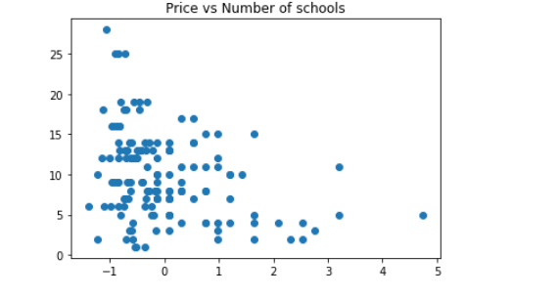
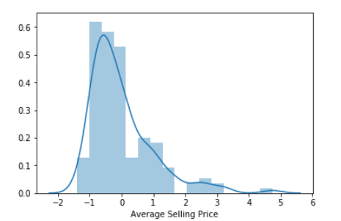
DATA VISUALIZATION

Slide 6
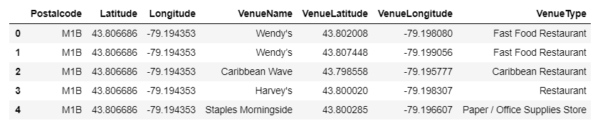
VENUE DATA
Venues present for each neighborhood were collected using Foursquare data

Slide 7
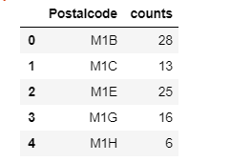
SCHOOL DATA
For each neighborhood, find the total number of elementary, intermediate and secondary schools from TDSB website (Toronto District School Board)

Slide 8
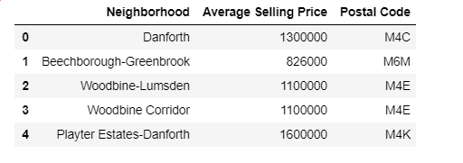
REAL ESTATE DATA
Scrapped zolo.ca webpage for a list of GTA neighborhoods and their corresponding detached home average price.

Slide 9
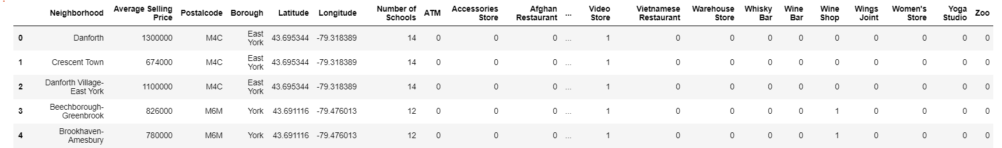
FINAL DATASET

Slide 10
MODELLING TECHNIQUES USED
Linear Regression:
Linear Regression was chosen because it is a simple technique. And by using Sklearn library, implementing the model is quick and easy. Which is perfect to start the analyzing process
2. Gradient Boosting Regression (GBR):
"Boosting" in machine learning is a way of combining multiple simple models into a single composite model. This is also why boosting is known as an additive model, since simple models (also known as weak learners) are added one at a time, while keeping existing trees in the model unchanged.

Slide 11




RESULTS
Linear Regression: The model generated the below R2 and MSE values
GBR: : The model generated the below R2 and MSE values. The result is promising as it shows
improvement over the simple Linear Regression.
The insight is still consistent compared to the Linear Regression’s.

Slide 12
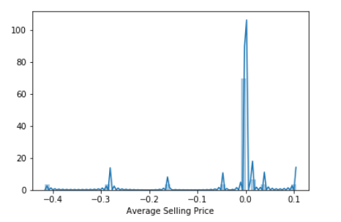

Slide 13
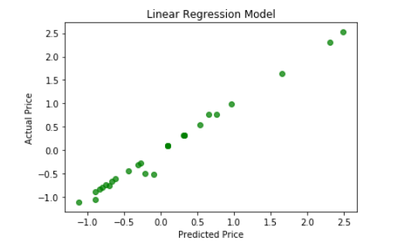
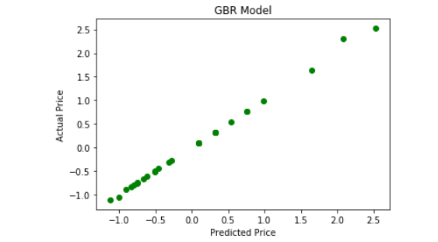

Slide 14
CONCLUSION
Even though the scores seem to be improved after applying a more sophisticate method, the model is still not suitable for the dataset. Thus, it can’t be used to precisely predict a neighborhood average price.
Explanations for the poor model can be:
The real estate price depends on number of factors.
The data is incomplete (small sample size, missing deciding factors).
The machine learning techniques are chosen poorly.
We focused our efforts on finding out if the number of schools and venues present in the vicinity affects the price of a property.
As natural next step, we would like to gather more data on the quality and rankings of these schools and built a model to predict prices.

