Slide 1
IIT KANPUR
GLIDO LABS
FOUNDER'S OFFICE
STRATEGY ASSIGNMENT
🪔
BHAGAVAD GITA DAILY
Monetization & Growth Strategy
PREPARED BY
DIVYAMAN PAL
THE THESIS
Not a product or audience problem.
A funnel + monetization-depth problem — both fixable in 90 days.
B.Tech, Civil Engineering · Indian Institute of Technology Kanpur
divyamp23@iitk.ac.in

Slide 2
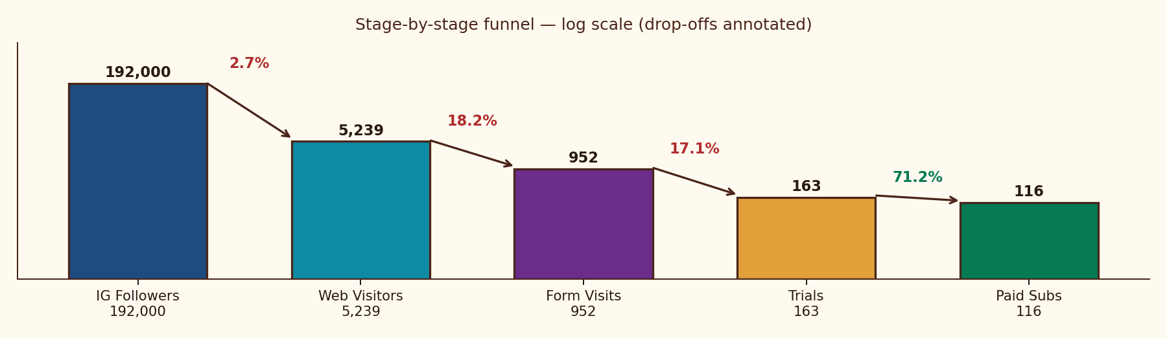
MARKET FAILURE DIAGNOSIS
THE TRUST EQUATION
FUNNEL OPTIMIZATION
ACQUISITION ENGINE
RETENTION & MONETIZATION
FINANCIAL MODEL
EXECUTION & OUTCOMES
Funnel converts at 2.2% — 4× below industry — but every leak is fixable in 30 days at zero new spend
01 · SITUATION
02 · COMPLICATION
03 · RESOLUTION
What we have today
Why growth has stalled
Three sequenced levers
• 192K Instagram followers — loyal, devotion-based
• ₹79/mo product, 116 paying users — proven PMF
• Live payment funnel · 5,239 monthly visits
• Current MRR ~₹9.2K · 71% Trial→Paid
• Visitor → Paid conversion stuck at 2.2% (vs 8–12% benchmark)
• 82% drop on homepage, 83% on form, 29% trial churn
• Single ₹79 SKU — no monetization depth
• Content is identical free vs paid — no value gap
• L1 · Seal funnel — homepage, mandate, Day-3 transparency
• L2 · Scale ToFu — DM automation → content → paid (in order)
• L3 · Deepen monetization — annual, PDF, premium, B2B
• Target · ₹1L+ MRR by Month 3, ₹3L+ by Month 12
WHAT IS WORKING
WHAT IS BROKEN
WHAT WE WILL DO
THE FUNNEL — WHERE 192K BECOMES 116
THE PRIZE
11×
MRR uplift in 90 days
₹1L+
Blended MRR by Month 3
₹3L+
Blended MRR by Month 12
85.5%
Gross margin per subscriber
7.9×
LTV / CAC at 8% churn
M5
Operational EBITDA breakeven
Source: Glido Labs case data (2025) | IMARC India Subscription Apps Benchmark 2024 | Sequoia India Subscription Unit Economics Guide | Team analysis

Slide 3
MARKET FAILURE DIAGNOSIS
THE TRUST EQUATION
FUNNEL OPTIMIZATION
ACQUISITION ENGINE
RETENTION & MONETIZATION
FINANCIAL MODEL
EXECUTION & OUTCOMES
Funnel failure is structural, not tactical — four root causes act simultaneously across product, process, people and promotion
ROOT CAUSE ANALYSIS — 5 WHYS METHOD
FISHBONE (ISHIKAWA) ANALYSIS — 4-LEVER STRUCTURAL FAILURE (MECE)
PROBLEM: 192K loyal followers, ₹79 product, 116 paying users — yet only 2.2% of website visitors convert.
PRODUCT
PROCESS
• Generic hero
• ₹5 mandate fear
WHY ARE VISITORS NOT SUBSCRIBING?
Homepage tries to be a marketing site, a Gita resource hub AND a subscription page. Avg scroll 51.95%, form below the fold.
• No sample preview
• No Day-3 transparency
POOR
FUNNEL
CONV.
WHY DO USERS NOT START THE TRIAL?
₹5 UPI mandate scares spiritually-motivated tier 2/3 users; no plain-language explainer at checkout.
• Tier 2/3 UPI distrust
• No DM automation
• No teacher face
• No viral loop
PEOPLE
PROMOTION
WHY DO TRIAL USERS CHURN ON DAY 3?
47 of 163 (29%) cancel — Day-3 charge is a surprise; 3 days is too short to feel value; no transparency before deduction.
KEY TAKEAWAY · 4-lever failure → no silver-bullet exists. Sequenced fixes only.
WHY DON'T FOLLOWERS BECOME SUBSCRIBERS?
Instagram serves the same shlok content for free; no visible value gap between the free and paid product.
VALUE PROPOSITION CANVAS — THE MODERN SEEKER
PRODUCT (GAIN CREATORS)
JOBS-TO-BE-DONE
WHY IS GROWTH NOT COMPOUNDING?
No DM automation, no daily Reels engine, no viral loop in WhatsApp messages — top of funnel grows linearly, not exponentially.
• 8 AM daily WhatsApp shlok
• Meaning + life-application
• 3-day taste-test trial
• Annual lock-in (₹699)
• Premium community (₹199)
Anchor my morning ·
Make sense of life events ·
Feel connected daily ·
Pass tradition forward
ROOT CAUSE · Funnel was built for users who already trust the brand. It must be re-built for users who must be earned.
STRATEGIC TAKEAWAY · The funnel breaks because product, process, people and promotion all fail at the same point — earning trust before asking for ₹79.
Source: Glido Labs case data | Lean Startup methodology (Eric Ries, 2011) | Maister-Green-Galford Trust Equation | Team analysis

Slide 4
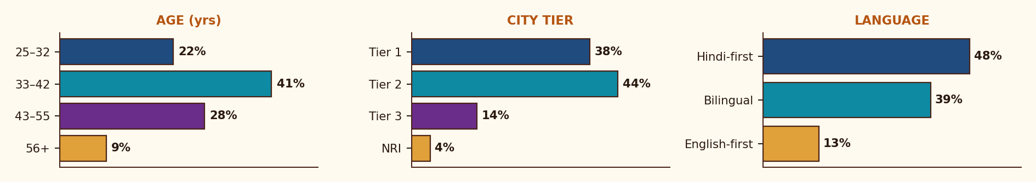
MARKET FAILURE DIAGNOSIS
THE TRUST EQUATION
FUNNEL OPTIMIZATION
ACQUISITION ENGINE
RETENTION & MONETIZATION
FINANCIAL MODEL
EXECUTION & OUTCOMES
The Modern Seeker is Hindi-first, mobile-first, festival-driven, UPI-skeptical — all four shape the funnel design
JTBD × ANXIETY × PAY-TRIGGER × STAY-TRIGGER · THE 4 PSYCHOLOGICAL SLOTS
🪔
JOBS-TO-BE-DONE
ANXIETIES THAT KILL CONVERSION
• Anchor my morning with meaning
• Make sense of life events through tradition
• Feel connected to something larger — daily
• Pass the wisdom to my kids and parents
• ₹5 mandate — "will they keep deducting?"
• UPI auto-pay distrust in tier 2/3 cohorts
• "Is this just another spiritual reels page?"
• Forgetting they signed up → angry chargebacks
WHAT MAKES THEM PAY
WHAT MAKES THEM STAY
THE MODERN SEEKER
• Sample message that feels personally written
• A friend forwarded it on WhatsApp
• A real face / scholar attached to the brand
• Festival or life-event trigger (Navratri, exam)
• Same time, every morning — without fail
• The verse "happens to" speak to today
• Felt sense of a teacher, not a bot
• Community of people on the same path
AGE
32–55 · median 38
LOCATION
Tier 1 + Tier 2 · Hindi belt
LANGUAGE
Hindi-first or bilingual
INCOME
₹6–25L p.a. · middle class
DEMOGRAPHIC PROFILE · AGE × CITY-TIER × LANGUAGE
DEVICE
Mobile-first (95%+)
PAYMENT
UPI native, mandate-skeptical
DISCOVERY
Reels · WhatsApp forwards
Source: Glido Labs follower analytics + LocalCircles 2024 (Hindi spiritual content consumption) + Bumble India Inclusion Report 2023 + Team interpretation

Slide 5
MARKET FAILURE DIAGNOSIS
THE TRUST EQUATION
FUNNEL OPTIMIZATION
ACQUISITION ENGINE
RETENTION & MONETIZATION
FINANCIAL MODEL
EXECUTION & OUTCOMES
The funnel's 3 leaks map cleanly to 3 pillars of trust — each leak earns a different fear, requires a different fix
TRUST = ( CREDIBILITY + RELIABILITY + INTIMACY ) ÷ SELF-ORIENTATION
PILLAR 1 · PSYCHOLOGICAL TRUST
PILLAR 2 · TRANSACTIONAL TRUST
PILLAR 3 · EXPERIENTIAL TRUST
PRE-CLICK
AT-CHECKOUT
POST-PAY
Earn the click before asking for the rupee.
Make ₹5 mandate feel like a handshake, not a hostage.
Earn the next 11 months in the first 3 days.
STRATEGIC IMPERATIVE
STRATEGIC IMPERATIVE
STRATEGIC IMPERATIVE
Reframe the brand from "another spiritual page" to "the one daily ritual you set your morning by."
Replace silent friction with bilingual transparency. Treat the mandate as a conversation, not a contract.
Day-3 charge must feel like a milestone, not a surprise. Trial is not a test — it is the product.
MECHANISM
MECHANISM
MECHANISM
Hero rewrite. Real founder/scholar face. Single social-proof number used everywhere.
Hindi+English mandate explainer · Razorpay logo · "Cancel anytime" badge · WhatsApp opt-in confirmation.
Day 1/2/3 WhatsApp arc: welcome → preview → pre-charge transparency. 48h re-engagement WhatsApp for cancels.
OUTCOME (30D)
OUTCOME (30D)
OUTCOME (30D)
Homepage → Form lifts from 18% → 30%+ in 30 days. Zero new spend.
Form → Trial lifts from 17% → 30%+. A/B test removing ₹5 mandate entirely.
Trial → Paid lifts from 71% → 88%+. 47 churned users get a 15–20% reactivation.
PILLAR 2 STRATEGIC TAKEAWAY · Trust is not a feature; it is the product. Each pillar reduces a different fear, at a different moment, in a different language.
Source: Maister, Green & Galford — The Trusted Advisor (2000) | adapted for consumer spiritual subscriptions | Team analysis

Slide 6
MARKET FAILURE DIAGNOSIS
THE TRUST EQUATION
FUNNEL OPTIMIZATION
ACQUISITION ENGINE
RETENTION & MONETIZATION
FINANCIAL MODEL
EXECUTION & OUTCOMES
88% of every leak sits in steps 2 and 3 — fixing them costs ₹0 in ad spend, takes 30 days, 4–5×'s revenue at constant traffic
FUNNEL DIAGNOSTIC — TODAY VS BENCHMARK
THREE LEAKS · THREE ROOT CAUSES · THREE FIXES
STAGE
TODAY
CONV.
BENCHMARK
STATUS
LEAK 01
Homepage → Form · 82% drop
ROOT · Page does too much. Form below the fold. Generic hero.
Instagram → Website
192K followers
2.7%
5–8%
CRITICAL
FIX · Single-purpose page · form above fold · sample message preview.
Homepage → Form visit
5,239 → 952
18.2%
35–45%
CRITICAL
LEAK 02
Form → Trial · 83% drop
Form visit → Trial
952 → 163
17.1%
40–55%
ROOT · ₹5 UPI mandate scares spiritually-motivated users.
CRITICAL
FIX · Bilingual mandate explainer · trust badges · A/B remove mandate.
Trial → Paid
163 → 116
71.2%
80–90%
IMPROVE
LEAK 03
Trial → Paid · 29% churn
Paid → Retained (30-day)
116 active / 47 churned
71.2%
85–92%
IMPROVE
ROOT · Day-3 charge surprises users; <3 days of value experienced.
FIX · Day 1/2/3 WhatsApp arc · pre-charge transparency · 48h re-engage.
TRIAL ACTIVATION ARC — A 3-DAY WHATSAPP SEQUENCE THAT EARNS THE ₹79 CHARGE
SIGN-UP
DAY 1
DAY 2
DAY 3
CANCEL?
1
2
3
4
5
T = 0
8 AM
8 AM + 7 PM
PRE-CHARGE
T + 48H
Instant WhatsApp:
"Your Gita journey starts tomorrow at 8 AM 🙏"
First shlok + permission to explore.
"For 3 days, this is completely free."
Shlok + evening preview of next 5 shlokas.
Annual upsell teaser appears here.
"Trial ends today. ₹79 will be charged.
Reply STOP to cancel."
Re-engagement WhatsApp: "Your spot is
still here." 15–20% reactivation.
PILLAR 3 STRATEGIC TAKEAWAY · 88% of every leak sits in steps 2 and 3. Fixing them costs ₹0 in ad spend, takes 30 days, and 4–5x's revenue at constant traffic.
Source: Glido Labs case data | Razorpay UPI mandate UX research | ManyChat Instagram automation conversion benchmarks | Team analysis

Slide 7
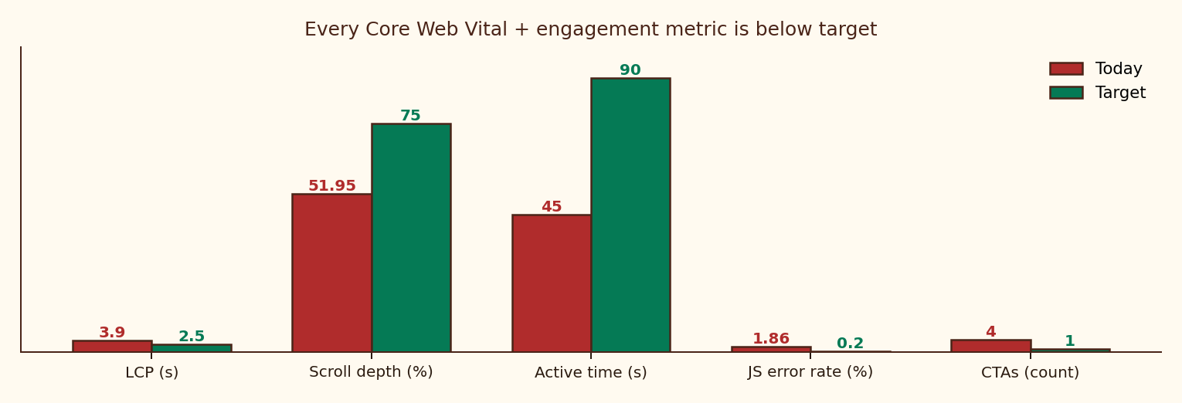
MARKET FAILURE DIAGNOSIS
THE TRUST EQUATION
FUNNEL OPTIMIZATION
ACQUISITION ENGINE
RETENTION & MONETIZATION
FINANCIAL MODEL
EXECUTION & OUTCOMES
Today's homepage misses target on every Core Web Vital, every engagement signal, AND every conversion principle
PERFORMANCE & ENGAGEMENT — TODAY VS TARGET
SPECIFIC ISSUES IDENTIFIED IN THE BRIEF
LCP at 3.9s
vs 2.5s target · −7–10% conversion per second
Avg scroll depth 51.95%
form below fold; most users never see CTA
Avg active time 45 seconds
Bounce-rate proxy; insufficient to absorb 4 CTAs
129 sessions hit JS error
1.86% of all sessions · "undefined is not an object"
4 competing CTAs
Subscribe / Explore Chapters / Explore Teachings / Start Learning
Social-proof contradiction
"Join 4,000+" vs "Join 12,000+" on the same page
Generic hero tagline
"Ancient Wisdom, Timeless Truth" says nothing about the product
No sample message preview
User cannot feel the product before paying
BEFORE VS AFTER — HOMEPAGE WIREFRAME (MOBILE)
TODAY · GENERIC + CLUTTERED
AFTER · SINGLE-PURPOSE
ALL HOMEPAGE FIXES — RANKED BY IMPACT
"Ancient Wisdom,
Timeless Truth"
"One shlok every morning on WhatsApp — explained for your life today."
FIX 01
Move subscribe form ABOVE the fold (mobile-first)
Recovers 30%+ of users who never reach CTA today
FIX 02
Replace hero with specific benefit-first promise
"One shlok from the Gita, every morning on WhatsApp — explained for your life today"
FIX 03
Kill 3 competing CTAs — keep ONLY Subscribe
Single-purpose page; recover 18%+ attention loss
Subscribe
Explore Chapters
Sample WhatsApp preview
shown next to the form
Show real WhatsApp message mock-up next to CTA
Lets users feel the product before paying
FIX 04
Explore Teachings
Start Learning
FIX 05
Reconcile social proof — pick ONE number, use everywhere
Eliminates trust-killing contradiction
"Join 4,000+"
Get today's shlok →
FIX 06
Compress hero image · target LCP < 2.5s
1-second LCP improvement = 7–10% mobile conversion lift
"Join 12,000+" (CONFLICT)
Single social proof: "12,000+ seekers"
FIX 07
Resolve "undefined is not an object" JS error
129 sessions/month lost to error; recover 100%
↓ Form below fold
FIX 08
Move Gita resources to POST-subscribe experience
Free resources stop being a "reason not to pay"
Source: Glido Labs case data (LCP 3.9s, scroll 51.95%, JS error rate 1.86%) | Google Web Vitals benchmarks | Nielsen Norman Group: "single-CTA pages convert 30%+ better"

Slide 8
MARKET FAILURE DIAGNOSIS
THE TRUST EQUATION
FUNNEL OPTIMIZATION
ACQUISITION ENGINE
RETENTION & MONETIZATION
FINANCIAL MODEL
EXECUTION & OUTCOMES
Today, Instagram delivers what subscribers pay for — close the value gap and Instagram becomes a tease, not a substitute
FREE VS PAID CONTENT ARCHITECTURE — THE 5-DIMENSION VALUE GAP
DIMENSION
FREE · Instagram
PAID · WhatsApp
Content depth
Shlok image / verse
Shlok + meaning + life application
Personalization
One-to-many caption
Reflection tied to today's verse
Cadence
Variable, algorithm-led
8 AM, every morning. No exceptions.
Relationship
Public broadcast
Private, ritual, companion-like
Discoverability
Anyone can find it
Curated channel just for you
FIVE CONTENT CAMPAIGNS RANKED BY EXPECTED IMPACT
#
CAMPAIGN
MECHANIC
EXPECTED IMPACT
PRIORITY
01
What is Krishna saying about your life right now?
Story poll: career / relationships / overthinking / lost. Auto-DM relevant shlok + trial link.
Warms cold leads, creates personalization signal, drives trial intent.
★★★★★
02
Subscriber Before & After Reels
1-line testimonials from active 116. Format: situation → shlok → outcome.
Native social proof, 2–3× reach uplift on platform.
★★★★☆
03
"Gita for [situation]" series
Anxiety, exams, heartbreak, Monday morning, quitting job. Shareable + searchable.
Drives both follower growth AND trial intent simultaneously.
★★★★☆
04
200K Milestone Unlock
First 200 to DM 'GITA200' get 1 month free. PR pitch to spiritual media.
Urgency, DM automation opt-ins, brand authority moment.
★★★☆☆
05
Festival gifting (Navratri / Diwali / birthdays)
Dedicated gift sub page. Spiritual gifting is real and underserved in India.
100–200 subs/single push · Near-zero CAC at festival times.
★★★★☆
Source: Glido Labs Instagram analytics | Story poll → DM auto-conversion benchmarks (ManyChat) | Festival gifting volumes — RedSeer 2024 spiritual e-commerce report

Slide 9
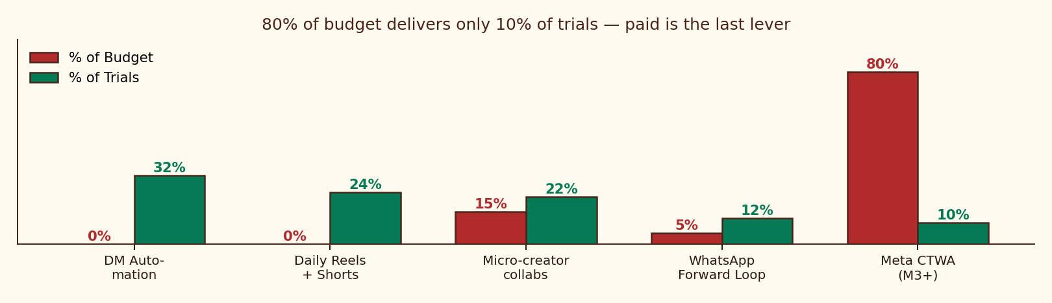
MARKET FAILURE DIAGNOSIS
THE TRUST EQUATION
FUNNEL OPTIMIZATION
ACQUISITION ENGINE
RETENTION & MONETIZATION
FINANCIAL MODEL
EXECUTION & OUTCOMES
9× top-of-funnel lift required — sequence 5 channels by cost; never run paid before homepage converts > 8%
THE 5-NODE CHANNEL EFFICIENCY MATRIX · TARGET BLENDED CAC < ₹150
DUAL VIRAL LOOPS · TARGET K > 1.2
ACQUISITION CHANNEL
STRATEGIC MECHANISM & MESSAGING
BUDGET
TARGET CAC
STRATEGIC IMPERATIVE Every 10 acquired subscribers must organically generate 12+ more.
DM AUTOMATION (INSTAGRAM)
ManyChat "GITA" trigger → auto-DM with form link. 30–45% comment→form vs 1–2% bio link.
0%
₹0
LOOP A · WHATSAPP FORWARD-LOOP
DAILY REELS + YT SHORTS
1 Reel/day on "Gita for [anxiety / exam / heartbreak]". Cross-post to Shorts for older buyers.
0%
₹0
Daily message ends with "Forward to someone who needs this 🙏". 116 active users × 28 days = 3,248 send-touches/month potential.
MICRO-CREATOR COLLABS
20–30 spiritual creators (100K–500K). 30-day free trial. One collab → 500–1,000 trials.
15%
₹40
WHATSAPP VIRAL LOOP
Every daily message: "Forward to someone who needs this 🙏". Shareable short link.
5%
₹0
LOOP B · CREATOR-AUDIENCE BORROW
30-day free trial offered to micro-creator audiences. One quality collab → 500–1,000 trials at zero CAC.
META CTWA · AFTER M2 ONLY
Click-to-WhatsApp ads. Lookalike of paid base. Hindi spiritual interests, T1+T2 cities.
80%
₹150
BUDGET VS TRIALS — 80% OF TRIALS COME FROM 0% OF BUDGET
PER-SUB UNIT ECONOMICS · Y1
Revenue/sub/year
₹948
Annual blend (avg)
₹823
Blended CAC
₹125
Payback period
1.6 mo
LTV @ 8% churn
₹987
LTV / CAC
7.9×
PILLAR 4 STRATEGIC TAKEAWAY · Acquisition is structurally cheap (80% organic), demand-elastic (creators), self-reinforcing (forward loop). Paid is the last lever, not the first.
Source: Glido Labs case | ManyChat IG conversion data (2024) | Meta India CTWA benchmarks | Sequoia India Subscription Unit Economics Guide | Team analysis

Slide 10
MARKET FAILURE DIAGNOSIS
THE TRUST EQUATION
FUNNEL OPTIMIZATION
ACQUISITION ENGINE
RETENTION & MONETIZATION
FINANCIAL MODEL
EXECUTION & OUTCOMES
₹79 is the entry-point, not the ceiling — habit + monetization-depth = ₹1.92L+ blended monthly revenue at scale
HOOK MODEL (NIR EYAL) — RE-ENGINEERING THE MORNING RITUAL
3-TIER LOYALTY LADDER
STRATEGIC IMPERATIVE Make the 8 AM shlok feel like coffee — non-negotiable, ritualistic, missed when absent.
ELITE · Annual prepay + premium community
TRIGGER
ACTION
REWARD
INVEST
INSIDER · PDF guides + Day-30 retention
8 AM WhatsApp arrives. Phone vibrates with familiar sender.
User opens. 30 seconds to read shlok + meaning.
Variable insight — "this happens to be exactly what I needed today."
User reflects, screenshots, forwards → builds attachment.
MEMBER · ₹79/mo daily WhatsApp shlok
FREE · Instagram + sample shlok
↻ THE LOOP COMPOUNDS · Each completed cycle deepens habit and reduces churn
MONETIZATION STACK · 7 STREAMS · POST-MONTH 3 BLENDED ₹1.92L+/MONTH
TIER
PRODUCT
PRICE
GO-LIVE
MONTHLY @ SCALE
STRATEGIC ROLE
FREE
Instagram content + sample shlok
₹0
Now
Acquisition layer
Top of funnel — feeds every paid tier
CORE
Daily WhatsApp shlok (monthly)
₹79/mo
Now
₹63,200 (800 users)
Anchor SKU, defines the ritual
ANNUAL
Daily WhatsApp (annual prepay)
₹699/yr
Month 1
₹34,950 (50 users)
Cuts churn to ~0%, upfront cash
DIGITAL
Situation PDF guides (5 topics)
₹99–149
Month 1
₹14,850
Built from 2,227 existing posts — zero COGS
PREMIUM
WhatsApp community + scholar Q&A
₹199/mo
Month 3
₹19,900 (100 users)
Gates community, drives status
PHYSICAL
108-card Gita wisdom deck
₹599–699
Month 4
₹29,950 (50 units)
Festival gifting, brand artefact
ENTERPRISE
Corporate Gita Daily for teams
₹5K–15K/mo
Month 5
₹30,000 (3 clients)
B2B halo + B2C credibility loop
PILLAR 5 STRATEGIC TAKEAWAY · ₹79 is the entry-point, not the ceiling. Monetization depth + habit retention = ₹1.92L+ blended monthly revenue at scale.
Source: Glido Labs case | Nir Eyal — Hooked: How to Build Habit-Forming Products (2014) | RedSeer Spiritual & Wellness Subscription Report 2024

Slide 11
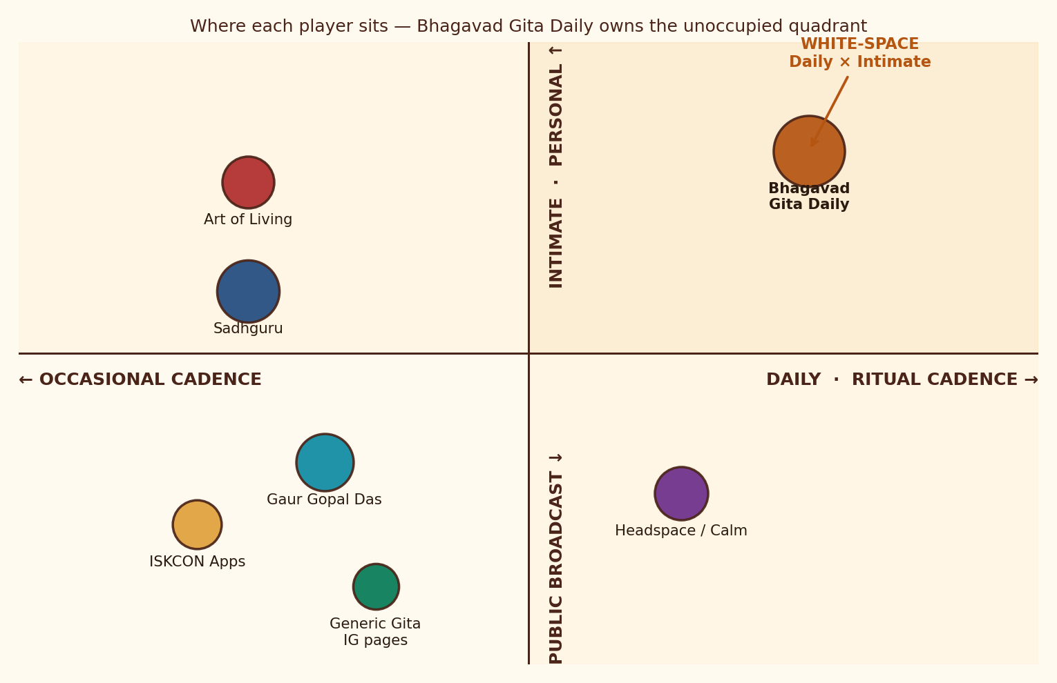
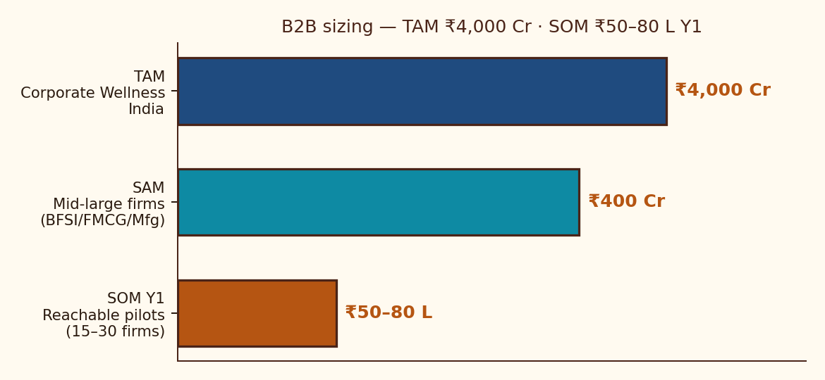
MARKET FAILURE DIAGNOSIS
THE TRUST EQUATION
FUNNEL OPTIMIZATION
ACQUISITION ENGINE
RETENTION & MONETIZATION
FINANCIAL MODEL
EXECUTION & OUTCOMES
No incumbent owns the daily-ritual + intimate quadrant — the white-space is structurally available, the B2B halo is asymmetric
COMPETITIVE POSITIONING — INTIMACY × CADENCE
B2B CORPORATE GITA DAILY · MARKET SIZING (₹)
B2B GO-TO-MARKET
PRODUCT
Daily WhatsApp/email shlok with workplace lens · monthly engagement report · optional quarterly scholar talk
BUYER
HR Heads at 500–5,000 employee firms in BFSI, FMCG, manufacturing
PRICING
₹5K (≤50 employees) · ₹10K (50–200) · ₹15K (200+)
MOTION
15-min LinkedIn outreach · pilot offer · case-study fly-wheel
DEFENSIBLE POSITION · A daily, intimate, vernacular ritual at the price of a coffee. No incumbent is structured to occupy it: Sadhguru/Gaur Gopal scale on broadcast; Headspace/Calm scale on Western mindfulness; generic Gita pages have no business model.
STRATEGIC
B2C halo — every corporate logo is a B2B social-proof asset
Source: Mercer Marsh Benefits India Wellness Survey 2024 (₹4,000 Cr TAM, 15% CAGR) | Glido Labs case | LinkedIn HR titles analysis | Team estimates

Slide 12
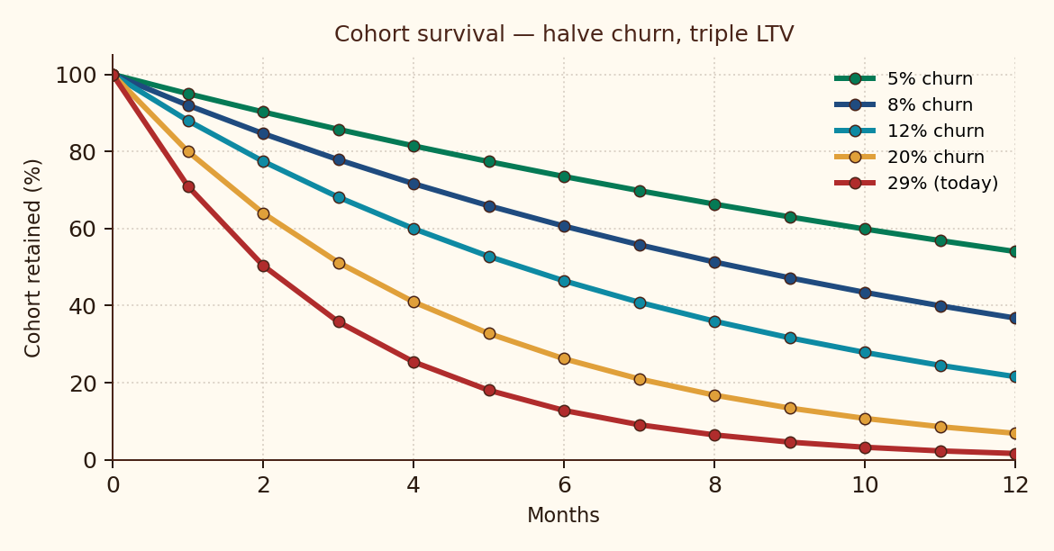
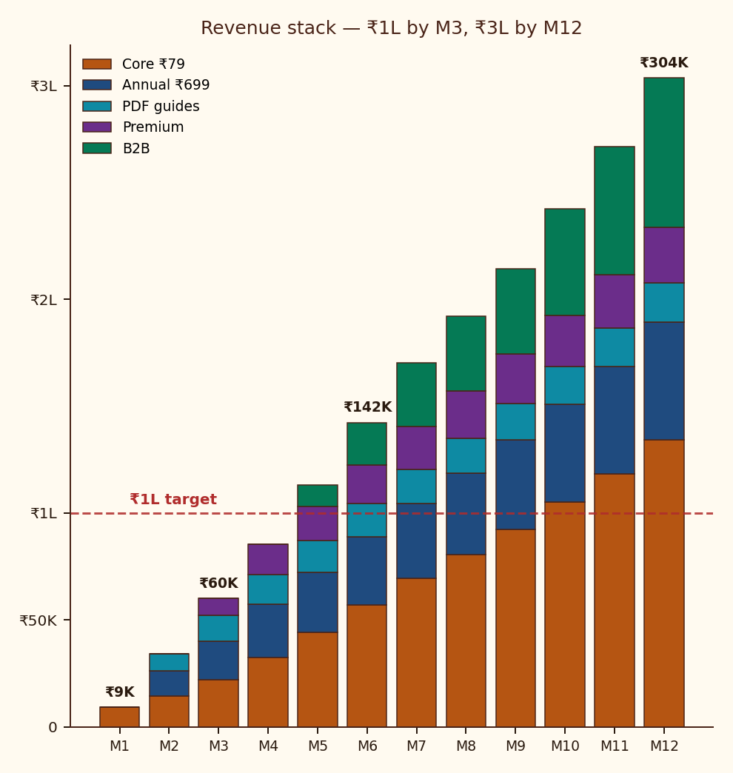
MARKET FAILURE DIAGNOSIS
THE TRUST EQUATION
FUNNEL OPTIMIZATION
ACQUISITION ENGINE
RETENTION & MONETIZATION
FINANCIAL MODEL
EXECUTION & OUTCOMES
Halving churn from 29% → 12% triples LTV — the Day-3 trial fix is the single highest-ROI intervention in this deck
87%
₹125
3 MONTHS
₹1.92L+
₹699/YR
GROSS MARGIN
PER SUB
BLENDED
CAC
TO ₹1 LAKH
MRR
MONTHLY REV
AT SCALE
ANNUAL
PREPAY SKU
PER-SUBSCRIBER UNIT ECONOMICS
COHORT RETENTION · LTV/CAC SENSITIVITY
MRR PROJECTION · STACKED REVENUE BUILD
LINE ITEM
AMOUNT
RATIONALE
Revenue / sub / year
+₹948
12 × ₹79
WhatsApp + payment fees
−₹95
~10% of revenue
Content production (alloc.)
−₹30
1 scholar contract / 800 subs
Tech + infra
−₹12
ManyChat, hosting
GROSS MARGIN
+₹811
85.5% — exceptional for solo SKU
Blended CAC (amortized Y1)
−₹125
Weighted ad+organic mix
Refund / chargeback reserve
−₹15
Conservative 2% allowance
MONTHLY CHURN
LTV
LTV / CAC
TRUE CONTRIBUTION (Y1)
+₹671
70.7% of revenue survives CAC
5%
₹1,580
12.6×
8%
₹987
7.9×
12%
₹655
5.2×
20%
₹395
3.2×
29% (today)
₹268
2.1×
Source: Glido Labs case | Sequoia India Subscription Unit Economics Guide | Cohort survival math: P(retained) = (1 − churn)^n | Team scenarios

Slide 13
MARKET FAILURE DIAGNOSIS
THE TRUST EQUATION
FUNNEL OPTIMIZATION
ACQUISITION ENGINE
RETENTION & MONETIZATION
FINANCIAL MODEL
EXECUTION & OUTCOMES
Fix the funnel before you scale it. Deepen monetization before you buy traffic. ₹1L MRR by Month 3 if Lever 1 lands in 30 days
90-DAY EXECUTION ROADMAP — SEQUENCED FOR ZERO-SPEND COMPOUNDING FIRST
WK 1–2
WK 2–3
WK 3–4
MONTH 2
MONTH 3
MONTH 3+
FIX THE LEAK
SEAL THE TRIAL
DM AUTOMATION
NEW REVENUE
SCALE CONTENT
PAID ACQUISITION
Homepage redesign
Form above fold
Mandate explainer
Day 1/2/3 WhatsApp
Re-engage 47 churns
Pre-charge transparency
ManyChat trigger
Update captions
First Story poll
Annual ₹699 launch
3 PDF guides live
Gift sub page
Daily Reels
2 creator collabs
B2B pitch deck
Meta CTWA ₹500/d
Lookalike audience
Weekly CAC review
MEASURABLE SUCCESS METRICS · KPI DASHBOARD
RISK & MITIGATION MATRIX
CATEGORY
KPI
NOW
DAY-30
DAY-60
DAY-90
RISK
IMPACT
MITIGATION
FUNNEL HEALTH
Homepage → Form rate
18.2%
30%
35%
40%+
WhatsApp policy / API ban
CRITICAL
Move to WhatsApp Business API + email mirror
FUNNEL HEALTH
Trial → Paid rate
71.2%
78%
82%
88%+
ACQUISITION
Daily new trials
2–3
8–10
15–18
20–30
Mandate distrust → chargebacks
HIGH
Bilingual explainer, pre-charge transparency
ACQUISITION
Blended CAC
—
₹0
₹80
<₹150
Founder content fatigue
Onboard 2 contributing scholars by Month 3
ACQUISITION
DM automation CTR
—
—
35%+
40%+
MED
RETENTION
Monthly churn
29%
<20%
<12%
<8%
Instagram algo dependency
HIGH
Diversify to Shorts, ShareChat. Email backup
RETENTION
Avg messages/user/month
—
—
Track
28+
REVENUE
Active paid subscribers
116
230
480
800+
Premium community quality dilution
MED
Hard cap at 150 members, founder moderation
REVENUE
Blended monthly revenue
₹9.2K
₹22K
₹70K
₹1.0L+
Source: Glido Labs case | Industry risk benchmarks | Team risk identification & mitigation design

Slide 14
APPENDIX
FRAMEWORKS USED
SOURCES & DATA REFERENCES
5 WHYS METHOD
Root cause identification of funnel collapse at every step
CASE DATA
Glido Labs Strategy Assignment brief — funnel data, audience size, performance metrics
FISHBONE (ISHIKAWA)
Mapping structural causes across product, process, people, promotion
MARKET BENCHMARK
IMARC India Subscription Apps Market Report 2024 — conversion benchmarks 8–12%
VALUE PROPOSITION CANVAS
Mapping Bhagavad Gita Daily product to The Modern Seeker JTBD
MARKET BENCHMARK
Mercer Marsh Benefits India Wellness Survey 2024 — corporate wellness ₹4,000 Cr
TRUST EQUATION (MAISTER)
Trust = (Credibility + Reliability + Intimacy) ÷ Self-Orientation
MARKET BENCHMARK
Meta India Click-to-WhatsApp Ads benchmark — 3–5× lift vs website ads
CONSUMER
LocalCircles Hindi Spiritual Content Consumption Survey 2024
HOOK MODEL (NIR EYAL)
Re-engineering the 8 AM shlok as a non-negotiable habit
CONSUMER
RedSeer Spiritual & Wellness E-commerce Report 2024
AARRR PIRATE METRICS
Acquisition / Activation / Retention / Referral / Revenue mapping
PRODUCT FRAMEWORK
Razorpay UPI Mandate UX Guidelines
UNIT ECONOMICS MODEL
Per-sub P&L: ₹948 → ₹671 true contribution at 85.5% gross margin
Google Web Vitals — LCP, INP, CLS conversion impact studies
PRODUCT FRAMEWORK
LTV/CAC SENSITIVITY
Monthly churn 5% → 29% scenarios across 5 cases
ManyChat Instagram automation conversion benchmarks
PRODUCT FRAMEWORK
TAM / SAM / SOM
₹4,000 Cr → ₹400 Cr → ₹50–80 L Y1 for the corporate B2B opportunity
THEORY
Maister, Green & Galford — The Trusted Advisor (2000)
KPI DASHBOARD
9 metrics × 4 milestones (now / 30 / 60 / 90 days)
THEORY
Nir Eyal — Hooked: How to Build Habit-Forming Products (2014)
RISK & MITIGATION MATRIX
5 risks with impact rating and named mitigation
THEORY
Eric Ries — The Lean Startup (2011) — Build/Measure/Learn loop
90-DAY EXECUTION ROADMAP
6 phases sequenced as ZERO-SPEND → REVENUE → SCALE → PAID
UNIT ECONOMICS
Sequoia India Subscription Unit Economics Guide
UI / UX
Nielsen Norman Group — single-CTA pages convert 30%+ better

Slide 15
DETAILED FINANCIAL VALIDATION · 12-MONTH COHORT PROJECTION
BHAGAVAD GITA DAILY · 12-MONTH P&L PROJECTION (₹)
METRIC
M1
M2
M3
M4
M5
M6
M7
M8
M9
M10
M11
M12
FY
REVENUE BUILD
Active subscribers (EOM)
116
180
280
410
560
720
880
1,020
1,170
1,330
1,500
1,700
1,700
Core MRR (₹79 × subs)
₹9.2K
₹14.2K
₹22.1K
₹32.4K
₹44.2K
₹56.9K
₹69.5K
₹80.6K
₹92.4K
₹1.1L
₹1.2L
₹1.3L
₹7.8L
Annual prepay revenue
—
₹12.0K
₹18.0K
₹25.0K
₹28.0K
₹32.0K
₹35.0K
₹38.0K
₹42.0K
₹46.0K
₹50.0K
₹55.0K
₹3.8L
PDF guides revenue
—
₹8.0K
₹12.0K
₹14.0K
₹15.0K
₹15.5K
₹16.0K
₹16.5K
₹17.0K
₹17.5K
₹18.0K
₹18.5K
₹1.7L
Premium community revenue
—
—
₹8.0K
₹14.0K
₹16.0K
₹18.0K
₹20.0K
₹22.0K
₹23.0K
₹24.0K
₹25.0K
₹26.0K
₹2.0L
Corporate B2B revenue
—
—
—
—
₹10.0K
₹20.0K
₹30.0K
₹35.0K
₹40.0K
₹50.0K
₹60.0K
₹70.0K
₹3.1L
TOTAL REVENUE
₹9.2K
₹34.2K
₹60.1K
₹85.4K
₹1.1L
₹1.4L
₹1.7L
₹1.9L
₹2.1L
₹2.4L
₹2.7L
₹3.0L
₹18.4L
COSTS
Cost of goods sold (~13%)
₹-1.2K
₹-4.4K
₹-7.8K
₹-11.1K
₹-14.7K
₹-18.5K
₹-22.2K
₹-25.0K
₹-27.9K
₹-31.5K
₹-35.3K
₹-39.5K
₹-2.4L
Gross profit
₹8.0K
₹29.8K
₹52.3K
₹74.3K
₹98.5K
₹1.2L
₹1.5L
₹1.7L
₹1.9L
₹2.1L
₹2.4L
₹2.6L
₹16.0L
Ad spend (Meta CTWA + collabs)
—
₹-5.0K
₹-10.0K
₹-12.0K
₹-15.0K
₹-18.0K
₹-20.0K
₹-22.0K
₹-24.0K
₹-26.0K
₹-28.0K
₹-30.0K
₹-2.1L
Fixed OPEX (tools + scholar)
₹-25.0K
₹-25.0K
₹-25.0K
₹-25.0K
₹-25.0K
₹-25.0K
₹-25.0K
₹-25.0K
₹-25.0K
₹-25.0K
₹-25.0K
₹-25.0K
₹-3.0L
EBITDA
₹-17.0K
₹-229
₹17.3K
₹37.3K
₹58.5K
₹80.9K
₹1.0L
₹1.2L
₹1.4L
₹1.6L
₹1.8L
₹2.1L
₹10.9L
Illustrative projection. Assumes Pillar 1 funnel fixes land in Month 1, paid acquisition activates in Month 3+, B2B contracts begin Month 5.

Slide 16
WHAT WE WILL HAVE BY MONTH 3
THE BIG BET
FUNNEL
Homepage → Trial above 8%, Trial → Paid above 88%
Fix the funnel
before you scale it.
Deepen monetization
before you buy traffic.
AUDIENCE
800+ active paying subscribers (vs 116 today)
REVENUE
₹1.0L+ blended MRR — 11× current
STACK
Annual, PDF guides, premium community live
PIPELINE
3 corporate pilots in motion · paid ads ROAS-positive
BRAND
200K+ Instagram, first PR mention as India's daily Gita ritual
Most spiritual subscriptions die buying ads into broken funnels. We will not. The 90-day plan is sequenced so the first ₹0 of new spend earns the right to the next ₹1 of paid acquisition.
FROM THE GITA · CHAPTER 2, VERSE 47
"You have a right to perform your prescribed duty, but not to the fruits of action."
Operating principle: ship the funnel; the MRR will follow.
DIVYAMAN PAL · IIT KANPUR · divyamp23@iitk.ac.in
Bhagavad Gita Daily · Strategy Deck v3.0 · Confidential

