Slide 1
IIT KANPUR
GLIDO LABS
FOUNDER'S OFFICE
STRATEGY ASSIGNMENT
🪔
BHAGAVAD GITA DAILY
Monetization & Growth Strategy
PREPARED BY
DIVYAMAN PAL
THE THESIS
Funnel + monetization-depth problem.
4 areas. 10 revenue streams. 11× MRR in 90 days.
B.Tech, Civil Engineering · Indian Institute of Technology Kanpur
divyamp23@iitk.ac.in

Slide 2
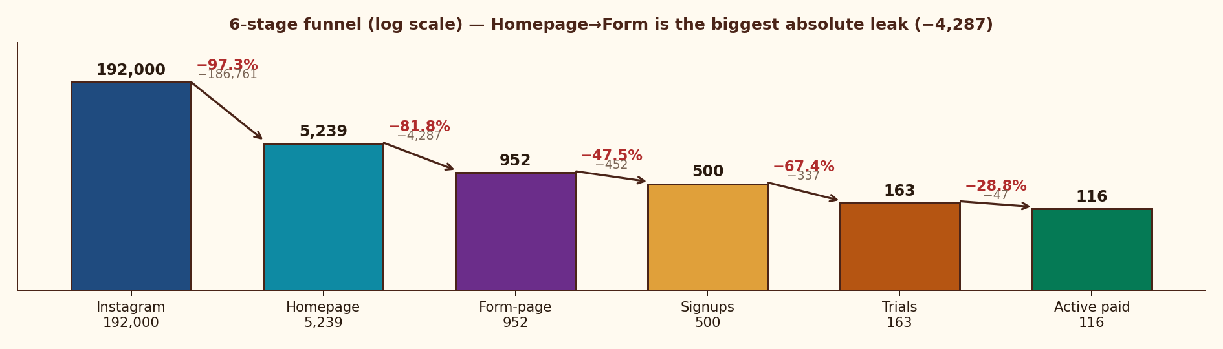
DIAGNOSIS & PERSONA
01 · FUNNEL FIX
02 · SCALING
03 · CONTENT
04 · NEW REVENUE ★
FINANCIAL MODEL
EXECUTION
11× MRR in 90 days — fix 3 funnel leaks at ₹0 spend, then deepen to a 10-stream India-grounded revenue stack
01 · SITUATION
02 · COMPLICATION
03 · RESOLUTION
What we have today
Why growth has stalled
4-area sequenced plan
• 192K Instagram · 2,227 posts
• 5,239 monthly homepage sessions
• ₹79/mo SKU · 116 active paid
• MRR ₹9.2K · 71% trial→paid
• PMF proven; ceiling = ₹79
• Homepage→Form: −81.8% (−4,287)
• Signup→Trial: −67.4% (₹5 UPI gate)
• Trial→Paid: 71% (Day-3 surprise)
• 29% churn · single ₹79 SKU
• Free IG = paid product (no gap)
• L1 · Seal funnel (homepage + UPI + Day-3)
• L2 · 2-3 → 20-30 trials/day in 13 wks
• L3 · Value-gap content + 5 campaigns
• L4 · 10-stream stack + festival economy
• Target ₹1L MRR M3, ₹3.5L M12
PMF + BROKEN FUNNEL
4 STRUCTURAL LEAKS
ZERO-SPEND FIRST
THE FUNNEL — WHERE 192K BECOMES 116
THE PRIZE
11×
MRR uplift
₹1L+
MRR by Month 3
₹3.5L+
MRR by Month 12
85.5%
Gross margin / sub
7.9×
LTV / CAC at 8% churn
M5
EBITDA breakeven
Glido Labs assignment brief (May 2025) | IMARC India Subscription Apps 2024 | Razorpay UPI mandate UX | Team analysis

Slide 3
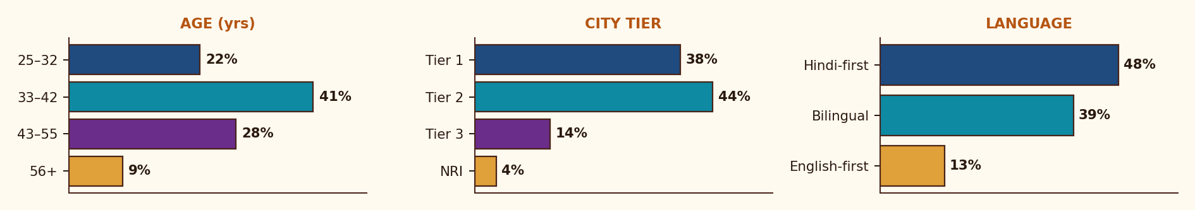
DIAGNOSIS & PERSONA
01 · FUNNEL FIX
02 · SCALING
03 · CONTENT
04 · NEW REVENUE ★
FINANCIAL MODEL
EXECUTION
Hindi-first, mobile-first, festival-driven, UPI-skeptical — every product, channel, pricing decision flows from this
JTBD × ANXIETY × PAY-TRIGGER × STAY-TRIGGER
🪔
JOBS-TO-BE-DONE
ANXIETIES (KILL CONVERSION)
• Anchor my morning with meaning
• Sense-make life events through tradition
• Feel connected to something larger
• Pass wisdom to kids and parents
• ₹5 mandate — "will they keep deducting?"
• UPI auto-pay distrust in tier 2/3
• "Just another reels page?"
• Forgotten signup → angry chargebacks
WHAT MAKES THEM PAY
WHAT MAKES THEM STAY
THE MODERN INDIAN SEEKER
• Sample message that feels personal
• Friend forwarded on WhatsApp
• Real face / scholar attached
• Festival or life-event trigger
• Same time every morning, no fail
• Verse "happens to" speak to today
• Felt sense of teacher, not bot
• Community of fellow seekers
AGE
32–55 · median 38
LOCATION
Tier 1 + 2 · Hindi belt
LANGUAGE
Hindi-first / bilingual (87%)
INCOME
₹6–25L p.a. · middle class
DEMOGRAPHICS · AGE × CITY-TIER × LANGUAGE
DEVICE
Mobile-first (95%+)
PAYMENT
UPI native, mandate-skeptical
DISCOVERY
Reels · WhatsApp forwards
Glido Labs follower analytics + LocalCircles 2024 (Hindi spiritual content) + RedSeer Spiritual & Wellness 2024 + Team interpretation

Slide 4
DIAGNOSIS & PERSONA
01 · FUNNEL FIX
02 · SCALING
03 · CONTENT
04 · NEW REVENUE ★
FINANCIAL MODEL
EXECUTION
AREA 1 · 3 leaks own 99% of lost users — sequenced fixes recover 30-40% lift in 30 days at ₹0 ad-spend
STAGE-BY-STAGE FUNNEL DIAGNOSTIC · ACTUAL VS BENCHMARK
STAGE
TODAY (DATA)
CONV.
BENCHMARK
ABS LOSS
STATUS
Instagram → Homepage
192,000 → 5,239
2.7%
5–8%
−186,761
OPPORTUNITY · DM auto + Reels
Homepage → Form-page
5,239 → 952
18.2%
35–45%
−4,287
BIGGEST ABS LEAK · homepage
Form-page → Signup
952 → 500
52.5%
60–70%
−452
MINOR · form length
Signup → Trial start
500 → 163 (₹5 UPI gate)
32.6%
70–85%
−337
BIGGEST % LEAK · UPI fear
Trial → Paid
163 → 116
71.2%
85–92%
−47
FIXABLE · Day-3 transparency
Paid → Retained (30D)
116 active / 47 churned
71.2%
88–94%
−47
FIXABLE · re-engage WhatsApp
FIX 01
HOMEPAGE → FORM
FIX 02
SIGNUP → TRIAL
FIX 03
TRIAL → PAID
ROOT
ROOT
ROOT
Multi-purpose page · 4 CTAs · scroll 51.95% · LCP 3.9s · form below fold
₹5 UPI mandate fear in tier 2/3 · no Hindi explainer · auto-deduct anxiety
Day-3 charge surprise · 47/163 cancel · <3 days to feel value · no transparency
FIX
FIX
FIX
Single-purpose LP · benefit-first hero · form above fold · WA preview · LCP <2.5s
Bilingual mandate page · Razorpay logo · "Cancel anytime" badge · A/B no-mandate
Day 1/2/3 WhatsApp arc: welcome → preview → pre-charge · T+48h re-engage
LIFT
LIFT
LIFT
18% → 30%+ · ~1,300 users/mo recovered
32.6% → 60%+ · removing mandate → 75%+
71.2% → 88%+ · 15-20% reactivation of 47 churns
Glido Labs case data: 5,239 sessions, 952 form views, 500 signups, 163 trial starts, 116 paid

Slide 5
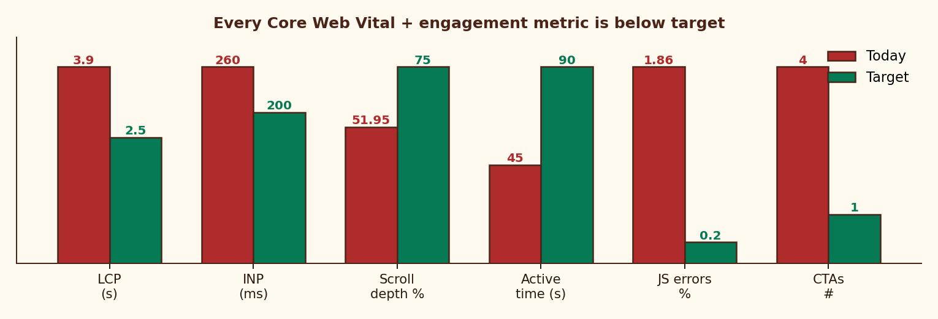
DIAGNOSIS & PERSONA
01 · FUNNEL FIX
02 · SCALING
03 · CONTENT
04 · NEW REVENUE ★
FINANCIAL MODEL
EXECUTION
AREA 1 · Homepage misses every Core Web Vital + every conversion principle — 8 fixes drive the ₹0 spend lift
PERFORMANCE & ENGAGEMENT — TODAY VS TARGET
8 SPECIFIC ISSUES IN THE BRIEF
LCP 3.9s
vs 2.5s · −7-10% conversion / sec
INP 260ms
vs <200ms · laggy interaction
Scroll 51.95%
form below fold · most never see CTA
Active time 45s
insufficient for 4 competing CTAs
129 JS errors
1.86% sessions · "undefined is not an object"
4 competing CTAs
Subscribe / Chapters / Teachings / Learning
Social-proof conflict
"4,000+" vs "12,000+" same page
Generic hero
"Ancient Wisdom, Timeless Truth" → nothing
8 HOMEPAGE FIXES — RANKED BY IMPACT
DAY 1/2/3 TRIAL ACTIVATION ARC · WHATSAPP
01
Move form ABOVE fold (mobile-first)
+30% reach
T = 0
Sign-up
"Your Gita journey starts tomorrow at 8 AM 🙏"
02
Replace hero with benefit-first promise
+15% relevance
Kill 3 CTAs · keep ONLY Subscribe
+18% focus
DAY 1
8 AM
First shlok + permission. "3 days, completely free."
03
04
Show real WA mock next to form
+12% trust
DAY 2
8 AM + 7 PM
Shlok + evening preview of next 5 verses. Annual teaser.
05
Reconcile social proof · ONE number
+8% credibility
06
Compress hero · LCP <2.5s
+7-10%/sec
DAY 3
Pre-charge
"Trial ends today. ₹79 will be charged. Reply STOP to cancel."
07
Resolve "undefined" JS error
+1.86% recovery
T+48H
Cancel re-engage
"Your spot is still here." → 15-20% reactivation.
08
Move Gita resources POST-subscribe
stops free leak
Glido Labs analytics (LCP 3.9s, INP 260ms, scroll 51.95%, JS 1.86%) | Google Web Vitals | Nielsen Norman Group

Slide 6
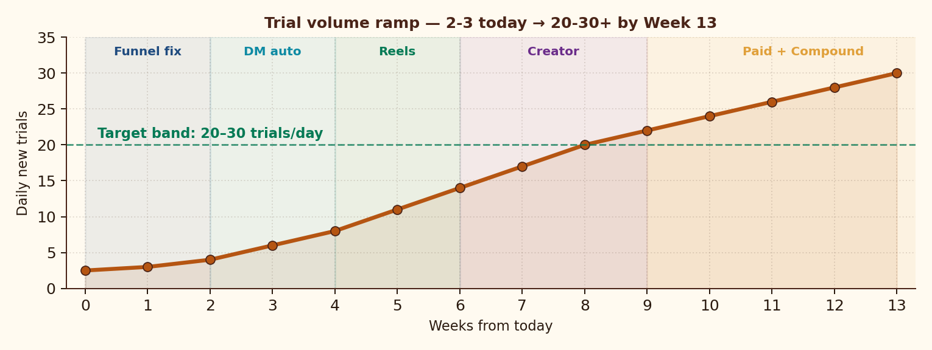
DIAGNOSIS & PERSONA
01 · FUNNEL FIX
02 · SCALING
03 · CONTENT
04 · NEW REVENUE ★
FINANCIAL MODEL
EXECUTION
AREA 2 · 2-3 → 20-30 trials/day in 13 weeks via 5 sequenced channels — 80% organic; paid is the LAST lever
TRIAL RAMP — WK0 → WK13 BY CHANNEL ACTIVATION
PER-SUB UNIT ECONOMICS · Y1
Revenue / sub / year
₹948
Annual blend (avg)
₹823
Gross margin
85.5%
Blended CAC
₹125
Payback period
1.6 mo
LTV @ 8% churn
₹987
LTV / CAC
7.9×
True contribution
₹671
5-CHANNEL ACQUISITION MATRIX · TARGET BLENDED CAC < ₹150
VIRAL LOOPS · TARGET K > 1.2
CHANNEL
MECHANISM (INDIA-GROUNDED)
BUDGET
CAC
TRIALS/DAY
WA FORWARD LOOP
DM AUTO (IG)
ManyChat "GITA" trigger → auto-DM form link
0%
₹0
8-10
116 active × 28 msg = 3,248 forward-touches/mo
DAILY REELS+SHORTS
1/day on "Gita for [anxiety/exam/heartbreak]"
0%
₹0
5-7
CREATOR BORROW
MICRO-CREATOR
20-30 spiritual creators × 30-day free trial
15%
₹40
4-6
1 quality collab → 500-1,000 trials @ ₹0 CAC
WHATSAPP FORWARD
Daily msg ends "Forward to someone 🙏"
5%
₹0
3-4
FAMILY-PACK SHARE
META CTWA (M3+)
Click-to-WhatsApp ads · lookalike of paid base
80%
₹150
2-3
₹149 covers 5 phones · built-in WoM
Glido Labs case | ManyChat IG conversion (2024) | Meta India CTWA benchmarks | Sequoia India Subscription Unit Economics Guide

Slide 7
DIAGNOSIS & PERSONA
01 · FUNNEL FIX
02 · SCALING
03 · CONTENT
04 · NEW REVENUE ★
FINANCIAL MODEL
EXECUTION
AREA 2 · 10 weekly + 8 monthly metrics across 4 categories — every decision tied to one number
WEEKLY KPIS · TRACK EVERY MONDAY
MONTHLY KPIS · REVIEW ON 1ST
CAT.
METRIC
TODAY
TARGET
CAT.
METRIC
TODAY
TARGET (30/60/90)
FUNNEL
Homepage → Form rate
18.2%
30%+
REV
Active paid subscribers
116
230 / 480 / 800
FUNNEL
Signup → Trial rate
32.6%
60%+
REV
Blended monthly revenue
₹9.2K
₹22K / ₹70K / ₹1L+
FUNNEL
Trial → Paid rate
71.2%
85%+
REV
ARPU per user
₹79
₹130+ blended
ACQ
Daily new trials
2-3
20-30
ECON
Blended CAC
—
<₹150
ACQ
DM auto CTR
—
35%+
ECON
LTV @ current churn
₹268
₹987 (8% churn)
ACQ
Reels saves / share
—
Track
ACQ
Creator pipeline
0
5+/wk
ECON
LTV / CAC
2.1×
7.9× target
ENG
Day-1 msg open rate
—
85%+
CHURN
Monthly churn
29%
<8% by M3
ENG
WA forward count
—
Track
STACK
Revenue from non-₹79
₹0
₹50K+ by M3
PROD
JS error sessions
129
<10
OPERATING CADENCE
Daily standup on weekly KPIs · monthly board on revenue+churn · quarterly LTV/CAC re-base.
Glido analytics | 18-metric KPI design | Weekly cadence on funnel, monthly cadence on revenue + economics

Slide 8
DIAGNOSIS & PERSONA
01 · FUNNEL FIX
02 · SCALING
03 · CONTENT
04 · NEW REVENUE ★
FINANCIAL MODEL
EXECUTION
AREA 3 · IG today delivers what subscribers pay for — close the value gap, IG becomes a tease, not a substitute
FREE VS PAID CONTENT ARCHITECTURE — 5-DIMENSION VALUE GAP
DIMENSION
FREE · Instagram (broadcast)
PAID · WhatsApp (intimate ritual)
Content depth
Shlok image / verse
Shlok + meaning + life application
Personalization
One-to-many caption
Reflection tied to today's verse
Cadence
Variable, algorithm-led
8 AM, every morning. No exceptions.
Relationship
Public broadcast
Private, ritual, companion-like
Discoverability
Anyone can find it
Curated channel just for you
5 CONTENT CAMPAIGNS RANKED BY EXPECTED IMPACT
#
CAMPAIGN
MECHANIC
EXPECTED IMPACT
PRIORITY
01
What is Krishna saying about your life right now?
Story poll: career / relationships / overthinking / lost. Auto-DM relevant shlok + trial link.
Warms cold leads · personalization signal
★★★★★
02
Subscriber Before & After Reels
1-line testimonials from active 116. Format: situation → shlok → outcome.
Native social proof · 2-3× reach uplift
★★★★☆
03
"Gita for [situation]" series
Anxiety, exams, heartbreak, Monday morning, quitting. Shareable + searchable.
Drives follower growth + trial intent
★★★★☆
04
200K Milestone Unlock
First 200 to DM 'GITA200' get 1 month free. PR pitch to spiritual media.
Urgency · DM opt-ins · brand authority
★★★☆☆
05
Festival gifting (Navratri/Diwali/Janmashtami)
Dedicated gift sub page. Spiritual gifting is real, underserved.
100-200 subs/push · near-zero CAC
★★★★☆
Glido IG analytics | ManyChat story poll → DM benchmarks | RedSeer 2024 spiritual e-commerce | Festival gifting volumes

Slide 9
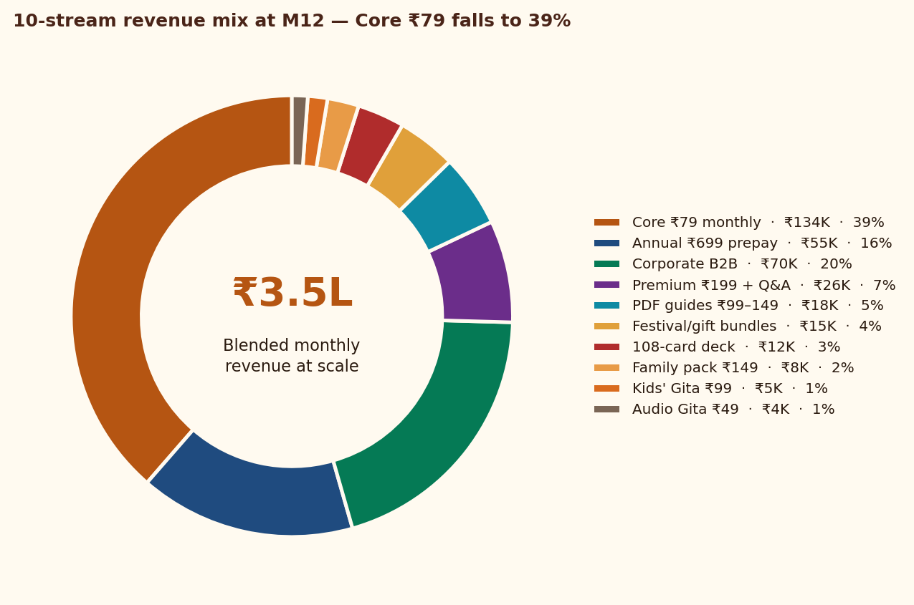
DIAGNOSIS & PERSONA
01 · FUNNEL FIX
02 · SCALING
03 · CONTENT
04 · NEW REVENUE ★
FINANCIAL MODEL
EXECUTION
AREA 4 · Single ₹79 SKU → 10-stream stack — ₹3.5L MRR by M12, where Core ₹79 falls to 39% of total revenue
10-STREAM REVENUE STACK · ALL INDIA-GROUNDED
REVENUE MIX AT SCALE · M12
#
STREAM · WHAT WE SELL
PRICE
GO-LIVE
M12 MRR
MARGIN
01
CORE · Daily WhatsApp shlok (monthly)
₹79/mo
Now
₹1.34L
85%
02
ANNUAL · Daily WhatsApp prepaid (saves 26%)
₹699/yr
Month 1
₹55K
92%
03
PDF GUIDES · "Gita for Anxiety/Career/Heartbreak/Parenting/Money"
₹99-149
Month 1
₹18K
97%
04
PREMIUM · Community + Q&A with scholar (Telegram/Discord)
₹199/mo
Month 3
₹26K
75%
05
FESTIVAL/GIFT · Diwali, Navratri, Janmashtami gift subs
₹199-499
Month 2
₹15K
88%
06
PHYSICAL · 108-card Bhagavad Gita wisdom deck
₹599-699
Month 4
₹12K
55%
07
CORPORATE B2B · Daily Gita for HR wellness (BFSI/FMCG/IT)
₹5K-15K/mo
Month 5
₹70K
80%
08
FAMILY PACK · 3-5 phones, multi-language
₹149/mo
Month 4
₹8K
82%
09
KIDS' GITA · Stories for ages 8-14 (parents buy)
₹99/mo
Month 6
₹5K
85%
10
AUDIO GITA · Voice version for commute / Bharat tier 3
₹49/mo
Month 5
₹4K
88%
BLENDED MONTHLY @ M12
₹3.5L+
82%
Pricing logic: ₹49-149 impulse · ₹199-499 commit · ₹599+ artefact · ₹5K+ B2B | Margin: digital 85-95%, physical 55%, B2B 80%

Slide 10
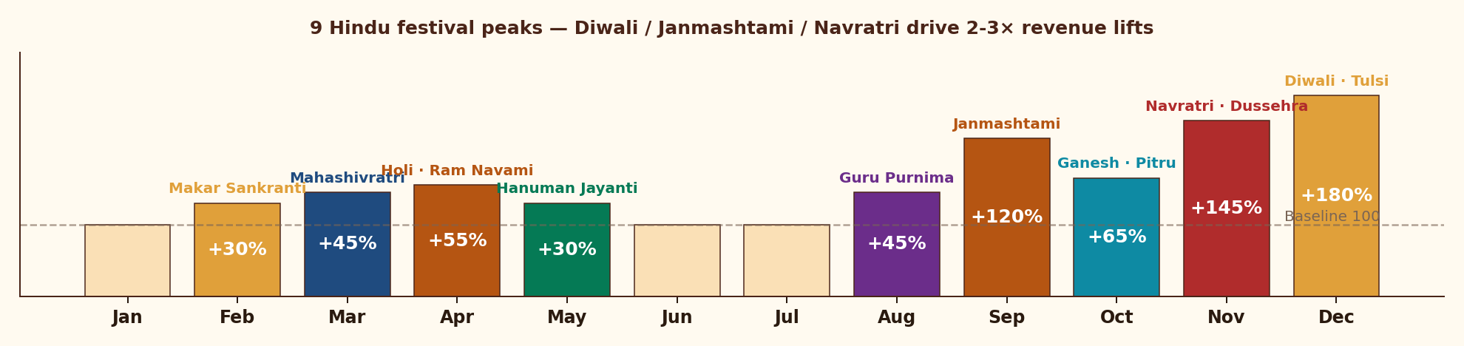
DIAGNOSIS & PERSONA
01 · FUNNEL FIX
02 · SCALING
03 · CONTENT
04 · NEW REVENUE ★
FINANCIAL MODEL
EXECUTION
AREA 4 · 9 Hindu festivals + life-event gifting drive 30-180% revenue lifts — uniquely Indian, structurally underserved
FESTIVAL CALENDAR · EXPECTED REVENUE LIFT BY MONTH (BASELINE = 100)
6 INDIA-GROUNDED BUNDLES · WILL NOT EXIST ELSEWHERE
DIWALI GIFT PACK
JANMASHTAMI
NAVRATRI 9-DAY
WEDDING / ANNIV
BIRTHDAY GIFT
EXAM SEASON
₹499
₹299
₹199
₹999
₹199
₹99
1-yr sub + e-card + Lakshmi-Ganesha audio
1-mo sub + 8 Krishna shlokas + art
9 daily reflections (Goddess + Gita)
Couple sub + Gita-on-Marriage PDF + Q&A
Personal 'shlok-for-month' + 6-mo sub
30-day 'Gita for exam stress' micro-sub
Family-to-family festive gifting
On-brand: Gita IS Krishna's words. Best PR moment.
October's biggest festival
₹3.7T Indian wedding market underserved
Year-round non-festival gifting
Parents buy for CBSE/JEE students
200 packs Nov · ₹1L spike
300 packs · ₹90K
400 packs · ₹80K
50/mo · ₹50K/mo recurring
100/mo · ₹20K/mo recurring
300/season · ₹30K/season
Hindu calendar 2025 | RedSeer Spiritual & Wellness 2024 (₹4,000 Cr TAM) | KPMG Wedding Industry India 2024 (₹3.7T) | Team estimates

Slide 11
DIAGNOSIS & PERSONA
01 · FUNNEL FIX
02 · SCALING
03 · CONTENT
04 · NEW REVENUE ★
FINANCIAL MODEL
EXECUTION
AREA 4 · ₹49 audio → ₹15K/mo corporate captures every willingness-to-pay segment in India
PRICING LADDER · MONTHLY EQUIVALENT
PRICING LOGIC · 4 ANCHOR PRINCIPLES
CORPORATE B2B
01 ANCHOR LOW
₹49 audio = pure curiosity tier. Coffee-cost paying habit.
₹5K-15K/mo
BFSI, FMCG, mfg HR
WEDDING / ANNIV
₹999 one-time
Couple gifting + 1-yr sub bundled
02 IMPULSE
₹99-149 PDFs + exam micro-subs. No auto-deduct fear.
PHYSICAL DECK
₹599-699
108-card Gita deck, festival
03 COMMIT
₹199-499 premium + festival. Conscious commit price.
DIWALI BUNDLE
₹499
Festival + 1-yr sub + audio + card
04 ARTEFACT/B2B
₹599+ deck, wedding, corporate. Gifting + enterprise.
ANNUAL PREPAY
₹699/yr ≈ ₹58/mo
26% off, ~0% churn lock-in
PREMIUM TIER
₹199/mo
Community + scholar Q&A
B2B CORPORATE OPPORTUNITY · TAM/SAM/SOM
TAM · Corporate Wellness India
₹4,000 Cr · 15% CAGR
FAMILY PACK
₹149/mo
Up to 5 phones, multi-lang
SAM · Mid-large firms (BFSI/FMCG/Mfg)
₹400 Cr
CORE
₹79/mo
Daily WA shlok (anchor SKU)
SOM Y1 · 15-30 pilot firms
₹50-80 L
KIDS' GITA
₹99/mo
Stories for 8-14, parents buy
PRICING · ₹5K (≤50) / ₹10K (50-200) / ₹15K (200+)
Per month per firm
AUDIO GITA
₹49/mo
Voice for commute / Bharat
BUYER · HR Heads at 500-5,000 employee firms
LinkedIn outreach
MOTION · 15-min outreach → pilot → case-study fly-wheel
Self-serve B2B
Mercer Marsh India Wellness Survey 2024 (₹4,000 Cr) | LinkedIn HR titles | Glido pricing | Team build-up

Slide 12
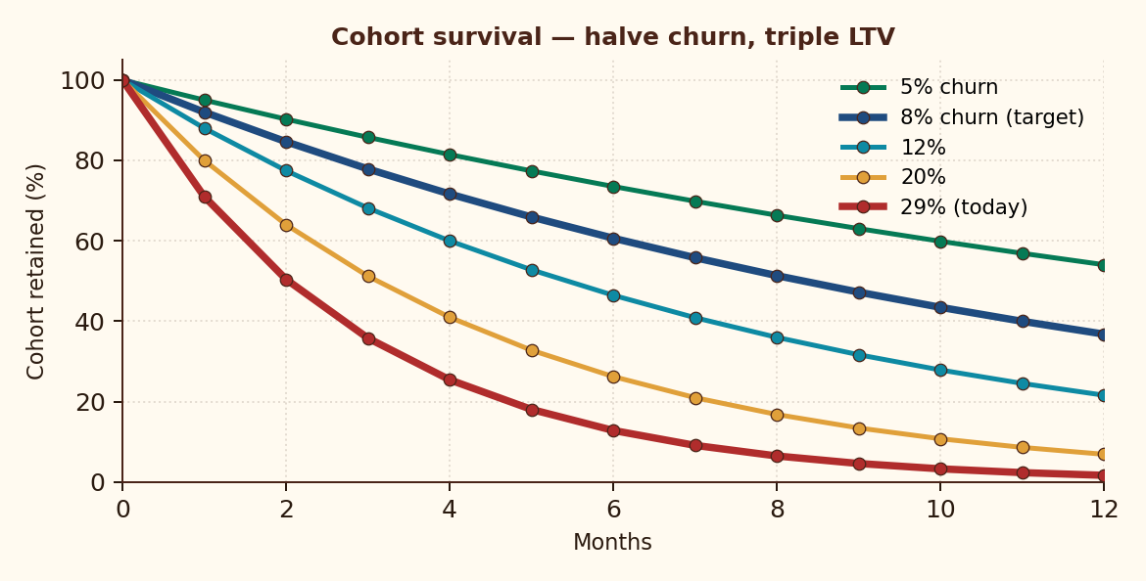
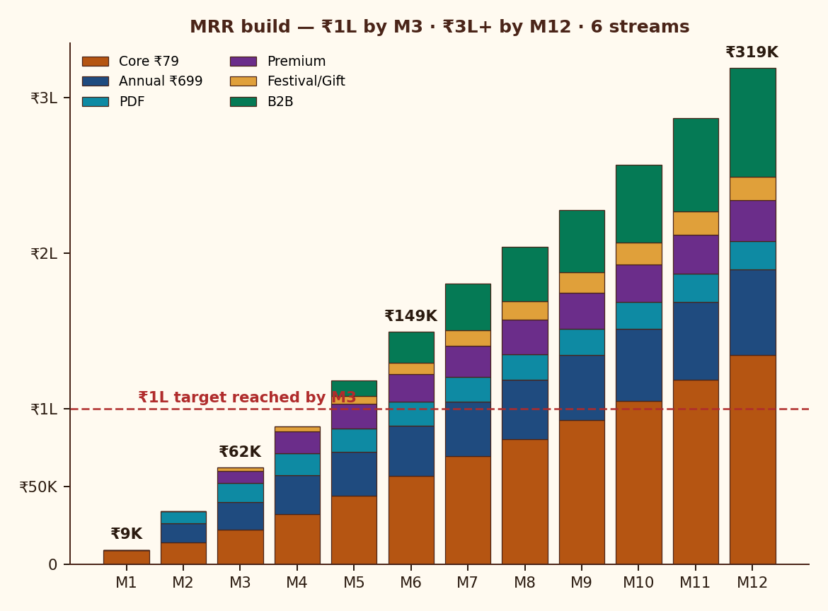
DIAGNOSIS & PERSONA
01 · FUNNEL FIX
02 · SCALING
03 · CONTENT
04 · NEW REVENUE ★
FINANCIAL MODEL
EXECUTION
Halving churn from 29% → 8% triples LTV — the Day-3 trial fix is the highest-ROI intervention in this deck
85.5%
₹125
M3
₹3.5L+
7.9×
GROSS MARGIN
BLENDED CAC
TO ₹1L MRR
MRR @ M12
LTV / CAC
PER-SUBSCRIBER UNIT ECONOMICS
COHORT RETENTION · LTV SENSITIVITY
MRR BUILD · 6 STREAMS
LINE ITEM
AMOUNT
RATIONALE
Revenue / sub / year
+₹948
12 × ₹79
WhatsApp + payment fees
−₹95
~10% of revenue
Content production
−₹30
1 scholar / 800 subs
Tech + infra
−₹12
ManyChat, hosting
GROSS MARGIN
+₹811
85.5%
Blended CAC (amortized)
−₹125
Y1 weighted
Refund / chargeback
−₹15
2% allowance
MONTHLY CHURN
LTV
LTV / CAC
TRUE CONTRIBUTION
+₹671
70.7% survives CAC
5%
₹1,580
12.6×
8% · TARGET
₹987
7.9×
12%
₹655
5.2×
20%
₹395
3.2×
29% · TODAY
₹268
2.1×
Sequoia India Subscription Unit Economics Guide | Cohort math: P(retained) = (1−churn)^n | Glido Labs case data

Slide 13
DIAGNOSIS & PERSONA
01 · FUNNEL FIX
02 · SCALING
03 · CONTENT
04 · NEW REVENUE ★
FINANCIAL MODEL
EXECUTION
Fix the funnel before scaling. Deepen monetization before buying traffic. ₹1L MRR by M3 if Lever 1 lands in 30 days
6-PHASE 90-DAY EXECUTION ROADMAP
WK 1-2
WK 2-3
WK 3-4
MONTH 2
MONTH 3
MONTH 3+
FIX THE LEAK
SEAL THE TRIAL
DM AUTOMATION
NEW REVENUE
SCALE CONTENT
PAID + B2B
Homepage redesign
Form above fold
Mandate explainer
LCP <2.5s
Day 1/2/3 WA arc
Re-engage 47 churns
Pre-charge transparency
ManyChat trigger
Update captions
First Story poll
Annual ₹699 launch
3 PDF guides live
Diwali gift sub page
Daily Reels
2 creator collabs
B2B pitch deck
Premium tier
Meta CTWA ₹500/d
Lookalike audience
5 corp pilots
Audio launch
MILESTONE OUTCOMES · NOW / 30 / 60 / 90 DAY
RISK & MITIGATION MATRIX
DIMENSION
TODAY
DAY-30
DAY-60
DAY-90
RISK
IMPACT
MITIGATION
Active paid subscribers
116
230
480
800+
WhatsApp policy / API ban
CRITICAL
WA Business API + email mirror
Daily new trials
2-3
8-10
15-18
20-30
Mandate distrust → chargebacks
Bilingual explainer, pre-charge
HIGH
Homepage → Form
18.2%
30%
35%
40%+
Trial → Paid
71%
78%
82%
88%+
Founder content fatigue
MED
Onboard 2 scholars by M3
Monthly churn
29%
<20%
<12%
<8%
Instagram algo dependency
HIGH
Diversify: Shorts, ShareChat, email
Blended monthly revenue
₹9.2K
₹22K
₹70K
₹1L+
Premium quality dilution
Hard cap 150 members, founder mod
Revenue streams live
1
3
5
7+
MED
Glido Labs case | Industry risk benchmarks | Team risk identification & mitigation design

Slide 14
APPENDIX
FRAMEWORKS USED IN THIS DECK
DATA SOURCES & REFERENCES
SCR · SITUATION-COMPLICATION-RES.
MBB synthesis (slide 2)
CASE
Glido Labs Strategy Assignment brief — funnel, perf, errors
FUNNEL DIAGNOSTIC
6-stage drop-off vs benchmark (slide 4)
MARKET
IMARC India Subscription Apps Report 2024
VALUE PROPOSITION CANVAS
JTBD × Anxieties × Pay × Stay (slide 3)
MARKET
Mercer Marsh India Wellness Survey 2024 (₹4,000 Cr)
CORE WEB VITALS AUDIT
LCP/INP/CLS perf (slide 5)
MARKET
RedSeer Spiritual & Wellness E-commerce 2024
MARKET
Meta India Click-to-WhatsApp Ads benchmark
HOOK MODEL · NIR EYAL
Trigger → Action → Reward → Invest
MARKET
KPMG Wedding Industry India 2024 (₹3.7T)
AARRR PIRATE METRICS
Acq / Activation / Retention / Ref / Rev
CONSUMER
LocalCircles Hindi Spiritual Survey 2024
UNIT ECONOMICS · PER-SUB P&L
₹948 → ₹671 contribution (slide 12)
Razorpay UPI Mandate UX Guidelines
PRODUCT
LTV / CAC SENSITIVITY
5%-29% churn scenarios (slide 12)
Google Web Vitals · LCP/INP/CLS impact
PRODUCT
TAM / SAM / SOM
B2B sizing ₹4,000 Cr → ₹50-80L (slide 11)
PRODUCT
ManyChat Instagram automation benchmarks
KPI DASHBOARD · 18 METRICS
10 weekly + 8 monthly (slide 7)
THEORY
Maister, Green & Galford — The Trusted Advisor (2000)
RISK & MITIGATION MATRIX
5 risks × impact × mitigation (slide 13)
THEORY
Nir Eyal — Hooked (2014)
FESTIVAL CALENDAR
9 Hindu festival lifts (slide 10)
THEORY
Eric Ries — The Lean Startup (2011)
UNIT ECON
Sequoia India Subscription Unit Economics Guide

Slide 15
WHAT WE WILL HAVE BY MONTH 3
THE BIG BET
FUNNEL
Homepage→Trial above 8% (vs 2.21% today)
Fix the funnel
before you scale it.
Deepen monetization
before you buy traffic.
AUDIENCE
800+ active paying subscribers (vs 116)
REVENUE
₹1L+ blended MRR — 11× current
STREAMS
7 of 10 streams live · ₹50K+ from non-₹79
PIPELINE
3 corp pilots · paid ads ROAS-positive
BRAND
200K+ Instagram · first PR mention
Most spiritual subs die buying ads into broken funnels. We will not. The 90-day plan is sequenced so the first ₹0 of new spend earns the right to the next ₹1 of paid acquisition.
FROM THE GITA · CHAPTER 2, VERSE 47
"You have a right to perform your prescribed duty, but not to the fruits of action."
Operating principle: ship the funnel; the MRR will follow.
DIVYAMAN PAL · IIT KANPUR · divyamp23@iitk.ac.in
Bhagavad Gita Daily · Strategy Deck v5.0 · Confidential

