Slide 1
PREPARED FOR
GLIDO LABS · FOUNDER'S OFFICE
STRATEGY · FOUNDER'S OFFICE
Bhagavad
Gita Daily
PREPARED BY
DIVYAMAN PAL
B.Tech, Civil Engineering · Indian Institute of Technology Kanpur
divyamp23@iitk.ac.in
THE THESIS
Monetization & Growth Strategy
Glido's funnel converts at 2.21% of homepage traffic — 4× below industry. The problem is not audience or product. It is (a) a funnel that loses 4,287 users at the homepage and 337 at the ₹5 UPI mandate, and (b) a single-SKU monetization model. Both are fixable in 90 days at zero new ad-spend.
A 4-area plan to fix the funnel,
scale acquisition, monetize content,
and build a 10-stream revenue stack.
01 FUNNEL OPTIMIZATION
02 SCALING STRATEGY
03 CONTENT-TO-MONETIZATION
04 NEW REVENUE STREAMS · KEY FOCUS
ASSIGNMENT COVERAGE · 4 AREAS · 15 SLIDES
Confidential · v4.0 · May 2025

Slide 2
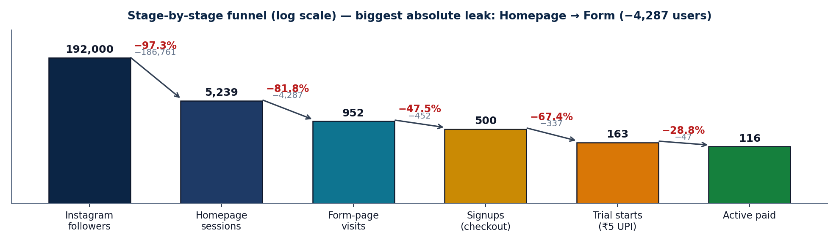
BHAGAVAD GITA DAILY · STRATEGY & GROWTH
EXECUTIVE SUMMARY
2 / 15
11× MRR achievable in 90 days — fix 3 funnel leaks at zero spend, then deepen monetization with 10 India-grounded revenue streams
01 · SITUATION
02 · COMPLICATION
03 · RESOLUTION
What we have today
Why growth has stalled
Sequenced 4-area plan
• 192K Instagram followers · 2,227 posts published
• 5,239 monthly homepage sessions · 4,981 unique users
• ₹79/mo product · 116 active paid users
• Current MRR ₹9.2K · 500 signups, 163 trials
• ₹9 LTV/visitor today (well below benchmark)
• Homepage → Form leak: 5,239 → 952 (−81.8%, −4,287 users)
• Signup → Trial leak: 500 → 163 (−67.4%, ₹5 UPI mandate fear)
• Trial → Paid leak: 163 → 116 (29% churn, Day-3 surprise)
• Single ₹79 SKU — no monetization depth, ceiling = ₹79/user
• Free Instagram = paid product → no value gap
• L1 · Seal funnel — homepage rebuild + UPI explainer + Day-3 arc
• L2 · Scale to 20-30 trials/day via DM auto + creator + paid
• L3 · Content-to-monetization — value-gap, festival activations
• L4 · 10-stream stack — annual, PDF, gift, B2B, audio, kids, family
• Target · ₹1L MRR by M3, ₹3.5L by M12
PROVEN PMF, BROKEN FUNNEL
4 STRUCTURAL LEAKS
ZERO-SPEND FIRST, PAID LAST
THE FUNNEL — WHERE 192K BECOMES 116
THE PRIZE · 90-DAY
11×
MRR uplift
₹1L+
MRR by Month 3
₹3.5L+
MRR by Month 12
85.5%
Gross margin / sub
7.9×
LTV / CAC at 8% churn
M5
EBITDA breakeven
SOURCE · Glido Labs assignment brief (May 2025) | IMARC India Subscription Apps 2024 | Razorpay UPI mandate UX | Team analysis

Slide 3
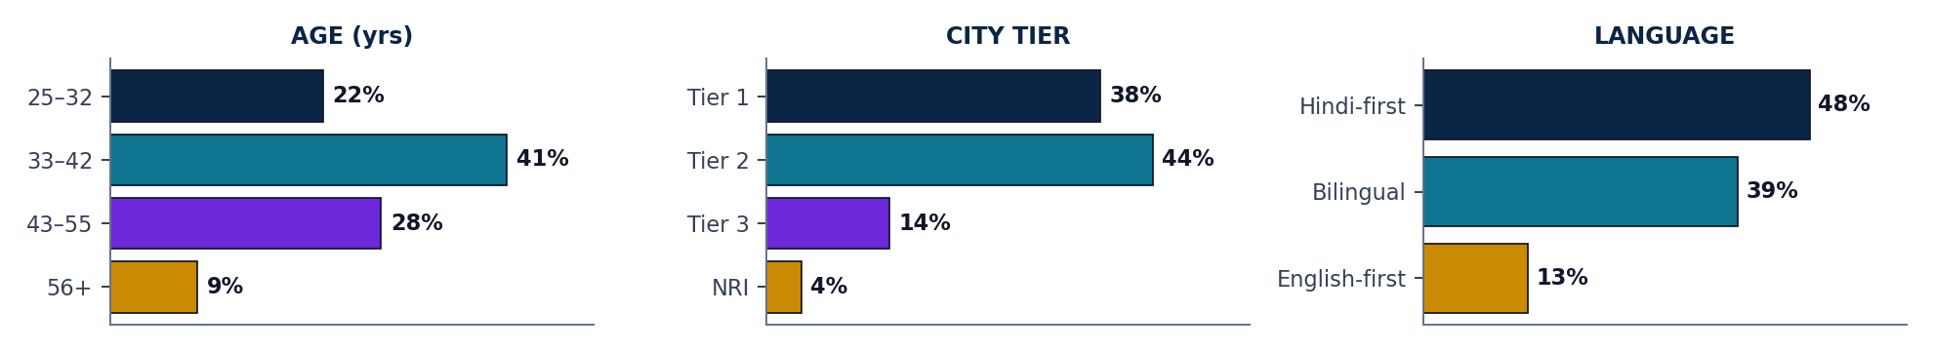
BHAGAVAD GITA DAILY · STRATEGY & GROWTH
PERSONA · INDIA-GROUNDED
3 / 15
The Modern Indian Seeker is Hindi-first, mobile-first, festival-driven, UPI-skeptical — every funnel choice flows from these four traits
THE MODERN INDIAN SEEKER
JTBD × ANXIETY × PAY-TRIGGER × STAY-TRIGGER
8 traits that drive every product, channel, pricing decision
JOBS-TO-BE-DONE
ANXIETIES THAT KILL CONVERSION
AGE
32–55 · median 38
• Anchor my morning with meaning
• Make sense of life events through tradition
• Feel connected to something larger — daily
• Pass the wisdom to my kids and parents
• ₹5 UPI mandate — "will they keep deducting?"
• Auto-pay distrust in tier 2/3 cohorts
• "Is this just another reels page?"
• Forgetting they signed up → angry chargebacks
LOCATION
Tier 1 + Tier 2 · Hindi belt
LANGUAGE
Hindi-first or bilingual (87%)
WHAT MAKES THEM PAY
WHAT MAKES THEM STAY
INCOME
₹6–25L p.a. · middle class
• Sample message that feels personally written
• A friend forwarded it on WhatsApp
• A real face / scholar attached to brand
• Festival or life-event trigger (Navratri, exam)
• Same time, every morning — without fail
• The verse "happens to" speak to today
• Felt sense of a teacher, not a bot
• Community of people on the same path
DEVICE
Mobile-first (95%+)
PAYMENT
UPI native, mandate-skeptical
DISCOVERY
Reels · WhatsApp forwards
DEMOGRAPHICS · AGE × CITY-TIER × LANGUAGE
MOTIVATION
Anchor mornings · pass tradition fwd
SOURCE · Glido Labs follower analytics | LocalCircles 2024 (Hindi spiritual content) | RedSeer Spiritual & Wellness 2024 | Team interpretation

Slide 4
BHAGAVAD GITA DAILY · STRATEGY & GROWTH
AREA 1 · FUNNEL OPTIMIZATION
4 / 15
Three leaks account for 99% of all lost users — sequenced fixes recover 30-40% lift in 30 days at zero ad-spend
STAGE-BY-STAGE FUNNEL DIAGNOSTIC · ACTUAL VS BENCHMARK
STAGE
TODAY (DATA)
CONVERSION
BENCHMARK
ABS. LOSS
STATUS
Instagram → Homepage
192,000 → 5,239
2.7%
5–8%
−186,761
BIGGEST OPPORTUNITY · DM auto + Reels
Homepage → Form-page
5,239 → 952
18.2%
35–45%
−4,287
BIGGEST ABSOLUTE LEAK · fix homepage
Form-page → Signup
952 → 500
52.5%
60–70%
−452
MINOR · form length, language toggle
Signup → Trial start
500 → 163 (₹5 UPI gate)
32.6%
70–85%
−337
BIGGEST % LEAK · UPI mandate fear
Trial → Paid
163 → 116
71.2%
85–92%
−47
FIXABLE · Day-3 transparency arc
Paid → Retained (30D)
116 active / 47 churned
71.2%
88–94%
−47
FIXABLE · re-engagement WhatsApp
FIX 01
HOMEPAGE → FORM
FIX 02
SIGNUP → TRIAL
FIX 03
TRIAL → PAID
ROOT CAUSE
ROOT CAUSE
ROOT CAUSE
Homepage tries to be marketing site, Gita resource hub AND subscription page. 4 competing CTAs. Avg scroll 51.95%, form below the fold. LCP 3.9s.
₹5 UPI auto-mandate scares spiritually-motivated tier 2/3 users. No bilingual explainer. "Will they keep deducting?" anxiety untreated.
Day-3 charge surprises users. 47/163 = 29% cancel. <3 days to feel value. No transparency before deduction.
FIX
FIX
FIX
Single-purpose landing page · benefit-first hero · form above fold · sample WhatsApp preview · LCP <2.5s · drop 3 CTAs.
Hindi+English mandate explainer · Razorpay logo + "Cancel anytime" badge · A/B test removing ₹5 mandate · WhatsApp opt-in pre-signup.
Day 1/2/3 WhatsApp arc: welcome → preview → pre-charge transparency. T+48h re-engagement WhatsApp for cancels.
EXPECTED LIFT
EXPECTED LIFT
EXPECTED LIFT
18% → 30%+ in 30 days · recovers ~1,300 users/month at constant traffic
32.6% → 60%+ in 30 days · ₹5 mandate removal can lift to 75%+
71.2% → 88%+ in 30 days · 47 churned users get 15-20% reactivation
SOURCE · Glido Labs case data: 5,239 sessions, 952 form-page visits, 500 signups, 163 trial starts (116+47), 116 active paid

Slide 5
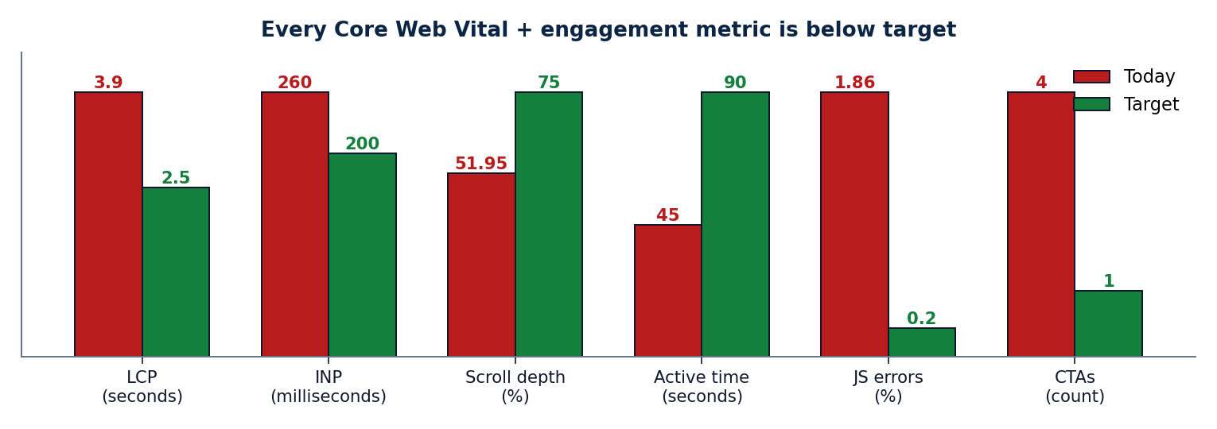
BHAGAVAD GITA DAILY · STRATEGY & GROWTH
AREA 1 · HOMEPAGE AUDIT
5 / 15
Homepage misses every Core Web Vital + every conversion principle — 8 specific fixes drive the ₹0 spend lift
PERFORMANCE & ENGAGEMENT — TODAY VS TARGET
SPECIFIC ISSUES IN THE BRIEF
LCP at 3.9s
vs 2.5s target · −7-10% conversion / sec
INP at 260ms
vs <200ms target · laggy interaction
Avg scroll depth 51.95%
form below fold; most users never see CTA
Avg active time 45 sec
insufficient to absorb 4 competing CTAs
129 sessions JS error
1.86% · "undefined is not an object"
4 competing CTAs
Subscribe / Chapters / Teachings / Learning
Social-proof contradiction
"4,000+" vs "12,000+" on same page
Generic hero tagline
"Ancient Wisdom, Timeless Truth" says nothing
8 HOMEPAGE FIXES — RANKED BY EXPECTED IMPACT
DAY 1/2/3 TRIAL ACTIVATION ARC · WHATSAPP
01
Move subscribe form ABOVE the fold (mobile)
+30% reach
T = 0
Sign-up
Instant WhatsApp: "Your Gita journey starts tomorrow at 8 AM 🙏"
02
Replace hero with benefit-first promise
+15% relevance
03
Kill 3 competing CTAs — keep ONLY Subscribe
+18% focus
DAY 1
8 AM
First shlok + permission. "For 3 days, this is completely free."
04
Show real WhatsApp message mock next to form
+12% trust
DAY 2
8 AM + 7 PM
Shlok + evening preview of next 5 verses. Annual upsell teaser.
05
Reconcile social proof — pick ONE number
+8% credibility
06
Compress hero · target LCP < 2.5s
+7-10% / sec
DAY 3
Pre-charge
"Trial ends today. ₹79 will be charged. Reply STOP to cancel."
07
Resolve "undefined" JS error (129 sessions)
+1.86% recovery
T+48H
Cancel re-engage
"Your spot is still here." → 15-20% reactivation.
08
Move Gita resources to POST-subscribe page
stops free leakage
SOURCE · Glido Labs analytics: LCP 3.9s, INP 260ms, scroll 51.95%, JS errors 1.86% | Google Web Vitals | Nielsen Norman Group

Slide 6
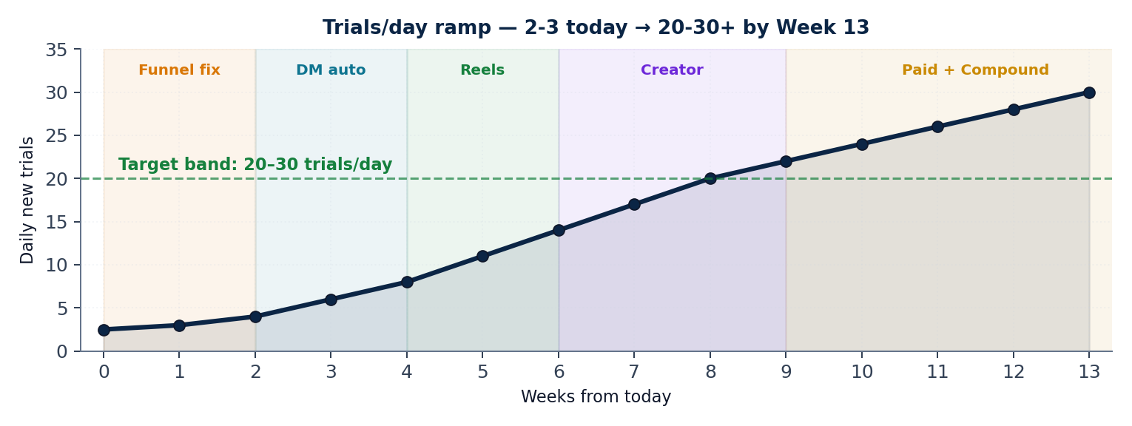
BHAGAVAD GITA DAILY · STRATEGY & GROWTH
AREA 2 · SCALING STRATEGY
6 / 15
Lift trials from 2-3/day to 20-30/day in 13 weeks via 5 sequenced channels — 80% organic, paid is the LAST lever
TRIAL VOLUME RAMP — WK0 → WK13 BY CHANNEL ACTIVATION
PER-SUB UNIT ECONOMICS · YEAR 1
Revenue / sub / year
₹948
Annual blend (avg)
₹823
Gross margin per sub
85.5%
Blended CAC (Y1)
₹125
Payback period
1.6 mo
LTV @ 8% churn
₹987
LTV / CAC
7.9×
True contribution / sub
₹671
5-CHANNEL ACQUISITION MATRIX · TARGET BLENDED CAC < ₹150
DUAL VIRAL LOOPS · TARGET K > 1.2
CHANNEL
MECHANISM (INDIA-GROUNDED)
BUDGET
TRIAL CAC
DAILY TRIALS
WHATSAPP FORWARD LOOP
DM AUTOMATION (IG)
ManyChat "GITA" trigger → auto-DM with form link.
0%
₹0
8-10
116 active × 28 messages = 3,248 forward-touches/month potential.
DAILY REELS + YT SHORTS
1 Reel/day on "Gita for [anxiety/exam/heartbreak]".
0%
₹0
5-7
CREATOR AUDIENCE BORROW
MICRO-CREATOR COLLABS
20-30 spiritual creators × 30-day free trial.
15%
₹40
4-6
30-day free trial offered to micro-creator audiences. One quality collab → 500-1,000 trials.
WHATSAPP FORWARD LOOP
Daily message: "Forward to someone who needs this 🙏"
5%
₹0
3-4
FAMILY-PACK SHARE
META CTWA (M3+ ONLY)
Click-to-WhatsApp ads · lookalike of paid base.
80%
₹150
2-3
₹149 family pack covers 5 phones — built-in word-of-mouth via household.
SOURCE · Glido Labs case | ManyChat IG conversion (2024) | Meta India CTWA benchmarks | Sequoia India Subscription Unit Economics Guide

Slide 7
BHAGAVAD GITA DAILY · STRATEGY & GROWTH
AREA 2 · KPI DASHBOARD
7 / 15
10 weekly metrics + 8 monthly metrics across 4 categories — every decision tied to one number
WEEKLY KPIS · TRACK EVERY MONDAY
MONTHLY KPIS · REVIEW ON 1ST
CAT.
METRIC
TODAY
TARGET
CAT.
METRIC
TODAY
TARGET (30/60/90)
FUNNEL
Homepage → Form rate
18.2%
30%+
REV.
Active paid subscribers
116
230 / 480 / 800
FUNNEL
Signup → Trial rate
32.6%
60%+
REV.
Blended monthly revenue
₹9.2K
₹22K / ₹70K / ₹1L+
FUNNEL
Trial → Paid rate
71.2%
85%+
REV.
ARPU per user
₹79
₹130+ blended
ACQ.
Daily new trials
2-3
20-30
ECON.
Blended CAC
—
<₹150
ACQ.
DM auto CTR
—
35%+
ECON.
LTV @ current churn
₹268
₹987 (8% churn)
ACQ.
Reels saves / share
—
Track
ACQ.
Creator collab pipeline
0
5+/wk
ECON.
LTV / CAC
2.1×
7.9× target
ENG.
Day-1 message open rate
—
85%+
CHURN.
Monthly churn
29%
<8% by M3
ENG.
WhatsApp forward count
—
Track
STACK.
Revenue from non-₹79
₹0
₹50K+ by M3
PROD.
JS error sessions
129
<10
OPERATING CADENCE
Daily standup on weekly KPIs · monthly board review on revenue + churn · quarterly LTV/CAC re-base.
SOURCE · Glido Labs analytics + 18-metric KPI design · weekly cadence on funnel, monthly cadence on revenue + economics

Slide 8
BHAGAVAD GITA DAILY · STRATEGY & GROWTH
AREA 3 · CONTENT-TO-MONETIZATION
8 / 15
Today, Instagram delivers what subscribers pay for — close the value gap and Instagram becomes a tease, not a substitute
FREE VS PAID CONTENT ARCHITECTURE — 5-DIMENSION VALUE GAP
DIMENSION
FREE · Instagram (broadcast)
PAID · WhatsApp (intimate ritual)
Content depth
Shlok image / verse
Shlok + meaning + life application
Personalization
One-to-many caption
Reflection tied to today's verse
Cadence
Variable, algorithm-led
8 AM, every morning. No exceptions.
Relationship
Public broadcast
Private, ritual, companion-like
Discoverability
Anyone can find it
Curated channel just for you
5 CONTENT CAMPAIGNS RANKED BY EXPECTED IMPACT
#
CAMPAIGN
MECHANIC
EXPECTED IMPACT
PRIORITY
01
What is Krishna saying about your life right now?
Story poll: career / relationships / overthinking / lost. Auto-DM relevant shlok + trial link.
Warms cold leads. Personalization signal. Drives trial intent.
★★★★★
02
Subscriber Before & After Reels
1-line testimonials from active 116. Format: situation → shlok → outcome.
Native social proof, 2-3× reach uplift.
★★★★☆
03
"Gita for [situation]" series
Anxiety, exams, heartbreak, Monday morning, quitting. Shareable + searchable.
Drives both follower growth AND trial intent.
★★★★☆
04
200K Milestone Unlock
First 200 to DM 'GITA200' get 1 month free. PR pitch to spiritual media.
Urgency, DM opt-ins, brand authority moment.
★★★☆☆
05
Festival gifting (Navratri/Diwali/Janmashtami)
Dedicated gift sub page. Spiritual gifting is real, underserved.
100-200 subs/single push · near-zero CAC.
★★★★☆
SOURCE · Glido Labs IG analytics | ManyChat story poll → DM benchmarks | RedSeer 2024 spiritual e-commerce | Festival gifting volumes

Slide 9
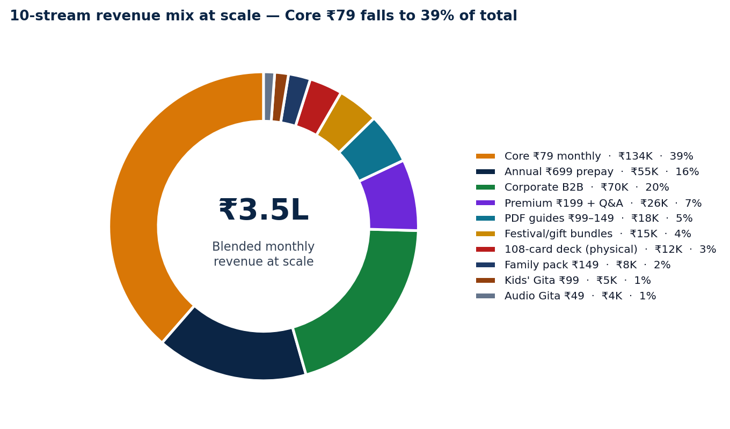
BHAGAVAD GITA DAILY · STRATEGY & GROWTH
AREA 4 · NEW REVENUE STREAMS · KEY FOCUS
9 / 15
Single ₹79 SKU → 10-stream stack — ₹3.5L blended MRR by M12, where Core ₹79 falls to 39% of total revenue
10-STREAM REVENUE STACK · ALL INDIA-GROUNDED
REVENUE MIX AT SCALE · M12
#
STREAM · WHAT WE SELL
PRICE
GO-LIVE
M12 MONTHLY
MARGIN
01
CORE · Daily WhatsApp shlok (monthly)
₹79/mo
Now
₹1.34L
85%
02
ANNUAL · Daily WhatsApp prepaid (saves 26%)
₹699/yr
Month 1
₹55K
92%
03
PDF GUIDES · "Gita for Anxiety/Career/Heartbreak/Parenting/Money"
₹99-149
Month 1
₹18K
97%
04
PREMIUM · Community + Q&A with scholar (Telegram/Discord)
₹199/mo
Month 3
₹26K
75%
05
FESTIVAL/GIFT · Diwali, Navratri, Janmashtami gift subscriptions
₹199-499
Month 2
₹15K
88%
06
PHYSICAL · 108-card Bhagavad Gita wisdom deck
₹599-699
Month 4
₹12K
55%
07
CORPORATE B2B · Daily Gita for HR wellness (BFSI, FMCG, IT)
₹5K-15K/mo
Month 5
₹70K
80%
08
FAMILY PACK · 3-5 phones, multi-language
₹149/mo
Month 4
₹8K
82%
09
KIDS' GITA · Stories for ages 8-14 (parents buy)
₹99/mo
Month 6
₹5K
85%
10
AUDIO GITA · Voice version for commute/Bharat
₹49/mo
Month 5
₹4K
88%
BLENDED MONTHLY @ M12
₹3.5L+
82%
SOURCE · Pricing logic: ₹49-149 impulse · ₹199 commit · ₹599+ artefact · ₹5K+ B2B | Margin: digital 85-95%, physical 55%, B2B 80% | RedSeer 2024

Slide 10
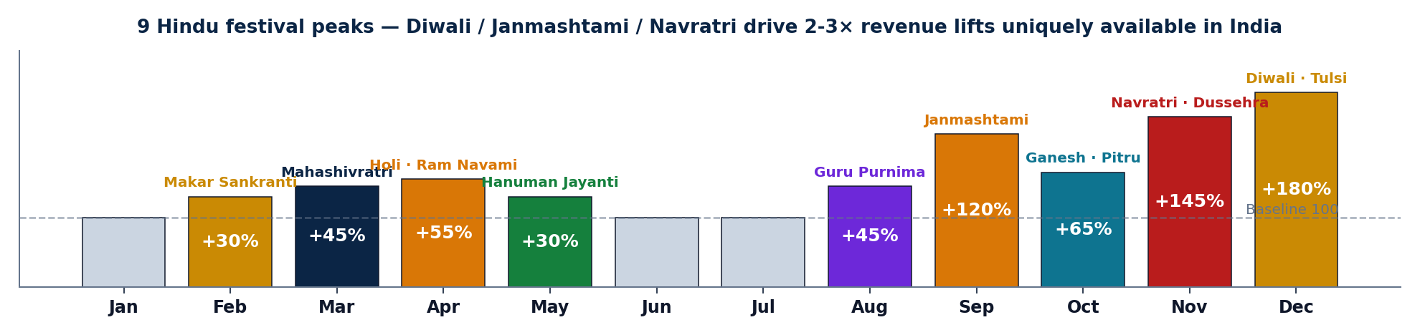
BHAGAVAD GITA DAILY · STRATEGY & GROWTH
AREA 4 · INDIA FESTIVAL & GIFT ECONOMY
10 / 15
9 Hindu festivals + life-event gifting drive 30-180% revenue lifts — uniquely Indian, structurally underserved by global subscription apps
FESTIVAL CALENDAR · EXPECTED REVENUE LIFT BY MONTH (BASELINE = 100)
6 INDIA-GROUNDED BUNDLE PRODUCTS · WILL NOT EXIST ANYWHERE ELSE
DIWALI GIFT PACK
JANMASHTAMI SPECIAL
NAVRATRI 9-DAY
WEDDING / ANNIVERSARY
BIRTHDAY GIFT SUB
EXAM SEASON
₹499
₹299
₹199
₹999
₹199
₹99
1-year sub + festival e-card + Lakshmi-Ganesha shloka audio
Krishna's birthday: 1-month sub + 8 special Bhagavad shlokas + Janmashtami art
9 daily reflections (one per Goddess + Gita parallel)
1-year couple sub + 'Gita on Marriage' PDF + scholar Q&A access
Personalised 'shlok-for-your-month' card + 6-month sub
Mar-May + Oct-Nov: 'Gita for exam stress' 30-day micro-sub
Family-to-family gifting (most lucrative spiritual occasion)
On-brand: Bhagavad Gita IS Krishna's words. Best PR moment.
October's biggest festival, mid-tier price point
Hindu weddings = ₹3.7T market; gifting cards underserved
Year-round non-festival gifting — most stable revenue
Parents buy for board exam students (CBSE/ICSE/JEE)
Target: 200 packs in Nov · ₹1L revenue spike
Target: 300 packs · ₹90K + brand authority moment
Target: 400 packs · ₹80K
Target: 50 packs/mo · ₹50K/mo recurring
Target: 100 packs/mo · ₹20K/mo recurring
Target: 300/season · ₹30K/season
SOURCE · Hindu calendar 2025 | RedSeer Spiritual & Wellness 2024 (₹4,000 Cr TAM) | KPMG Wedding Industry India 2024 (₹3.7T) | Team estimates

Slide 11
BHAGAVAD GITA DAILY · STRATEGY & GROWTH
AREA 4 · PRICING ARCHITECTURE
11 / 15
Tiered pricing from ₹49 audio to ₹15K/mo corporate captures every willingness-to-pay segment in India
PRICING LADDER · MONTHLY EQUIVALENT
PRICING LOGIC · 4 ANCHOR PRINCIPLES
CORPORATE B2B
₹5K-15K/mo
01 ANCHOR LOW
BFSI, FMCG, manufacturing HR
₹49 audio is the pure-curiosity tier. Builds top-of-funnel paying habit at coffee-cost.
WEDDING / ANNIV
₹999 one-time
Couple gifting, 1-year sub bundled
02 ₹99-149 IMPULSE
PDF guides, exam-season micro-subs. Buy on impulse, no auto-deduct fear.
PHYSICAL DECK
₹599-699
108-card Gita wisdom deck, festival gifting
03 ₹199-499 COMMIT
Premium, festival bundles, family. Commit-level price, conscious purchase.
DIWALI BUNDLE
₹499
Festival + 1-yr sub + audio + e-card
04 ₹599+ ARTEFACT / B2B
Physical deck, wedding pack, corporate. Status + gifting + enterprise economics.
ANNUAL PREPAY
₹699/yr ≈ ₹58/mo
26% discount, ~0% churn lock-in
PREMIUM TIER
₹199/mo
Community + scholar Q&A access
B2B CORPORATE OPPORTUNITY · TAM/SAM/SOM
FAMILY PACK
₹149/mo
Up to 5 phones, multi-language
TAM · Corporate Wellness India
₹4,000 Cr · 15% CAGR
CORE
₹79/mo
Daily WhatsApp shlok (anchor SKU)
SAM · Mid-large firms (BFSI/FMCG/Mfg)
₹400 Cr
SOM Y1 · 15-30 pilot firms
₹50-80 L
KIDS' GITA
₹99/mo
Stories for 8-14, parents buy
PRICING · ₹5K (≤50) / ₹10K (50-200) / ₹15K (200+)
Per month per firm
AUDIO GITA
₹49/mo
Voice for commute/Bharat tier 3
BUYER · HR Heads at 500-5,000 employee firms
LinkedIn outreach
MOTION · 15-min outreach → pilot → case-study fly-wheel
Self-serve B2B
SOURCE · Mercer Marsh India Wellness Survey 2024 (₹4,000 Cr) | LinkedIn HR titles | Glido pricing assumptions | Team build-up

Slide 12
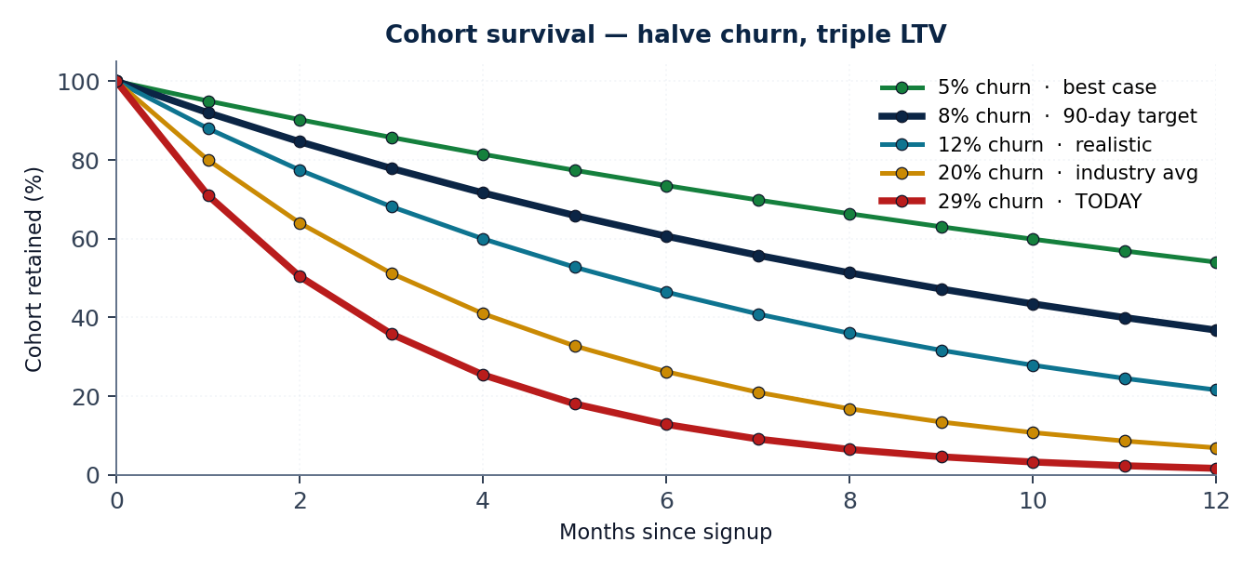
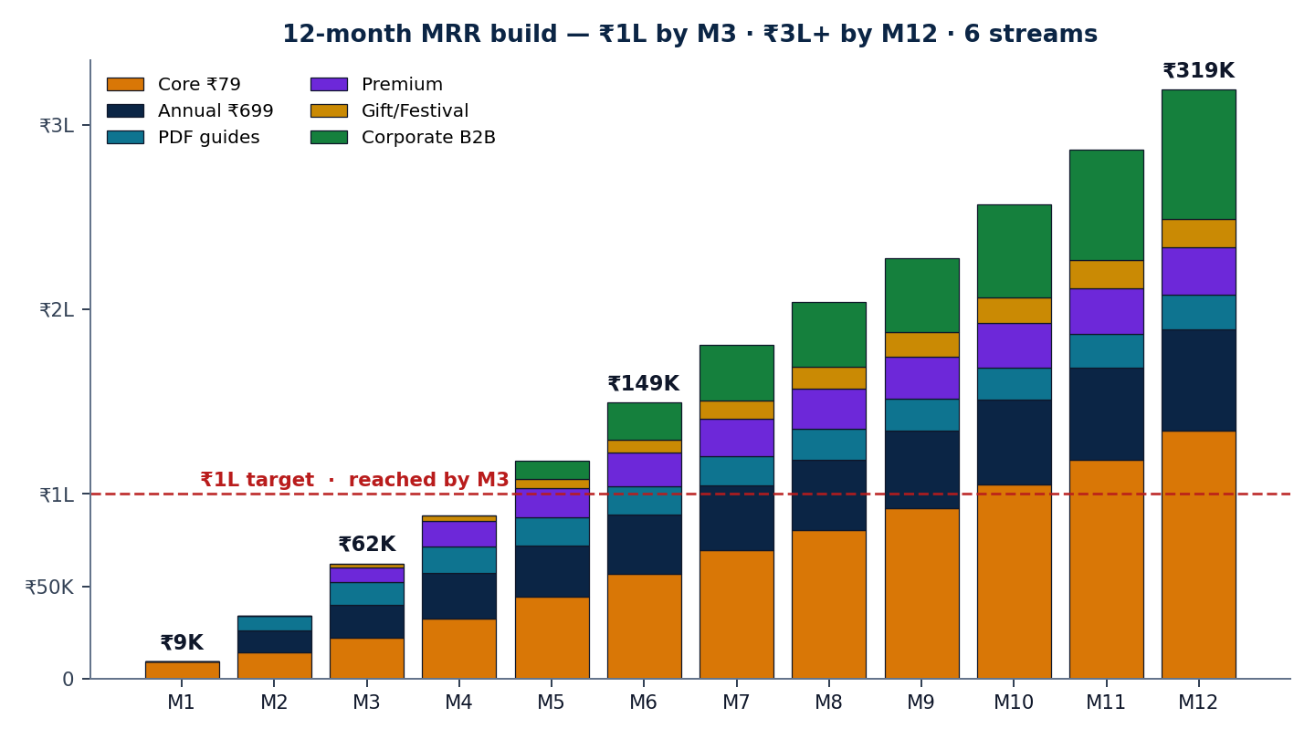
BHAGAVAD GITA DAILY · STRATEGY & GROWTH
FINANCIAL MODEL
12 / 15
Halving churn from 29% → 8% triples LTV — the Day-3 trial fix is the single highest-ROI intervention in this deck
85.5%
₹125
M3
₹3.5L+
7.9×
GROSS MARGIN
BLENDED CAC
TO ₹1L MRR
MRR @ M12
LTV / CAC
PER-SUBSCRIBER UNIT ECONOMICS
COHORT RETENTION · LTV SENSITIVITY
12-MONTH MRR BUILD · 6 STREAMS
LINE ITEM
AMOUNT
RATIONALE
Revenue / sub / year
+₹948
12 × ₹79
WhatsApp + payment fees
−₹95
~10% of revenue
Content production
−₹30
1 scholar / 800 subs
Tech + infra
−₹12
ManyChat, hosting
GROSS MARGIN
+₹811
85.5%
Blended CAC (amortized)
−₹125
Y1 weighted
Refund / chargeback
−₹15
2% allowance
MONTHLY CHURN
LTV
LTV / CAC
TRUE CONTRIBUTION
+₹671
70.7% survives CAC
5%
₹1,580
12.6×
8% · TARGET
₹987
7.9×
12%
₹655
5.2×
20%
₹395
3.2×
29% · TODAY
₹268
2.1×
SOURCE · Sequoia India Subscription Unit Economics Guide | Cohort math: P(retained) = (1-churn)^n | Glido Labs case data

Slide 13
BHAGAVAD GITA DAILY · STRATEGY & GROWTH
EXECUTION · 90-DAY ROADMAP
13 / 15
Fix the funnel before scaling. Deepen monetization before buying traffic. ₹1L MRR by M3 if Lever 1 lands in 30 days
6-PHASE TIMELINE · ZERO-SPEND COMPOUNDING FIRST
WK 1-2
WK 2-3
WK 3-4
MONTH 2
MONTH 3
MONTH 3+
FIX THE LEAK
SEAL THE TRIAL
DM AUTOMATION
NEW REVENUE
SCALE CONTENT
PAID + B2B
Homepage redesign · Form above fold · Mandate explainer · LCP <2.5s
Day 1/2/3 WhatsApp arc · Re-engage 47 churns · Pre-charge transparency
ManyChat 'GITA' trigger · Update captions · First Story poll campaign
Annual ₹699 launch · 3 PDF guides live · Diwali gift sub page
Daily Reels · 2 creator collabs · B2B pitch deck · Premium tier launch
Meta CTWA ₹500/d · Lookalike audience · 5 corporate pilots · Audio launch
MILESTONE OUTCOMES · NOW / 30 / 60 / 90 DAY
RISK & MITIGATION MATRIX
DIMENSION
TODAY
DAY-30
DAY-60
DAY-90
RISK
IMPACT
MITIGATION
Active paid subscribers
116
230
480
800+
WhatsApp policy / API ban
CRITICAL
WA Business API + email mirror
Daily new trials
2-3
8-10
15-18
20-30
Mandate distrust → chargebacks
Bilingual explainer, pre-charge
HIGH
Homepage → Form
18.2%
30%
35%
40%+
Trial → Paid
71%
78%
82%
88%+
Founder content fatigue
MED
Onboard 2 scholars by Month 3
Monthly churn
29%
<20%
<12%
<8%
Instagram algo dependency
HIGH
Diversify: Shorts, ShareChat, email
Blended monthly revenue
₹9.2K
₹22K
₹70K
₹1L+
Premium quality dilution
Hard cap 150 members, founder mod
Revenue streams live
1
3
5
7+
MED
SOURCE · Glido Labs case | Industry risk benchmarks | Team risk identification & mitigation design

Slide 14
BHAGAVAD GITA DAILY · STRATEGY & GROWTH
APPENDIX · FRAMEWORKS & SOURCES
14 / 15
Every analysis traces to a named framework and a published data source
FRAMEWORKS USED IN THIS DECK
DATA SOURCES & REFERENCES
SCR · SITUATION-COMPLICATION-RESOLUTION
MBB synthesis structure (slide 2)
CASE DATA
Glido Labs Strategy Assignment brief — funnel, sessions, perf, errors
FUNNEL DIAGNOSTIC
Stage-by-stage drop-off vs benchmark (slide 4)
MARKET
IMARC India Subscription Apps Market Report 2024
VALUE PROPOSITION CANVAS
JTBD × Anxieties × Pay × Stay (slide 3)
MARKET
Mercer Marsh Benefits India Wellness Survey 2024 (₹4,000 Cr B2B TAM)
CORE WEB VITALS AUDIT
LCP/INP/CLS perf (slide 5)
MARKET
RedSeer Spiritual & Wellness E-commerce Report 2024
MARKET
Meta India Click-to-WhatsApp Ads benchmark 3-5× lift
HOOK MODEL · NIR EYAL
Trigger → Action → Reward → Invest
MARKET
KPMG Wedding Industry India 2024 (₹3.7T)
AARRR PIRATE METRICS
Acquisition / Activation / Retention / Referral / Revenue
CONSUMER
LocalCircles Hindi Spiritual Content Survey 2024
UNIT ECONOMICS
Per-sub P&L: ₹948 → ₹671 contribution (slide 12)
PRODUCT
Razorpay UPI Mandate UX Guidelines
LTV / CAC SENSITIVITY
5%-29% churn scenarios (slide 12)
PRODUCT
Google Web Vitals — LCP/INP/CLS conversion impact
TAM / SAM / SOM
B2B sizing ₹4,000 Cr → ₹50-80 L Y1 (slide 11)
PRODUCT
ManyChat Instagram automation benchmarks
KPI DASHBOARD
10 weekly + 8 monthly metrics (slide 7)
THEORY
Maister, Green & Galford — The Trusted Advisor (2000)
RISK & MITIGATION MATRIX
5 risks × impact × mitigation (slide 13)
THEORY
Nir Eyal — Hooked: How to Build Habit-Forming Products (2014)
FESTIVAL CALENDAR REVENUE LIFTS
9 Hindu festivals × baseline 100 (slide 10)
THEORY
Eric Ries — The Lean Startup (2011)
UNIT ECON.
Sequoia India Subscription Unit Economics Guide

Slide 15
WHAT WE WILL HAVE BY MONTH 3
THE BIG BET
FUNNEL
Homepage → Trial above 8% (vs 2.21% today)
Fix the funnel
before you scale it.
Deepen monetization
before you buy traffic.
AUDIENCE
800+ active paying subscribers (vs 116 today)
REVENUE
₹1L+ blended MRR — 11× current
STREAMS
7 of 10 revenue streams live (Annual, PDF, Premium, Festival, B2B, Family, Audio)
PIPELINE
3 corporate pilots in motion · paid ads ROAS-positive
BRAND
200K+ Instagram, first PR mention as India's daily Gita ritual
Most spiritual subscriptions die buying ads into broken funnels. We will not. The 90-day plan is sequenced so the first ₹0 of new spend earns the right to the next ₹1 of paid acquisition.
FROM THE GITA · CHAPTER 2, VERSE 47
"You have a right to perform your prescribed duty, but not to the fruits of action."
Operating principle: ship the funnel; the MRR will follow.
DIVYAMAN PAL · IIT KANPUR · divyamp23@iitk.ac.in
Bhagavad Gita Daily · Strategy Deck v4.0 · Confidential

