Slide 1
ISSUE 01 · PRODUCT REVIEWS · 2025
A PRODUCT REVIEW · AFTER 3 DAYS OF USE
Aise.
voice · memory · persona
Why a thoughtful AI coach feels like a chatbot —
and the five fixes that turn the tool into a relationship.
01
THE GAPS
02
THE PEERS
03
THE FIX
Five product holes I noticed by Day 2 of use
What Replika, Pi, Sesame & Hume already do
A 14-day rebuild memo for the Aise team
REVIEWED & WRITTEN BY
App · com.vel.aise.app on Google Play
Divyaman Pal · IIT Kanpur · divyamp23@iitk.ac.in

Slide 2
AISE · AI COACH APP — A 3-DAY PRODUCT REVIEW
FOREWORD
2 / 15
I downloaded Aise on a Tuesday, talked to it for three mornings, and stopped on Friday — here's why.
WHY I'M WRITING THIS
GROUND RULES OF THIS REVIEW
WHO
I'm a recent IIT-K grad who tries new AI products carefully and notes what works and what doesn't. I'm not affiliated with the Aise team.
✓
Observations are mine — calibrated against published peer features, not internal Aise data.
✓
Where I cite numbers (latency, etc.), the source is public — Sesame demo, Pi blog, OpenAI release notes.
WHAT
Aise is positioned as an AI coaching app — voice + chat — with multiple personas. The promise is clear: a daily companion for personal growth.
✗
I do not invent Aise-specific metrics (D7, NPS, etc.). I haven't been given them; I won't fabricate them.
HOW
I tried the app on a Pixel device for three consecutive days. Roughly four short sessions per day. Some voice, some text. No edge-case prodding — just normal use.
✗
I do not name personas, screenshots, or proprietary content from the app.
WHY THIS DECK
By day three I felt the same gaps that, in my view, hold back many AI consumer apps in India. They are all fixable. This is a memo, not a takedown.
→
Where I project an outcome, I label it 'directional' — the magnitude is for the team to validate.
→
Where peers are clearly ahead, I say so plainly. Where Aise leads, I say so plainly.
NOTE · Personal usage · Pixel-class Android · 3 consecutive days · ~4 sessions/day · voice + text mixed

Slide 3
AISE · AI COACH APP — A 3-DAY PRODUCT REVIEW
METHODOLOGY
3 / 15
What I knew going in, and what I tried to test — kept the test set deliberately narrow and ordinary.
THE APP · WHAT IS AISE?
3-DAY USAGE LOG · WHAT I OBSERVED
CATEGORY
AI coaching app — voice + text chat with multiple AI characters/personas
DAY 1
ONBOARDING
Picked a coach. Voice immediately felt synthetic. Tried both voice & text modes side-by-side.
PROMISE
On-demand coaching · personal growth, focus, mood support
DAY 1
FIRST CHAT
Asked about a near-term goal. Got a response that felt generic — could've been written for anyone.
INTERFACE
Pick a coach · talk in voice or type · session-based
DAY 2
SECOND OPEN
The coach didn't recall the goal from yesterday. I had to re-introduce context to get usable replies.
LANGUAGES
Visible Hindi support — appears tailored to Indian users
DAY 2
VOICE MODE
Voice felt slow to start; no fillers, no pauses. Conversation rhythm felt one-sided.
BUSINESS
Free with paid tier visible in-app (assumed freemium)
DAY 2
MOOD CHECK
Tone stayed flat across topics. When I sounded down, the coach didn't shift.
PLATFORM
Google Play · com.vel.aise.app
DAY 3
FEEDBACK SEARCH
Looked for a thumbs-up or rating after a useful reply. Couldn't find one.
DAY 3
FINAL SESSION
By session ten or so, the relationship hadn't deepened. The pull to come back tomorrow wasn't there.
VERDICT
MY READ
Strong intent + clean UI + India-focus. But no relationship layer = no reason to return on Day 4.
NOTE · Personal observation only — no internal Aise metrics consulted, no edge-case stress testing

Slide 4
AISE · AI COACH APP — A 3-DAY PRODUCT REVIEW
THE 5 GAPS
4 / 15
Five gaps span the AI stack — voice (hearing), memory (continuity), persona (warmth), feedback (learning), experimentation (compounding).
01
ROBOTIC
VOICE
02
NO MEMORY
ACROSS DAYS
03
GENERIC
AI VOICE
04
NO FEEDBACK
LOOP
05
NO VISIBLE
LEARNING
🎙️
🧠
🎭
💬
🔬
Voice felt synthetic from the first sentence. No emotional adaptation. Latency made it feel turn-based, not conversational.
Day-2 conversation began like Day 1. No continuity of goal, preference, or recent moments.
Replies sounded like they could be addressed to anyone. No distinct character, no signature phrasing.
I couldn't tell the app what worked or what didn't — no thumbs, no rating, no end-of-session pulse.
Across three days, the experience felt static. Nothing about my use seemed to be informing what I got next.
• Same prosody every line
• Noticeable wait before voice starts
• No fillers · no pauses
• One voice across all topics
• Coach forgot the Day-1 context
• Re-introduction every session
• No goal tracking carried forward
• Preferences re-asked
• No felt 'character' in the coach
• Tone flat across moods
• Falls into 'as an AI...' pattern
• Hard to remember the coach later
• No way to mark a good response
• No end-of-session prompt
• Drop-offs aren't surfaceable
• Quality slips can't be caught
• No personalization felt over time
• No A/B variants observable
• No iteration cadence visible
• Feels frozen, not improving
NOTE · Each gap is a qualitative observation from 3-day use — severity is my read, not Aise-internal data

Slide 5
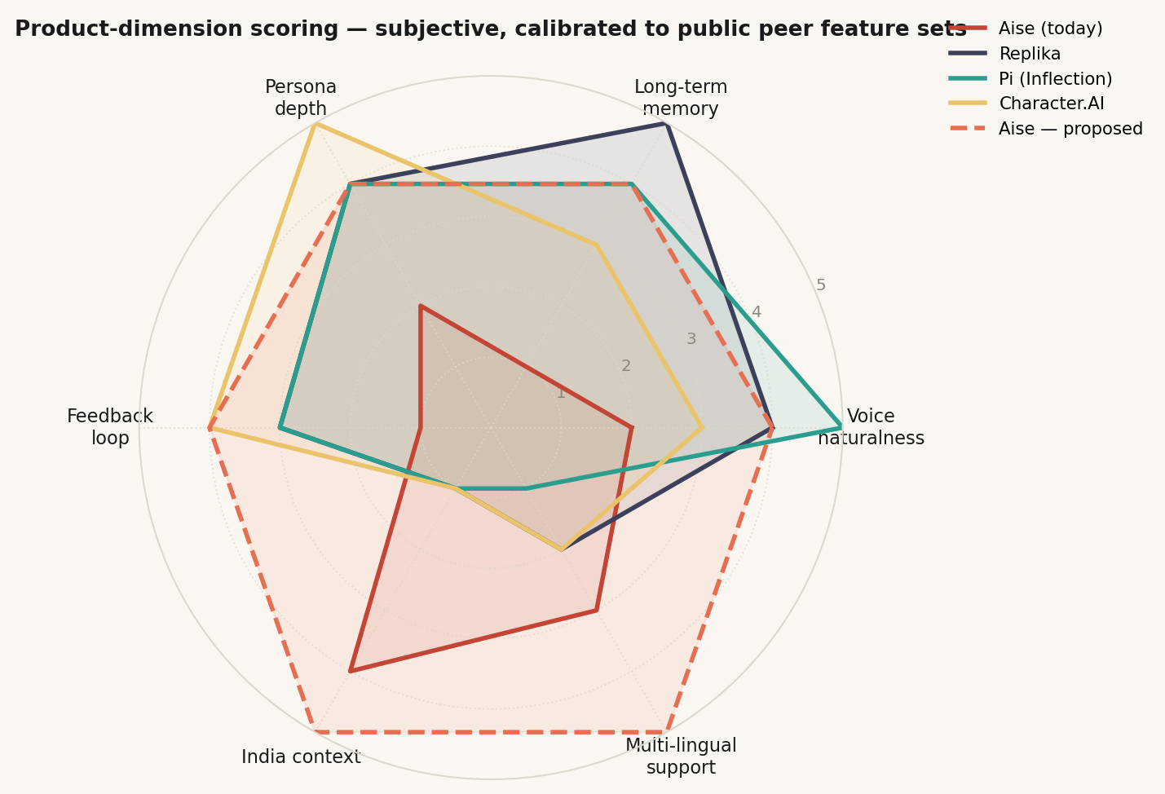
AISE · AI COACH APP — A 3-DAY PRODUCT REVIEW
WHAT PEERS ALREADY DO
5 / 15
Peers have publicly shipped solutions to four of Aise's five gaps — Aise's only standalone strength is India context.
FEATURE PRESENCE · AISE VS 7 PEERS (PUBLICLY VERIFIABLE)
VISUAL · AISE TODAY VS PEERS VS PROPOSED
PLATFORM
VOICE
MEMORY
PERSONA
FEEDBACK
EXPER.
INDIA
Aise (current)
✕
—
✕
—
—
✓
Replika
✓
✓✓
✓
~
~
—
Pi (Inflection)
✓✓
✓
✓
~
~
—
Character.AI
~
~
✓✓
✓
✓
—
Sesame AI (Maya/Miles)
✓✓
—
~
—
~
—
ChatGPT Voice
✓
✓
~
✓
✓
✕
Hume EVI
✓
~
✓
✓
✓
—
Wysa (mental health)
—
~
~
~
✕
✓
✓✓
Best-in-class
✓
Solid
~
Partial
✕
Missing
—
n/a
NOTE · Scoring: my read after 3-day use, calibrated against public docs — Sesame.com, Pi.ai, Replika.com, hume.ai, character.ai, openai.com, wysa.com

Slide 6
AISE · AI COACH APP — A 3-DAY PRODUCT REVIEW
5 GAPS → 5 SOLUTIONS
6 / 15
Each gap maps to a known, well-documented solution — none of these are new ideas; they're tablestakes peers have shipped.
01 VOICE
GAP
01 EMOTION-AWARE TTS
SHAPE OF THE FIX
Robotic · slow start · no emotion
Streaming output · pauses & fillers · multiple voice presets
References: Sesame TTS, ElevenLabs Multilingual v2, Hume EVI, Sarvam Bulbul-2 (Hindi)
02 MEMORY
GAP
02 TWO-TIER MEMORY
SHAPE OF THE FIX
No continuity across sessions
Short-term context window + long-term semantic store with summaries
Patterns: vector store (e.g., pgvector / Pinecone), Mem0, OpenAI Memory pattern
03 PERSONA
GAP
03 PERSONA SYSTEM
SHAPE OF THE FIX
Generic AI voice · 'as an AI...' patterns
Distinct character archetypes · adaptive tone by user mood
References: Character.AI persona docs, Anthropic Claude character work, prompt-eng best practice
04 FEEDBACK
GAP
04 FEEDBACK CAPTURE
SHAPE OF THE FIX
No way for user to signal good/bad
Per-response thumbs + end-of-session pulse + implicit drop-off telemetry
References: ChatGPT thumbs · LangSmith eval · Anthropic Constitutional AI feedback
05 EXPERIMENT
GAP
05 A/B HARNESS
SHAPE OF THE FIX
No visible iteration / improvement
Prompt versioning · feature-flag-gated rollout · weekly experiment cadence
References: GrowthBook, Statsig, Langfuse, Helicone — all support prompt-level experiments
NOTE · Each fix has prior art — the goal is to assemble known patterns thoughtfully, not invent new technology

Slide 7
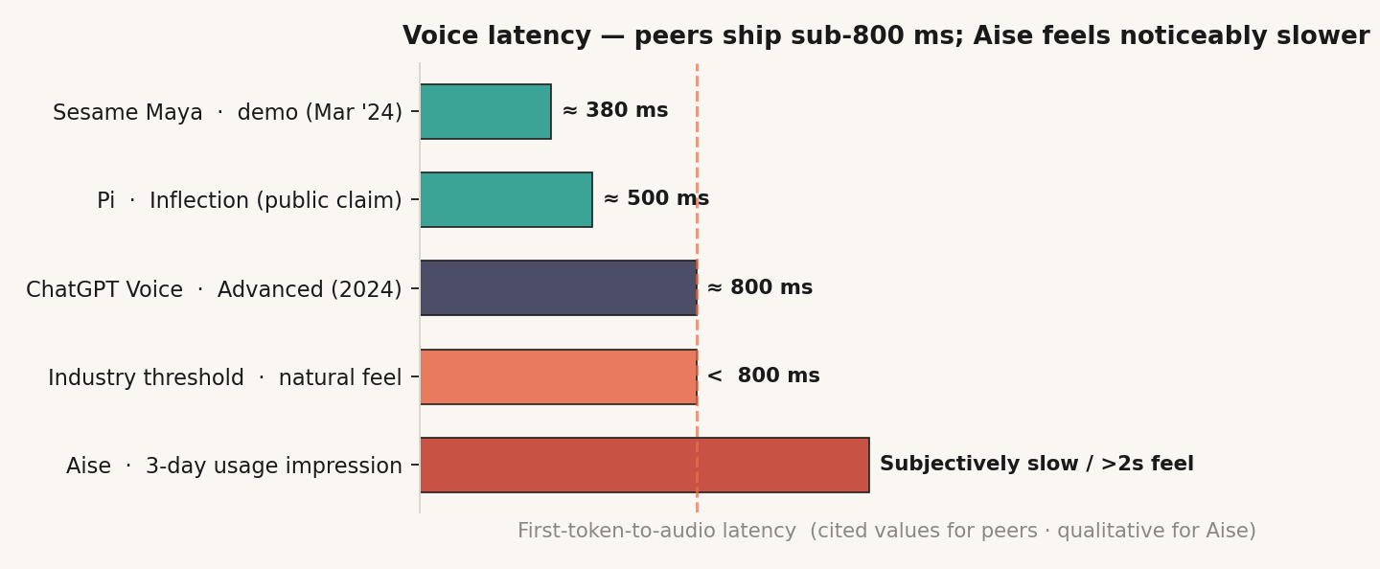
AISE · AI COACH APP — A 3-DAY PRODUCT REVIEW
SOLUTION 01 · VOICE
7 / 15
Fix the voice and you change the first impression — peers have publicly demoed sub-800ms first-token; that is the bar to clear.
🎙️
WHAT I FELT
🛠️
WHAT TO DO
🌱
WHAT IT BUYS US (DIRECTIONAL)
• Voice sounded synthetic from the first reply
• Noticeable wait before voice starts speaking
• Tone stayed flat regardless of topic
• No natural pauses, no fillers — just sentences
• Same voice across personas
• Adopt a streaming-capable TTS (Hume / Sesame / 11Labs)
• Stream audio while text is generating
• Insert pauses & fillers in the system prompt
• Detect user mood → switch tone (happy/calm/serious)
• Ship 3–5 voice presets so users can pick a vibe
• First-impression flips from "chatbot" to "someone"
• Voice mode becomes the default, not a fallback
• Word-of-mouth: people show their friends
• Foundation for emotion-aware coaching later
• Hindi-first voices unlock Bharat tier-2/3 users
VOICE LATENCY · PUBLIC PEER REFERENCES (AISE SHOWN QUALITATIVELY)
CANDIDATE TECH STACK · REVIEW WITH ENG
TTS ENGINE
Hume EVI / ElevenLabs / Sesame / OpenAI TTS
STREAMING
Chunked WebSocket playback for first-audio speed
EMOTION MODEL
Whisper STT + emotion classifier or Hume native
HINDI VOICES
Sarvam Bulbul-2 / ElevenLabs Hindi voices
PAUSES
SSML <break/> + prompt instructions for fillers
NOTE · Latency anchors: Sesame.com Mar-2024 demo · Pi.ai public claims · OpenAI ChatGPT Voice (2024) · qualitative bar from product reviews

Slide 8
AISE · AI COACH APP — A 3-DAY PRODUCT REVIEW
SOLUTION 02 · MEMORY
8 / 15
Memory is what turns a chatbot into a coach — the architecture is well-trodden; it's an integration job, not a research project.
TWO-TIER MEMORY ARCHITECTURE
BUILD CHOICES · WORTH DEBATING WITH ENG
🧠 SHORT-TERM (STM)
💾 LONG-TERM (LTM)
Vector store
pgvector if Postgres-native · Pinecone / Weaviate as managed alts
• In-session conversation context
• Generous token window
• Maintains tone & topic continuity
• Volatile · resets at session end
• Cross-session vector store
• Goals · preferences · facts · key moments
• Top-k semantic retrieval per turn
• Persistent · summarised periodically
Embeddings
OpenAI / Cohere multilingual — Hindi quality matters
Retrieval
Top-k semantic + recency decay + importance score
Summarizer
Periodic compaction every N turns / session-end
Privacy
User-controlled deletion · DPDP Act compliance · clear UI
WHAT MEMORY CHANGES (DIRECTIONAL)
🤖 PROMPT = SYSTEM + PERSONA + RETRIEVED MEMORIES + STM + USER TURN
CONTINUITY
Day-2 conversation feels like Day-2, not Day-1 again
Each turn pulls top-k memories by semantic relevance + recency + importance score.
PERSONAL
User feels "this coach knows me" — qualitative shift
WHAT THE COACH MIGHT REMEMBER (ILLUSTRATIVE — NOT REAL USER DATA)
LESS RE-PROMPT
User stops re-introducing the same context
Goal
User said "I want to crack CAT this November" → tracked
GOAL TRACKING
Coach can hold the user accountable to stated goals
Preference
Prefers Hindi · short replies · evening sessions
Fact
Final-year B.Tech · in Jaipur · stress before mocks
FOUNDATION
Unlocks every future personalisation feature
Last topic
Day 4 was about time-management · agreed on 2-hr daily plan
NOTE · Patterns: standard RAG + memory architectures (LangChain/LlamaIndex/Mem0) · Replika & Pi public memory features · DPDP Act 2023

Slide 9
AISE · AI COACH APP — A 3-DAY PRODUCT REVIEW
SOLUTION 03 · PERSONA
9 / 15
Distinct personas + adaptive tone is what turns 'an AI' into 'a coach' — and pulls users back the next morning.
5 SUGGESTED ARCHETYPES · USER PICKS ONE AT ONBOARDING
THE COACH
THE MENTOR
THE FRIEND
THE THERAPIST
THE TRAINER
🏆
🧘
💬
❤️
🎯
Sharp · direct · accountability-first
Wise · patient · long-view
Casual · warm · funny
Empathetic · listens · reflects
Tactical · structured · drill-mode
For: career & exam goals
For: life decisions
For: daily check-ins
For: anxiety / mood
For: skill-building
"You said 2 hours — what did you actually do?"
"Tell me what feels true to you..."
"Areee, kya chal raha hai aaj?"
"I hear you. What's underneath that?"
"Today, five questions on time management."
ADAPTIVE TONE · USER MOOD SHIFTS HOW THE COACH TALKS
ANTI-PATTERNS · THINGS THAT BREAK THE FEEL
USER: "I failed the test..."
→ Soften tone · slow pace · lead with empathy · skip metrics
✗ "As an AI, I cannot..."
→ "Hmm, let's think about this differently..."
Sad / defeat
USER: "YES! Got the offer!"
→ Match the excitement · celebrate · then anchor next goal
✗ "I'm here to help you with..."
→ Skip · jump straight into substance
Joy / win
✗ Generic "That's a great question!"
→ Engage with the actual content
USER: "I don't know what to do"
→ Slow down · ask one clarifying question · no advice yet
Confusion
✗ Disclaimers + caveats every reply
→ Speak with conviction (within scope)
USER: "Stop telling me what to do"
→ Acknowledge · drop directive tone · reflect feeling back
Frustration
✗ Same response length every turn
→ Vary: 1 line · 3 lines · question back
NOTE · Persona references: Character.AI persona system, Anthropic Claude character work, prompt-engineering patterns

Slide 10
AISE · AI COACH APP — A 3-DAY PRODUCT REVIEW
SOLUTION 04 · FEEDBACK
10 / 15
Without a feedback loop, every prompt change is a guess — capture explicit & implicit signals; both feed the same quality model.
EXPLICIT · USER-INITIATED
IMPLICIT · PASSIVELY OBSERVED
FROM SIGNAL → IMPROVEMENT
👍👎
PER-RESPONSE THUMBS
⏱️
SESSION LENGTH
STEP 1
CAPTURE
2-tap · captured per turn
Long = engaging · short = bouncing
All signals → event log
⭐⭐⭐
END-OF-SESSION PULSE
🔁
RE-PROMPT RATE
STEP 2
SCORE
1 question · skippable
User asks again = first answer was poor
LLM-judge labels each conv: helpful/off
📝
OPTIONAL COMMENT BOX
⏹️
MID-CONVERSATION DROP-OFF
STEP 3
AGGREGATE
After thumbs-down only
Where in the turn user closes the app
Weekly: persona × topic × outcome
🚩
REPORT INAPPROPRIATE RESPONSE
🎧
VOICE PLAYBACK COMPLETION
STEP 4
DIAGNOSE
Critical safety signal
Did they listen full? Skip = bad voice
Lowest-scoring buckets surfaced to PM
⚙️
PERSONALISATION PREFERENCES
📅
RETURN CADENCE (D1, D7)
STEP 5
ITERATE
User edits memory · marks topics
Best lagging signal of overall quality
Prompt edits · persona tweaks · model upgrades
⭐
APP-STORE RATING PROMPT
📊
TIME-OF-DAY PATTERN
STEP 6
RE-TEST
After 3rd good session · soft nudge
Habit formation marker
A/B vs baseline · roll if clear winner
NOTE · References: ChatGPT thumbs · LangSmith eval · Constitutional AI · LinkedIn quality engineering practices

Slide 11
AISE · AI COACH APP — A 3-DAY PRODUCT REVIEW
SOLUTION 05 · EXPERIMENTATION
11 / 15
Without an A/B harness, prompt changes ship blind — with one, every release is measurable and reversible.
WHAT TO A/B TEST · 4 LAYERS
PROMPT VERSIONS
VOICE MODELS
PERSONA MIX
MEMORY DEPTH
v1.2.4 · v1.2.5 · v1.2.6
Hume vs ElevenLabs vs Sarvam
Coach vs Mentor vs Friend by user
Top-3 vs Top-5 vs Top-10 retrieval
Few-shot variants, system-prompt edits, instruction tuning
Latency, cost, naturalness, India-language quality
Which archetype drives most return-rate in which segment
Diminishing-returns curve · cost vs quality trade-off
CANDIDATE STACK · ALL HAVE FREE TIERS
CADENCE · ONE EXPERIMENT, EVERY WEEK
FEATURE FLAGS
GrowthBook (open-source) · Statsig
MON
Hypothesis → spec doc · ship variant on small traffic split
ANALYTICS
PostHog · Amplitude — event-driven
Mid-week health check · stop on safety regressions
WED
PROMPT REGISTRY
Langfuse · Helicone · Git-tracked
STAT TEST
Bayesian comparison · sequential testing
FRI
Statistical test · go / no-go on broader rollout
DASHBOARD
Metabase · Looker Studio · custom
MON+1
Roll winner to 100% · OR retire · OR iterate
NOTE · Tools cited are open-source or have public free tiers · cadence patterned on Statsig / GrowthBook docs

Slide 12
AISE · AI COACH APP — A 3-DAY PRODUCT REVIEW
WHAT TO TRACK
12 / 15
Track the right things first — baselines come from your own production data, not from any deck.
🔁
RETENTION
💬
ENGAGEMENT
⭐
QUALITY
📊
BUSINESS
D1 retention
Avg session length
Response quality (LLM-judge)
NPS
First-impression health
Depth of one interaction
Auto-graded reply usefulness
Recommend-to-a-friend score
Direction: improve
Direction: improve
Direction: improve
Direction: improve
D7 retention
Voice session duration
Thumbs-up rate
Free → Paid conversion
Habit-formation signal
Voice quality + immersion
Direct user signal
Willingness-to-pay signal
Direction: improve
Direction: improve
Direction: improve
Direction: improve
D30 retention
Sessions / user / week
Re-prompt rate
Paid retention
Relationship signal
Habit cadence
How often user has to re-ask
Stickiness of monetised cohort
Direction: improve
Direction: improve
Direction: improve
Direction: improve
NOTE · Targets intentionally not specified — baselines should come from Aise's own production data; this deck doesn't have it

Slide 13
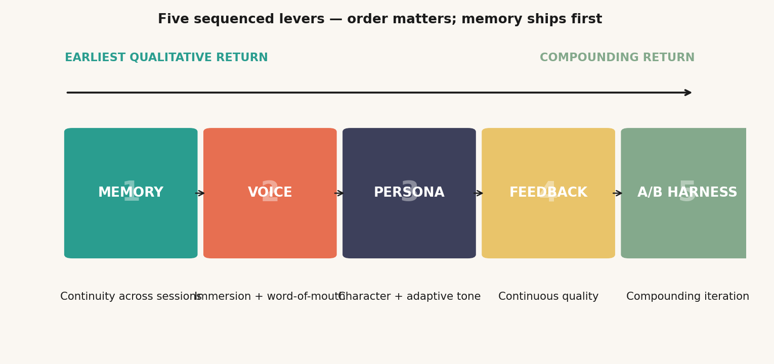
AISE · AI COACH APP — A 3-DAY PRODUCT REVIEW
EXECUTION · 14-DAY SPRINT
13 / 15
Memory ships first — voice second — feedback third — A/B harness gets in by Day 14 to compound everything from there on.
14-DAY ROADMAP · PARALLEL TRACKS
Start
D2
D4
D6
D8
D10
D12
D14
MEMORY LAYER
D0–D5
Vector store · embeddings · retrieval · summary
VOICE NATURALNESS
D3–D9
TTS swap · streaming · pauses · 4 voice presets
PERSONA ENGINE
D2–D7
Define 5 archetypes · system prompts · few-shot
FEEDBACK LOOP
D7–D12
Thumbs UI · pulse survey · pipeline plumbing
A/B HARNESS
D10–D14
Flag tool · prompt registry · first dashboard
SOFT-LAUNCH
D13–D14
Phased rollout · live metric watch
THREE PHASES · EARLIEST RETURN FIRST
WHY THIS ORDER · LEVER STACK
PHASE 1 · D1–5
MEMORY
Two-tier memory plumbing. Highest qualitative leap.
Owner: Backend · estimate: 5 person-days
PHASE 2 · D4–9
VOICE
TTS swap · streaming · 4 voice presets · emotion-aware tone.
Owner: ML/Audio · estimate: 6 person-days
PHASE 3 · D8–14
FEEDBACK + A/B
Thumbs UI · feedback pipeline · A/B harness · soft-launch.
Owner: Full-stack + PM · estimate: 6 person-days
NOTE · Sequencing principle: earliest qualitative leap ships first · resource estimates assume a 3–4 person team

Slide 14
AISE · AI COACH APP — A 3-DAY PRODUCT REVIEW
RISKS & WHAT TO WATCH
14 / 15
Three real risks worth pre-empting — and the assumptions I'd ask the Aise team to confirm before committing.
RISKS · AND HOW TO MITIGATE
ASSUMPTIONS TO VALIDATE · ASK THE TEAM
Voice latency on patchy 3G/4G in tier-2/3
MED
AUDIENCE
MITIGATION · Pre-fetch first chunk · graceful degrade to text · cache common openers
Core users are young Indian professionals + students 18–35, comfortable with English+Hindi
ENGINEERING
Memory raises privacy concerns
HIGH
Team has 3–4 contributors who can ship in 14 days with focused scope
MITIGATION · User-controlled deletion in settings · DPDP Act compliance · clear consent UI at onboard
BACKBONE LLM
Persona feels gimmicky / forced
MED
An LLM with comparable quality to GPT-4o-mini is acceptable as base model
MITIGATION · Default to one archetype · reveal others slowly · let user discover, not pick
VOICE
Hindi-language voice quality from Sarvam / 11Labs is acceptable for tier-2/3
Feedback prompt fatigue → ratings stop arriving
MED
MITIGATION · Show pulse on 1-of-5 sessions · always skippable · never block flow
PRIVACY
User consent and DPDP-compliant deletion patterns are within current legal capacity
A/B test contamination across cohorts
LOW
EXISTING DATA
MITIGATION · User-stratified bucketing · respect existing arms · pre-register hypotheses
Aise has internal D1/D7/voice-duration baselines available to validate impact
Voice provider cost runs hot at scale
MED
PERSONA FREEDOM
MITIGATION · Cache common system prompts · fall back to cheaper TTS for low-engagement turns
Product team is willing to pick distinct personas, even at risk of polarisation
NOTE · Risk register: standard product / privacy / scaling risks · assumption list flagged so the team can confirm or correct

Slide 15
AISE · AI COACH APP — A 3-DAY PRODUCT REVIEW
15 / 15
A NOTE TO THE AISE TEAM
AN OPERATING NOTE
Build the relationship.
"People don't fall in love with AI.
They fall in love with how AI makes them feel — heard, remembered, understood."
The product will follow.
Memory is the moat.
Personality is the magic.
Feedback is the flywheel.
I downloaded Aise because I wanted to talk to a coach. I came back the next day to see if anything had changed. It hadn't. That is the only finding that really matters in this deck — and it is the only one worth fixing first.
Fix that, and the rest follows. Voice. Persona. Feedback. Experimentation. They all snap into place once the user has a reason to come back tomorrow.
WRITTEN BY
Divyaman Pal
B.Tech, Civil Engineering
Indian Institute of Technology Kanpur
✉ divyamp23@iitk.ac.in
IF I HAD TO SHIP THREE THINGS THIS WEEK
📱 com.vel.aise.app
01
Memory — even basic
02
Voice with pauses
03
A thumbs-up button
Happy to discuss any part of this.
Day-2 should not feel like Day-1
It's about cadence, not just pitch
Zero feedback = flying blind
Aise · A 3-Day Product Review · v2 · Confidential to the Aise team

