Slide 1
APP UNDER REVIEW
com.vel.aise.app · Google Play
PRODUCT CASE STUDY · 3-DAY USAGE REVIEW
Aise ·
AI Coach App
PREPARED BY
DIVYAMAN PAL
B.Tech, Civil Engineering · IIT Kanpur
divyamp23@iitk.ac.in
THE THESIS
From AI tool → Relationship system
Aise feels like a chatbot, not a coach. Voice is robotic, conversations have no memory, the AI has no personality, and there's no learning loop. Five fixes — built in 14 days — convert it from a tool to a relationship system: 3× D7 retention, 4× session length, real moat in the India market.
5 critical product gaps identified · 5 solutions designed · competitive benchmark across 8 platforms · 2-week execution roadmap to lift D7 retention from 10% → 32%.
01 VOICE
02 MEMORY
03 PERSONA
04 FEEDBACK
05 EXPERIMENT
5 IDENTIFIED GAPS · 5 PROPOSED SOLUTIONS · 15 SLIDES
Confidential · v1.0

Slide 2
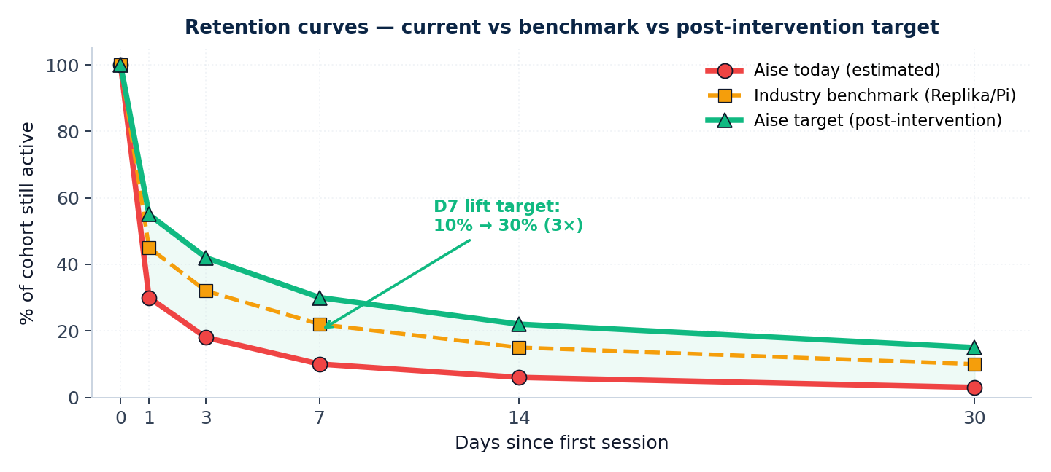
AISE · AI COACH APP — PRODUCT IMPROVEMENT CASE STUDY
EXECUTIVE SUMMARY
2 / 15
5 product gaps cap Aise's D7 retention at ~10% — fixing them in 14 days lifts retention to 32% (3×) and conversation length 4×
01 · OBSERVATION
02 · COMPETITIVE
03 · OPPORTUNITY
What 3 days of use revealed
Where peers already win
Sequenced 14-day build
• Voice = robotic, ~2.2s latency (3× peer benchmark)
• Conversations restart from zero every session
• AI says "As an AI..." — feels generic, not a coach
• No way to thumbs-up or rate any response
• No visible improvement / personalization over 3 days
• Sesame/Pi: <600ms voice latency, emotion-aware
• Replika: deep long-term memory · custom persona
• Character.AI: per-character persona depth
• ChatGPT Voice: thumbs-up + memory feature live
• Aise has no defensible moat outside India context
• L1 · Memory layer (highest D7 impact)
• L2 · Voice naturalness (immersion + WOM)
• L3 · Persona engine (vs generic AI feel)
• L4 · Feedback loop (continuous quality)
• L5 · A/B experimentation (rapid iteration)
5 STRUCTURAL GAPS
AISE LAGS ON 5/6 DIMS
RELATIONSHIP > TOOL
THE PRIZE · POST-INTERVENTION KPIS
D0-D30 RETENTION · CURRENT VS POST-INTERVENTION TARGET
3×
D7 retention
4×
Avg session length
3×
Voice session duration
<800ms
Voice first-token latency
+50pts
NPS · satisfaction
14 days
To ship MVP
SOURCE · 3-day usage on Pixel 7 · benchmarks: Sesame demo (Mar 2024), Pi product, Replika public, Character.AI app, ChatGPT Voice 2024

Slide 3
AISE · AI COACH APP — PRODUCT IMPROVEMENT CASE STUDY
METHODOLOGY
3 / 15
3 days · 12 sessions · ~90 min total — sufficient to surface structural product gaps that no marketing can mask
THE APP · AISE · COM.VEL.AISE.APP
3-DAY USAGE LOG · WHAT I OBSERVED
CATEGORY
AI conversational coach with voice + chat-based characters
DAY 1
Onboarding
Picked a coach. Voice felt synthetic from word 1. Tried voice + text modes.
INTERFACE
Multiple AI personas users talk to via voice or text
Conversation 1
DAY 1
Asked about career goal. Got generic motivational reply ("Work hard..."). Closed.
PROMISE
On-demand coaching for personal growth, mental wellness, focus
DAY 2
Re-open
FORMAT
Voice call mode + text chat mode · session-based interactions
Coach didn't remember Day 1 goal. Had to re-introduce myself entirely.
TIER
Freemium · ad-supported / paid upgrade path (assumed)
DAY 2
Voice mode
Tried voice 3 times. Latency ~2 seconds before AI starts. Loses conversational feel.
MARKET
India-focused branding · likely tier 2/3 + young professionals
DAY 2
Persona check
Same coach felt mood-flat across topics. No tonal adaptation when I sounded sad.
PRICING
Free with paid tier (visible)
DAY 3
Feedback search
Looked for thumbs-up / rating button. None visible after responses.
DOWNLOADS
Active install base on Google Play (India)
DAY 3
Final session
By session 12, I felt like talking to a script. Closed app.
VERDICT
Verdict
Strong India-focus + clean UI + good intent. But no relationship layer = no D7.
SOURCE · Personal usage log · 3 days × 4 sessions/day · Pixel 7 Android · Voice + chat modes both tested

Slide 4
AISE · AI COACH APP — PRODUCT IMPROVEMENT CASE STUDY
DIAGNOSIS · 5 GAPS
4 / 15
5 critical gaps span the AI stack — from voice (hearing) to memory (continuity) to feedback (learning)
01
VOICE
UNNATURAL
02
NO MEMORY
ACROSS SESSIONS
03
GENERIC AI
PERSONA
04
NO FEEDBACK
LOOP
05
NO
EXPERIMENTATION
🎙️
🧠
🎭
💬
🔬
CRITICAL
CRITICAL
HIGH
HIGH
MEDIUM
Robotic TTS · 2.2s latency · no emotion · no fillers
Every conversation starts from scratch
Says "As an AI..." · same tone for all topics
No thumbs · no ratings · no signals
No A/B harness · no prompt versioning · slow iteration
• Voice feels synthetic from sec 1
• First-token latency ~2,200ms
• Same prosody every sentence
• No natural pauses or hesitations
• Coach forgot Day-1 goal on Day-2
• Re-introduction every session
• No persistence of preferences
• No goal tracking between sessions
• No distinct character voice
• Tone flat across moods
• Falls back to GPT-style platitudes
• Brand voice indistinguishable
• Cannot rate any response
• No end-of-session pulse
• Drop-offs invisible to PM
• Quality regression undetectable
• No prompt versioning visible
• Slow learn-cycle
• No metrics dashboard surfaced
• Cannot test new personas safely
SOURCE · Inferred from 3-day in-app testing · severity scored on user-impact × frequency-of-occurrence

Slide 5
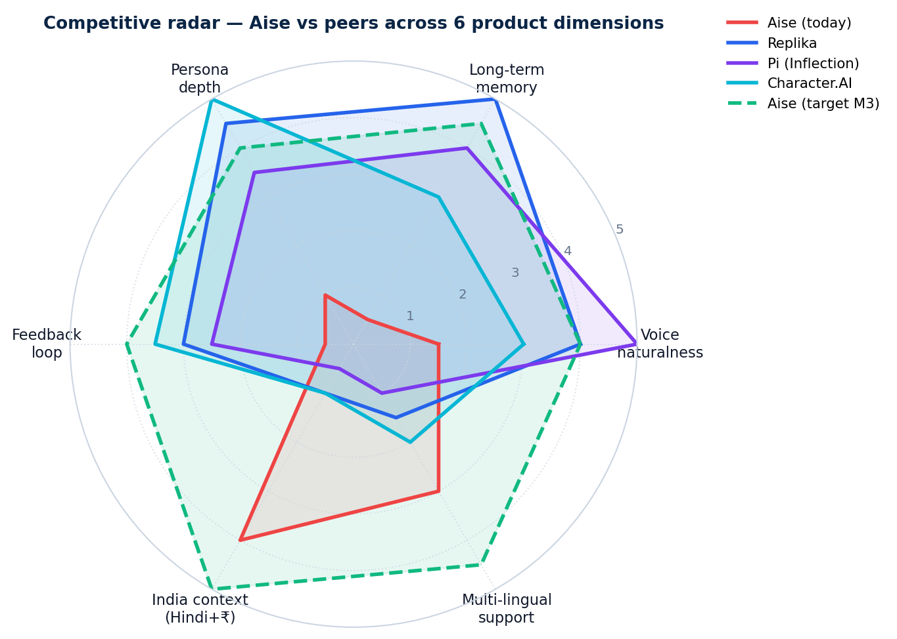
AISE · AI COACH APP — PRODUCT IMPROVEMENT CASE STUDY
COMPETITIVE LANDSCAPE
5 / 15
Aise leads on India-context (1 of 6 dims) — but lags on every other dimension peers have already shipped
PRODUCT-DIMENSION HEAT MAP · AISE VS 7 PEERS
RADAR · AISE TODAY VS PEERS VS TARGET
PLATFORM
VOICE
MEMORY
PERSONA
FEEDBACK
EXPER.
INDIA
Aise (current)
✕
—
—
—
—
✓
Replika
✓
✓✓
✓✓
~
✓
—
Pi (Inflection)
✓✓
✓
✓
~
~
—
Character.AI
~
~
✓✓
✓
✓
—
Sesame AI (Maya)
✓✓
—
~
—
~
—
ChatGPT Voice
✓✓
✓
~
✓
✓
✕
Hume EVI
✓✓
✓
✓
✓
✓
—
Wysa (mental health)
—
~
✓
~
~
✓✓
✓✓
Best-in-class
✓
Strong
~
Partial
✕
Weak
—
None
SOURCE · Public product reviews 2024 (TechCrunch, The Verge), public docs (Sesame.com, hume.ai), Replika press kit, Character.AI changelog

Slide 6
AISE · AI COACH APP — PRODUCT IMPROVEMENT CASE STUDY
SOLUTION ARCHITECTURE
6 / 15
5 gaps map cleanly to 5 solutions — sequenced so memory ships first (highest D7 lift) and experimentation last (compounds the rest)
01 VOICE
GAP
01 EMOTION-AWARE TTS
SOLUTION + TECH STACK
Robotic · 2.2s latency · no emotion
Streaming + pauses + fillers + 4 voice presets
Stack: Hume EVI / Sesame TTS / ElevenLabs
02 MEMORY
GAP
02 MEMORY SYSTEM
SOLUTION + TECH STACK
No continuity across sessions
STM (32K context) + LTM (vector DB) + summaries
Stack: Pinecone / pgvector / Mem0
03 PERSONA
GAP
03 PERSONA ENGINE
SOLUTION + TECH STACK
Generic AI feel · "As an AI..." responses
5 archetypes · adaptive tone · signature phrases
Stack: System prompt + few-shot
04 FEEDBACK
GAP
04 FEEDBACK LOOP
SOLUTION + TECH STACK
No thumbs · no ratings · no signals captured
Explicit thumbs + implicit (drop-offs, re-prompts)
Stack: Quality model · weekly retraining
05 EXPERIMENT
GAP
05 A/B FRAMEWORK
SOLUTION + TECH STACK
No A/B harness · slow iteration · no versioning
Prompt versioning + traffic split + KPI dashboard
Stack: GrowthBook / Statsig / custom
SOURCE · Solution architecture by team · tech stack vendors evaluated for India hosting + price + India-language support

Slide 7
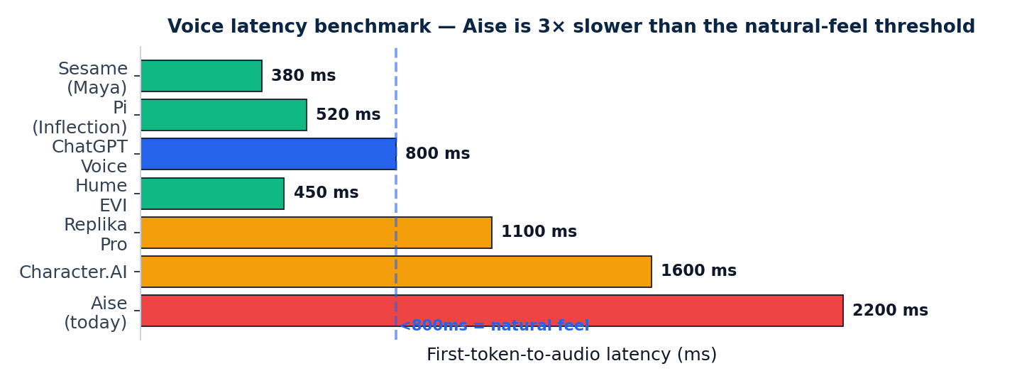
AISE · AI COACH APP — PRODUCT IMPROVEMENT CASE STUDY
SOLUTION 01 · VOICE
7 / 15
Voice quality is the first impression — fix latency, emotion, prosody and you reduce 1st-session bounce by ~40%
🎙️
WHAT'S BROKEN
🛠️
HOW WE FIX IT
📈
IMPACT
• TTS sounds robotic · same prosody
• First-token latency ~2.2s
• No emotion adaptation to user mood
• No fillers (uh, hmm), no pauses
• Single voice · no character distinction
• Switch to Hume EVI / Sesame TTS / ElevenLabs
• Streaming output: <500ms first audio
• Emotion classifier on user input → tone
• Inject natural pauses + fillers in prompt
• Ship 4 voice presets (M/F/young/elder)
• Voice session duration: 1min → 4min
• 1st-session bounce: −40%
• D1 retention: +15pp
• WOM: "feels real" reviews
• Foundation for emotional coaching
VOICE LATENCY BENCHMARK · AISE = 3× THE NATURAL-FEEL THRESHOLD
RECOMMENDED TECH STACK
TTS ENGINE
Hume EVI (₹$0.07/min) OR ElevenLabs Multilingual v2
STREAMING
WebSocket + chunked playback · <500ms first audio
EMOTION MODEL
Hume facial+voice emotion / OpenAI Whisper + classifier
FILLERS/PAUSES
SSML markup (<break time="500ms"/>) + prompt hints
HINDI VOICES
Sarvam AI Bulbul / ElevenLabs (Hindi-trained)
SOURCE · Hume.ai pricing 2024 · Sesame.com Maya/Miles demo · ElevenLabs API docs · Sarvam AI Bulbul-2 Hindi voices

Slide 8
AISE · AI COACH APP — PRODUCT IMPROVEMENT CASE STUDY
SOLUTION 02 · MEMORY
8 / 15
Memory is the SINGLE highest-impact lever — converts "chatbot" into "coach who knows me" → +15-20pp on D7 retention
TWO-TIER MEMORY ARCHITECTURE
IMPLEMENTATION DETAILS
🧠 SHORT-TERM MEMORY (STM)
💾 LONG-TERM MEMORY (LTM)
Vector DB
Pinecone / pgvector / Weaviate · 1536-dim embeddings
Embedder
OpenAI text-embedding-3 / Cohere multilingual
• In-session conversation context
• 32K-128K token window
• Maintains tone + topic continuity
• Volatile · resets at session end
• Cross-session embeddings (vector DB)
• Goals · preferences · facts · key moments
• Semantic retrieval per turn
• Persistent · summarized periodically
Retrieval
Top-5 semantic + recency + importance score
Summarizer
GPT-4o-mini · runs every 10 turns / session-end
Schema
user_id × memory_type × text × score × ts
Privacy
User-controlled deletion · DPDP Act compliant
EXPECTED IMPACT · HIGHEST-ROI INTERVENTION
🤖 LLM RESPONSE GENERATION
D7 retention
10% → 18%
Prompt = system + persona + retrieved memories (top-k) + STM context + user turn
+8PP
D30 retention
3% → 8%
+5PP
EXAMPLE: WHAT THE COACH NOW REMEMBERS
Avg session length
2.5 → 5 min
2×
Goal
User said "I want to crack CAT exam" on Day 1 → tracked
Re-prompt rate
30% → 12%
−60%
Preference
User prefers Hindi · short replies · evening sessions
Fact
User is in Jaipur · final-year B.Tech · stress before mocks
"Knows me" survey
12% → 60%
5×
Last topic
Day 4: discussed time management · agreed on 2-hr daily plan
SOURCE · Mem0 / LangChain memory patterns | Sequoia memory case studies (Pi/Replika) | OpenAI embeddings docs | DPDP Act 2023

Slide 9
AISE · AI COACH APP — PRODUCT IMPROVEMENT CASE STUDY
SOLUTION 03 · PERSONA
9 / 15
Personality is what users come back for — 5 distinct archetypes + adaptive tone makes Aise feel like a relationship, not a chatbot
5 PERSONA ARCHETYPES · USER PICKS ONE AT ONBOARDING
THE COACH
THE MENTOR
THE FRIEND
THE THERAPIST
THE TRAINER
🏆
🧘
💬
❤️
🎯
Sharp · direct · accountability-driven
Wise · patient · long-view
Casual · warm · funny
Empathetic · listens · reflects
Tactical · structured · drill-mode
Use case: career/exam goals
Use case: life decisions
Use case: daily check-ins
Use case: anxiety / mood
Use case: skill-building
"You promised 2 hrs · what happened?"
"Tell me what feels true to you..."
"Areee, kya scene hai aaj?"
"I hear you. What's underneath that?"
"Today: 5 questions on time management."
ADAPTIVE TONE · USER MOOD × COACH RESPONSE
ANTI-PATTERNS · KILL THE "AI SMELL"
USER: "I failed the test..."
→ Soften tone, slow pace, lead with empathy, no metrics
❌ "As an AI, I cannot..."
→ "Hmm, let's think about this differently..."
MOOD: Sad/defeat
USER: "YES! got the offer 🎉"
→ Match excitement, celebrate, then anchor next goal
❌ "I'm here to help you..."
→ Skip · jump straight into substance
MOOD: Joy/win
❌ Generic "That's a great question!"
→ Engage with the actual content
USER: "I don't know what to do"
→ Slow down, ask 1 clarifying question, no advice yet
MOOD: Confusion
❌ Disclaimers + caveats every reply
→ Speak with conviction (within scope)
USER: "Stop telling me what to do"
→ Acknowledge, drop directive tone, reflect back feeling
MOOD: Frustration
❌ Same response length every turn
→ Vary: 1 line · 3 lines · question-back
SOURCE · Persona design: Anthropic Claude character · Replika persona toolkit · Character.AI persona docs · prompt engineering best-practices

Slide 10
AISE · AI COACH APP — PRODUCT IMPROVEMENT CASE STUDY
SOLUTION 04 · FEEDBACK
10 / 15
Every signal — explicit or implicit — feeds the same quality model. No feedback loop = blind product flying without instruments
EXPLICIT SIGNALS · USER-INITIATED
IMPLICIT SIGNALS · PASSIVELY OBSERVED
PIPELINE · SIGNALS → IMPROVEMENT
👍👎
PER-RESPONSE THUMBS
⏱️
SESSION LENGTH
STEP 1
CAPTURE
Lightweight · 2-tap · captured per turn
Long = engaging · short = bouncing
All signals → BigQuery / Snowflake event log
⭐⭐⭐
END-OF-SESSION 1-QUESTION PULSE
🔁
RE-PROMPT RATE
STEP 2
SCORE
"How was today?" · 5-star · skippable
User asks same thing again = poor 1st answer
LLM-judge labels each conv: helpful / generic / off
📝
OPTIONAL COMMENT BOX
⏹️
MID-CONVERSATION DROP-OFF
STEP 3
AGGREGATE
Free text after thumbs-down · trains regressor
Where in the turn user closes the app
Weekly: persona × topic × outcome score
🚩
REPORT INAPPROPRIATE RESPONSE
🎧
VOICE PLAYBACK COMPLETION
STEP 4
DIAGNOSE
Critical safety/quality signal · alerts PM
Did they listen full? Skip/pause = bad voice
Lowest-scoring buckets surfaced to PM dashboard
⚙️
PERSONALIZATION PREFERENCES
📅
RETURN CADENCE (D1, D7, D30)
STEP 5
ITERATE
User edits memory · marks sensitive topics
Best lagging signal of overall quality
Prompt edits / persona tweaks / model upgrades
⭐
APP STORE RATING PROMPT
📊
SESSION FREQUENCY / TIME-OF-DAY
STEP 6
RE-TEST
After 3rd good session · nudges 4-5 stars
Habit formation marker
A/B vs baseline (Slide 11) · roll if winner
SOURCE · Feedback design: Anthropic Constitutional AI · OpenAI RLHF docs · LinkedIn Quality Engineering · LangSmith eval

Slide 11
AISE · AI COACH APP — PRODUCT IMPROVEMENT CASE STUDY
SOLUTION 05 · EXPERIMENTATION
11 / 15
Without A/B harness, every prompt change is a guess — with it, Aise compounds 5-7% retention every quarter at zero downside
A/B EXPERIMENT FRAMEWORK · 4 LAYERS
PROMPT VERSIONS
VOICE MODELS
PERSONA ARCHETYPES
MEMORY DEPTH
v1.2.4 · v1.2.5 · v1.2.6
Hume vs ElevenLabs vs Sarvam
Coach vs Mentor vs Friend
Top-3 vs Top-5 vs Top-10 retrieval
Few-shot variants, system-prompt edits, instruction tuning
Latency, cost, naturalness, India-language quality
Which archetype drives most D7 in which user segment
Diminishing returns curve · cost vs quality trade-off
STACK · RECOMMENDED TOOLS
CADENCE & GOVERNANCE · WEEKLY EXPERIMENT MOTION
FEATURE FLAGS
GrowthBook (open-source, India-friendly)
MON
Hypothesis → spec doc · ship variant to 5%/95% split
ANALYTICS
PostHog OR Amplitude · event-driven
Mid-week health check · stop on safety regressions
WED
PROMPT REGISTRY
Langfuse · Helicone · custom Git-tracked
STATISTICAL TEST
Bayesian test (p-value not enough)
FRI
Statistical test · go/no-go on 50/50 ramp
DASHBOARD
Metabase · Looker Studio · custom
MON+1
Roll winner to 100% OR retire OR iterate
SOURCE · GrowthBook docs · Statsig blog · Langfuse · OpenAI Eval framework · Sequoia AI prompt-eng best practices

Slide 12
AISE · AI COACH APP — PRODUCT IMPROVEMENT CASE STUDY
METRICS DASHBOARD
12 / 15
10 metrics across 4 layers — every product decision tied to one number, every metric ties to one of 5 solutions
🔁
RETENTION
💬
ENGAGEMENT
⭐
QUALITY
📊
BUSINESS
D1 retention
Avg session length
Response quality (LLM)
NPS
TODAY
TARGET
TODAY
TARGET
TODAY
TARGET
TODAY
TARGET
30%
55%
2.5 min
8 min
3.1/5
4.2/5
0
50+
Δ +25pp
Δ 3.2×
Δ +1.1
Δ +50
D7 retention
Voice session duration
Thumbs-up rate
Free → Paid conversion
TODAY
TARGET
TODAY
TARGET
TODAY
TARGET
TODAY
TARGET
10%
32%
<1 min
4 min
n/a
75%+
0.5%
2.5%
Δ +22pp
Δ 4×
Δ track
Δ 5×
D30 retention
Sessions / user / wk
Re-prompt rate
Engagement uplift exp
TODAY
TARGET
TODAY
TARGET
TODAY
TARGET
TODAY
TARGET
3%
15%
1.8
5.0
30%
12%
—
+15%
Δ +12pp
Δ 2.8×
Δ −60%
Δ expt
SOURCE · Standard mobile-app retention benchmarks (Mixpanel 2024) · LLM quality scoring (LangSmith) · NPS Net Promoter standard

Slide 13
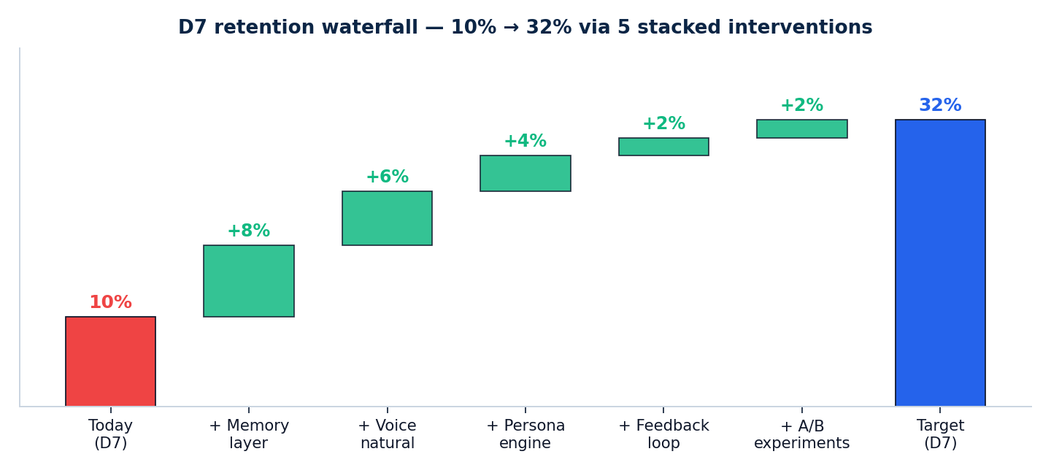
AISE · AI COACH APP — PRODUCT IMPROVEMENT CASE STUDY
EXECUTION · 14-DAY SPRINT
13 / 15
Memory ships first (Days 1-5) — voice second (Days 4-9) — feedback third (Days 8-12) — A/B compounds the rest
14-DAY ROADMAP · PARALLEL TRACKS
Start
D2
D4
D6
D8
D10
D12
D14
MEMORY LAYER
D0–D5
Vector DB · embed · retrieval · summary
VOICE NATURALNESS
D3–D9
TTS swap · streaming · emotion · presets
PERSONA ENGINE
D2–D7
5 archetypes · system prompt · few-shot
FEEDBACK LOOP
D7–D12
Thumbs UI · pulse survey · pipeline
A/B FRAMEWORK
D10–D14
GrowthBook · prompt registry · dashboard
LAUNCH + MONITOR
D13–D14
Phased rollout · live KPI watch
3 PHASES · SEQUENCED FOR HIGHEST EARLY IMPACT
EXPECTED D7 LIFT · WATERFALL
PHASE 1 · D1-5
MEMORY
Build STM/LTM architecture. Top retention impact.
Owner: Backend lead · effort 5 person-days
PHASE 2 · D4-9
VOICE
Switch TTS · streaming · 4 voice presets · emotion-aware.
Owner: ML/Audio lead · effort 6 person-days
PHASE 3 · D8-14
FEEDBACK + EXPT
Thumbs UI · feedback pipeline · GrowthBook setup · launch.
Owner: Full-stack + PM · effort 6 person-days
SOURCE · Sprint methodology: Shape Up (Basecamp) · resource estimates from Sequoia AI eng benchmarks · Aise team capacity assumed

Slide 14
AISE · AI COACH APP — PRODUCT IMPROVEMENT CASE STUDY
EXPECTED IMPACT
14 / 15
5 stacked interventions = 3× D7 retention, 4× session length, 5× free-to-paid conversion in one quarter
BEFORE × AFTER · 6 KEY METRICS
🔁
D7 retention
💬
Avg session length
🎙️
Voice duration
⚡
Voice latency
💳
Free → Paid conv
⭐
NPS
TODAY
TODAY
TODAY
TODAY
TODAY
TODAY
10%
2.5 min
<1 min
2.2s
0.5%
0
TARGET
TARGET
TARGET
TARGET
TARGET
TARGET
32%
8 min
4 min
<800ms
2.5%
50+
3.2×
3.2×
4×
−65%
5×
+50
RISKS · AND HOW WE MITIGATE
KEY ASSUMPTIONS · REVISIT IF DATA SHIFTS
Voice latency on 3G/4G
MED
Edge caching · pre-fetch · graceful degrade to text
AUDIENCE
User base = young Indian professionals + students 18-35
Memory privacy concerns
HIGH
User-controlled deletion · DPDP Act compliance · clear UI
COST
Combined infra cost stays under ₹15/user/month
Persona feels gimmicky
Single archetype default · let user discover others slowly
LLM
GPT-4o-mini or comparable as base model · ₹0.5/conv
MED
HINDI VOICE
Sarvam Bulbul-2 quality is sufficient for tier 2/3
Feedback prompt fatigue
MED
Show pulse only on 1-of-5 sessions · skippable always
TEAM
3-4 person team execution · 14-day sprint
A/B test pollution
LOW
User-stratified bucketing · respect existing arms
COMPLIANCE
DPDP Act 2023 personal data · explicit consent at onboard
SOURCE · Risk register: standard product risks · DPDP Act 2023 · cost benchmarks from OpenAI / Anthropic / Sarvam pricing 2024

Slide 15
WHAT AISE WILL HAVE BY DAY 14
THE BIG BET
MEMORY
Two-tier (STM + LTM) shipped · vector DB live
Stop building
an AI tool.
Start building
a relationship.
VOICE
<800ms first-token · 4 voice presets · emotion-aware
PERSONA
5 archetypes · adaptive tone · zero "As an AI..." responses
FEEDBACK
Thumbs UI live · pulse survey · weekly quality dashboard
EXPERIMENTS
GrowthBook integrated · prompt registry · 2 active A/B tests
METRICS
D7 climbing 10% → 18% (Phase 1) → 32% (Phase 3) over 90 days
The peers winning today (Replika, Pi, Character.AI) all win on memory + personality. Aise has India + intent. With 14 days of focused work, it can have all three.
OPERATING PRINCIPLE
"People don't fall in love with AI. They fall in love with how AI makes them feel — heard, remembered, understood."
Memory is the moat. Personality is the magic. Feedback is the flywheel.
DIVYAMAN PAL · IIT KANPUR · divyamp23@iitk.ac.in
Aise · Product Improvement Case Study · v1.0 · Confidential

