Slide 1
IIT KANPUR
GLIDO LABS
FOUNDER'S OFFICE
STRATEGY ASSIGNMENT
🪔
BHAGAVAD GITA DAILY
Monetization & Growth Strategy
PREPARED BY
DIVYAMAN PAL
THE THESIS
Funnel + monetization-depth problem.
4 areas. 10 revenue streams. 11× MRR in 90 days.
B.Tech, Civil Engineering · Indian Institute of Technology Kanpur
divyamp23@iitk.ac.in

Slide 2
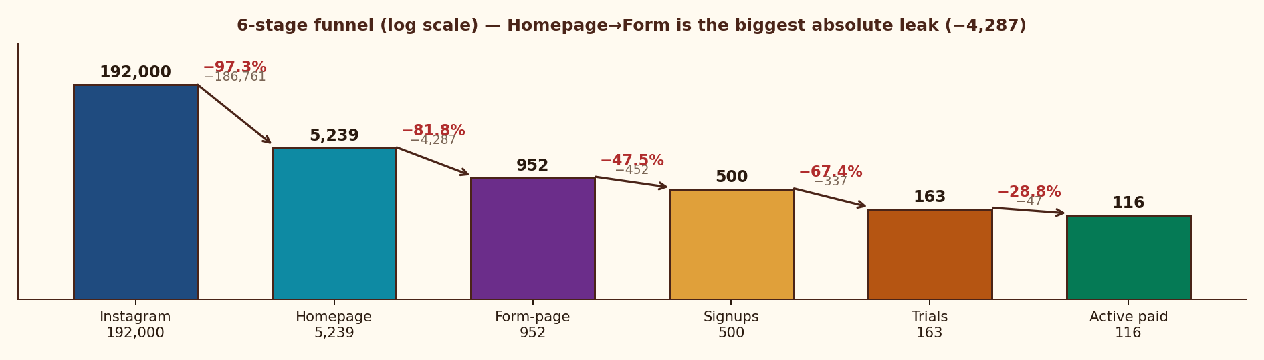
STRATEGIC FRAMING
01 · FUNNEL FIX
02 · SCALING
03 · CONTENT
04 · NEW REVENUE ★
STRATEGY · BO + BCG
FINANCIAL & EXECUTION
11× MRR in 90 days — fix 3 funnel leaks at ₹0 spend, then deepen to a 10-stream India-grounded revenue stack
01 · SITUATION
02 · COMPLICATION
03 · RESOLUTION
What we have today
Why growth has stalled
4-area sequenced plan
• 192K Instagram · 2,227 posts
• 5,239 monthly homepage sessions
• ₹79/mo SKU · 116 active paid
• MRR ₹9.2K · 71% trial→paid
• PMF proven; ceiling = ₹79
• Homepage→Form: −81.8% (−4,287)
• Signup→Trial: −67.4% (₹5 UPI gate)
• Trial→Paid: 71% (Day-3 surprise)
• 29% churn · single ₹79 SKU
• Free IG = paid product (no gap)
• L1 · Seal funnel (homepage + UPI + Day-3)
• L2 · 2-3 → 20-30 trials/day in 13 wks
• L3 · Value-gap content + 5 campaigns
• L4 · 10-stream stack + festival economy
• Target ₹1L MRR M3, ₹3.5L M12
PMF + BROKEN FUNNEL
4 STRUCTURAL LEAKS
ZERO-SPEND FIRST
THE FUNNEL — WHERE 192K BECOMES 116
THE PRIZE
11×
MRR uplift
₹1L+
MRR by Month 3
₹3.5L+
MRR by Month 12
85.5%
Gross margin / sub
7.9×
LTV / CAC at 8% churn
M5
EBITDA breakeven
Glido Labs assignment brief (May 2025) | IMARC India Subscription Apps 2024 | Razorpay UPI mandate UX | Team analysis

Slide 3
STRATEGIC FRAMING
01 · FUNNEL FIX
02 · SCALING
03 · CONTENT
04 · NEW REVENUE ★
STRATEGY · BO + BCG
FINANCIAL & EXECUTION
Macro tailwinds align (PESTLE) but rivalry is fierce (Porter) — defensibility comes from habit + India-vernacular IP + offline distribution
PESTLE · INDIA-SPECIFIC MACRO LENS
PORTER'S 5 FORCES · INDUSTRY STRUCTURE
POLITICAL
ECONOMIC
SOCIAL
✺ INDUSTRY RIVALRY
MEDIUM
Fragmented · Sadhguru
/ Calm dominate
• Hindutva-friendly govt — religious tax-exempt 80G/12A
• Cultural revival policy push (Sanskrit Bharati)
• Ayodhya, Kashi corridors → spiritual tourism boom
• Corporate wellness ₹4,000 Cr · 15% CAGR
• Indian wedding industry ₹3.7T · gifting underserved
• Tier 2/3 disposable income +18% YoY
• Multi-gen households · grandparent-child Gita ritual
• Tier 2/3 spiritual revival (post-COVID)
• Festival economy 9 mega-events Aug-Nov
⬆ NEW ENTRANTS
HIGH
Any IG page can launch · low barrier
TECHNOLOGICAL
LEGAL
ENVIRONMENTAL
⬅ BUYER POWER
MED
• 850M smartphones · UPI 12B txns/mo
• WhatsApp 535M users · Hindi internet boom
• Vernacular content 6× growth (RedSeer 2024)
• RBI UPI auto-mandate rules (₹15K cap)
• Religious Endowments Act limits B2T temple deals
• Consumer Protection Act 2019 — refund clarity
• Zero physical footprint · WhatsApp delivery
• Brand halo from "sustainable digital sadhana"
• Carbon-light gifting alternative to physical poojas
Low ARPU but ritual = high switching cost
⮕ SUPPLIER POWER
LOW
Content public domain · no exclusivity
⬇ SUBSTITUTES
HIGH
Free YT/IG · ChatGPT · Sadhguru · Calm
✦ TEMPLE / OFFLINE
EDGE
Underused · structural moat for India
VERDICT · Niche white-space exists. Defensibility built through habit ritualization + vernacular IP + offline temple/yatra distribution where global apps cannot follow.
PESTLE: TRAI 2024, RBI UPI data, RedSeer 2024 | Porter (1979) — Competitive Strategy | Glido Labs case | Team analysis

Slide 4
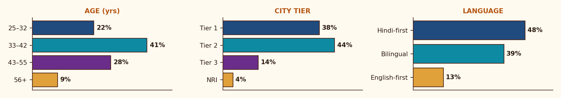
STRATEGIC FRAMING
01 · FUNNEL FIX
02 · SCALING
03 · CONTENT
04 · NEW REVENUE ★
STRATEGY · BO + BCG
FINANCIAL & EXECUTION
Hindi-first, mobile-first, festival-driven, UPI-skeptical — every product, channel, pricing decision flows from this
JTBD × ANXIETY × PAY-TRIGGER × STAY-TRIGGER
🪔
JOBS-TO-BE-DONE
ANXIETIES (KILL CONVERSION)
• Anchor my morning with meaning
• Sense-make life events through tradition
• Feel connected to something larger
• Pass wisdom to kids and parents
• ₹5 mandate — "will they keep deducting?"
• UPI auto-pay distrust in tier 2/3
• "Just another reels page?"
• Forgotten signup → angry chargebacks
WHAT MAKES THEM PAY
WHAT MAKES THEM STAY
THE MODERN INDIAN SEEKER
• Sample message that feels personal
• Friend forwarded on WhatsApp
• Real face / scholar attached
• Festival or life-event trigger
• Same time every morning, no fail
• Verse "happens to" speak to today
• Felt sense of teacher, not bot
• Community of fellow seekers
AGE
32–55 · median 38
LOCATION
Tier 1 + 2 · Hindi belt
LANGUAGE
Hindi-first / bilingual (87%)
INCOME
₹6–25L p.a. · middle class
DEMOGRAPHICS · AGE × CITY-TIER × LANGUAGE
DEVICE
Mobile-first (95%+)
PAYMENT
UPI native, mandate-skeptical
DISCOVERY
Reels · WhatsApp forwards
Glido Labs follower analytics + LocalCircles 2024 (Hindi spiritual content) + RedSeer Spiritual & Wellness 2024 + Team interpretation

Slide 5
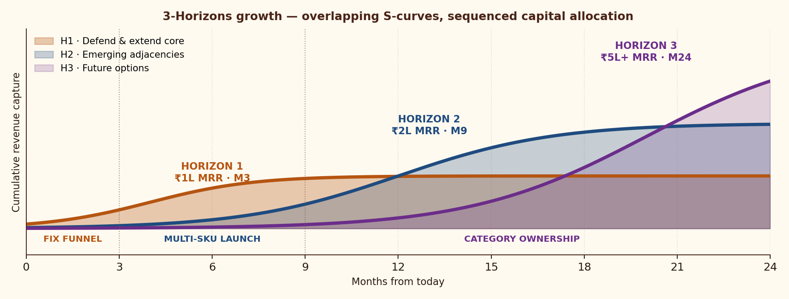
STRATEGIC FRAMING
01 · FUNNEL FIX
02 · SCALING
03 · CONTENT
04 · NEW REVENUE ★
STRATEGY · BO + BCG
FINANCIAL & EXECUTION
Horizon 1 funds Horizon 2 funds Horizon 3 — Ansoff matrix shows where each new revenue stream sits
MCKINSEY 3 HORIZONS OF GROWTH — OVERLAPPING S-CURVES, SEQUENCED CAPITAL
H1 · DEFEND CORE
70% CAPITAL
Funnel fix · UPI · Day-3 arc · ₹1L MRR @ M3
H2 · EMERGING
20% CAPITAL
Annual · PDF · Premium · Festival · B2B
H3 · FUTURE
10% CAPITAL
Audio · Kids · Family · NRI · Regional
ANSOFF GROWTH MATRIX — WHERE EACH NEW REVENUE STREAM SITS
← EXISTING PRODUCT NEW PRODUCT →
← EXISTING PRODUCT NEW PRODUCT →
MARKET
→
→
→
PRODUCT
MARKET PENETRATION · EXISTING MARKET × EXISTING PRODUCT
PRODUCT DEVELOPMENT · EXISTING MARKET × NEW PRODUCT
• Convert more of 192K IG followers (DM auto · viral loops)
• OFFLINE: temple QR, yatra groups, mahila mandal, RWA boards
• Recharge vouchers at panwala / corner store · cash-on-trial
• Annual ₹699 · PDF guides · Premium ₹199 community
• Audio Gita ₹49 (Bharat tier 3 · senior-friendly)
• 108-card physical deck · Festival bundles
MARKET DEVELOPMENT · NEW MARKET × EXISTING PRODUCT
DIVERSIFICATION · NEW MARKET × NEW PRODUCT
• B2B corporate Gita (BFSI, FMCG, IT, manufacturing)
• NRI users (US/UK/UAE diaspora · ₹999 USD pricing)
• Regional languages: Tamil, Telugu, Marathi, Bengali
• Kids' Gita app (8-14 yrs · parents buy)
• Wedding pack ₹999 · Annaprashan/Mundan ceremony gifts
• Pilgrimage tour audio guides · Spiritual events ₹4-19K
McKinsey Quarterly — Enduring Ideas: 3 Horizons of Growth (Baghai/Coley/White, 2009) | Ansoff (1957) | Glido Labs portfolio mapping

Slide 6
STRATEGIC FRAMING
01 · FUNNEL FIX
02 · SCALING
03 · CONTENT
04 · NEW REVENUE ★
STRATEGY · BO + BCG
FINANCIAL & EXECUTION
AREA 1 · 3 leaks own 99% of lost users — sequenced fixes recover 30-40% lift in 30 days at ₹0 ad-spend
STAGE-BY-STAGE FUNNEL DIAGNOSTIC · ACTUAL VS BENCHMARK
STAGE
TODAY (DATA)
CONV.
BENCHMARK
ABS LOSS
STATUS
Instagram → Homepage
192,000 → 5,239
2.7%
5–8%
−186,761
OPPORTUNITY · DM auto + Reels
Homepage → Form-page
5,239 → 952
18.2%
35–45%
−4,287
BIGGEST ABS LEAK · homepage
Form-page → Signup
952 → 500
52.5%
60–70%
−452
MINOR · form length
Signup → Trial start
500 → 163 (₹5 UPI gate)
32.6%
70–85%
−337
BIGGEST % LEAK · UPI fear
Trial → Paid
163 → 116
71.2%
85–92%
−47
FIXABLE · Day-3 transparency
Paid → Retained (30D)
116 active / 47 churned
71.2%
88–94%
−47
FIXABLE · re-engage WhatsApp
FIX 01
HOMEPAGE → FORM
FIX 02
SIGNUP → TRIAL
FIX 03
TRIAL → PAID
ROOT
ROOT
ROOT
Multi-purpose page · 4 CTAs · scroll 51.95% · LCP 3.9s · form below fold
₹5 UPI mandate fear in tier 2/3 · no Hindi explainer · auto-deduct anxiety
Day-3 charge surprise · 47/163 cancel · <3 days to feel value · no transparency
FIX
FIX
FIX
Single-purpose LP · benefit-first hero · form above fold · WA preview · LCP <2.5s
Hindi mandate explainer + WhatsApp Pay + cash-on-trial + voucher option for 50+
Day 1/2/3 WhatsApp arc: welcome → preview → pre-charge · T+48h re-engage
LIFT
LIFT
LIFT
18% → 30%+ · ~1,300 users/mo recovered
32.6% → 60%+ · removing mandate → 75%+
71.2% → 88%+ · 15-20% reactivation of 47 churns
Glido Labs case data: 5,239 sessions, 952 form views, 500 signups, 163 trial starts, 116 paid

Slide 7
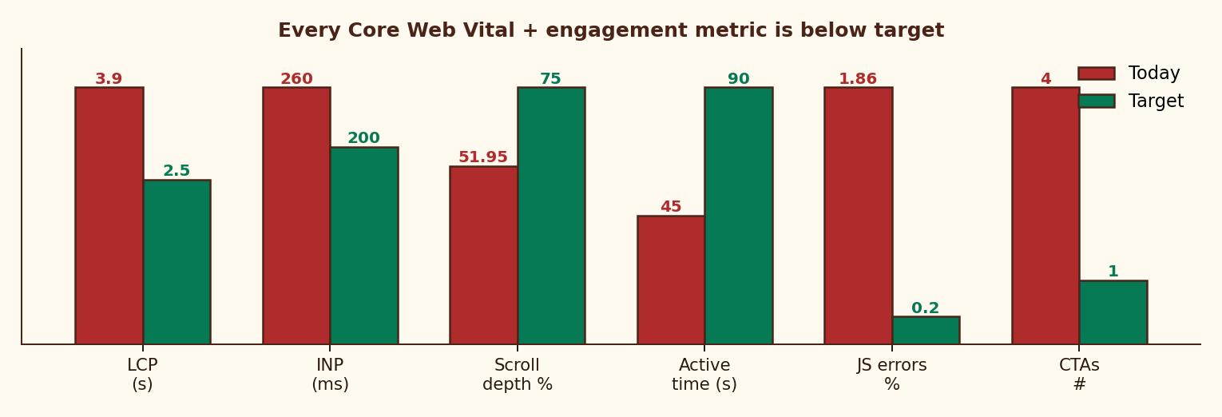
STRATEGIC FRAMING
01 · FUNNEL FIX
02 · SCALING
03 · CONTENT
04 · NEW REVENUE ★
STRATEGY · BO + BCG
FINANCIAL & EXECUTION
AREA 1 · Homepage misses every Core Web Vital + every conversion principle — 8 fixes drive the ₹0 spend lift
PERFORMANCE & ENGAGEMENT — TODAY VS TARGET
8 SPECIFIC ISSUES IN THE BRIEF
LCP 3.9s
vs 2.5s · −7-10% conversion / sec
INP 260ms
vs <200ms · laggy interaction
Scroll 51.95%
form below fold · most never see CTA
Active time 45s
insufficient for 4 competing CTAs
129 JS errors
1.86% sessions · "undefined is not an object"
4 competing CTAs
Subscribe / Chapters / Teachings / Learning
Social-proof conflict
"4,000+" vs "12,000+" same page
Generic hero
"Ancient Wisdom, Timeless Truth" → nothing
8 HOMEPAGE FIXES — RANKED BY IMPACT
DAY 1/2/3 TRIAL ACTIVATION ARC · WHATSAPP
01
Move form ABOVE fold (mobile-first)
+30% reach
T = 0
Sign-up
"Your Gita journey starts tomorrow at 8 AM 🙏"
02
Replace hero with benefit-first promise
+15% relevance
Kill 3 CTAs · keep ONLY Subscribe
+18% focus
DAY 1
8 AM
First shlok + permission. "3 days, completely free."
03
04
Show real WA mock next to form
+12% trust
DAY 2
8 AM + 7 PM
Shlok + evening preview of next 5 verses. Annual teaser.
05
Reconcile social proof · ONE number
+8% credibility
06
Compress hero · LCP <2.5s
+7-10%/sec
DAY 3
Pre-charge
"Trial ends today. ₹79 will be charged. Reply STOP to cancel."
07
Resolve "undefined" JS error
+1.86% recovery
T+48H
Cancel re-engage
"Your spot is still here." → 15-20% reactivation.
08
Move Gita resources POST-subscribe
stops free leak
Glido Labs analytics (LCP 3.9s, INP 260ms, scroll 51.95%, JS 1.86%) | Google Web Vitals | Nielsen Norman Group

Slide 8
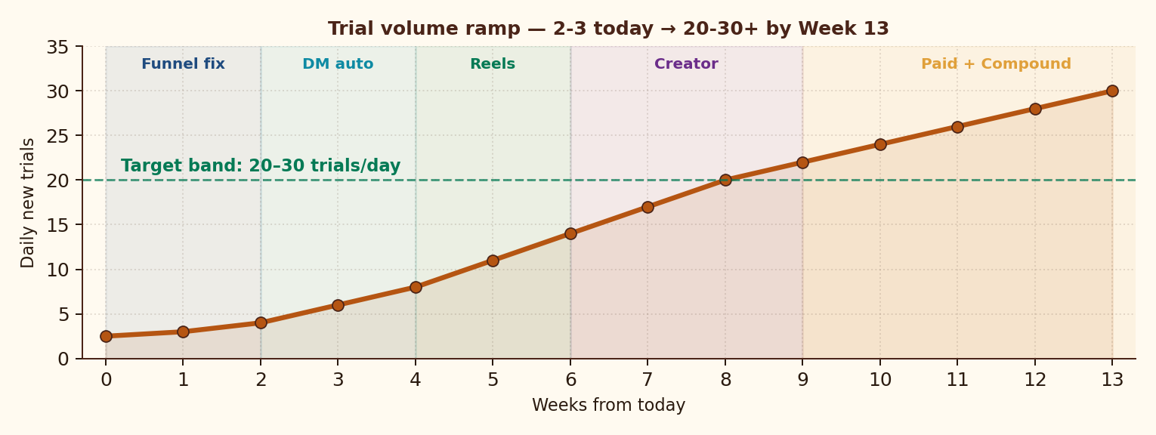
STRATEGIC FRAMING
01 · FUNNEL FIX
02 · SCALING
03 · CONTENT
04 · NEW REVENUE ★
STRATEGY · BO + BCG
FINANCIAL & EXECUTION
AREA 2 · 2-3 → 20-30 trials/day in 13 weeks via 5 sequenced channels — 80% organic; paid is the LAST lever
TRIAL RAMP — WK0 → WK13 BY CHANNEL ACTIVATION
PER-SUB UNIT ECONOMICS · Y1
Revenue / sub / year
₹948
Annual blend (avg)
₹823
Gross margin
85.5%
Blended CAC
₹125
Payback period
1.6 mo
LTV @ 8% churn
₹987
LTV / CAC
7.9×
True contribution
₹671
5-CHANNEL ACQUISITION MATRIX · TARGET BLENDED CAC < ₹150
VIRAL LOOPS · TARGET K > 1.2
CHANNEL
MECHANISM (INDIA-GROUNDED)
BUDGET
CAC
TRIALS/DAY
WA FORWARD LOOP
DM AUTO (IG)
ManyChat "GITA" trigger → auto-DM form link
0%
₹0
8-10
116 active × 28 msg = 3,248 forward-touches/mo
DAILY REELS+SHORTS
1/day on "Gita for [anxiety/exam/heartbreak]"
0%
₹0
5-7
CREATOR BORROW
MICRO-CREATOR
20-30 spiritual creators × 30-day free trial
15%
₹40
4-6
1 quality collab → 500-1,000 trials @ ₹0 CAC
WHATSAPP FORWARD
Daily msg ends "Forward to someone 🙏"
5%
₹0
3-4
FAMILY-PACK SHARE
META CTWA (M3+)
Click-to-WhatsApp ads · lookalike of paid base
80%
₹150
2-3
₹149 covers 5 phones · built-in WoM
Glido Labs case | ManyChat IG conversion (2024) | Meta India CTWA benchmarks | Sequoia India Subscription Unit Economics Guide

Slide 9
STRATEGIC FRAMING
01 · FUNNEL FIX
02 · SCALING
03 · CONTENT
04 · NEW REVENUE ★
STRATEGY · BO + BCG
FINANCIAL & EXECUTION
AREA 2 · India runs on offline trust — temple, yatra, pandit, RWA networks reach the older 60% no Reels can touch
9-CHANNEL OFFLINE ACQUISITION GRID · TIER 2/3 + 50+ AGE FOCUS
EASY PAYMENT + SENIOR-FRIENDLY UX
01
TEMPLE QR PARTNERSHIPS
CASH-ON-TRIAL
Tirupati (1Cr+ visitors/yr), Vaishno Devi, Shirdi, ISKCON 50+ centres, Char Dham. QR poster + sample sevak. Revenue-share model.
Pay ₹79 after 7 days (newspaper-vendor model). Removes UPI fear entirely.
02
YATRA TOUR-GROUP NETWORK
RECHARGE VOUCHERS
Char Dham, Vrindavan, Mathura, Kashi tour operators (₹50/sub commission). Bus-loudspeaker scripts + free-trial leaflets.
Buy ₹99/₹699 voucher at panwala/corner store. Scratch-and-redeem on WA. Like phone recharge.
03
PANDIT / BRAHMIN ROSTER
FAMILY-PAY UPI
Onboard 5,000 pandits across India · ₹50/sub commission · Trust-multiplier (pandit-as-recommender). WhatsApp dashboard.
Kids/grandkids pay from their UPI for parents' subscription. Most natural India behavior.
04
BHAJAN MANDALI / KIRTAN
Sunday neighbourhood bhajan groups · ladies' kitty parties · senior society morning walks. Sample message + voucher distribution.
WHATSAPP PAY
WA Pay (no auto-mandate) — 100M+ Indians active. Simpler than separate UPI app.
05
RWA + SENIOR LIVING
Tier 1/2 RWAs (5,000+ communities) · Avadh, Antara, Athulya retirement homes · cooperative society notice boards.
VOICE-CALL IVR
RELIGIOUS TV + RADIO
Hindi-only call-to-subscribe. Toll-free 1800. For users who can't read forms.
06
Aastha TV, Sanskar TV, Sadhna · Vividh Bharati FM · Radio Mirchi religious slots · sponsor 'Aaj ka Shlok' segment.
PENSION-DAY DEBIT
NEWSPAPER COLUMNS
Auto-debit on 5th of month (when pension hits) — aligns with cash flow rhythm.
07
Dainik Jagran 'Aaj ka Vichar', Amar Ujala 'Dharm', Hindustan 'Adhyatm' — paid columns + free-trial QR strip.
POSTAL MONEY ORDER
08
NEWSPAPER-BOY / DOODHWALA
₹699/yr by postal MO — RBI-trusted by 65+ users. Slow but converts.
Morning delivery network in tier 2/3 · pamphlet-with-QR insert · ₹2/sub kickback. Reaches 50+ males who don't use IG.
LARGE-FONT + VOICE
09
WEDDING / FUNERAL TIE-UPS
WA template: 24pt font, voice OTP, slow Hindi audio. Senior-first design.
Banquet hall + funeral service partners · 'Gita on Marriage' & 'Gita on Grief' bundles · 5,000+ event bookings/yr nationally.
Tirupati TTD 2024 footfall data | TRAI tier 2/3 internet 2024 | RBI pension-day cycle data | India Post UPI substitutes 2023 | Team design

Slide 10
STRATEGIC FRAMING
01 · FUNNEL FIX
02 · SCALING
03 · CONTENT
04 · NEW REVENUE ★
STRATEGY · BO + BCG
FINANCIAL & EXECUTION
AREA 2 · 10 weekly + 8 monthly metrics across 4 categories — every decision tied to one number
WEEKLY KPIS · TRACK EVERY MONDAY
MONTHLY KPIS · REVIEW ON 1ST
CAT.
METRIC
TODAY
TARGET
CAT.
METRIC
TODAY
TARGET (30/60/90)
FUNNEL
Homepage → Form rate
18.2%
30%+
REV
Active paid subscribers
116
230 / 480 / 800
FUNNEL
Signup → Trial rate
32.6%
60%+
REV
Blended monthly revenue
₹9.2K
₹22K / ₹70K / ₹1L+
FUNNEL
Trial → Paid rate
71.2%
85%+
REV
ARPU per user
₹79
₹130+ blended
ACQ
Daily new trials
2-3
20-30
ECON
Blended CAC
—
<₹150
ACQ
DM auto CTR
—
35%+
ECON
LTV @ current churn
₹268
₹987 (8% churn)
ACQ
Reels saves / share
—
Track
ACQ
Creator pipeline
0
5+/wk
ECON
LTV / CAC
2.1×
7.9× target
ENG
Day-1 msg open rate
—
85%+
CHURN
Monthly churn
29%
<8% by M3
ENG
WA forward count
—
Track
STACK
Revenue from non-₹79
₹0
₹50K+ by M3
PROD
JS error sessions
129
<10
OPERATING CADENCE
Daily standup on weekly KPIs · monthly board on revenue+churn · quarterly LTV/CAC re-base.
Glido analytics | 18-metric KPI design | Weekly cadence on funnel, monthly cadence on revenue + economics

Slide 11
STRATEGIC FRAMING
01 · FUNNEL FIX
02 · SCALING
03 · CONTENT
04 · NEW REVENUE ★
STRATEGY · BO + BCG
FINANCIAL & EXECUTION
AREA 3 · IG today delivers what subscribers pay for — close the value gap, IG becomes a tease, not a substitute
FREE VS PAID CONTENT ARCHITECTURE — 5-DIMENSION VALUE GAP
DIMENSION
FREE · Instagram (broadcast)
PAID · WhatsApp (intimate ritual)
Content depth
Shlok image / verse
Shlok + meaning + life application
Personalization
One-to-many caption
Reflection tied to today's verse
Cadence
Variable, algorithm-led
8 AM, every morning. No exceptions.
Relationship
Public broadcast
Private, ritual, companion-like
Discoverability
Anyone can find it
Curated channel just for you
5 CONTENT CAMPAIGNS RANKED BY EXPECTED IMPACT
#
CAMPAIGN
MECHANIC
EXPECTED IMPACT
PRIORITY
01
"Gita for [Indian situation]" Reel series
Saas-bahu, exam stress, job loss, EMI worry, child marriage, retirement — culturally specific.
Tier 2/3 pull · highly searchable · saves 5×
★★★★★
02
Subscriber Before & After (Hindi voice notes)
1-min audio testimonial from 116 paid users — voice = trust signal in India.
Native social proof · 2-3× reach · senior-friendly
★★★★☆
03
"What is Krishna saying about your life RIGHT NOW?"
IG story poll → auto-DM shlok + trial. Personalisation engine for warm leads.
Warms cold leads · DM auto opt-in
★★★★★
04
Bollywood × Gita reframe series
"Mahabharat in 3 idiots" / "Gita lesson in DDLJ" — meme-format viral hook.
Cross-over reach · 18-35 segment pull
★★★☆☆
05
Festival gifting + IPL/Cricket integration
Diwali/Janmashtami gift bundles + IPL-stress shloka series during cricket season.
100-200 subs/push · near-zero CAC
★★★★☆
06
Newspaper religious-column tie-up
Dainik Jagran 'Aaj ka Vichar' weekly column with QR + free-trial promo.
Reaches 50+ Hindi belt non-IG users
★★★★☆
Glido IG analytics | ManyChat story poll → DM benchmarks | RedSeer 2024 spiritual e-commerce | Festival gifting volumes

Slide 12
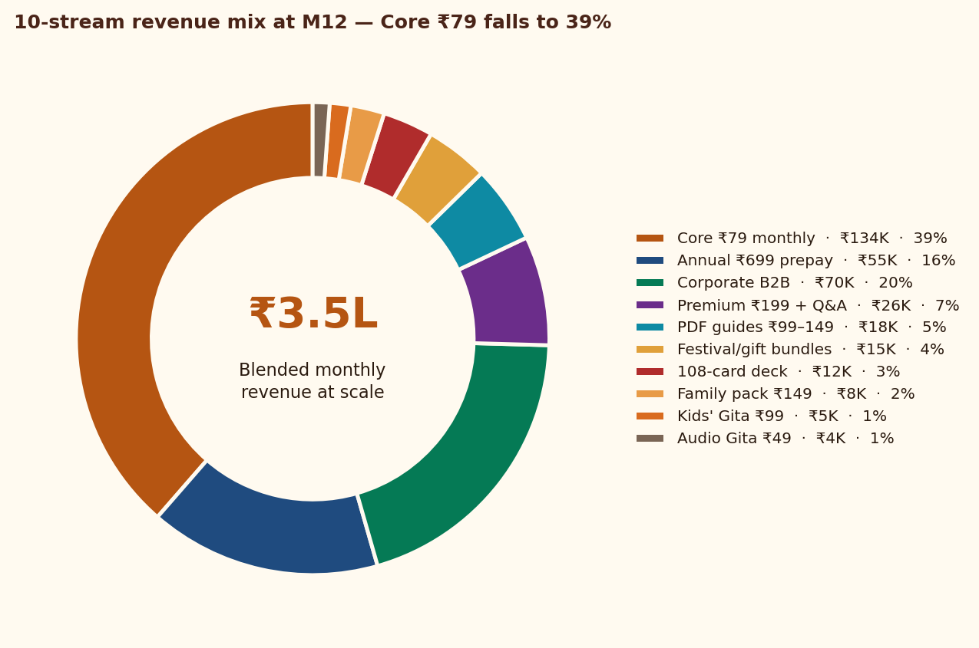
STRATEGIC FRAMING
01 · FUNNEL FIX
02 · SCALING
03 · CONTENT
04 · NEW REVENUE ★
STRATEGY · BO + BCG
FINANCIAL & EXECUTION
AREA 4 · Single ₹79 SKU → 10-stream stack — ₹3.5L MRR by M12, where Core ₹79 falls to 39% of total revenue
10-STREAM REVENUE STACK · ALL INDIA-GROUNDED
REVENUE MIX AT SCALE · M12
#
STREAM · WHAT WE SELL
PRICE
GO-LIVE
M12 MRR
MARGIN
01
CORE · Daily WhatsApp shlok (monthly)
₹79/mo
Now
₹1.34L
85%
02
ANNUAL · Daily WhatsApp prepaid (saves 26%)
₹699/yr
Month 1
₹55K
92%
03
PDF GUIDES · "Gita for Anxiety/Career/Heartbreak/Parenting/Money"
₹99-149
Month 1
₹18K
97%
04
PREMIUM · Community + Q&A with scholar (Telegram/Discord)
₹199/mo
Month 3
₹26K
75%
05
FESTIVAL/GIFT · Diwali, Navratri, Janmashtami gift subs
₹199-499
Month 2
₹15K
88%
06
PHYSICAL · 108-card Bhagavad Gita wisdom deck
₹599-699
Month 4
₹12K
55%
07
CORPORATE B2B · Daily Gita for HR wellness (BFSI/FMCG/IT)
₹5K-15K/mo
Month 5
₹70K
80%
08
FAMILY PACK · 3-5 phones, multi-language
₹149/mo
Month 4
₹8K
82%
09
KIDS' GITA · Stories for ages 8-14 (parents buy)
₹99/mo
Month 6
₹5K
85%
10
AUDIO GITA · Voice version for commute / Bharat tier 3
₹49/mo
Month 5
₹4K
88%
BLENDED MONTHLY @ M12
₹3.5L+
82%
Pricing logic: ₹49-149 impulse · ₹199-499 commit · ₹599+ artefact · ₹5K+ B2B | Margin: digital 85-95%, physical 55%, B2B 80%

Slide 13
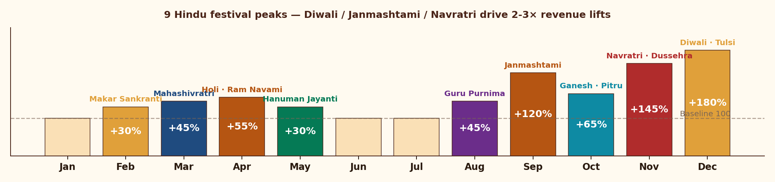
STRATEGIC FRAMING
01 · FUNNEL FIX
02 · SCALING
03 · CONTENT
04 · NEW REVENUE ★
STRATEGY · BO + BCG
FINANCIAL & EXECUTION
AREA 4 · 9 Hindu festivals + life-event gifting drive 30-180% revenue lifts — uniquely Indian, structurally underserved
FESTIVAL CALENDAR · EXPECTED REVENUE LIFT BY MONTH (BASELINE = 100)
6 INDIA-GROUNDED BUNDLES · WILL NOT EXIST ELSEWHERE
DIWALI GIFT PACK
JANMASHTAMI
NAVRATRI 9-DAY
WEDDING / ANNIV
BIRTHDAY GIFT
EXAM SEASON
₹499
₹299
₹199
₹999
₹199
₹99
1-yr sub + e-card + Lakshmi-Ganesha audio
1-mo sub + 8 Krishna shlokas + art
9 daily reflections (Goddess + Gita)
Couple sub + Gita-on-Marriage PDF + Q&A
Personal 'shlok-for-month' + 6-mo sub
30-day 'Gita for exam stress' micro-sub
Family-to-family festive gifting
On-brand: Gita IS Krishna's words. Best PR moment.
October's biggest festival
₹3.7T Indian wedding market underserved
Year-round non-festival gifting
Parents buy for CBSE/JEE students
200 packs Nov · ₹1L spike
300 packs · ₹90K
400 packs · ₹80K
50/mo · ₹50K/mo recurring
100/mo · ₹20K/mo recurring
300/season · ₹30K/season
Hindu calendar 2025 | RedSeer Spiritual & Wellness 2024 (₹4,000 Cr TAM) | KPMG Wedding Industry India 2024 (₹3.7T) | Team estimates

Slide 14
STRATEGIC FRAMING
01 · FUNNEL FIX
02 · SCALING
03 · CONTENT
04 · NEW REVENUE ★
STRATEGY · BO + BCG
FINANCIAL & EXECUTION
AREA 4 · ₹49 audio → ₹15K/mo corporate captures every willingness-to-pay segment in India
PRICING LADDER · MONTHLY EQUIVALENT
PRICING LOGIC · 4 ANCHOR PRINCIPLES
CORPORATE B2B
₹5K-15K/mo
BFSI, FMCG, mfg HR
01 ANCHOR LOW
₹49 audio = pure curiosity tier. Coffee-cost paying habit.
WEDDING / ANNIV
₹999 one-time
Couple gifting bundle
02 IMPULSE
₹99-149 PDFs + exam micro-subs. No auto-deduct fear.
PHYSICAL DECK
₹599-699
108-card deck · festival
03 COMMIT
₹199-499 premium + festival. Conscious commit price.
DIWALI BUNDLE
₹499
Festival pack
04 ARTEFACT/B2B
₹599+ deck, wedding, corporate. Gifting + enterprise.
ANNUAL PREPAY
₹699/yr
26% off · ~0% churn
PREMIUM TIER
₹199/mo
Community + scholar Q&A
B2B CORPORATE OPPORTUNITY · TAM/SAM/SOM
TAM · Corporate Wellness India
₹4,000 Cr · 15% CAGR
FAMILY PACK
₹149/mo
Up to 5 phones
SAM · Mid-large firms (BFSI/FMCG/Mfg)
₹400 Cr
CORE
₹79/mo
Daily WA shlok (anchor)
SOM Y1 · 15-30 pilot firms
₹50-80 L
KIDS' GITA
₹99/mo
Stories for 8-14
PRICING · ₹5K (≤50) / ₹10K (50-200) / ₹15K (200+)
Per month per firm
AUDIO GITA
₹49/mo
Voice · Bharat tier 3
BUYER · HR Heads at 500-5,000 employee firms
LinkedIn outreach
MOTION · 15-min outreach → pilot → case-study fly-wheel
Self-serve B2B
Mercer Marsh India Wellness Survey 2024 (₹4,000 Cr) | LinkedIn HR titles | Glido pricing | Team build-up

Slide 15
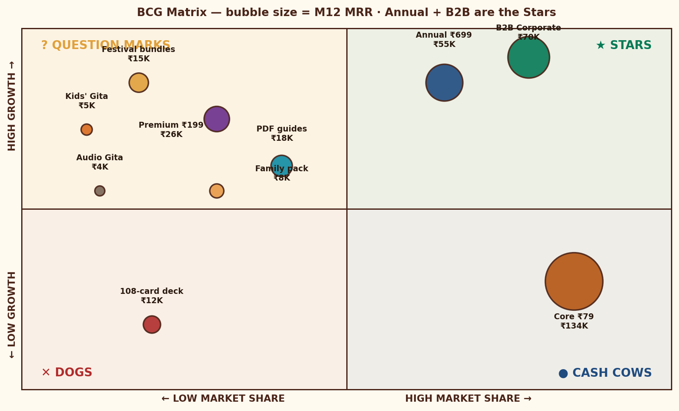
STRATEGIC FRAMING
01 · FUNNEL FIX
02 · SCALING
03 · CONTENT
04 · NEW REVENUE ★
STRATEGY · BO + BCG
FINANCIAL & EXECUTION
Blue Ocean tells us WHAT to build differently · BCG tells us WHERE to invest — both point to Annual + B2B as Stars
BLUE OCEAN ERRC GRID — STOP / SLOW / ACCELERATE / INVENT
BCG MATRIX — BUBBLE = MRR @ M12
⬇ ELIMINATE
⬊ REDUCE
STOP doing
Do LESS of
• Generic broadcast Gita content
• Celebrity-scholar dependency
• Long-form 1-hour discourses
• English-first for ₹79 tier 2/3
• Production cost per shloka
• IG algorithm-only dependency
• Single-SKU monetization
• Auto-mandate friction
⬈ RAISE
✦ CREATE
Do MORE of
Build NEW
• Vernacular Hindi + regional
• Intimate WhatsApp ritual feel
• Festival-timed content
• Family-pricing tiers
• Daily 8 AM ritual ownership
• Family pack ₹149 / 5 phones
• Festival/wedding/funeral bundles
• B2B Gita Daily · ₹4,000 Cr TAM
INVESTMENT THESIS · PORTFOLIO PLAY
★ STARS
Annual + B2B · invest 70%
? Q-MARKS
Festival/Premium/Audio · validate
● CASH COWS
Core ₹79 · defend, milk
✕ DOGS
Physical deck · tactical only
W. Chan Kim & R. Mauborgne — Blue Ocean Strategy (2005) | BCG Boston Consulting Group Growth-Share Matrix (1968) | Glido streams plotted by team

Slide 16
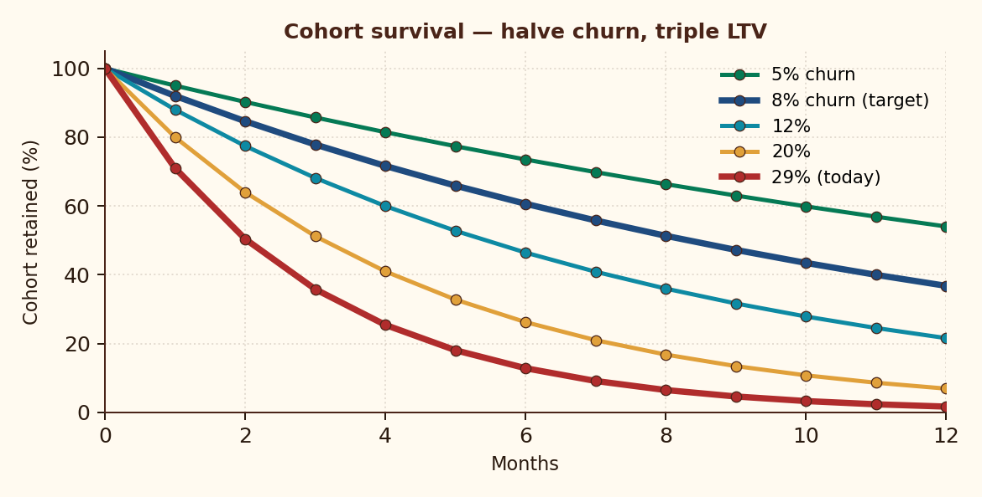
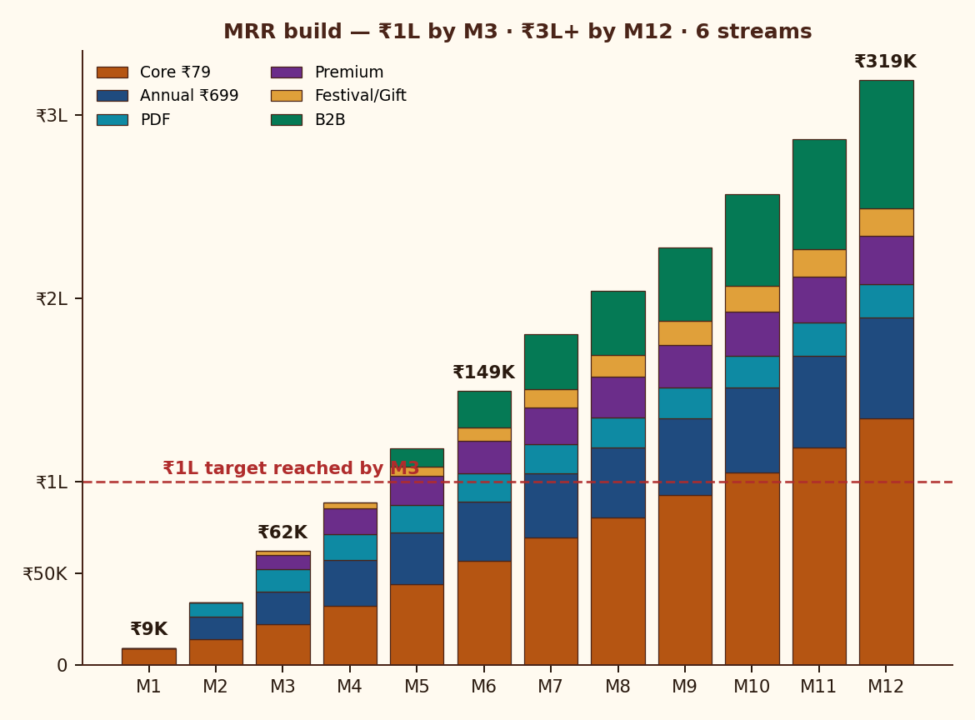
STRATEGIC FRAMING
01 · FUNNEL FIX
02 · SCALING
03 · CONTENT
04 · NEW REVENUE ★
STRATEGY · BO + BCG
FINANCIAL & EXECUTION
Halving churn from 29% → 8% triples LTV — the Day-3 trial fix is the highest-ROI intervention in this deck
85.5%
₹125
M3
₹3.5L+
7.9×
GROSS MARGIN
BLENDED CAC
TO ₹1L MRR
MRR @ M12
LTV / CAC
PER-SUBSCRIBER UNIT ECONOMICS
COHORT RETENTION · LTV SENSITIVITY
MRR BUILD · 6 STREAMS
LINE ITEM
AMOUNT
RATIONALE
Revenue / sub / year
+₹948
12 × ₹79
WhatsApp + payment fees
−₹95
~10% of revenue
Content production
−₹30
1 scholar / 800 subs
Tech + infra
−₹12
ManyChat, hosting
GROSS MARGIN
+₹811
85.5%
Blended CAC (amortized)
−₹125
Y1 weighted
Refund / chargeback
−₹15
2% allowance
MONTHLY CHURN
LTV
LTV / CAC
TRUE CONTRIBUTION
+₹671
70.7% survives CAC
5%
₹1,580
12.6×
8% · TARGET
₹987
7.9×
12%
₹655
5.2×
20%
₹395
3.2×
29% · TODAY
₹268
2.1×
Sequoia India Subscription Unit Economics Guide | Cohort math: P(retained) = (1−churn)^n | Glido Labs case data

Slide 17
STRATEGIC FRAMING
01 · FUNNEL FIX
02 · SCALING
03 · CONTENT
04 · NEW REVENUE ★
STRATEGY · BO + BCG
FINANCIAL & EXECUTION
Fix the funnel before scaling. Deepen monetization before buying traffic. ₹1L MRR by M3 if Lever 1 lands in 30 days
6-PHASE 90-DAY EXECUTION ROADMAP
WK 1-2
WK 2-3
WK 3-4
MONTH 2
MONTH 3
MONTH 3+
FIX THE LEAK
SEAL THE TRIAL
DM AUTOMATION
NEW REVENUE
SCALE CONTENT
PAID + B2B
Homepage redesign
Form above fold
Mandate explainer
LCP <2.5s
Day 1/2/3 WA arc
Re-engage 47 churns
Pre-charge transparency
ManyChat trigger
Update captions
First Story poll
Annual ₹699 launch
3 PDF guides live
Diwali gift sub page
Daily Reels
2 creator collabs
B2B pitch deck
Premium tier
Meta CTWA ₹500/d
Lookalike audience
5 corp pilots
Audio launch
MILESTONE OUTCOMES · NOW / 30 / 60 / 90 DAY
RISK & MITIGATION MATRIX
DIMENSION
TODAY
DAY-30
DAY-60
DAY-90
RISK
IMPACT
MITIGATION
Active paid subscribers
116
230
480
800+
WhatsApp policy / API ban
CRITICAL
WA Business API + email mirror
Daily new trials
2-3
8-10
15-18
20-30
Mandate distrust → chargebacks
Bilingual explainer, pre-charge
HIGH
Homepage → Form
18.2%
30%
35%
40%+
Trial → Paid
71%
78%
82%
88%+
Founder content fatigue
MED
Onboard 2 scholars by M3
Monthly churn
29%
<20%
<12%
<8%
Instagram algo dependency
HIGH
Diversify: Shorts, ShareChat, email
Blended monthly revenue
₹9.2K
₹22K
₹70K
₹1L+
Premium quality dilution
Hard cap 150 members, founder mod
Revenue streams live
1
3
5
7+
MED
Glido Labs case | Industry risk benchmarks | Team risk identification & mitigation design

Slide 18
APPENDIX
FRAMEWORKS USED IN THIS DECK
DATA SOURCES & REFERENCES
PESTLE × INDIA-SPECIFIC
Macro 6-axis lens (slide 3)
CASE
Glido Labs Strategy Assignment brief — funnel, perf, errors
PORTER'S 5 FORCES
Industry rivalry + new entrants (slide 3)
MARKET
IMARC India Subscription Apps Report 2024
VALUE PROPOSITION CANVAS
JTBD × Anxieties × Pay × Stay (slide 4)
MARKET
Mercer Marsh India Wellness Survey 2024 (₹4,000 Cr)
MCKINSEY 3 HORIZONS OF GROWTH
H1 core / H2 emerging / H3 future (slide 5)
MARKET
RedSeer Spiritual & Wellness E-commerce 2024
ANSOFF GROWTH MATRIX
Penetration / Product / Market / Diversify (slide 5)
MARKET
KPMG Wedding Industry India 2024 (₹3.7T)
FUNNEL DIAGNOSTIC × 5 WHYS
6-stage drop-off vs benchmark (slide 6)
MARKET
Tirupati TTD 2024 footfall data · Char Dham yatra stats
CORE WEB VITALS AUDIT
LCP/INP/CLS perf (slide 7)
CONSUMER
LocalCircles Hindi Spiritual Survey 2024 · TRAI tier 2/3
AARRR PIRATE METRICS
Acq / Activation / Retention / Ref / Rev
PRODUCT
Razorpay UPI Mandate UX · Google Web Vitals
HOOK MODEL · NIR EYAL
Trigger → Action → Reward → Invest
PRODUCT
ManyChat IG automation · Meta India CTWA benchmarks
BLUE OCEAN STRATEGY (ERRC)
Eliminate / Reduce / Raise / Create (slide 15)
THEORY
Porter (1979) — Competitive Strategy / 5 Forces
BCG GROWTH-SHARE MATRIX
Stars / Cows / ?Marks / Dogs (slide 15)
THEORY
McKinsey · Baghai Coley White (2009) — 3 Horizons
UNIT ECONOMICS · PER-SUB P&L
₹948 → ₹671 contribution (slide 16)
THEORY
Ansoff (1957) — Strategies for Diversification
LTV / CAC SENSITIVITY
5%-29% churn scenarios (slide 16)
THEORY
Kim & Mauborgne (2005) — Blue Ocean Strategy
TAM / SAM / SOM
B2B ₹4,000 Cr → ₹50-80L Y1 (slide 14)
THEORY
BCG Growth-Share Matrix (1968)
RISK & MITIGATION MATRIX
5 risks × impact × mitigation (slide 17)
THEORY
Nir Eyal — Hooked (2014) · Eric Ries — Lean Startup (2011)
UNIT ECON
Sequoia India Subscription Unit Economics Guide

Slide 19
WHAT WE WILL HAVE BY MONTH 3
THE BIG BET
FUNNEL
Homepage→Trial above 8% (vs 2.21% today)
Fix the funnel
before you scale it.
Deepen monetization
before you buy traffic.
AUDIENCE
800+ active paying subscribers (vs 116)
REVENUE
₹1L+ blended MRR — 11× current
STREAMS
7 of 10 streams live · ₹50K+ from non-₹79
PIPELINE
3 corp pilots · paid ads ROAS-positive
BRAND
200K+ Instagram · first PR mention
Most spiritual subs die buying ads into broken funnels. We will not. The 90-day plan is sequenced so the first ₹0 of new spend earns the right to the next ₹1 of paid acquisition.
FROM THE GITA · CHAPTER 2, VERSE 47
"You have a right to perform your prescribed duty, but not to the fruits of action."
Operating principle: ship the funnel; the MRR will follow.
DIVYAMAN PAL · IIT KANPUR · divyamp23@iitk.ac.in
Bhagavad Gita Daily · Strategy Deck v7.0 · Confidential

