Slide 1
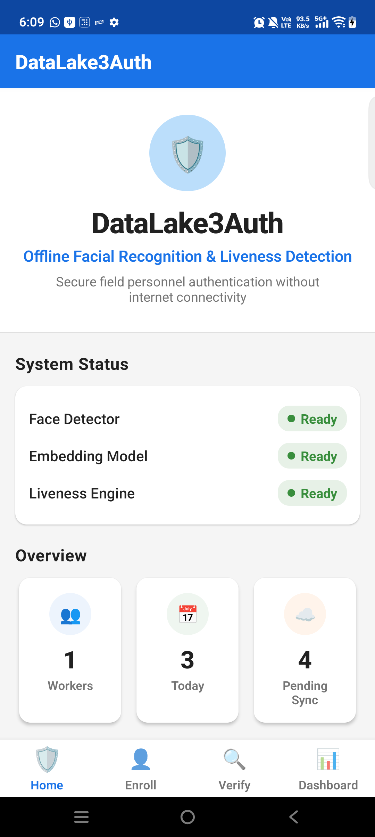
DataLake3Auth
Offline facial recognition and liveness detection for remote field authentication
Final Android + AWS validated submission snapshot
97.28%
16.14 MB
16.84 ms
AWS
LFW verification accuracy
Combined ONNX assets
Mean embedding latency
Lambda + DynamoDB sync proof
APK SHA-256: 16DB822E1A9CD4B1C32984799E333AC79EB62B202CF88DF35789A6269163B63B
Android app home
DataLake3Auth | Hackathon 7.0
01

Slide 2
REQUIREMENTS FIT
The frozen build answers the core Android/offline problem with measured evidence.
A clear baseline is preserved before attempting iOS work.
Hackathon requirement | Current implementation | Status
Offline recognition | Camera video, local detection, embedding, liveness, matching, SQLite | Implemented
Model footprint ~20 MB | 16.14 MB combined ONNX assets | Pass
<1 second speed | 16.84 ms embedding mean; app designed under 1 second | Pass
>95% accuracy | 97.28% on LFW; 95.49% top-1 with 3 templates | Pass on public benchmark
Sync and purge | Queue -> API Gateway -> Lambda -> DynamoDB -> local queue purge | Validated
Android + iOS | Android validated; iOS native camera validation pending | Partial
82-86
b14ccd5
honest score range
frozen Git commit
Safe submission posture
Keep Android/AWS baseline untouched. Do iOS work on a separate branch and update only if it validates.
Important honesty note
Do not claim fully iOS compatible yet. Claim React Native scaffold present, Android validated, iOS validation planned on Mac/Xcode.
DataLake3Auth | Hackathon 7.0
02

Slide 3
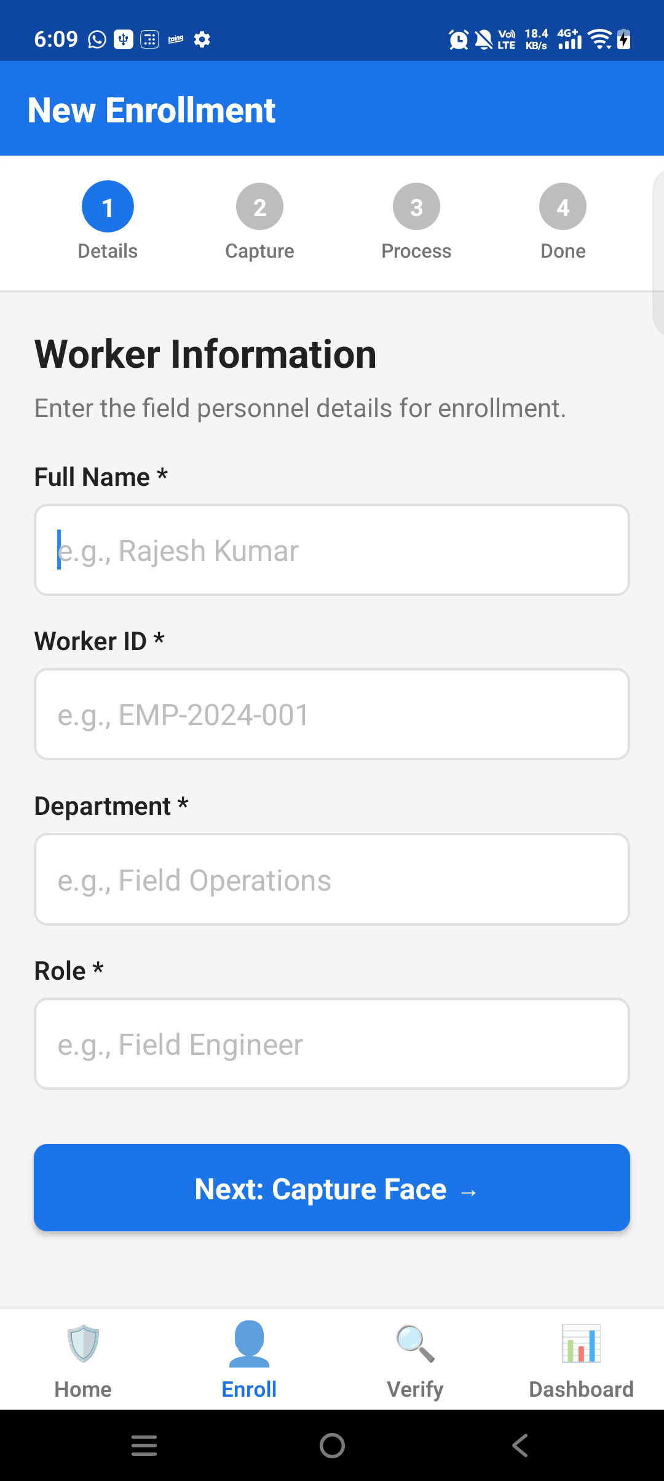
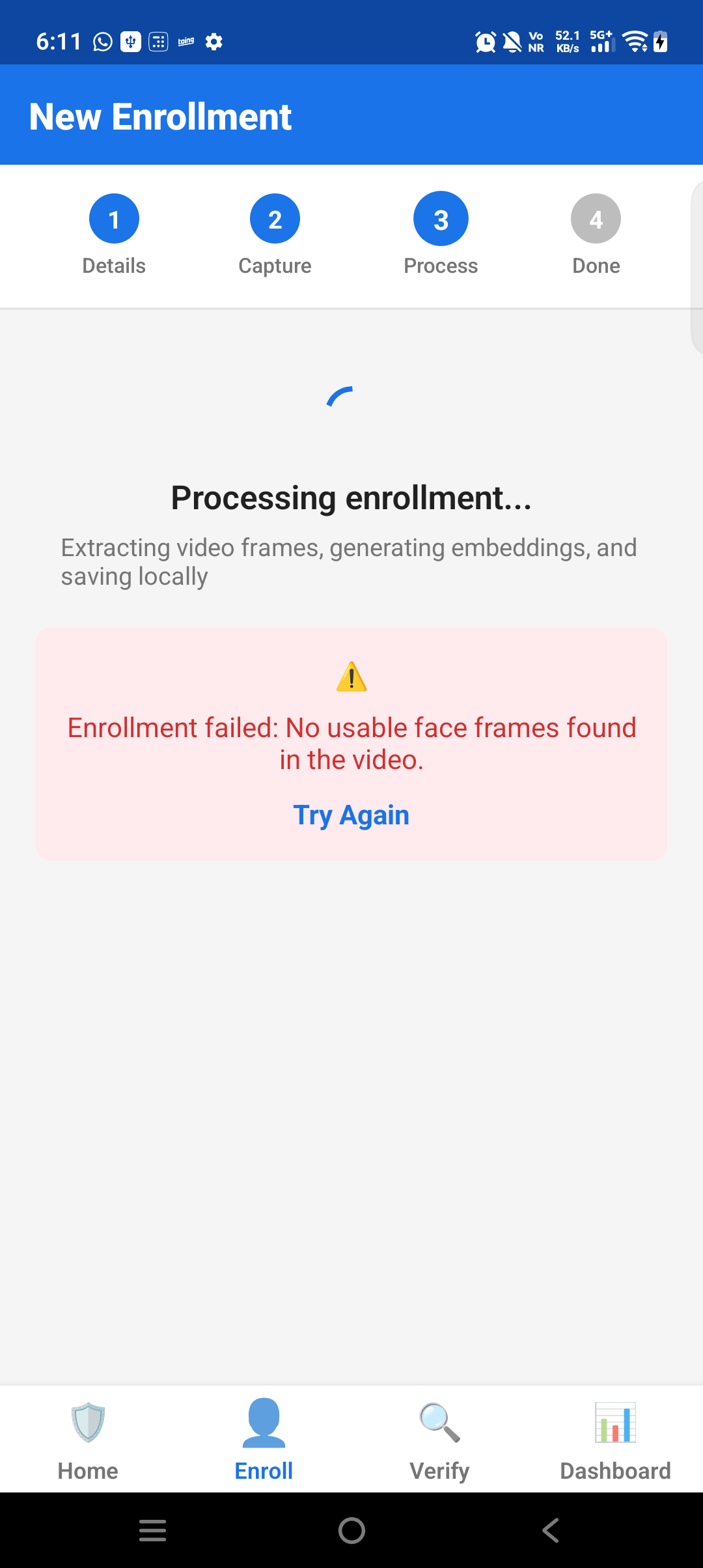
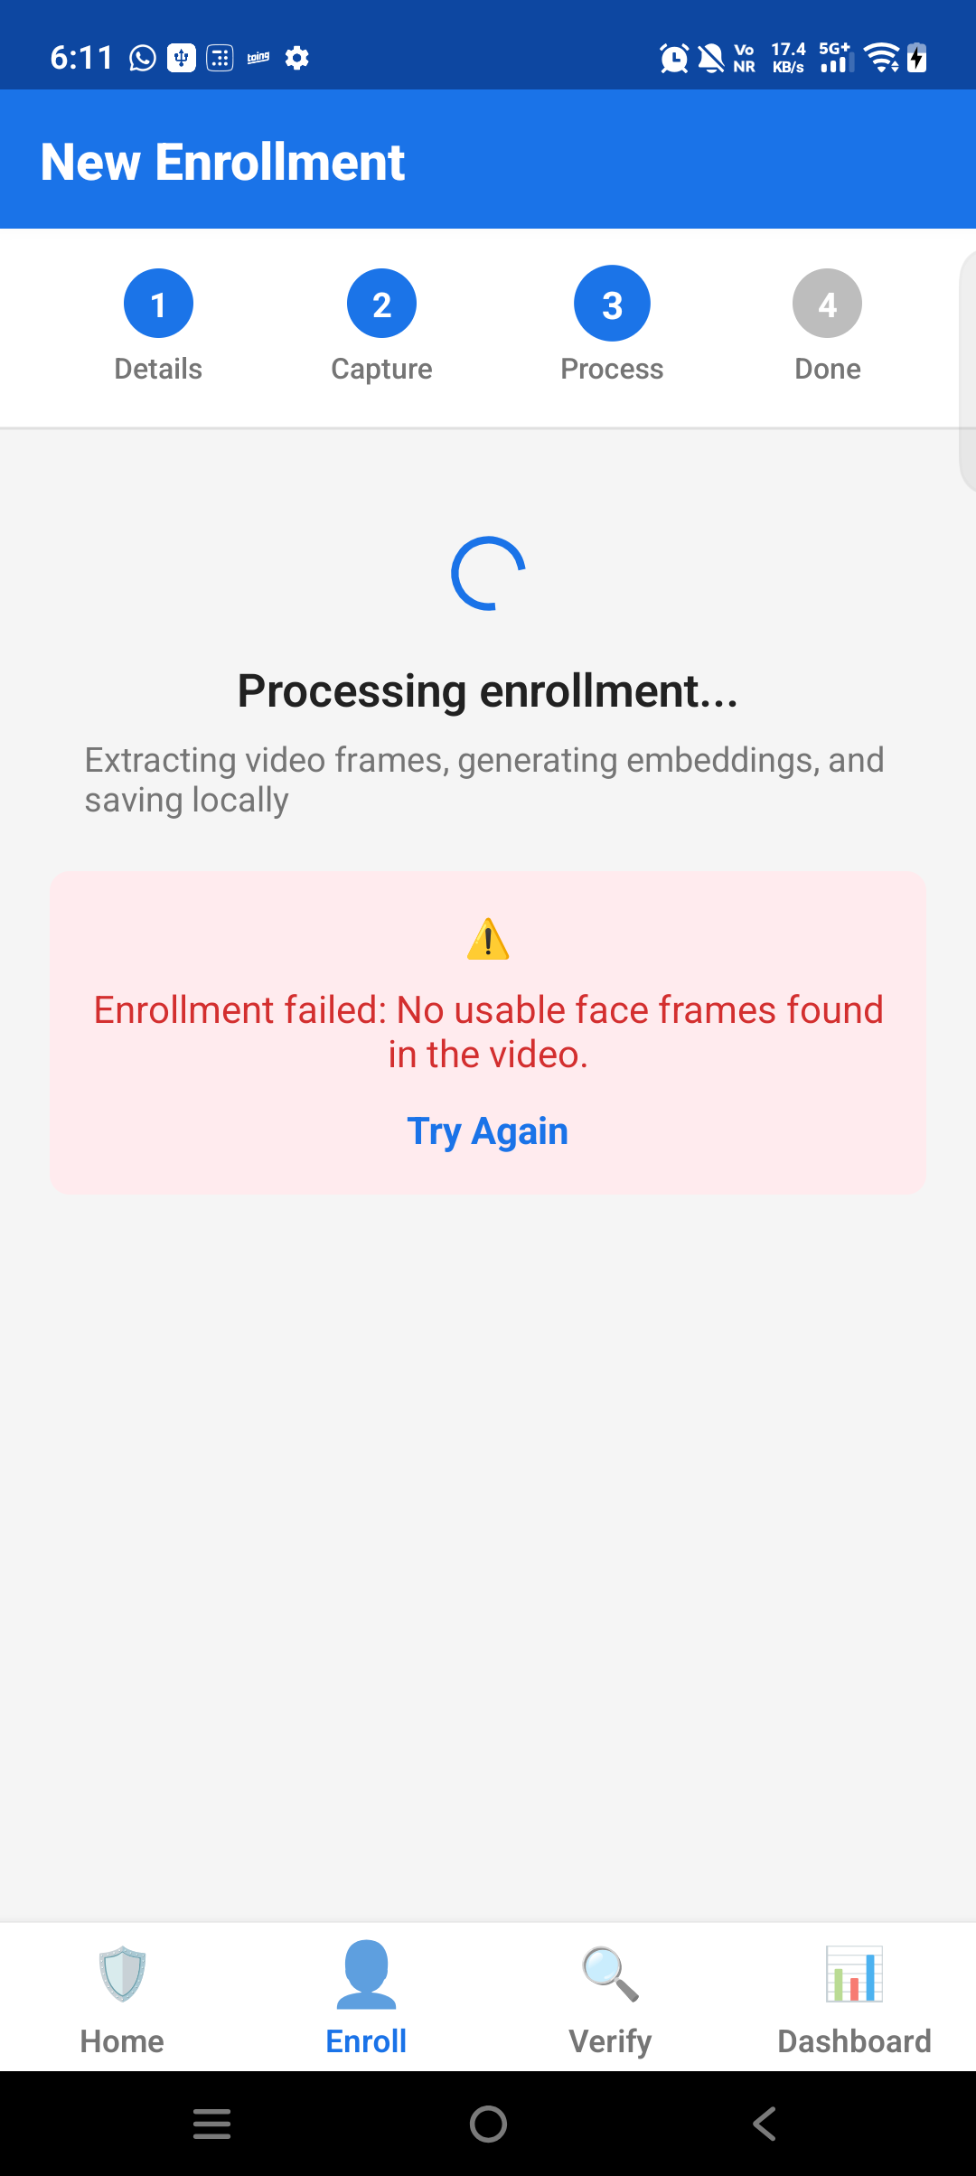
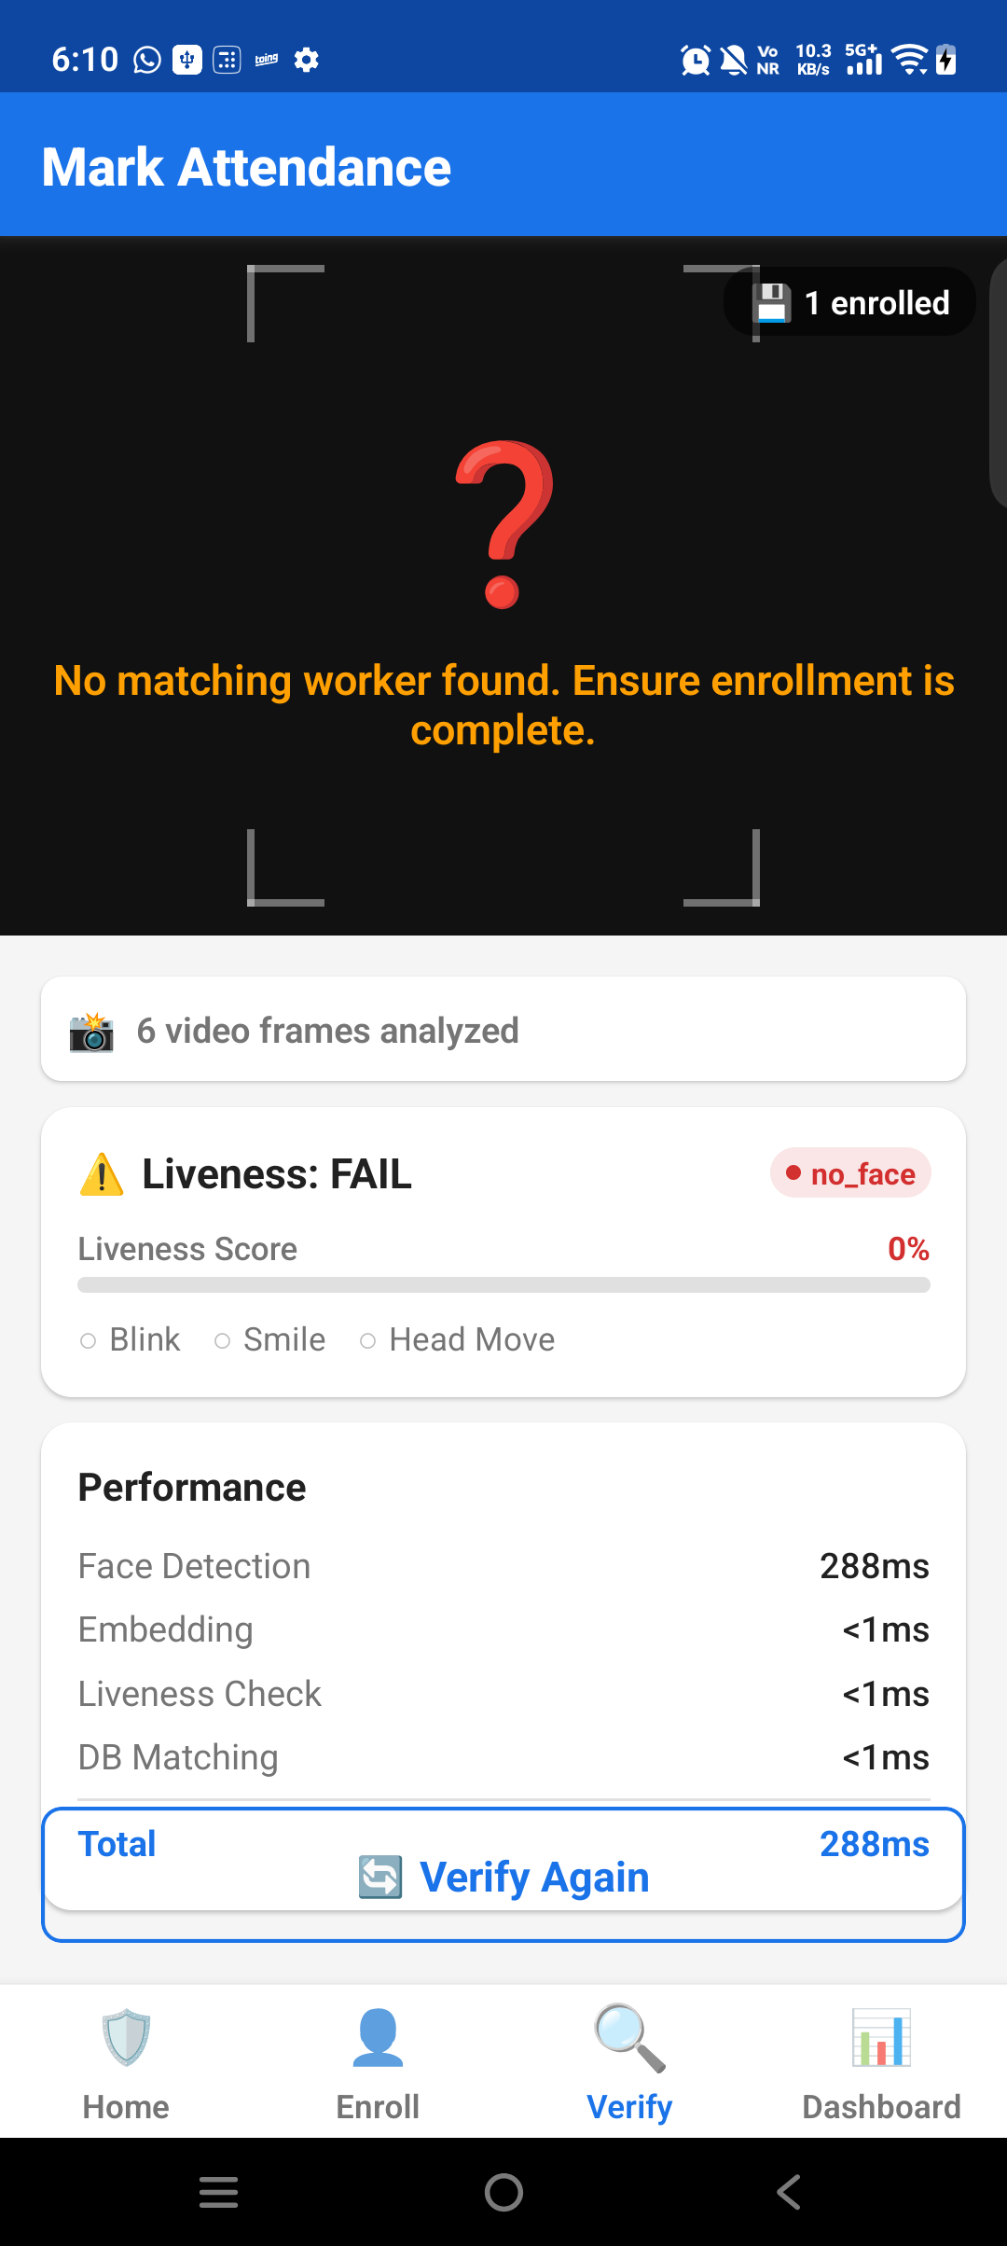
ANDROID PROOF
The prototype uses the in-app video flow judges asked for.
Screenshots are from the final Android app state used for the frozen submission.
Home/status
Enrollment
Recording
Frames captured
Verification
Proof point
Enrollment and verification are video-driven in-app flows; no internet is required for capture, liveness, embedding, or matching.
DataLake3Auth | Hackathon 7.0
03

Slide 4
WORKFLOW
Enrollment and verification share one offline ML pipeline.
The app stores templates locally and later syncs attendance records.
Video capture
Face detection
Liveness cues
Embedding
Matching
Local result
3.2s, 6 frames
ML Kit local
blink/smile/turn
MobileFaceNet ONNX
cosine + margin
SQLite + queue
Enrollment output
Verification output
Offline guarantee
Multiple templates per worker are saved locally. The final app supports up to 5 templates to improve recognition reliability.
Best match must pass both similarity threshold and margin against the second-best score.
No backend call is needed to authenticate a field worker.
DataLake3Auth | Hackathon 7.0
04

Slide 5
MODEL ARCHITECTURE
A compact MobileFaceNet embedding model carries recognition under the size budget.
The app uses w600k_mbf.onnx for 512-d embeddings and ML Kit for on-device face signals.
512-d
112x112
5
0.40
0.06
embedding output
face crop input
templates per worker
similarity threshold
match margin
Asset | Purpose | Size
w600k_mbf.onnx | MobileFaceNet / ArcFace-style face recognition embedding | 13.62 MB
det_500m.onnx | SCRFD backup/reference detector | 2.52 MB
ML Kit Face | Primary face detector plus eye/smile/head signals | Runtime/device
Model hash
9CC6E4A75F0E2BF0B1AED94578F144D15175F357BDC05E815E5C4A02B319EB4F
Interpretation
The model footprint is under the 20 MB target while keeping a standard face-embedding architecture suitable for mobile offline matching.
DataLake3Auth | Hackathon 7.0
05

Slide 6
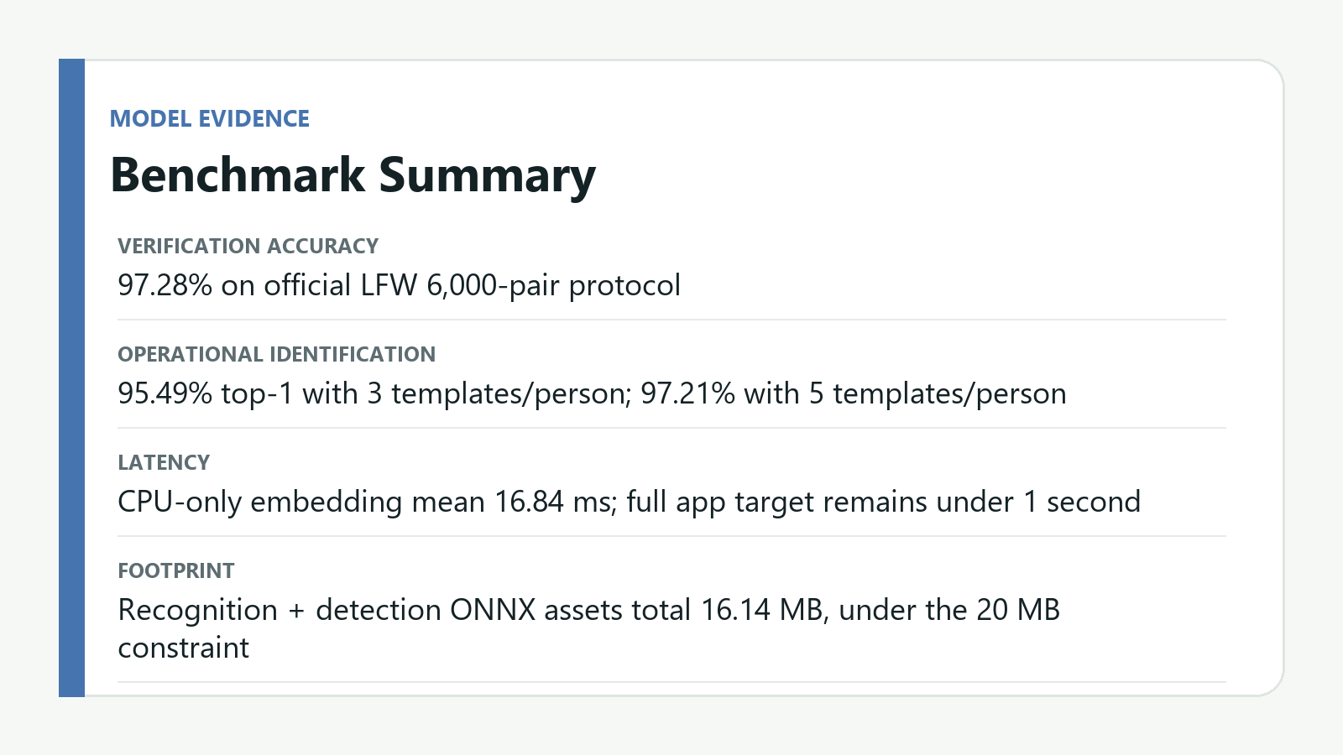
BENCHMARK EVIDENCE
Recognition clears the >95% target on a public verification protocol.
LFW validates recognition strength; field/liveness testing remains separate.
97.28%
1.53%
LFW accuracy
false accept rate
95.49%
97.21%
top-1, 3 templates
top-1, 5 templates
16.84 ms
CPU embedding mean
Caveat
LFW is not an Indian outdoor field-worker or spoof dataset. Report it as recognition-model evidence, not full field robustness evidence.
DataLake3Auth | Hackathon 7.0
06

Slide 7
LIVENESS
The prototype adds active video cues without adding a heavy spoof model.
This is hackathon-grade liveness; production spoof resistance needs deeper testing.
Blink
Smile
Head turn
Face quality
Cue | Source | Role
Blink | Eye open probability | Reject static photo attempts
Smile | Smile probability | Adds expression challenge
Head movement | Euler angles | Adds pose/motion evidence
Texture/quality | Bounds and landmarks | Reject poor or unusable captures
Honest limitation
Current liveness is basic. A production upgrade should add replay/screen detection and a small anti-spoof classifier.
DataLake3Auth | Hackathon 7.0
07

Slide 8
PRIVACY AND STORAGE
The app is offline-first and keeps biometric templates on the phone.
Only operational metadata and attendance records are sent to the backend.
Local table | Purpose | Sync behavior
enrolled_workers | Worker profile metadata | Can sync metadata
face_templates | 512-d embeddings | Local only by design
attendance_logs | Verification records | Queued and synced
sync_queue | Pending backend operations | Purged after success
app_config | Settings/state | Local
Privacy claim
Face embeddings are not included in default backend sync payloads.
Offline guarantee
Enrollment, verification, matching, and attendance logging can continue without active internet.
Purge behavior
Successful queue items are marked synced and removed from sync_queue.
DataLake3Auth | Hackathon 7.0
08

Slide 9
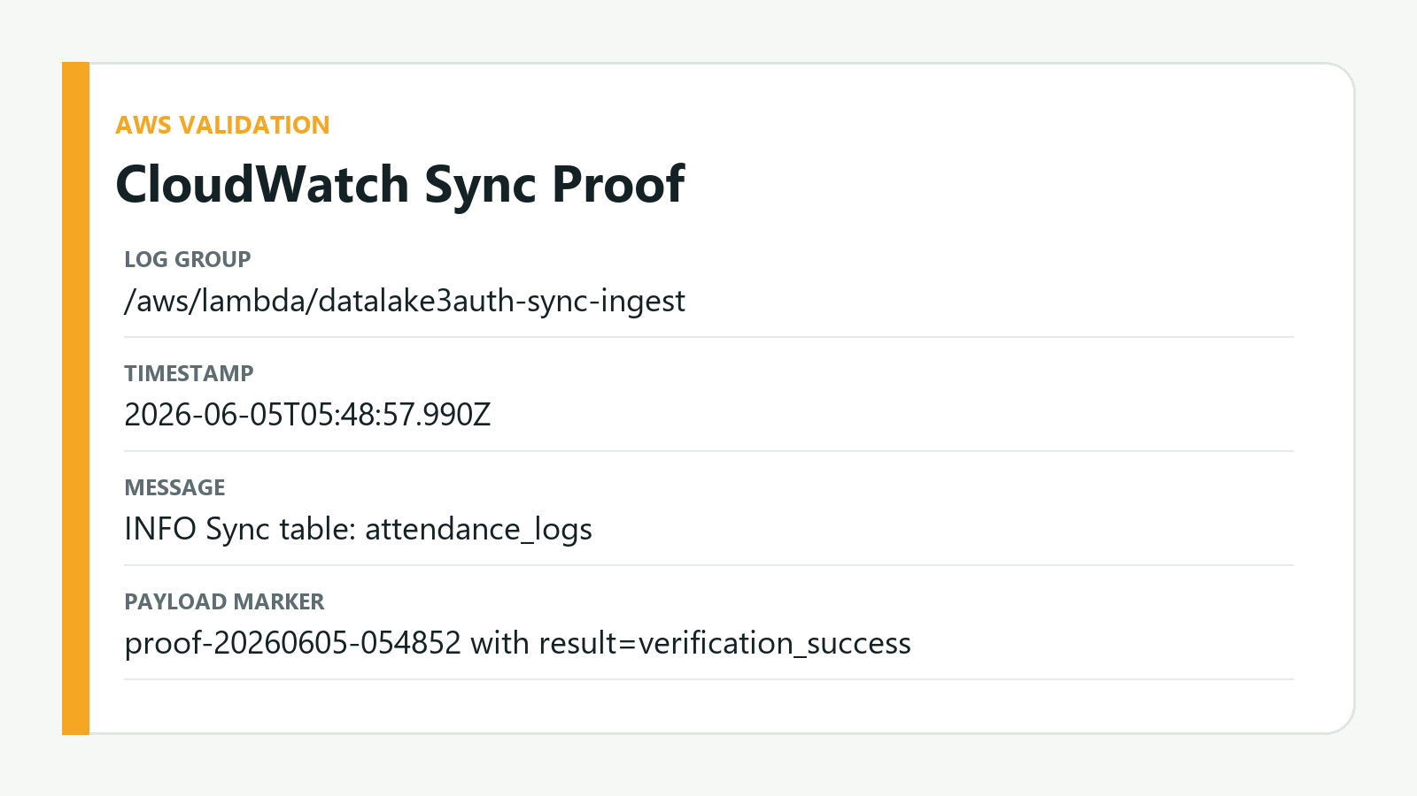
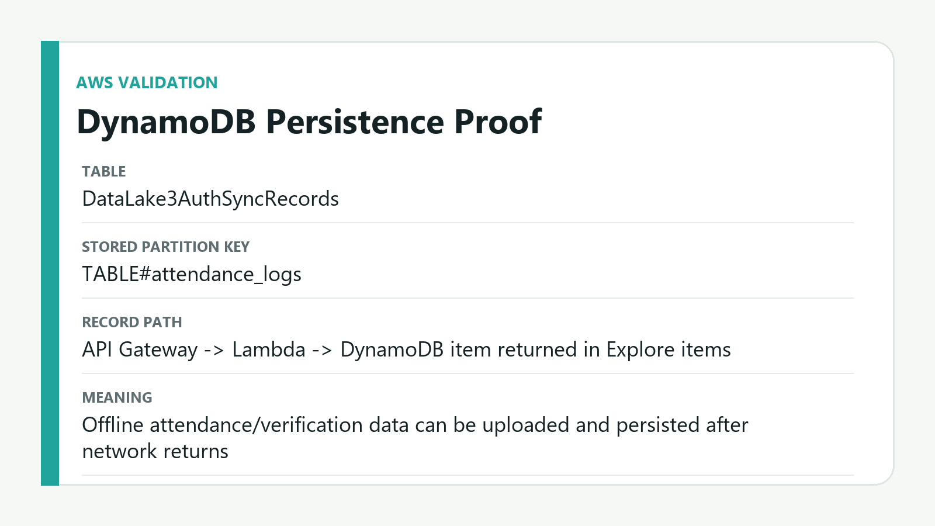
AWS SYNC PROOF
The backend now stores received sync records, not just logs them.
CloudWatch and DynamoDB evidence validate the sync requirement.
Configured endpoint
Lambda
DynamoDB
https://v8ihgcm30b.execute-api.ap-southeast-2.amazonaws.com/v1
datalake3auth-sync-ingest
DataLake3AuthSyncRecords
DataLake3Auth | Hackathon 7.0
09

Slide 10
SYNC DESIGN
Queue, retry, acknowledge, purge: the offline-to-online loop is explicit.
This is the mechanism judges asked for in remote locations.
1
2
3
4
5
Local write
Queue item
Batch POST
Backend write
Purge
Attendance stored immediately in SQLite
sync_queue entry created
SyncService sends records when online
Lambda writes DynamoDB item
Synced queue rows are deleted
Retry logic
Batch size
Max retry count is 5. Network failures are retried later instead of losing offline records.
Sync batch size is 50 items, grouped by table name for the /sync/{tableName} route.
DataLake3Auth | Hackathon 7.0
10

Slide 11
INTEGRATION GUIDE
The prototype can be rebuilt and validated from the frozen folder.
These are the practical setup steps for evaluators or teammates.
Area | Command or action
Mobile setup | npm install; cd android && gradlew assembleRelease
Models | Confirm assets/models/w600k_mbf.onnx and det_500m.onnx are present
AWS API | POST /v1/sync/{tableName} -> Lambda integration
Lambda | Parse records array and PutItem into DataLake3AuthSyncRecords
Validation | Tap sync in app; confirm CloudWatch payload and DynamoDB item
Final APK
DataLake3Auth-aws-sync-release.apk
Git checkpoint
b14ccd5
Backend table
DataLake3AuthSyncRecords
DataLake3Auth | Hackathon 7.0
11

Slide 12
JUDGE SCORECARD
The strongest honest score is around 82-86/100 after DynamoDB proof.
It is strong for Android validation; iOS remains the biggest gap.
Criteria | Evidence | Score
Innovation / 30 | Light MobileFaceNet, offline liveness cues, under 20 MB | 23-25
Feasibility / 30 | Android app works, offline verification, sub-second target | 25-27
Scalability / 20 | Sync queue plus Lambda/DynamoDB persistence | 17-18
Docs / 20 | PPTX, PDF, source, APK, benchmark evidence | 17-18
Total / 100 | Strong Android-first working prototype | 82-86
82-86
honest total range
Best claim
Android validated offline face recognition with AWS sync proof and measured recognition benchmark.
Do not overclaim
Do not say fully iOS validated until a Mac/Xcode build and camera flow pass.
DataLake3Auth | Hackathon 7.0
12

Slide 13
NEXT STEPS
iOS should be pursued without touching the Android baseline.
Treat this deck and commit as the safe frozen submission.
1. Freeze Android
2. Branch for iOS
3. Implement iOS camera
Keep commit b14ccd5 as the final Android/AWS validated backup.
Use a separate iOS validation branch on Mac with Xcode and CocoaPods.
Add AVFoundation/Vision native DataLakeCamera or a cross-platform camera replacement.
4. Field test
5. Harden liveness
6. Backend hardening
Collect consenting Indian outdoor samples across lighting conditions.
Add replay/screen attack checks and anti-spoof benchmark.
Least-privilege IAM, auth token, dedupe keys, operational monitoring.
DataLake3Auth | Hackathon 7.0
13

Slide 14
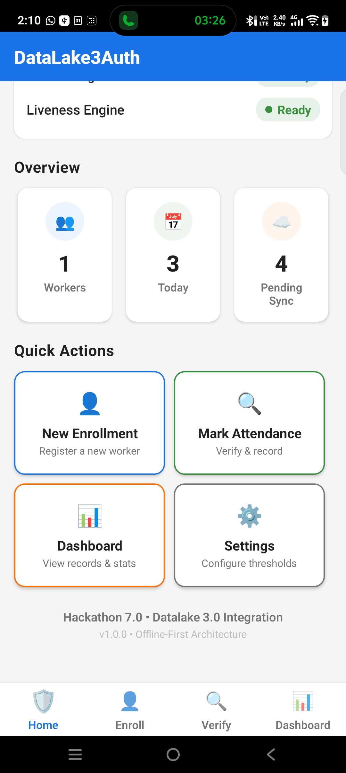
Submission-ready baseline
Android offline authentication, benchmark evidence, and AWS persistence proof are now frozen together.
APK
Source
Benchmarks
AWS
final release included
snapshot included
LFW reports included
CloudWatch + DynamoDB proof
Final folder: DataLake3Auth_Final_Submission_2026-06-04
Sync-ready Android app
Recommended live demo: enroll by video -> verify by video -> show local attendance -> tap sync -> show DynamoDB item.
DataLake3Auth | Hackathon 7.0
14

