Slide 1
SPEECH
RECOGNITION

Slide 2
PROJECT MEMBERS
Divya Mathew - 19bce10456
Anushka Khare - 19bce10273
Aditi Nigam - 19bce10300
Laveena Dudani - 19bce10378
PROJECT GUIDE
Dr Chandan Kumar Behera faculty SCSE

Slide 3
01
INTRODUCTION
Objectives of the project
TABLE OF CONTENTS
EXISTING WORK
02
Applications
Limitations
03
PROPOSED WORK
Methodology
Codes and outputs (approaches)
04
NOVELTY
VIT Directory
05
REAL TIME USAGE
Real life models (examples) of speech recognition

Slide 4
06
REQUIREMENTS
Hardware
Software
TABLE OF CONTENTS
07
LITERATURE REVIEW
Researches on speech recognition
08
MODULE DESCRIPTION
What is speech recognition?
Components of speech recognition
09
MODULE WORK FLOW EXPLANANTION
VIT Directory (Speech recognition process)
10
IMPLEMENTATION AND CODING
Implementations of STT, TTS and GUI

Slide 5
11
DEMO VIDEO
Testing of VIT Directory
TABLE OF CONTENTS
ADVANTAGES
12
Benefits of VIT Directory
13
RESULT
Results of VIT Directory
14
CONCLUSION
Summary of the whole project
15
REFERENCES
Resources which helped to build our project

Slide 6
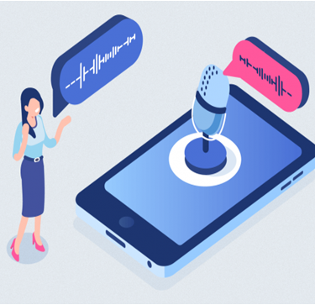

INTRODUCTION
Speech recognition is the ability of a machine or program to identify words and phrases in spoken language and convert them to a machine-readable format.
laveena

Slide 7
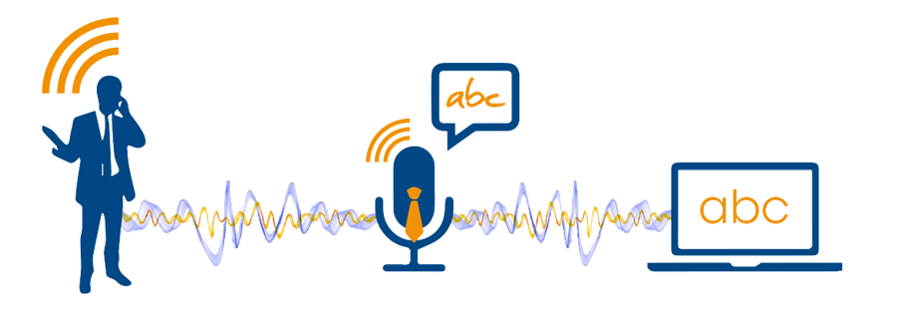
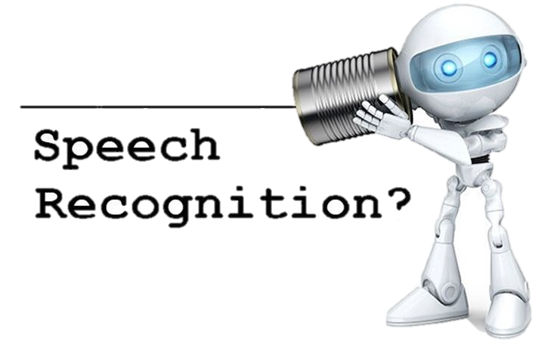
OBJECTIVES
This project focuses on the following points----
01
TO UNDERSTAND THE SPEECH RECOGNITION AND IT’S FUNDAMENTALS
02
ITS WORKING AND APPLICATIONS IN DIFFERENT AREAS
03
IMPLEMENTATION OF VIT DIRECTORY THROUGH SPEECH RECOGNITION
laveena

Slide 8
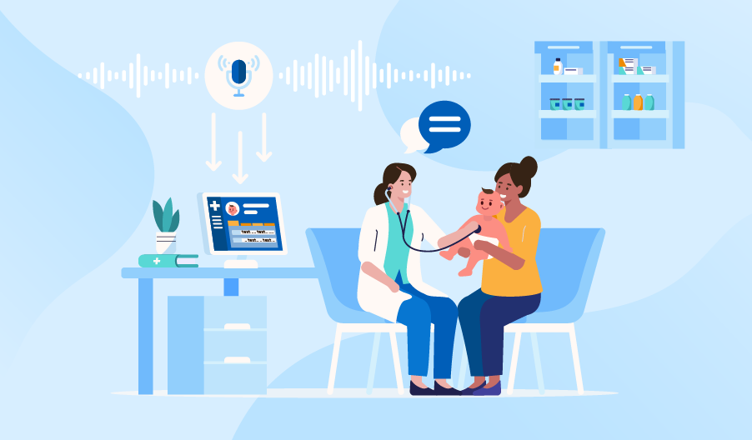
APPLICATIONS
(EXISTING WORK)
IN HEALTHCARE
HEALTHCARE
In a crucial and sterile operating conditions hands-free and immediate access to information can have a positive impact on patient’s life.
Speech recognition is especially useful for people having difficulty in using hands , where these programs are much beneficial and can be used for operating computers. (deaf telephony)
.
Quickly finding information from medical records
Less paperwork
WORKPLACE
MILITARY
LANGUAGE LEARNING
Less time inputting data
Improved workflows
IN MILITARY
BANKING
In Air force speech recognition has definite potential for reducing pilot workload.
These programs can also be trained to be used in helicopters, battle management and other applications.
aditi

Slide 9

APPLICATIONS
(EXISTING WORK)
IN LANGUAGE LEARNING
One of the most transformative applications of speech recognition technology from a human perspective is its ability to remove language barriers and cultural boundaries in aspects of social life and in the workplace.
HEALTHCARE
IN WORKPLACE
Speech recognition program incorporates simple tasks to increase efficiency, as well as beyond tasks that have traditionally needed humans, to be performed.
.
WORKPLACE
MILITARY
Search for reports or documents on your computer
Dictate the information you want to be incorporated into document
LANGUAGE LEARNING
IN BANKING
Speech recognition aims to reduce friction in banking and financial industry for the customer . A personalised banking assistant could in return boost customer satisfaction and loyalty.
BANKING
Make payments
Receive information about your transaction history
aditi

Slide 10
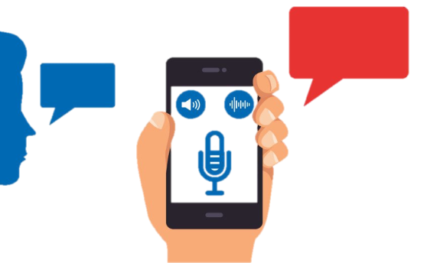
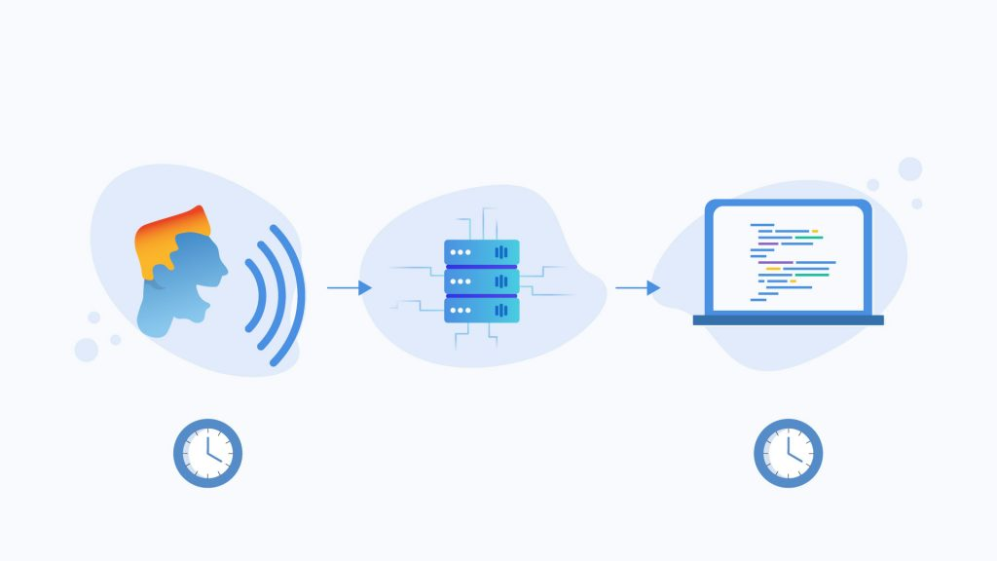
LIMITATIONS
(EXISTING WORK)
LACK OF ACCURACY & MISINTERPRETATION
Speech Recognition programs cannot understand the context of language which often leads to misinterpretations.
Speech recognition program decodes the speech and give it a meaning which may not be always accurate. For example, it cannot always differentiate between homonyms, such as "their" and "there.“
It may also have problems with slang, accents, technical words ,acronyms., Style of speaking, voice change(due to cough, cold or throat problem) and language constraints.
TIME COSTS & PRODUCTIVITY
Speech recognition programs may not always speed up our work and we may have to invest more time than expected in any process.
Some programs adapt to our voice and speech patterns over time; this may slow down our workflow until the program is up to speed.
Getting used to using a system's commands and speaking punctuation out loud is not always easy. This can affect the flow and speed of our speech.
anushka

Slide 11
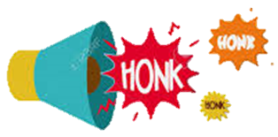

LIMITATIONS
(EXISTING WORK)
BACKGROUND NOISE INTERFERENCE
To get the best out of speech recognition program, we need to have a quiet environment such as an isolated room.
The program may not be able to differentiate between your speech and other ambient noise, leading to transcription mix-ups and errors.
PHYSICAL SIDE EFFECTS
If we use voice recognition technology frequently, you may experience some physical discomfort and vocal problems.
Talking for extended periods can cause hoarseness, dry mouth, muscle fatigue, temporary loss of voice and vocal strain.
anushka

Slide 12

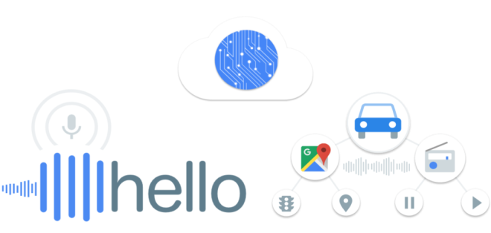
PROPOSED WORK
TEXT TO SPEECH
VIT DIRECTORY
A Program that takes input in text form and converts it into speech form.
This program uses the speech recognition technology for taking the input in speech format (faculty name) and giving the output in text format which contains the phone number and e-mail Id of each faculty and staff working in VIT Bhopal.
.
SPEECH TO TEXT (AUDIO FILE)
A Program that takes input in speech form and converts it into text form using audio file
SPEECH TO TEXT (MICROPHONE)
A Program that takes input in speech form and converts it into text form using microphone.
VIRTUAL ASSISTANCE
This program is capable of performing all operations (STT , TTS) in a single program.
anushka

Slide 13
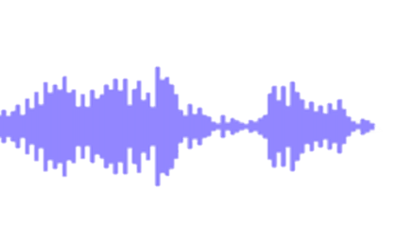
METHODOLOGY
Acoustic Front-end
SPEECH UTTERANCE
With the help of microphone audio is input the system. The pc sound card produces the equivalent digital representation of received audio. Acoustic model is responsible for signal process and feature extraction.
10%
ACOUSTIC MODEL
Acoustic Model
40%
An acoustic model is created by taking audio recordings of speech, and their text transcriptions, and using software to create statistical representation of the sound that make up each word.
FEATURE VECTOR
20%
ACOUSTIC
FRONT-END
SEARCH ALGORITHM
(DECODER)
Language Model
HYPOTHESIZED
WORD
Language model in speech recognition tries to capture the properties of a language.
30%
Lexicon
Lexicon is responsible for the pronunciation of the words.
LANGUAGE
MODEL
LEXICON
Decoder
Architecture
Decoder predicts the next word in speech sequence. At the end, the most probable word or sentence is given as output.
divya

Slide 14
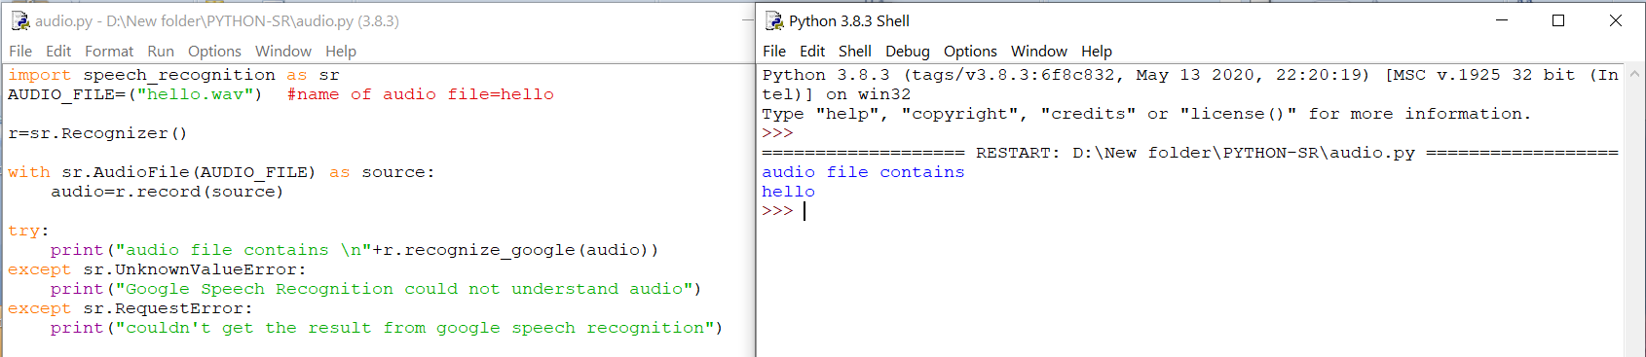
CODES AND OUTPUTS
(APPROACHES)
SPEECH TO TEXT (AUDIO FILE)
OUTPUT
CODE
divya

Slide 15
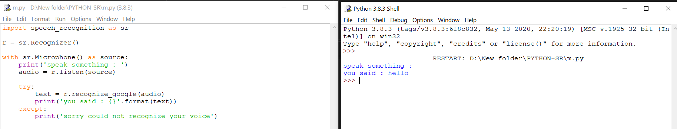
CODES AND OUTPUTS
(APPROACHES)
SPEECH TO TEXT (MICROPHONE)
OUTPUT
CODE
anushka

Slide 16
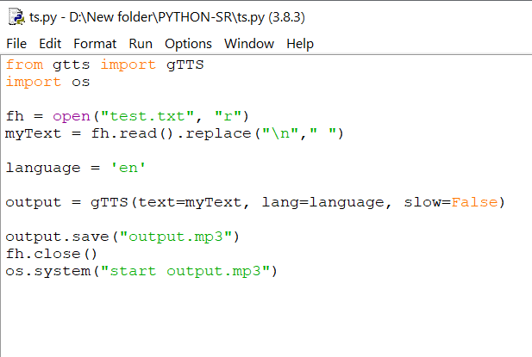
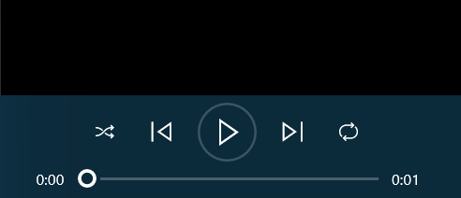

CODES AND OUTPUTS
(APPROACHES)
TEXT TO SPEECH
hello how are you
OUTPUT
CODE
aditi

Slide 17
NOVELTY OF THE PROJECT
With the help of python and its inbuilt libraries, we have developed
5 programs
The project aims to ease human lifestyle. The most significant use is to input text, check how words are spelled and to dictate messages. For some disabled people who might struggle, or find it impossible, to work with a mouse or keyboard, speech recognition enables a world of productive possibilities. It can free people from typing and keyboard use, helping those with physical impairments and reducing the risk of repetitive strain injury from excessive typing or mouse use. People with dyslexia can write more fluently, accurately and quickly using voice recognition.
Program that converts Text to Speech
2) Program that converts Speech to Text using
audio file
3) Program that converts Speech to Text using microphone
4) Virtual Assistance
5) VIT Directory

Slide 18

VIT DIRECTORY
We aim to develop a program - “VIT Directory” that contains phone number and e-mail Id of each faculty and staff working in VIT Bhopal.
Instead of spending time roaming around the college and trying to find a particular teacher, students can directly contact the teacher through this program via the given details.
All a student has to do is speak the name of the faculty and the program itself will display the details of that teacher.
VIT
DIRECTORY
BY: GROUP - 69
divya

Slide 19

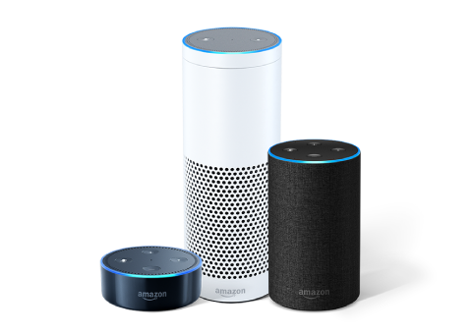
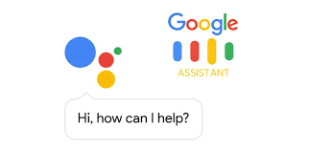

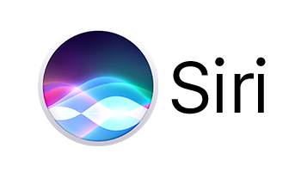
REAL TIME USAGE
Virtual Assistants
Introducing speech recognition in real life as digital assistants. Digital assistants are designed to help people perform or complete basic tasks and respond to queries. With the ability to access information from vast databases and various digital sources, these robots help to solve problems in real time, enhancing the user experience and human productivity. Popular digital voice assistants, include:
anushka

Slide 20
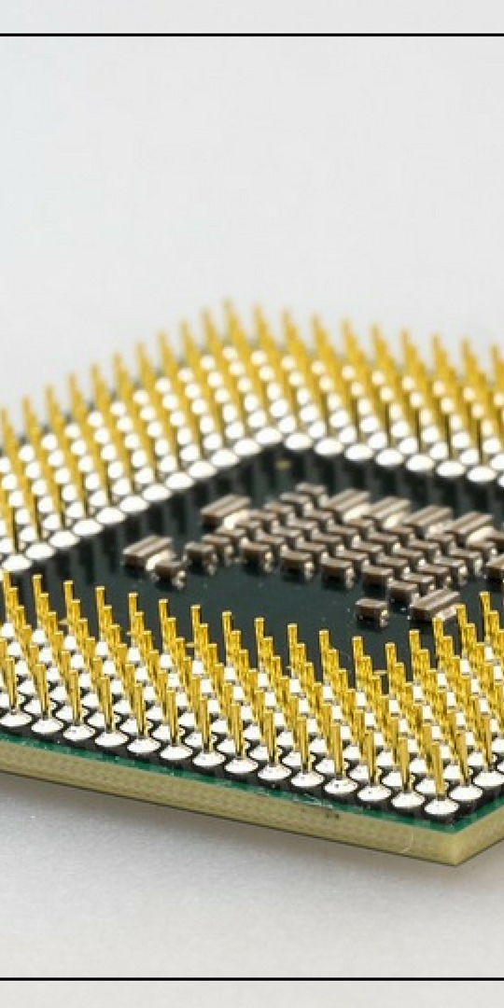
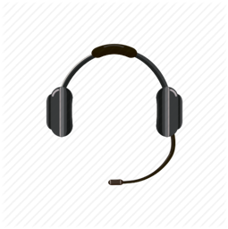

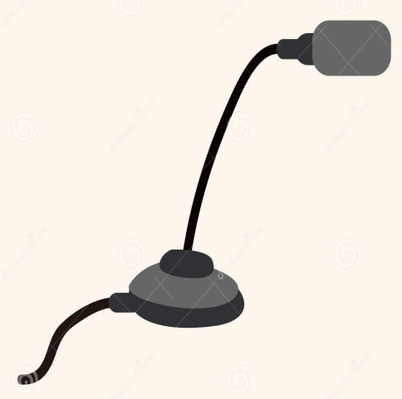
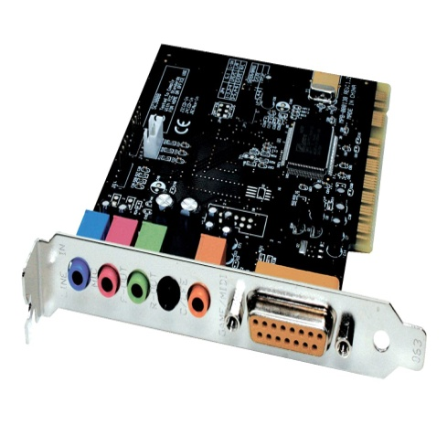
HARDWARE REQUIREMENTS
SOUND CARDS
High quality 16 bit sound card (min.)
Proper driver installed
Clear signals (A/D)
2. MICROPHONES
(desktop microphones shouldn’t be used)
Headsets – with or without earphones
(mono or stereo)
3. COMPUTER / PROCESSORS
Dependent on Processing speed
(large amount of digital filtering and signal processing takes place)
laveena

Slide 21
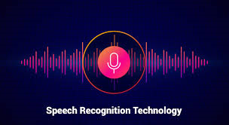


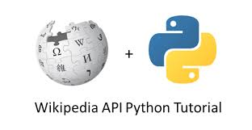
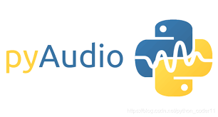
SOFTWARE REQUIREMENTS
This is a Python based program therefore, we need to have PYTHON APPLICATION installed in our system.
Included libraries are:-
Speech Recognition
gtts (google text to speech)
Pyaudio
Port Audio
Wikipedia
This library converts spoken words into text.
Installation command – pip install SpeechRecognition
This library converts the entered text into audio form.
Installation command – pip install gtts
This library is used to recognize & record the speech uttered by the user
Installation command – pip install pyaudio
This library is used to implement the recorded speech from the user.
Installation command – pip install port audio
This library is used to give information to the user as asked.
Installation command – pip install wikipedia
laveena

Slide 22

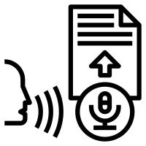
LITERTURE REVIEW
Thiang, et al. (2011) presented speech recognition using for controlling movement of mobile robot. Input signals were sampled directly from the microphone.
Ms. Vimala. C and Dr. V. Radha (2012) proposed speaker independent isolated speech recognition system for Tamil language..
Cini Kurian and Kannan Balakrishnan (2012) found development and evaluation of different acoustic models for Malayalam continuous speech recognition.
Annu Choudhary et al. (2013) proposed an automatic speech recognition system for isolated and connected words of Hindi language.
Md. Akkas Ali et al. (2013) presented automatic speech recognition technique for Bangla words.
Jitendra Singh Pokhariya and Dr. Sanjay Mathur (2014) introduced Sanskrit speech Recognition.

Slide 23
MODULE DESCRIPTION
Speech recognition, the ability of devices to respond to spoken commands. Speech recognition enables hands-free control of various devices , provides input to automatic translation, and creates print-ready dictation. It also enables personal assistants in vehicles and smart phones, such as Apple’s Siri.
Before any machine can interpret speech, a microphone must translate the vibrations of a person’s voice into a wavelike electrical signal. This signal in turn is converted by the system’s hardware—for instance, a computer’s sound card—into a digital signal. It is the digital signal that a speech recognition program analyzes in order to recognize separate phonemes, the basic building blocks of speech. The phonemes are then recombined into words.
On the other hand, continuous speech programs, such as dictation programs, must be trained to recognize an individual’s speech patterns; training involves the user reading aloud samples of text. Today, with the growing power of personal computers and mobile devices, the accuracy of speech recognition has improved markedly. Error rates have been reduced to about 5 percent in vocabularies containing tens of thousands of words.

Slide 24
COMPONENTS OF SPEECH RECOGNITION
A speech capturing Device
It consists of a microphone, which converts the sound wave signals to electrical signals and an Analog to Digital Converter which samples and digitizes the analog signals to obtain the discrete data that the computer can understand
Reference Speech patterns
The computer or the system consists of predefined speech patterns or templates already stored in the memory, to be used as the reference for matching.
A Digital Signal Module or Processor
It performs processing on the raw speech signal like frequency domain conversion, restoring only the required information etc.
Pattern matching algorithm
The unknown speech signal is compared with the reference speech pattern to determine the actual words or the pattern of words.
Preprocessed signal storage
The preprocessed speech is stored in the memory to carry out further task of speech recognition.

Slide 25
START
SPEECH IS
RECORDED
CLICKING
RECORD BUTTON
SPEECH BROKEN
INTO BITS OF SOUND
REQUIRED DATA DISPLAYED
SOUND BIT CONVERTED INTO DIGITAL FORMAT
VIT DIRECTORY
(SPEECH RECOGNITION PROCESS)
SUITABLE DATA -SEARCHED AND SELECTED ACCORDING TO TEXT
ANALYZATION OF
DIGITAL FORMAT
TEXT GOES TO DATA BASE
MOST PROBABLE WORD SELECTED
PROBABLE WORD CONVERTED INTO TEXT
divya

Slide 26
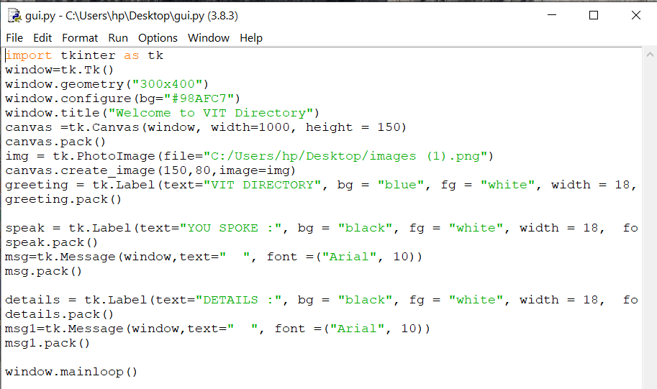

IMPLEMENTATION AND CODES
GUI OF VIT DIRECTORY
CODE
OUTPUT
aditi

Slide 27
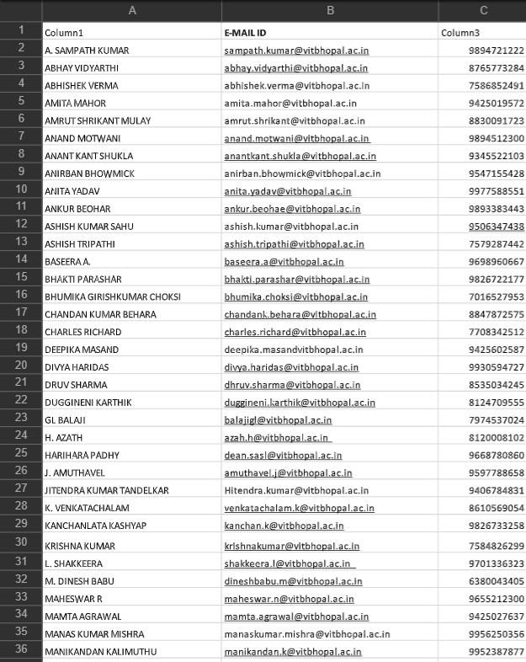
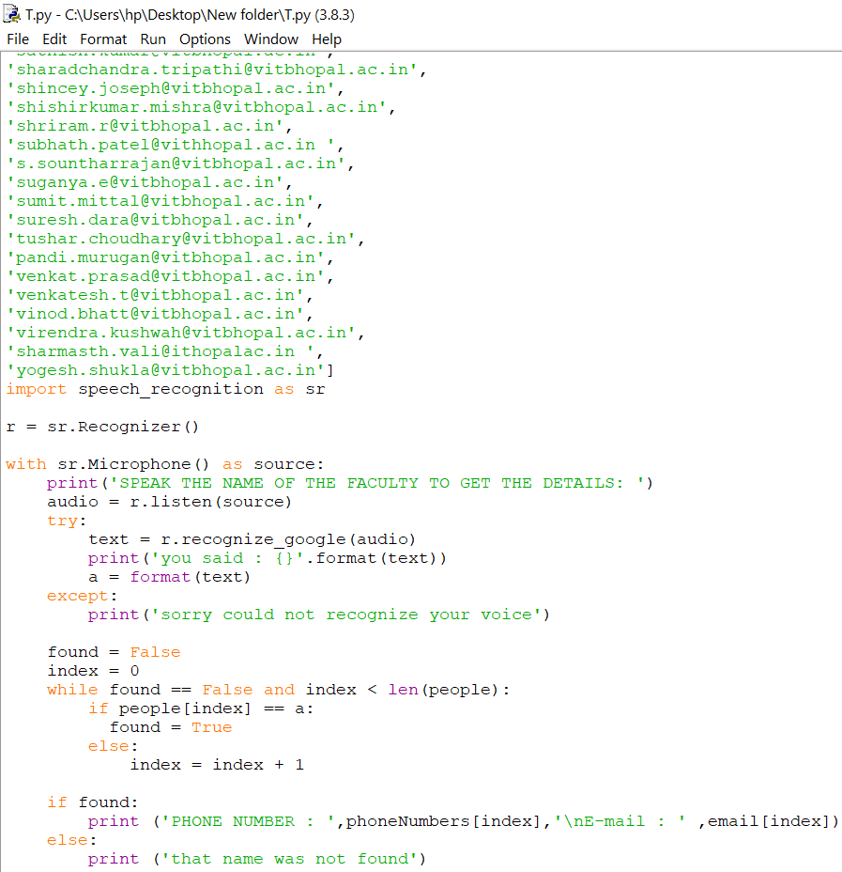
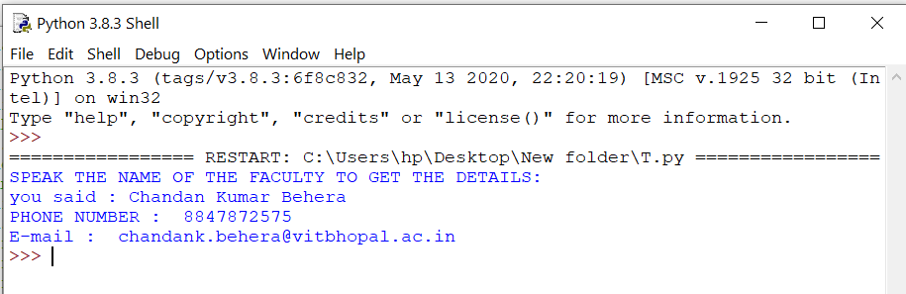
IMPLEMENTATION AND CODES
VIT DIRECTORY CODE
FACULTY
DETAILS
To check the spoken word in the list and display the details in text form
OUTPUT

Slide 28
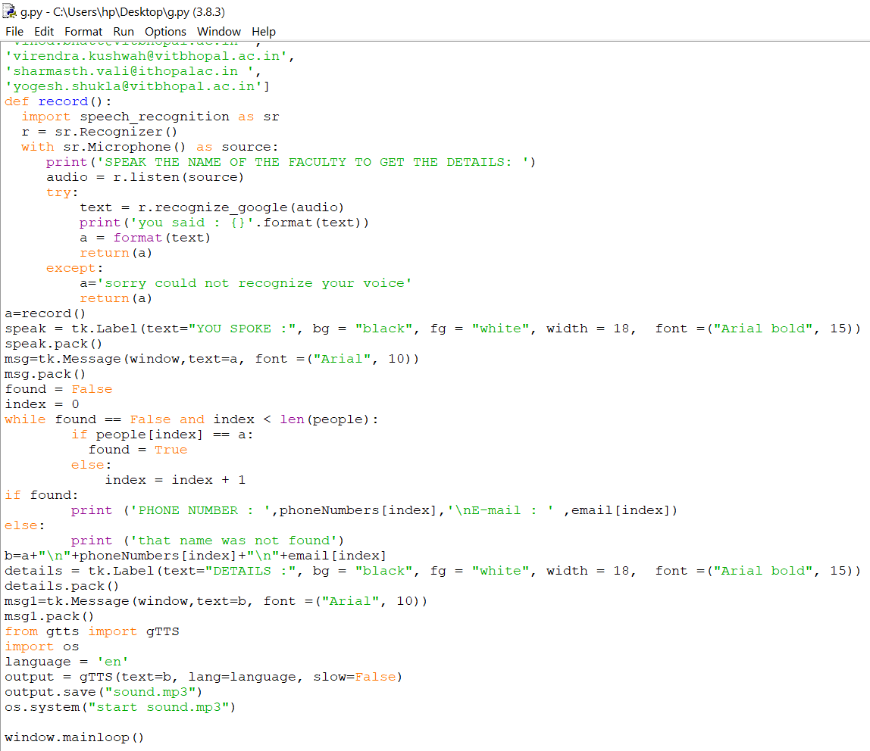
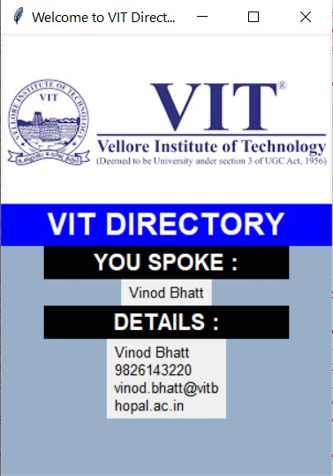
IMPLEMENTATION AND CODES
CODE
Implementation of speech recognition
To check the spoken word in the list and display the details in text form
Implementation of GUI
The details are spoken ---
Text to speech implemented
OUTPUT

Slide 29

DEMO VIDEO

Slide 30
ADVANTAGES OF VIT DIRECTORY
(PROPOSED WORK)
FAST CONSULTANCE
PERSONEL SUPPORT
BETTER UNDERSTANDING
SAVES
TIME
Through this program students can directly consult to the teacher much faster.
Students can get personnel assistance with their concerned teacher.
Doubt clearance and submission of various assignments will become much easier.
This program will save the time of a student to search for a student.
divya

Slide 31
RESULT
“VIT Directory” contains phone number and e-mail Id of each faculty and staff working in VIT Bhopal.
Now there is no need to get troubled for finding the faculty here and there, they can directly contact the teacher through this program .
All a student has to do is speak the name of the faculty and the program itself will display the details of that teacher.

Slide 32
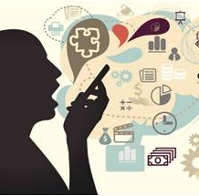
CONCLUSION
This presentation started with a brief introduction of speech recognition which stated the objectives , brief of existing work and limitations. Later we discussed about our proposed work which included our proposed approach on VIT DIRECTORY and it's advantages. We also discussed the software hardware used for bringing the idea into practical work. A detailed explanation of how speech recognition works on VIT DIRECTORY was given through a UML diagram and GUI of our program.
Speech recognition if implemented properly can ease human lifestyle. For some disabled people who might struggle, or find it impossible, to work with the mouse or keyboard, speech recognition enable a world of productive possibilities. It can free people from typing and keyboard use, helping those with physical impairments and reducing the risk of repetitive strain injury from excessive typing or mouse use.
20
aditi

Slide 33
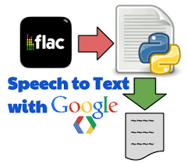
REFERENCES
www.python.org
https://nptel.ac.in/courses
Mark Summerfield, “Programming in Python 3”,
2nd Edition, Pearson Education, 2011
Harvey M. Deitel, “Python – How to program” ,
Prentice Hall, 2002
Michael Dawson, “Python Programming for the
Absolute Beginner”, Third Edition, Cengage Learning, 2010.
Mark Lutz, “Learning Python”, 4th Edition, O’Reilly, 2000.
21

Slide 34
THANK YOU

