Slide 1
SALARY PREDICTION

Slide 2
Table Of Contents
Feature
Engineering
Data Overview
Model Selection and Performance
Problem
Overview
Data
Acquisition
Takeaways

Slide 3
Problem Overview
GOAL
Predict salaries of employees by leveraging Machine Learning techniques
POTENTIAL INTERESTED PARTIES
Websites like Glassdoor or Paysa wanting to understand and predict salaries for jobs that they don’t have the data for
DATA SOURCE
CSV file
OUTCOME
Create a predictive model with the utilization of numerical and categorical data to predict salaries.

Slide 4
Data Overview
6
CATEGORICAL FEATURES
2
NUMERICAL FEATURES
JobId, CompanyId, jobType, degree, major, industry
Years of Experience, Miles from Metropolis
0
DUPLICATED ROWS
1M
ROWS
There is no missing data
There are 1 million rows of data

Slide 5
Data Acquisition + Outliers
We got lucky with not having to deal with any challenges around data storage and no duplicate values
In real life this wont be the scenario so we need to be prepared in terms of identifying what to do when we come across missing data or corrupt data
Regarding Outliers, there were 5 rows where salary was 0 for the roles that were obviously non voluntary so we removed those rows.
There were also 20 rows for salaries more than 220.5k and this was for majorly Junior roles that were in the high paying industries so we KEPT this data in the final analysis.

Slide 6
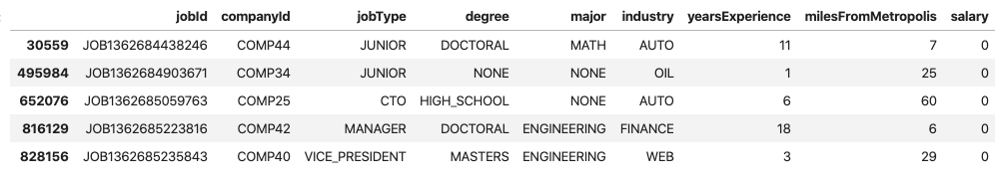
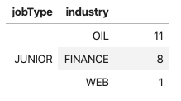
The above chart shows the jobs with salaries less than 8.5k and we can conclude that this is just bad data
The above insight shows that we have junior roles that pay more than 220.5k mostly in the high paying industries

Slide 7
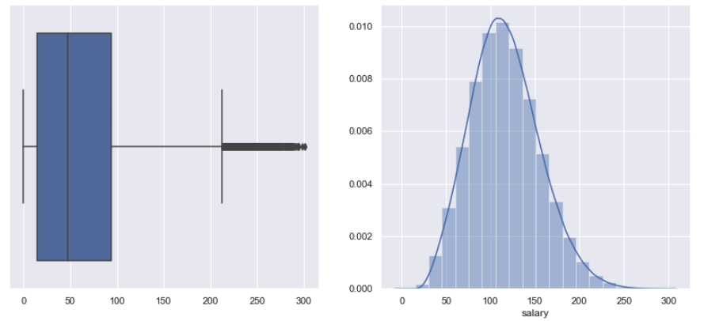
Target variable
Target Variable: Salary
Distribution: Normal
Boxplot: Shows Interquartile Range between 20k to 90k for Salaries, outliers are in the range of 210k to 300k.
These outliers can be seen in depth in the previous slide.

Slide 8
Exploratory Data Analysis
Insights
Salaries are weakly correlated to companyId
Salaries are higher for upper exec level jobs
Salaries are higher for higher levels of degrees obtained by students
Salaries are higher for STEM majors (CompSci, Bioengineering, Math), Business is the only non STEM major earning higher salaries
People in the web, finance and the oil industry earn higher salaries
Salaries are positively correlated with years of experience
Salaries are negatively correlated with distance from the center of a metropolis, so the more in suburbs you go the lower the salaries
The numbered bullets correspond to the number in the figures in the following slides

Slide 9
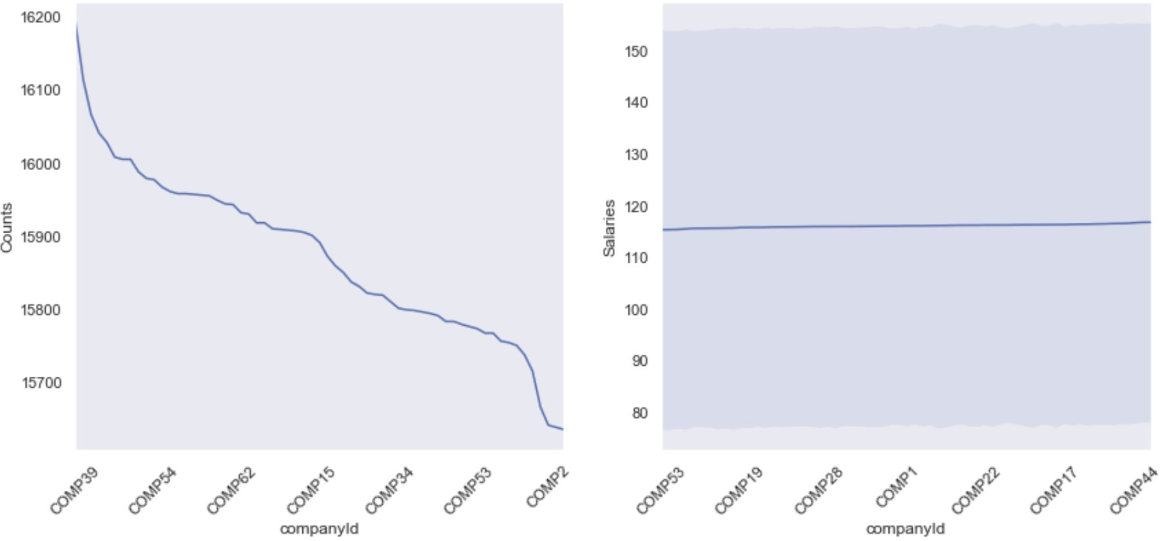
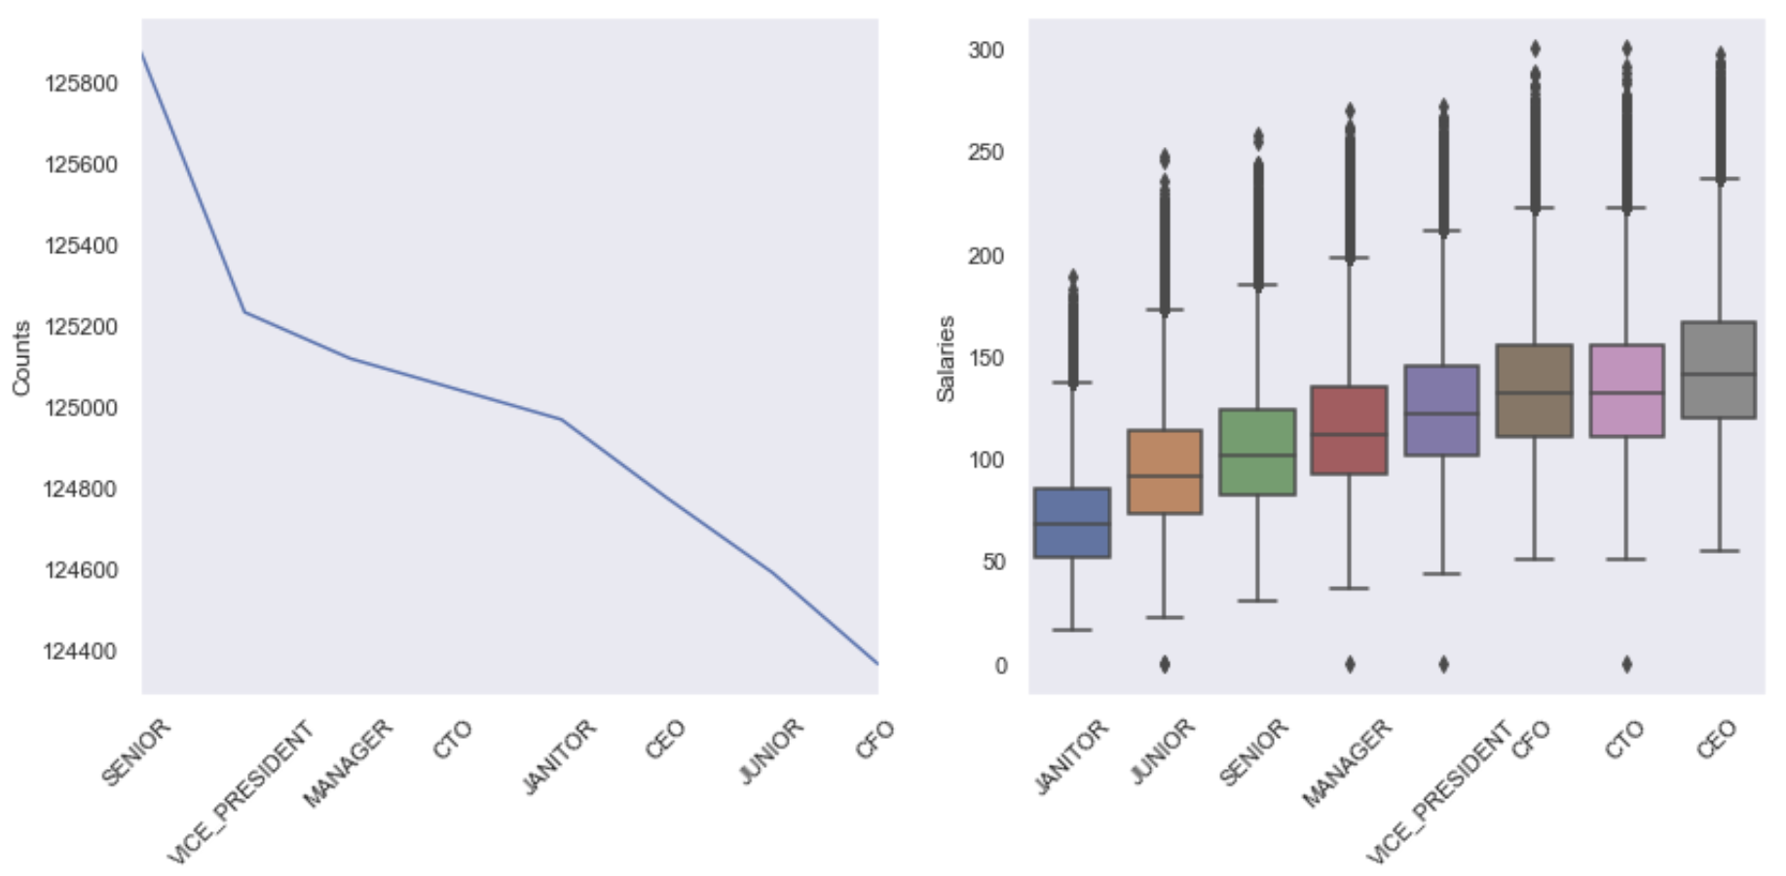
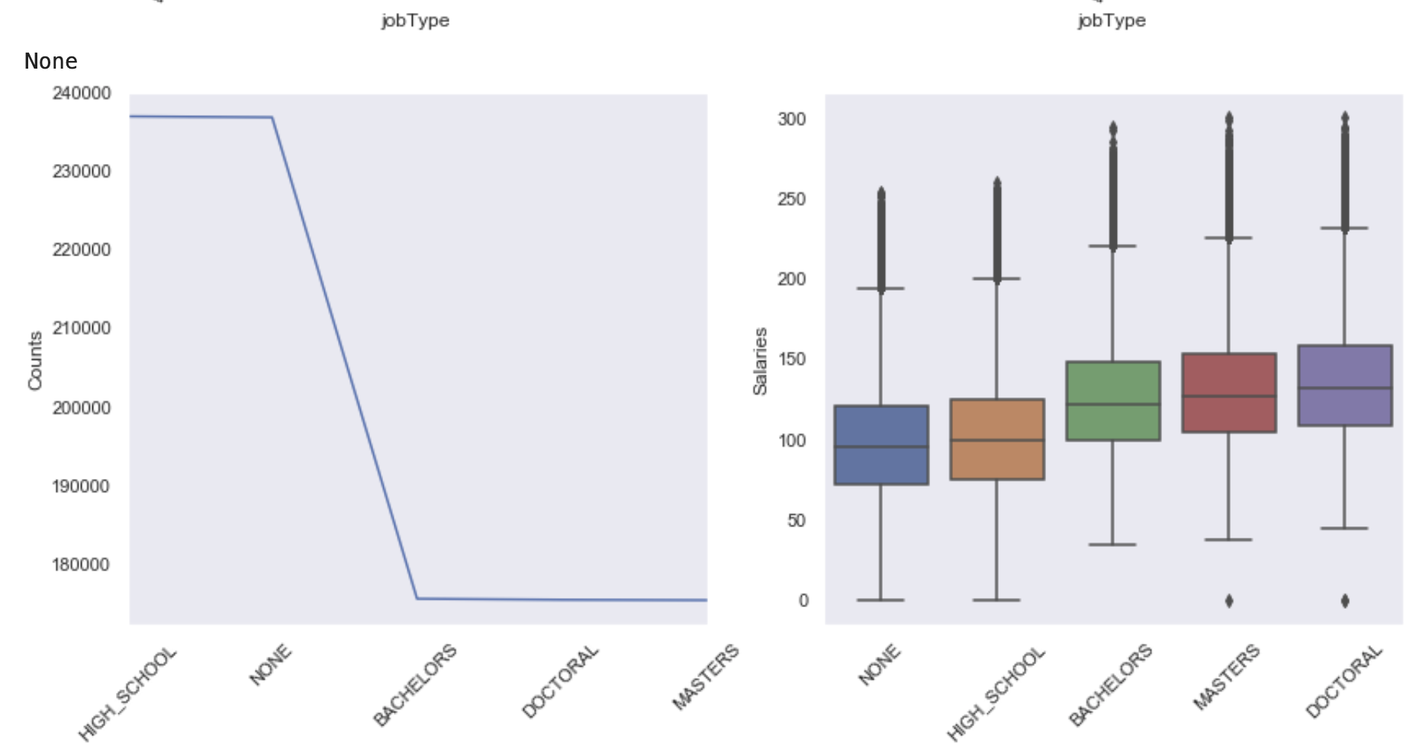
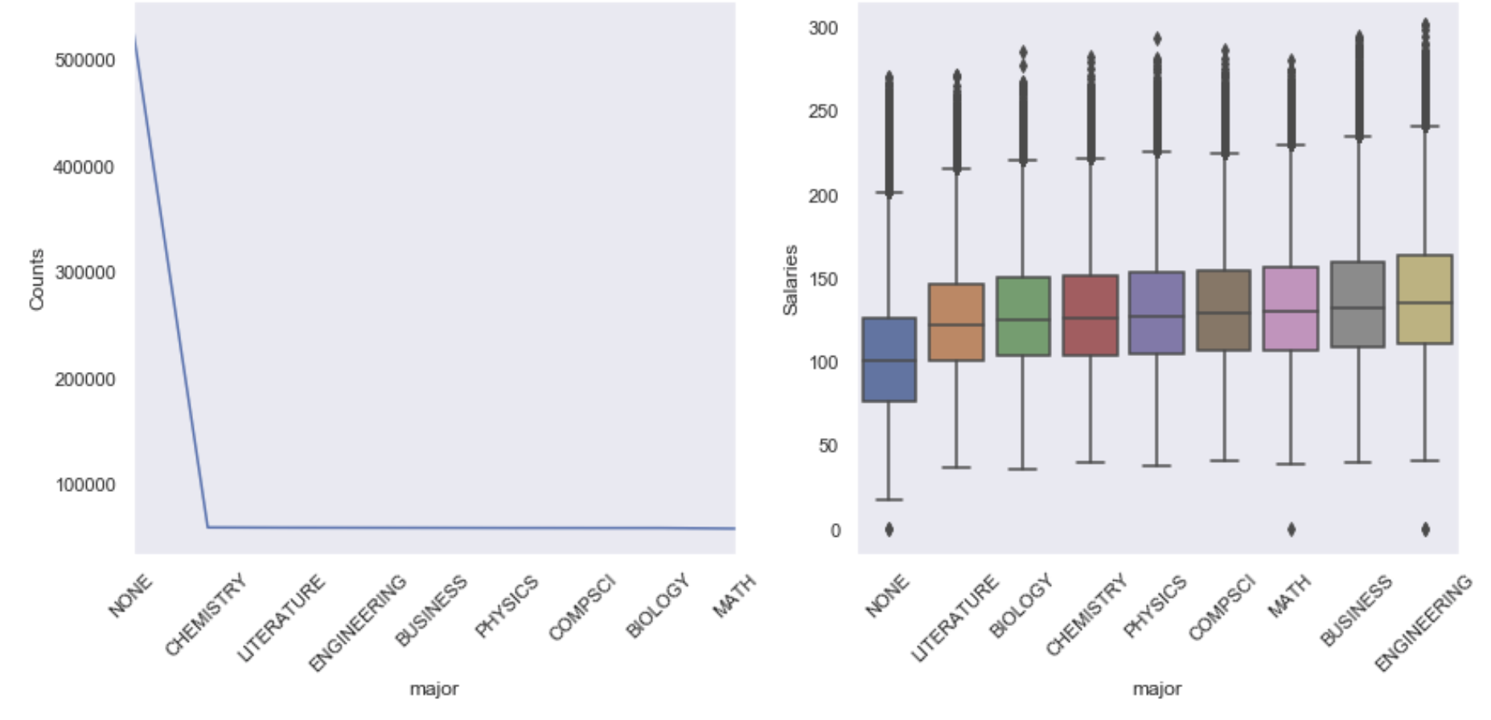
1.
2.
3.
4.

Slide 10
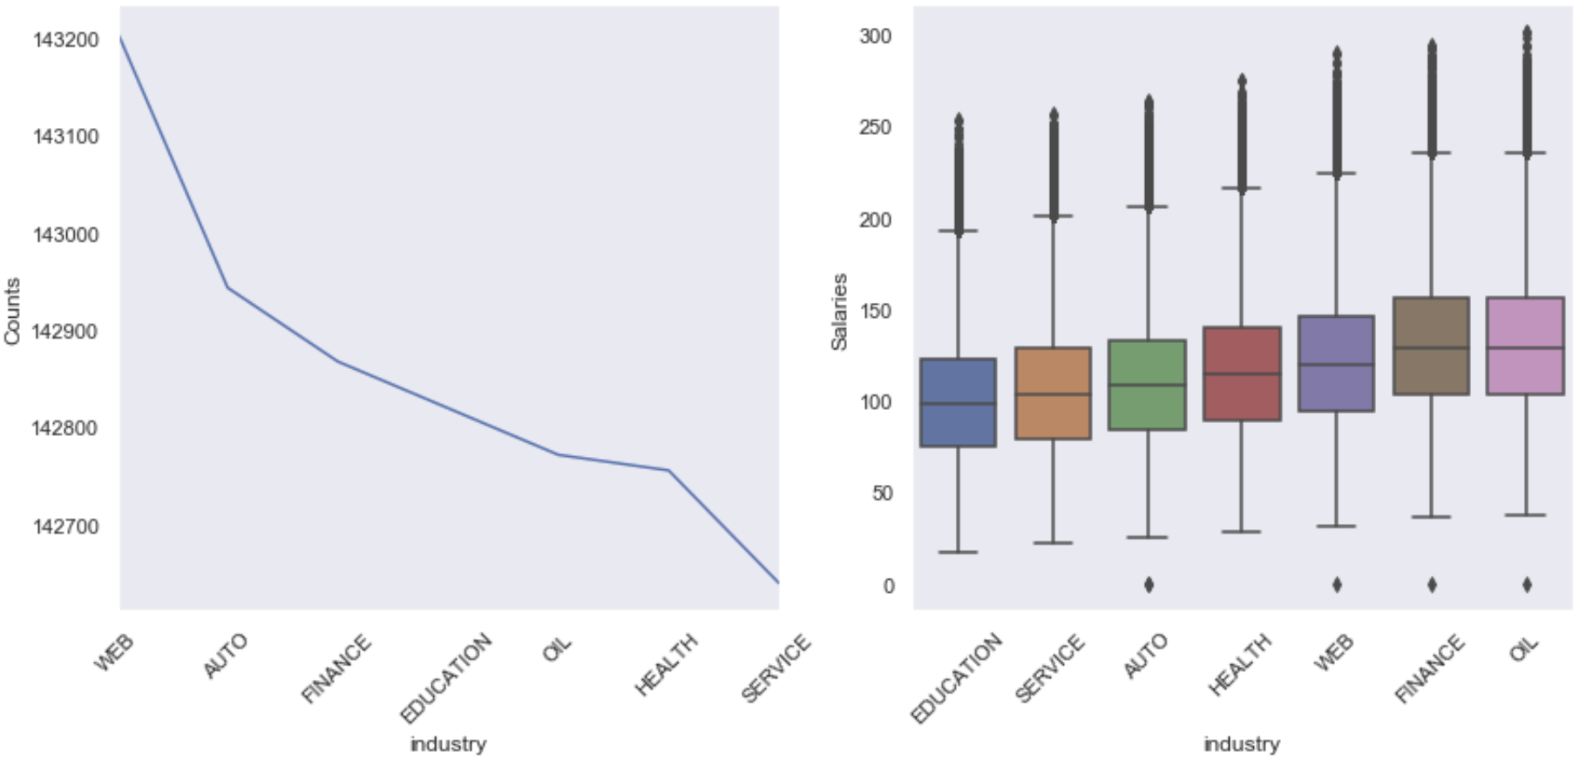
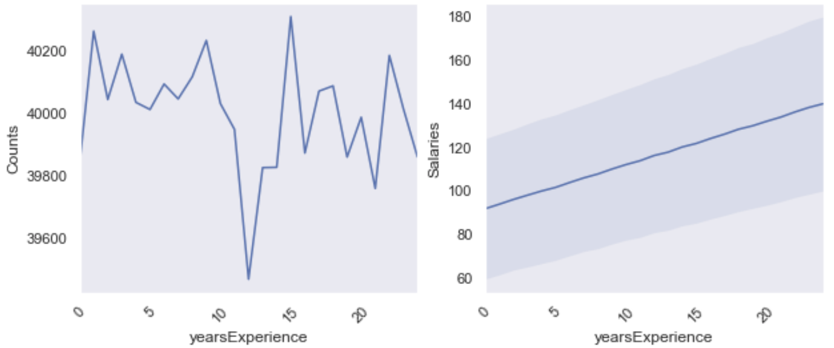
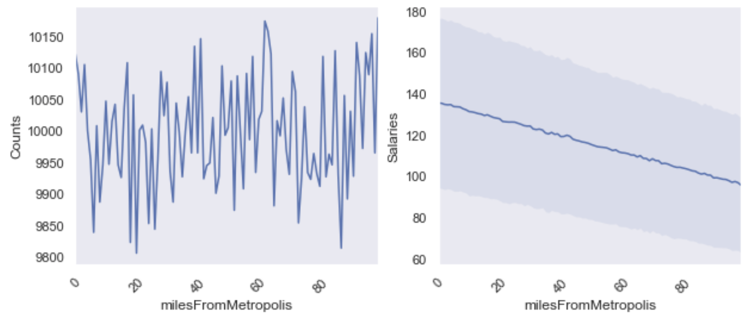
5.
6.
7.

Slide 11
Feature engineering and selection
A total of 7 features were used in the building of the model.
We got rid of JobId feature since that was noise and provided no signal towards building the model.
Since 5 of the 7 features were categorical data we had to encode them into numerical features.
Two of the 7 features (degree, jobType) had ordinal data so we chose to encode them ordinally instead of dummies like we did with the rest of the categorical features.

Slide 12
Model Selection
Our goal was to try and predict the salaries which is something Regression Models do really well, hence the following four approaches were used.
Linear Regression – Baseline
Linear Regression after Standard Scaling and Dimensionality Reduction (PCA)
Random Forest Regressor
Gradient Boosting Regressor
NOTE: The Random Forest Regressor and Gradient Boosting Regressor hyperparameters were tuned by hand.

Slide 13
Model Performance
Linear Regression
MSE : 394.46
Pipeline of Standard Scaler, PCA, LR
MSE: 394.46
Random Forest Regressor
MSE: 366.18
Gradient Boosting Regressor
MSE: 356.73
MSE = Mean Squared Error

Slide 14
Takeaways and next steps
Our Best model (Gradient Boosting Regressor) gave us a mean squared error (MSE) of 356.73 which is good but it can be improved upon and pushed even lower by doing extensive feature engineering such as adding polynomial features or adding grouped statistics as a feature.
We can attempt to test other models such as Lasso Regression to come up with a better performing model, and also use GridSearch or RandomSearch to tune the hyperparameters instead of by hand.
Next steps involve using the insights learned from this project to attempt a higher difficulty project to improve analytical skills even further.

