Slide 1
NON FUNCTIONAL TESTING
TASK-9

Slide 2
Difference Between Functional Testing and Non Functional Testing
Functional testing checks the correctness of internal functions
Non-Functional testing checks the ability to work in an external environment.

Slide 3
TYPES OF NON-FUNCTIONAL TESTING
GUI/UI TESTING
USABILITY TESTING
SECURITY TESTING
COMPATABILITY TESTING
PERFORMANCE TESTING
RECOVERY TESTING
INSTALIZATION TESTING
UNINSTALIZATION TESTING
GLOBALIZATION TESTING
LOCALIZATION TESTING

Slide 4
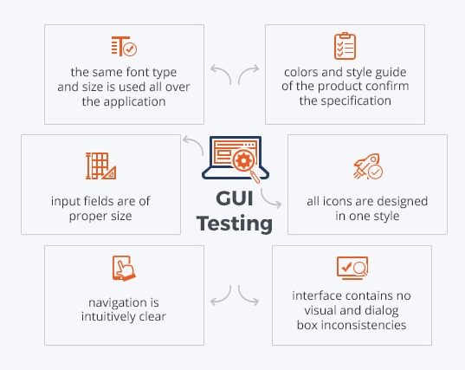
GUI/UI TESTING

Slide 5

USABILITY TESTING
VALIDATING THE USER FRIENDLYNESS
CHECKING DOES THE APPLICATION IS UNDERSTANDABLE

Slide 6
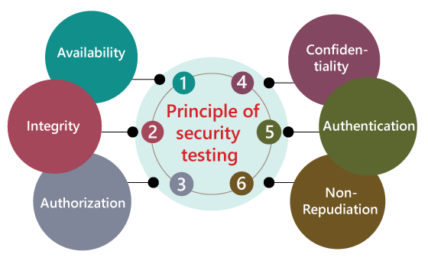
SECURITY TESTING

Slide 7
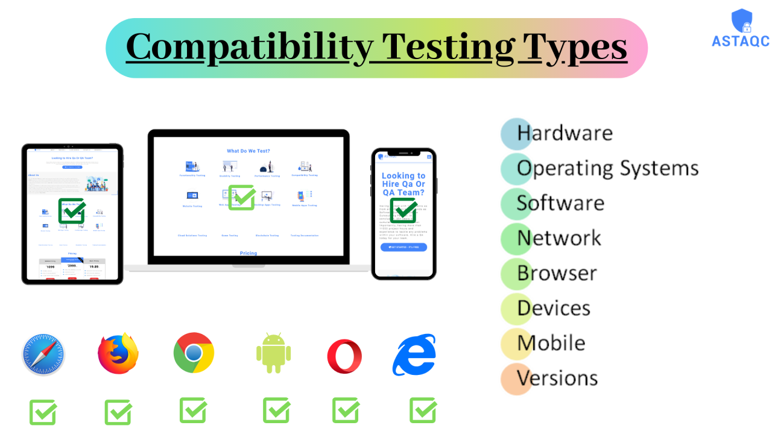
COMPATABILITY TESTING

Slide 8
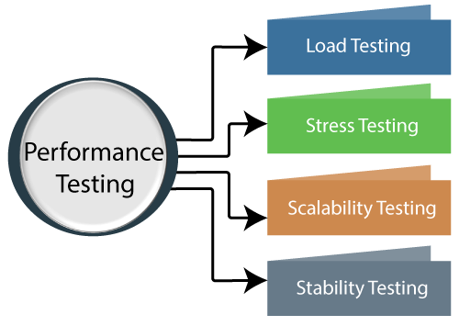
PERFORMANCE TESTING

Slide 9
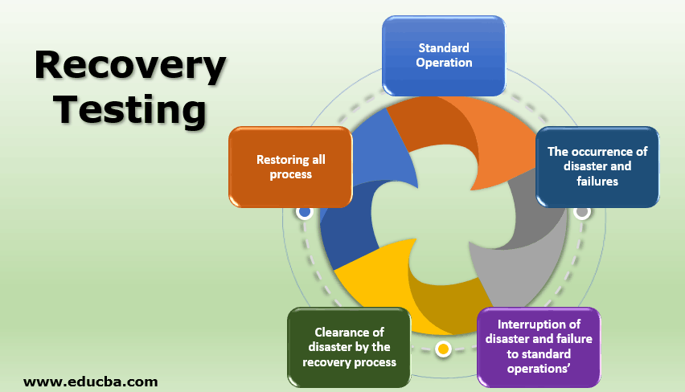
RECOVERY TESTING

Slide 10
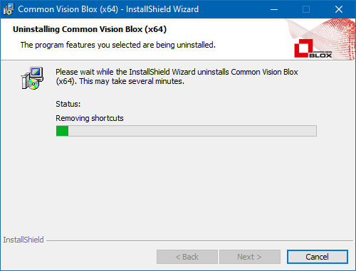
INSTALIZATION AND UNINSTALIZATION TESTING

Slide 11
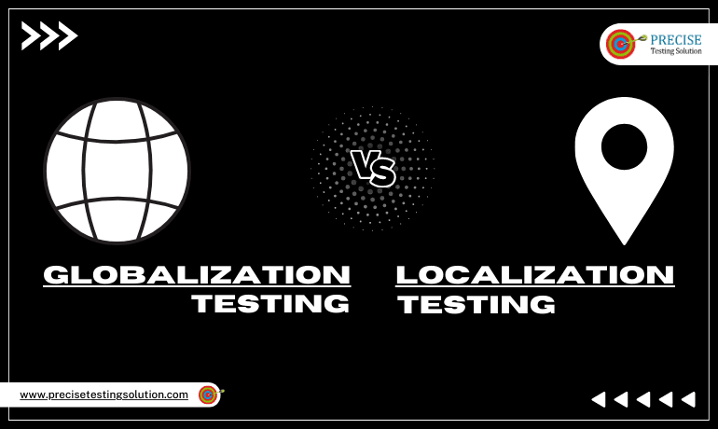
GLOBALIZATION & LOCALIZATION TESTING

Slide 12

THANK YOU

