Slide 1
SAHARA Donation Website
Project by:
Divya Mhetre
Aishwarya Khude
Akash Shedage
Akshay Shende
Mahesh Nagtilak
Shubham Maghade
Guidance:
Srinivas Sir

Slide 2
Introduction:
Sahara is a web-based application which bridges the gap between the Donor and Organizations like NGO/Orphanage.
Donor can donate food packets and Organization can ask for help by visiting the website and providing the details about their need.
This platform provides separate view for each user role for fulfilling their need.
Platform also supports shipping management to pick up and drop food packages to different location.
The donation will be safely reach to the intended organization..

Slide 3
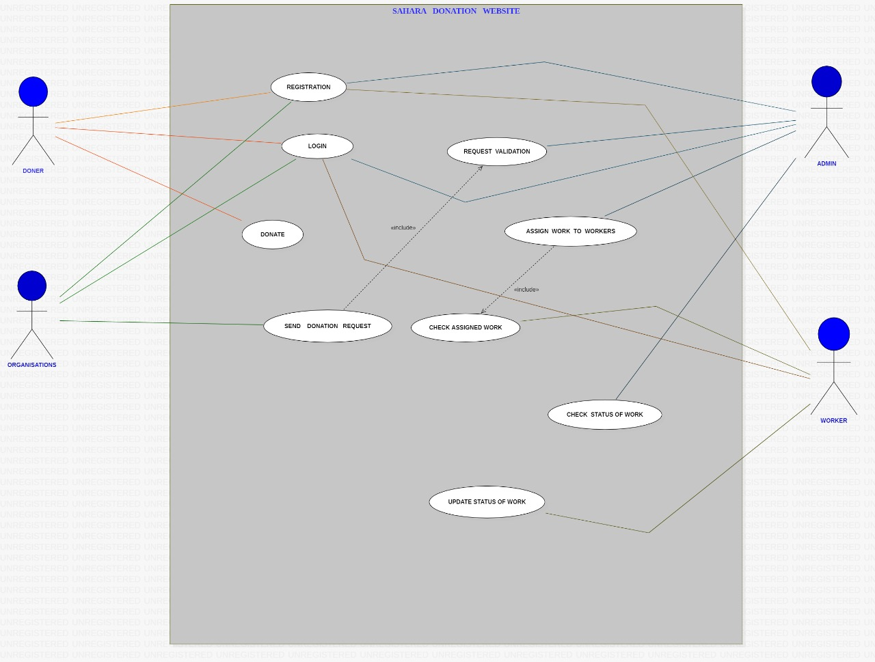

Slide 4
Functionality provided by website For Donor :
Register as donor.
Login as donor.
Donate Food packets for needy people

Slide 5
For Needy Organization :
Register as needy Organization
Login as needy Organization
Submit the required details and ask for donation.

Slide 6
For Volunteer Member :
Registration for New volunteer member
Login for volunteer.
Manager will schedule volunteer to pick up donation (Food packets) as per information provided by donor.
Volunteer will checkout the schedule provided by manger and complete the task.

Slide 7
Thank you……

