Slide 1

ACADEMIC PRESENTATION
Expense Tracker Automation
n8n + Google Forms + Google Sheets
Devansh 2520982555
Sidharth 2520982733
Divyam 2520982563
Aastha 2520982504
Himanshu 2520982593

Slide 2
PROBLEM STATEMENT
The Manual Expense Process: A Business Bottleneck
Most organizations still rely on paper-based or spreadsheet-only expense reporting — a process that is slow, error-prone, and difficult to audit. Without automation, finance teams lose hours every week on repetitive data handling instead of strategic analysis.
⏱ Delays
❌ Errors
Manual approvals and data entry create bottlenecks, delaying reimbursements by days or weeks.
Human mistakes in data entry lead to incorrect expense records and financial discrepancies.
📂 Missing Records
🔍 No Visibility
Paper receipts and untracked submissions result in lost documentation and audit gaps.
Finance teams lack real-time insight into spending patterns, making budget control nearly impossible.

Slide 3


PROPOSED SOLUTION
Automated Expense Tracker: End-to-End Workflow
The proposed system replaces the entire manual process with a fully automated pipeline. Employees submit expenses via a Google Form, data is stored in Google Sheets, and n8n automatically processes, categorizes, and notifies the finance team — all without human intervention.
Submit Form
Store Sheet
n8n Trigger
Categorize
Notify Finance
This pipeline ensures every expense submission is captured, validated, categorized, and communicated in seconds — enabling finance teams to focus on decision-making rather than data entry.
Real-Time Processing
Fully Automated
Centralized System
Every submission is processed instantly — no waiting for batch updates or manual review cycles.
n8n orchestrates the entire flow: triggers, logic, data transformation, and email delivery — zero manual steps.
All expense data lives in a single Google Sheet, creating a unified, auditable record for the entire organization.

Slide 4
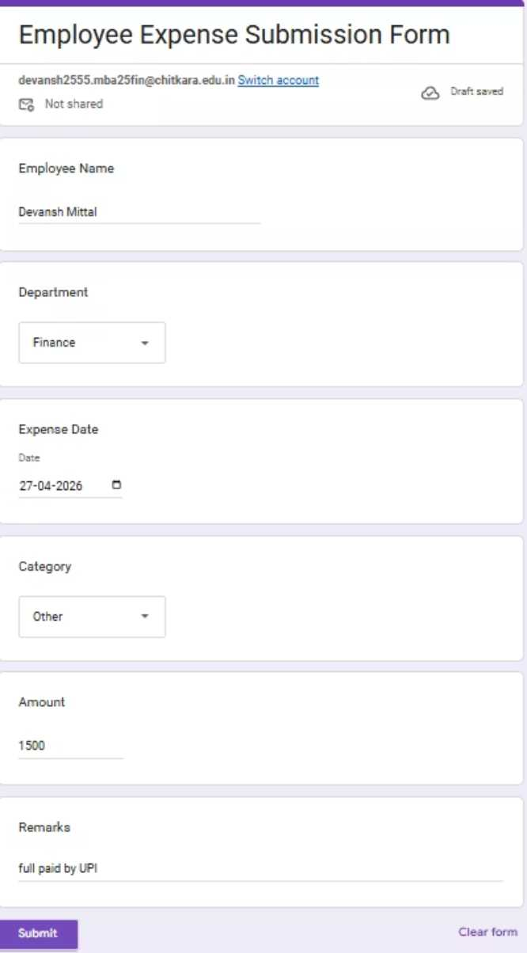
WORKFLOW DESIGN
Step-by-Step Data Flow
Each stage of the workflow is designed for reliability and transparency. Below is a detailed breakdown of how data moves from submission to notification.
1.
Form Submission
Employee fills out a structured Google Form with fields: Name, Department, Expense Type, Amount, and Remarks from raw form data into a structured object for downstream processing.

Slide 5
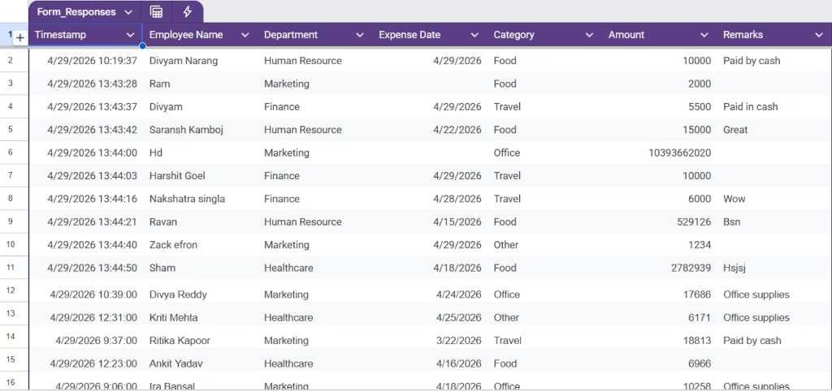
2.
Data Storage
Google Forms automatically appends each submission as a new row in the linked Google Sheet — timestamped and organized.

Slide 6
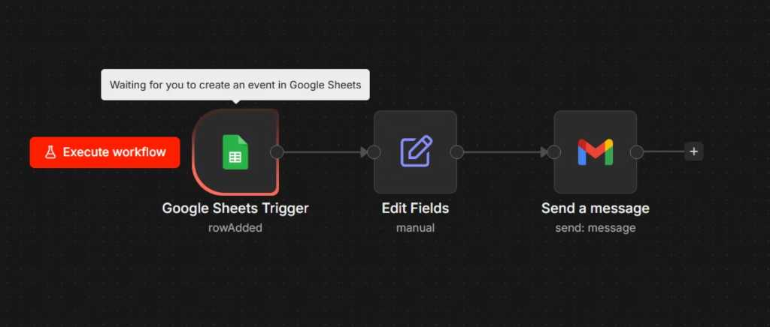
3.
n8n Trigger
n8n's Google Sheets trigger node detects the new row in real time and initiates the workflow automatically.

Slide 7
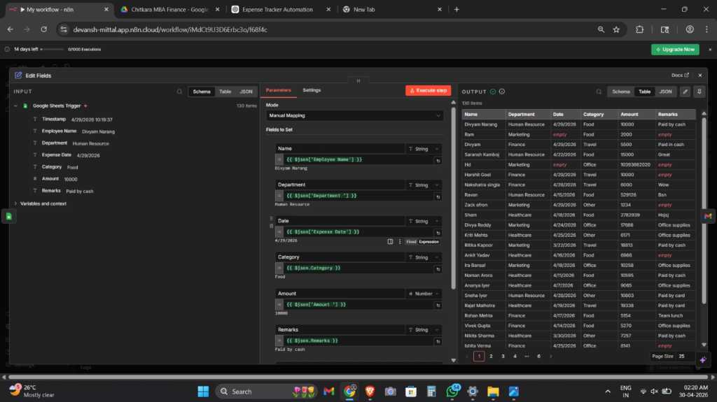
4.
Data Processing
The Set Node maps and formats raw form data into a structured object for downstream processing.

Slide 8
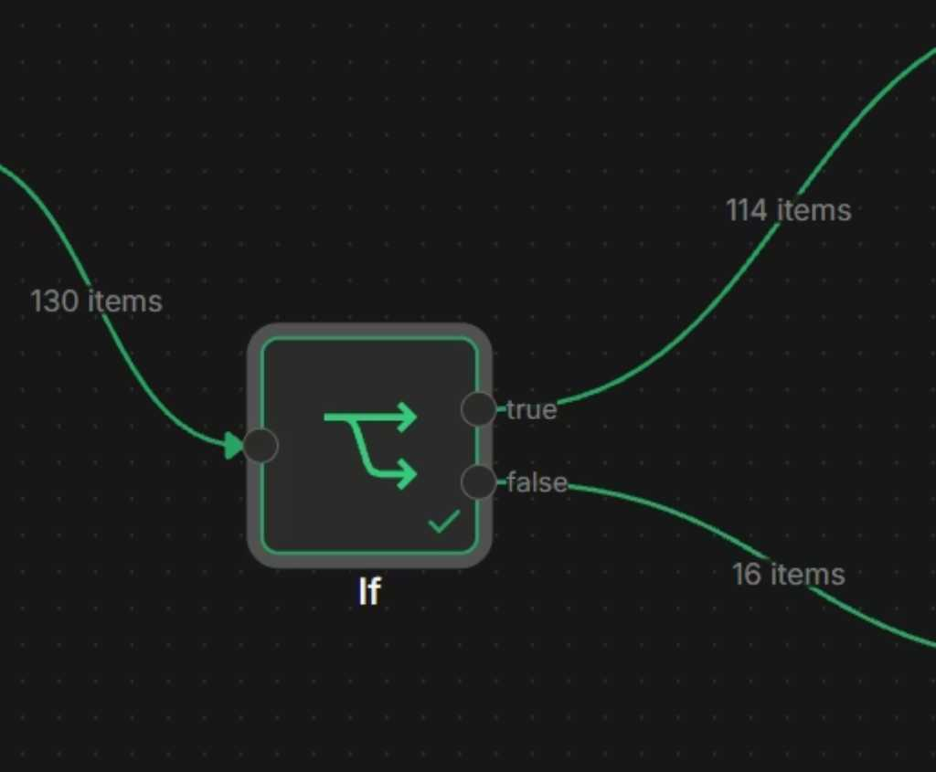
5.
Conditional Logic
The If Node evaluates the expense amount: above ₹5,000 is flagged as "High Expense"; below is "Normal Expense."

Slide 9
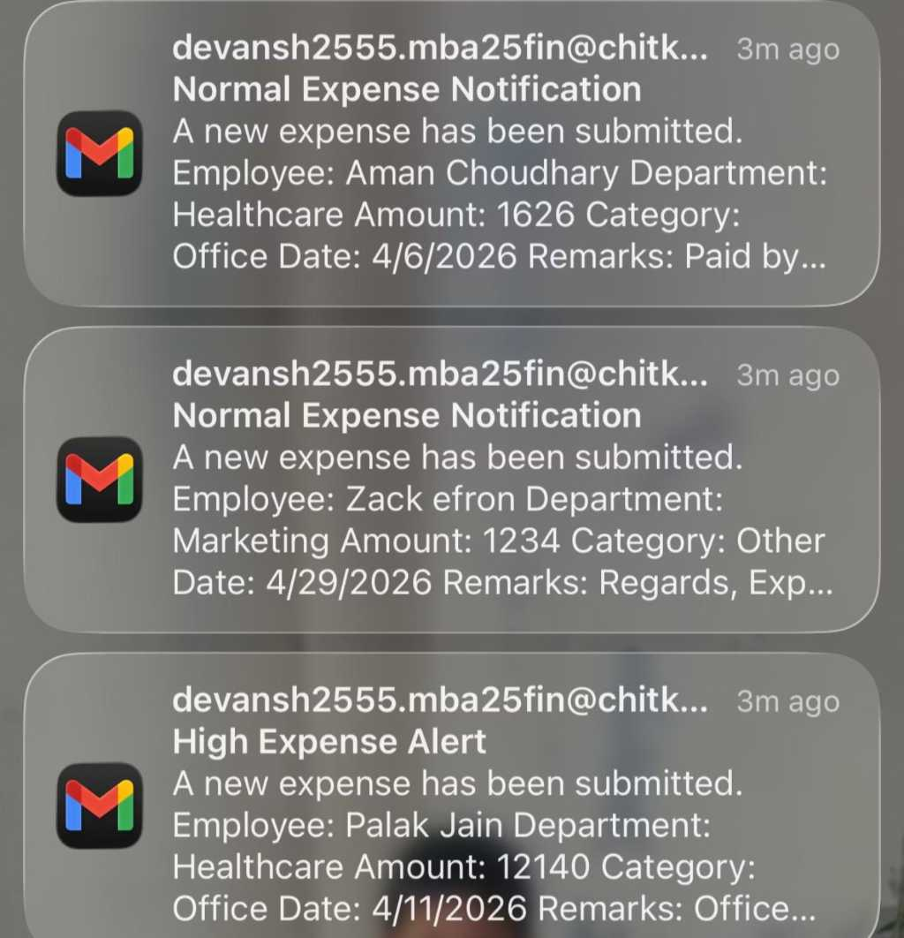
6.
Email Output
The Gmail Node sends a formatted alert to the finance team with expense details and category classification.

Slide 10
TOOLS USED
Technology Stack Overview
The automation leverages a lightweight, no-code stack that is free to use, easy to configure, and enterprise-ready. Each tool plays a specific role in the pipeline.
Google Forms
Google Sheets
Captures structured expense submissions from employees. Fields include Name, Department, Expense Type, and Amount.
Acts as the centralized database. Stores all submissions with auto-generated timestamps for audit trails.
n8n
Gmail Node
Open-source workflow automation platform. Orchestrates triggers, logic, data transformation, and notifications.
Sends automated email alerts to the finance team with formatted expense details and category classification.
Set Node
If Node
Maps and renames raw form fields into clean, structured data objects for consistent downstream processing.
Applies the core finance rule: evaluates whether expense amount is above or below the ₹5,000 threshold.

Slide 11
FINANCE LOGIC
Core Automation Rule: Expense Classification
The heart of this automation is a simple but powerful finance rule embedded in the n8n If Node. Every expense is automatically classified based on a predefined threshold, enabling instant prioritization for the finance team.
High Expense
Normal Expense
Condition: Expense Amount > ₹5,000
Condition: Expense Amount ≤ ₹5,000
Flagged for immediate review. Finance team receives an urgent alert with full expense details for priority approval.
Logged automatically. Finance team receives a standard notification for routine record-keeping and monthly reconciliation.
How the If Node Works
Why This Matters in Finance
The If Node reads the amount field from the incoming data object and evaluates the condition. Based on the result, the workflow branches into two separate paths — each with its own email template and alert priority.
Threshold-based classification is a standard internal control in corporate finance. Automating this rule ensures consistent enforcement, eliminates subjective judgment, and creates an auditable trail of every classification decision.

Slide 12


OUTPUT DEMONSTRATION
Automated Email Notification System
Once the workflow processes an expense, the finance team receives an instant, formatted email alert. This eliminates the need to manually check spreadsheets and ensures no expense goes unnoticed.
Sample Email Alert — High Expense
Subject: ⚠️ High Expense Alert — ₹7,200
Employee: Arjun Mehta
Department: Marketing
Expense Type: Client Entertainment
Amount: ₹7,200
Category: High Expense (> ₹5,000)
Action Required: Please review and approve.
What Each Output Shows
Form Input: Employee-submitted data captured in real time
Sheet Data: Full audit trail with timestamps in Google Sheets
n8n Workflow: Visual execution log showing each step's status
Email Alert: Instant notification with expense classification
Benefit to Finance Team: Automated alerts eliminate manual monitoring. Finance staff are proactively notified of every submission — especially high-value expenses requiring immediate attention — reducing response time from days to seconds.

Slide 13
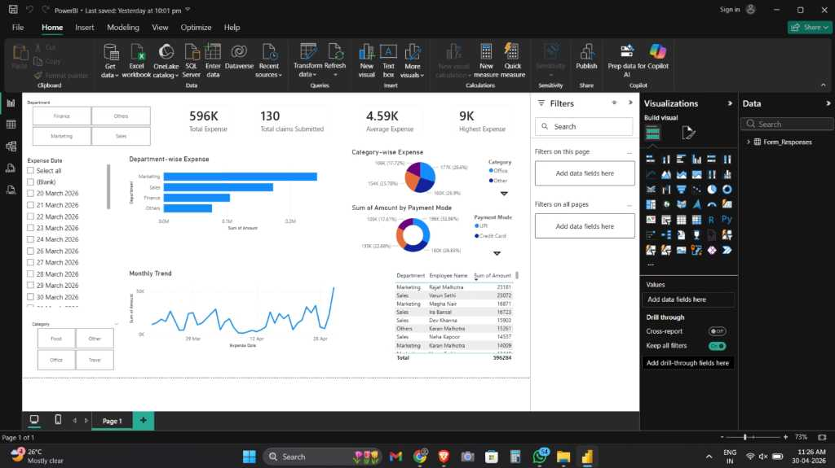
Power BI

Slide 14
BENEFITS & CONCLUSION
Business Impact & Future Scope
This automation delivers measurable improvements across every dimension of expense management — from processing speed to financial control. The system is also designed to scale as organizational needs grow.
Faster Processing
Real-Time Tracking
Reduced Manual Work
Expenses are categorized and communicated in seconds, not hours or days.
Finance teams gain instant visibility into all submissions via the centralized Google Sheet.
Eliminates repetitive data entry, freeing staff for higher-value analytical tasks.
Better Control
Improved Efficiency
Threshold-based classification enforces consistent finance policies automatically.
End-to-end automation reduces processing costs and improves team productivity.
Conclusion & Future Scope
This project demonstrates that lightweight, no-code automation can solve real business problems effectively. The system is production-ready and can be extended with approval workflows, multi-level thresholds, integration with accounting software (e.g., Tally, Zoho Books), and a Power BI dashboard for executive-level expense analytics.

Slide 15


