Slide 1
Rainfall Prediction Using Data Visualisation Techniques
Authors of this Paper are:
Yogesh Kumar Joshi
Udit Chawla
Shipra Shukla

Slide 2
Introduction
What DATA VISUALISATION exactly is?
Data visualisation is the representation of the data in a graphical form.
It makes the data more understandable and user-friendly.
Data visualisation is divided into five categories.
Temporal
Hierarchical
Networks
Multidimensional
Geospatial.

Slide 3
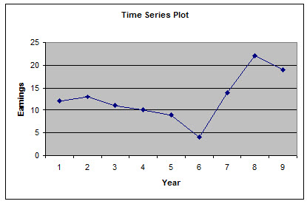
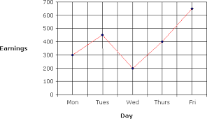
Temporal
Earnings
It is used when the data is linear and one dimensional in nature.
These graphs are very basic and easy to understand
Temporal data visualisation consists of line graph, scatter plot and time series sequences.
Line Graph
Time Graph
Scatter Plot

Slide 4
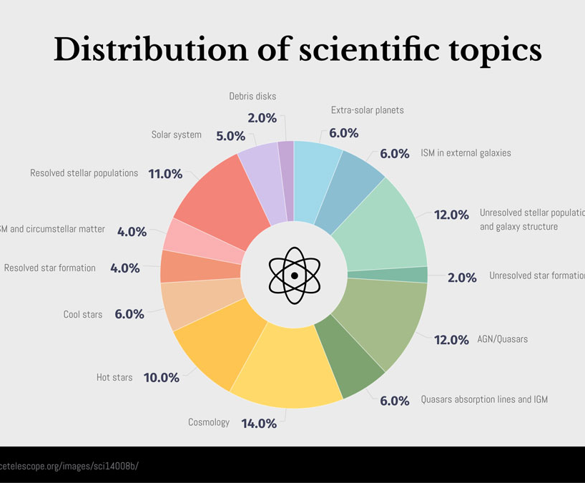
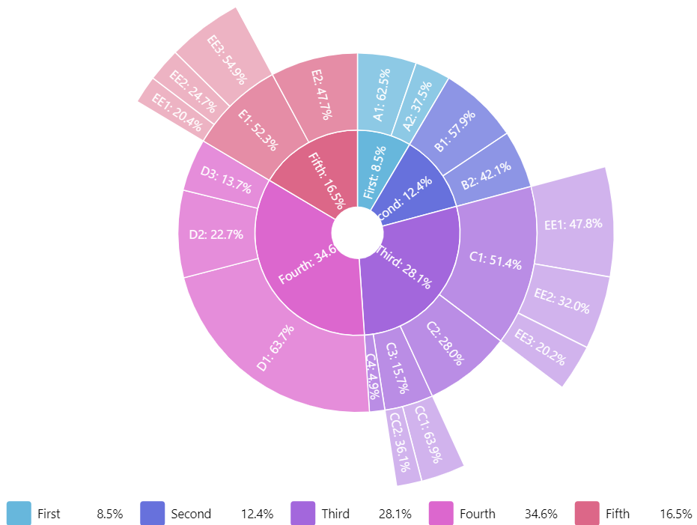
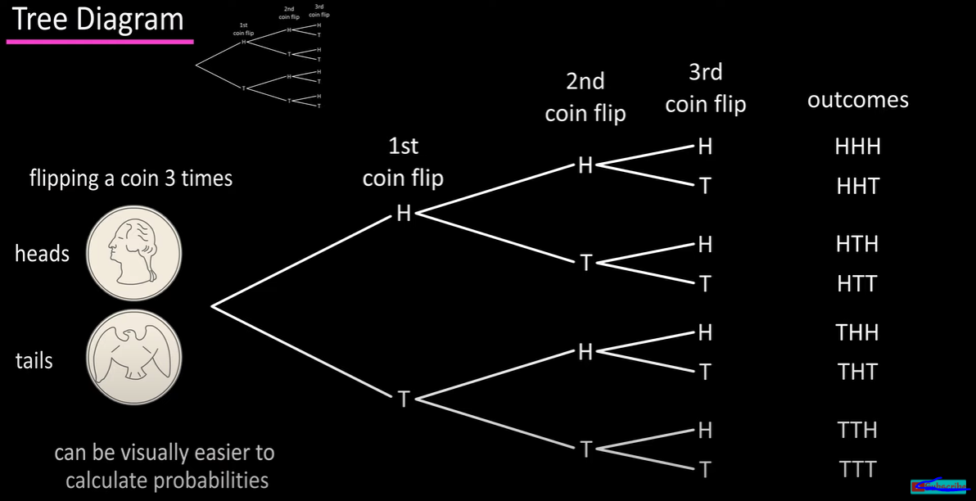
Hierarchical
They are used when a cluster of information flowing from a single point is present.
These graphs are usually very complex and difficult to understand
Examples of hierarchical data visualisation are tree diagrams, ring chart, sunburst diagram.
RingChart
Sunburst Diagram
Tree Diagram

Slide 5
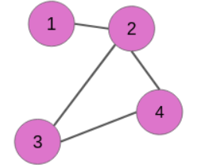
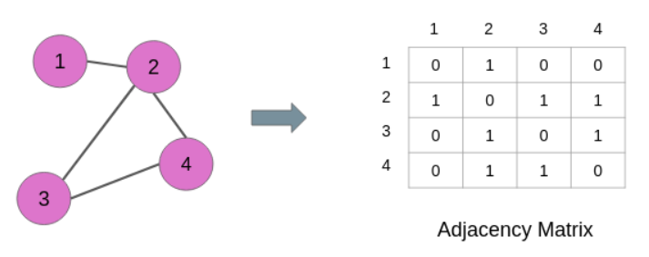
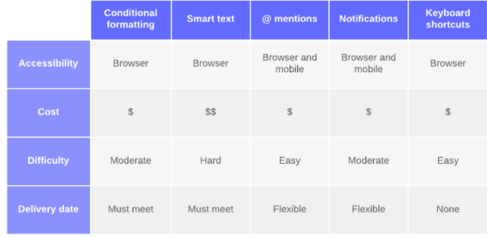
Networks
Network Visualisation (also called Network Graph) is often used to visualise complex relationships between a huge amount of elements.
A network visualisation displays undirected and directed graph structures.
Entities are displayed as round nodes and lines show the relationships between them.
Node-link diagram and matrix diagram are the examples of network data visualisation.
Node Diagram
L-Shaped Matrix Diagram

Slide 6
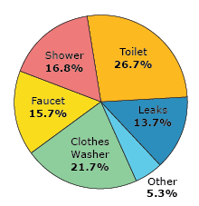
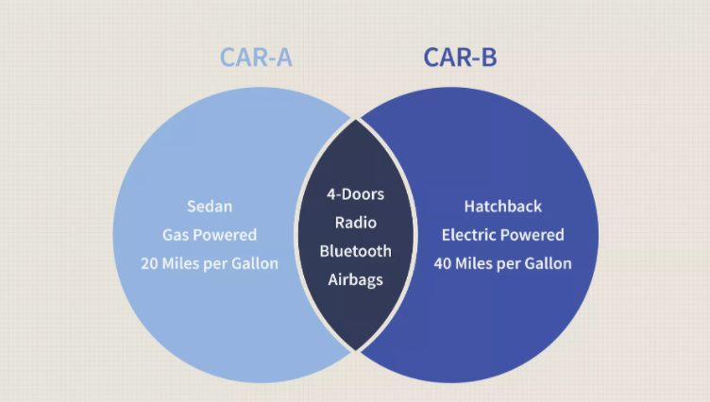
Multidimensional
Pie Diagram
As the name suggests multidimensional data visualisation have multiple dimensions
Examples of multidimensional data visualisations are Scatter plot, pie charts and Venn diagram.
Venn Diagram

Slide 7
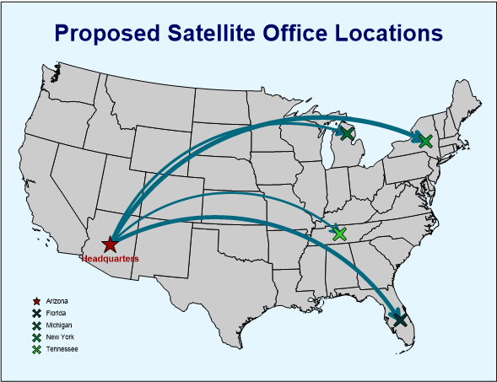
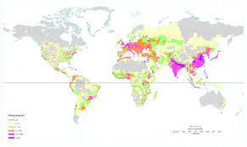
geospatial
Flow Map
Geospatial data visualisation overlays the real life physical location with different data points.
For example flow map, density map and heat map.
Density Map

Slide 8

Tools and libraries
For data visualization we can use:
Seaborn, numpy and pandas present in the Python language.
These libraries consists of various tools which can be used convert the raw data into a more understandable form

Slide 9
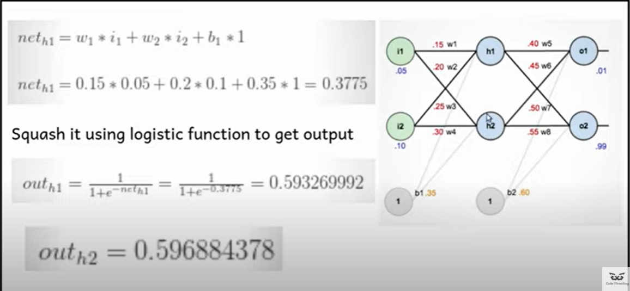
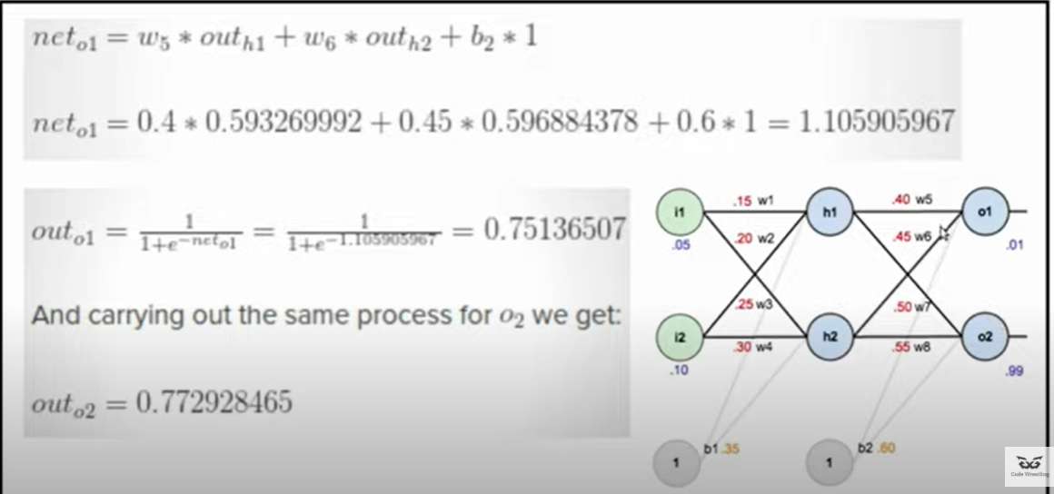
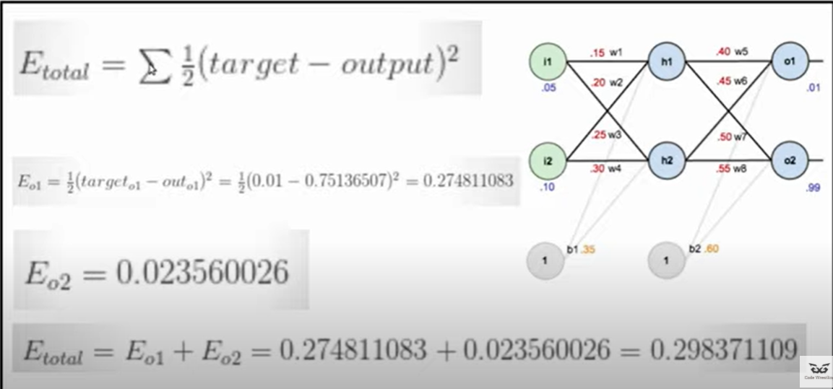
Related work
Many researchers had already worked on the rainfall prediction and their connection with climate change with different methods of machine learning
Tripathi [3] ,have discussed rainfall prediction with the use of Artificial neural network by the Cascade-forward Back propagation Neural Network (CFBPNN) technique
To study the data set of the rainfall information they have used 2 hidden layers of CFBPNN technique, with three different epochs.
Eventually, CFBPNN algorithm has provided a best accuracy model to predict monthly rainfall.

Slide 10

Methodology for data visualisation
There are several steps involved in the visualisation of data
Analysing the Problem
Cleaning the Datasets
Data Preprocessing
Algorithm and Methods

Slide 11
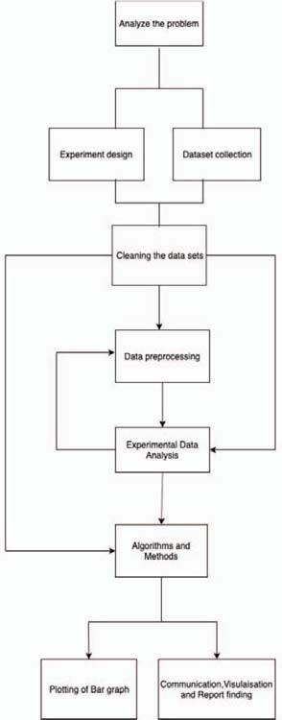

Slide 12
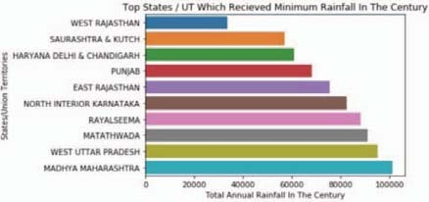
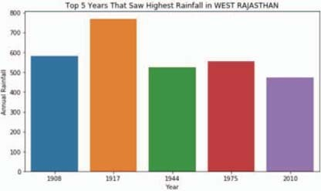
RESULT & DISCUSSIONS
Minimum rainfall graph
Shows the top ten States/Union Territories off India having the least rainfall in the period 1901 to 2015
West Rajasthan has the least rainfall in India of a little over 20000mm
Rainfall in West Rajasthan
Shows the top 5 years when West Rajasthan saw highest rainfall
The average annual rainfall in West Rajasthan is around 300mm.

Slide 13
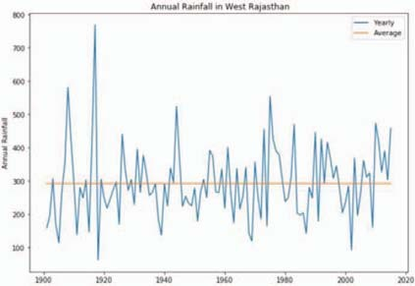
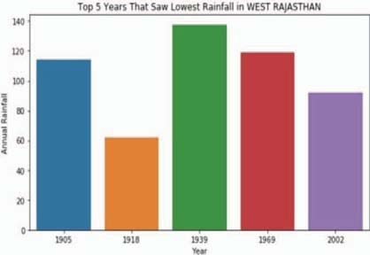
Shows the annual rainfall in the region of West Rajasthan
The highest being around 700mm in the year 1917. The lowest being a little less than 60mm in the year 1918.
Shows the top five years which saw the lowest annual rainfall in the region of West Rajasthan.
The lowest being a little less than 60mm in the year 1918.

Slide 14
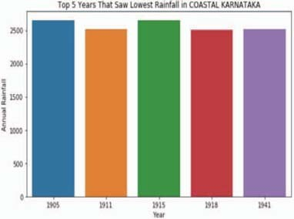
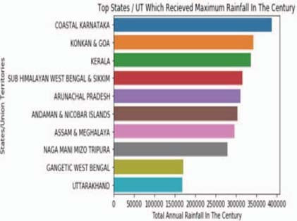
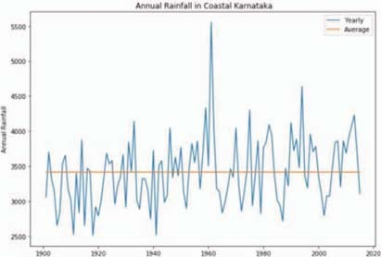
Maximum Rainfall State/Union Territories
Shows the top 10 States/Union Territories of India having the highest rainfall in the period 1901 to 2015.
Lowest Rainfall in Coastal Karnataka
Annual Rainfall in Coastal Karnataka

Slide 15

bibliography
https://www.sciencedirect.com/science/article/abs/pii/S0097849304000275
Rainfall Prediction Using Data Visualisation Techniques | IEEE Conference Publication | IEEE Xplore (somaiya.edu)
https://www.statisticshowto.com/probability-and-statistics/descriptive-statistics/pie-chart/
https://www.investopedia.com/terms/v/venn-diagram.asp

Slide 16
CONCLUSION
In this paper, all the various trends in rainfall in the States/Union Territories over the past century has been shown with the help of data visualisation using bar as well as line graphs
The chronic drought state of the region of West Rajasthan and the destructively heavy rainfall in the region of Coastal Karnataka is talked about.
Visualising the data has greatly simplified the data and improved the understandability.

Slide 17

Idea to implementation
I will be using a rainfall dataset which contains the monthly rainfall detail.
So following the methodology I will first analyse the problem and choose the type of visualisation for the dataset and then clean the dataset and replace or remove all the Nan values.
I will be using Matplotlib/Seaborn,Numpy and Pandas in python for all the graphs and data visualisation.

Slide 18
Thank you! ☺
Name-Divyam S Patani
Roll number-1911035
Batch-A3

