Slide 1

TripME
One mood. One budget. One complete trip.
Seven AI agents that plan it, argue about it in front of you, and are held to your budget in code — built, deployed, and live.
scan → live product
7 AGENTS · 1 BACKWARD EDGE
6 TRAVEL PATHS
7 LANGUAGES
₹0 INFRASTRUCTURE
Team DEBUGGERS — BITSoM · Product Management with Generative & Agentic AI
Shiva K · Nusrat Sultana · Divyam Singh · Manish Dwivedi · Devyani Harpale · Prajwal D R

Slide 2
Problem Statement
How can the process of travel planning be simplified by designing a multi-agent system that can handle research, bookings, budget optimisation, and contextual recommendations?
Today, no single system spans that whole brief planning, booking, budget and recommendations each live in a different, disconnected app:
1
2
3
4
5
Booking
Discovery
Planning
Local Life
Expenses
MakeMyTrip, Expedia
Google Travel, Skyscanner
Wanderlog, TripIt
Zomato, Uber, Ola
Splitwise, spreadsheets
Inventory — no personalization
Fast search — zero continuity
Organises — doesn't decide or budget
Great in-city — separate app entirely
Manual re-entry, after the fact
So, the real brief isn't “build a better booking app.” It's to design one multi-agent system that researches, books, optimises budget and recommends contextually across the whole trip, in one place. That's the system we built next.
TripME · Debuggers
2

Slide 3
Proposed Solution
TripME: Seven agents, Typed handoffs, One backward edge.
Mood & Intent
Discovery
Budget
Itinerary
Booking
Referee
Notification
→
→
→
→
→
→
↩ the backward edge — the Referee can reject another agent’s work and send it BACK to be re-done. Agents that negotiate — not a sequence of prompts.
Mood & Intent
Turns a feeling + budget into a structured brief — never invents a preference the traveller didn’t express.
Discovery
Picks the destination with line-by-line evidence per non-negotiable; India-only scope enforced in the pipeline.
Budget
Allocates every rupee across transport, stay, food, activities and buffer — before anything is booked.
Itinerary
Builds the day-by-day plan from real, map-resolved places — open data, not model memory.
Booking
Prepares simulated, gated bookings with real deep links; spend above threshold needs explicit approval.
Referee
Audits agents against each other, states conflicts in rupees; one Advocate per traveller in group mode.
Notification
Builds opt-in, time-anchored reminders — only from the bookings the traveller actually accepted.
The design rules
LLM for judgment, code for money — a model never touches arithmetic. Six travel paths, one architecture. The traveller gets the last word.
TripME · Team DEBUGGERS · tripme-khaki.vercel.app
3

Slide 4
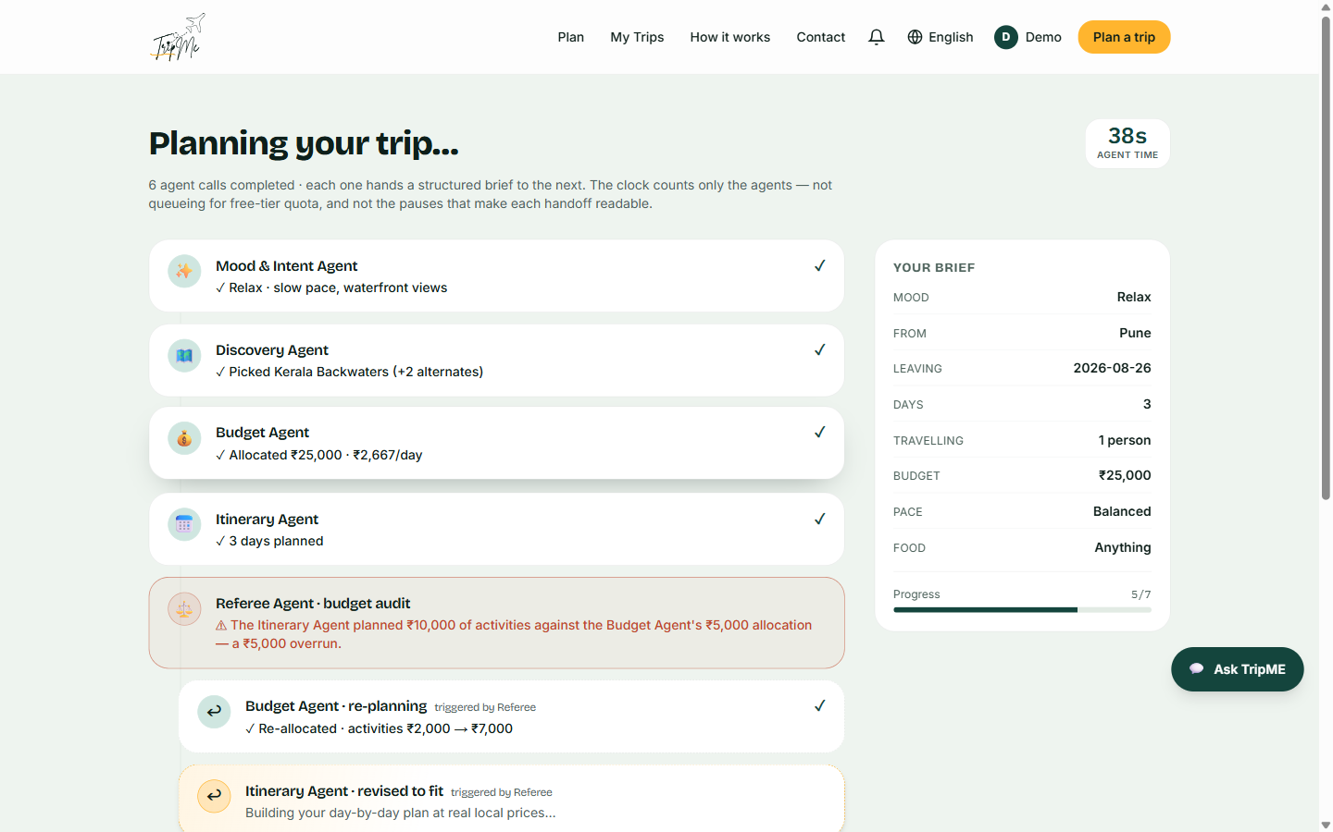
IMPLEMENTATION — HOW WE BUILT IT
A negotiating pipeline, a lean stack, AI only where it earns its place
THE PLANNING PROCESS — HOW AGENTS WORK TOGETHER
TOOLS & FRAMEWORKS
AI & MODELS
1 One brief in — mood, budget, days, origin. Never a destination.
2 Mood & Intent structures it; each agent then receives only the slice of trip-state its job needs.
3 Validated JSON handoffs carry it down the chain: Discovery → Budget → Itinerary → Booking.
4 Code audits Itinerary against Budget; on conflict the Referee fires and sends work BACK — both agents re-run.
5 In group mode one Advocate argues per traveller; the Referee blends them and publishes who conceded what.
6 The traveller approves each spend, confirms, opts into reminders — every change re-prices in code.
Next.js App Router + TypeScript — UI and server routes in one deployable
Tailwind CSS v4 on a fixed design system — pine, marigold, Plex Mono for money
Vercel — push-to-deploy on every commit to main
Auth.js + Google OAuth + a password-less test user; the gate sits at commitment
OpenStreetMap + Nominatim + Wikipedia — real places, licensed photos, keyless
Trips in browser storage — a privacy position, not a missing database
Three Groq-hosted models, routed per agent by job:
• gpt-oss-120b — reasoning: Discovery, Itinerary, Budget
• qwen3.8-27b — arbitration: Referee, consensus, intent
• gpt-oss-20b — structural: Booking, Advocates, translation
Typed JSON-schema handoffs — every output validated before it enters trip-state
Per-agent failover chains across all three — quota, schema errors, even model retirement
Deterministic money layer in code; translation runs after generation completes
Total infrastructure cost: ₹0 — every dependency inside a free tier. The constraint drove the engineering: three-model failover, identical-brief caching, zero-quota sample trips.
TripME · Team DEBUGGERS · tripme-khaki.vercel.app
4

Slide 5
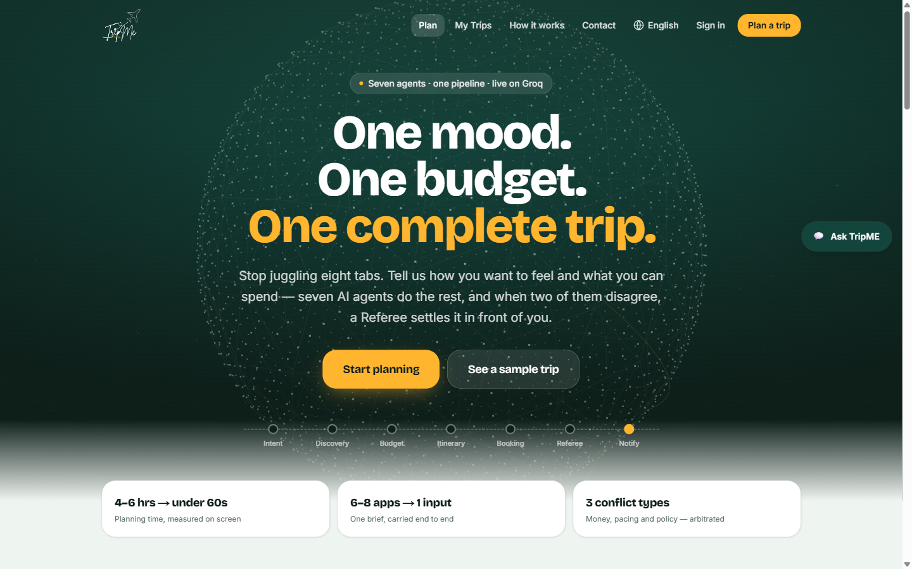
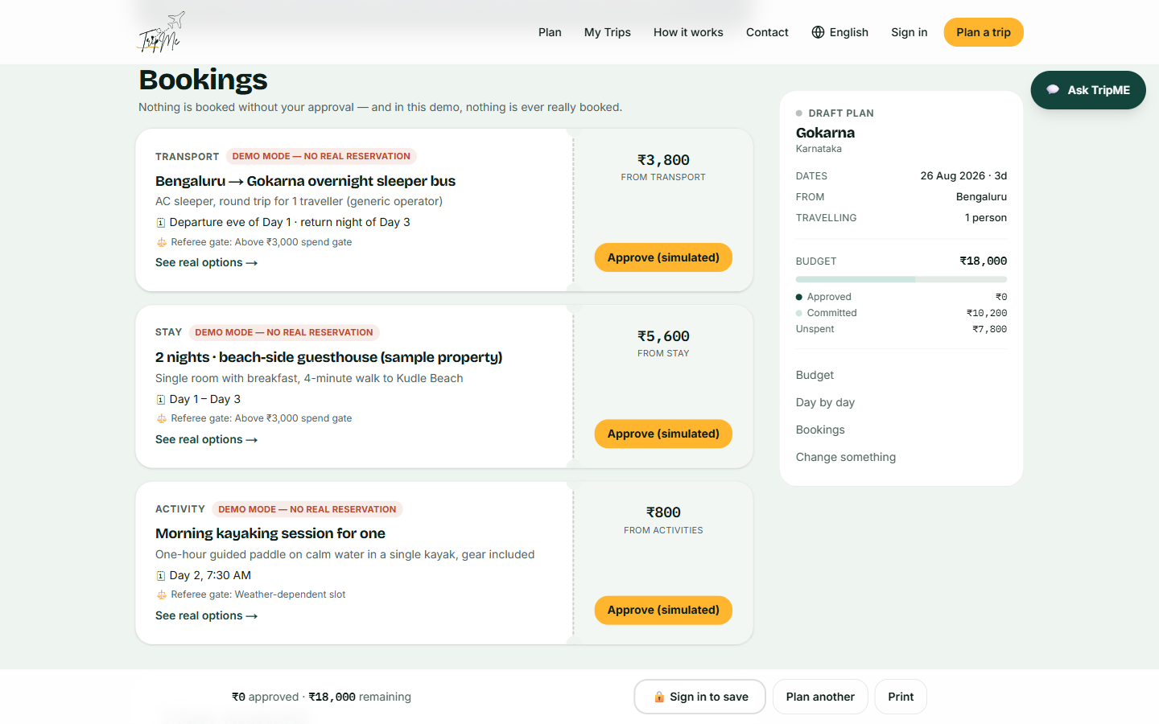
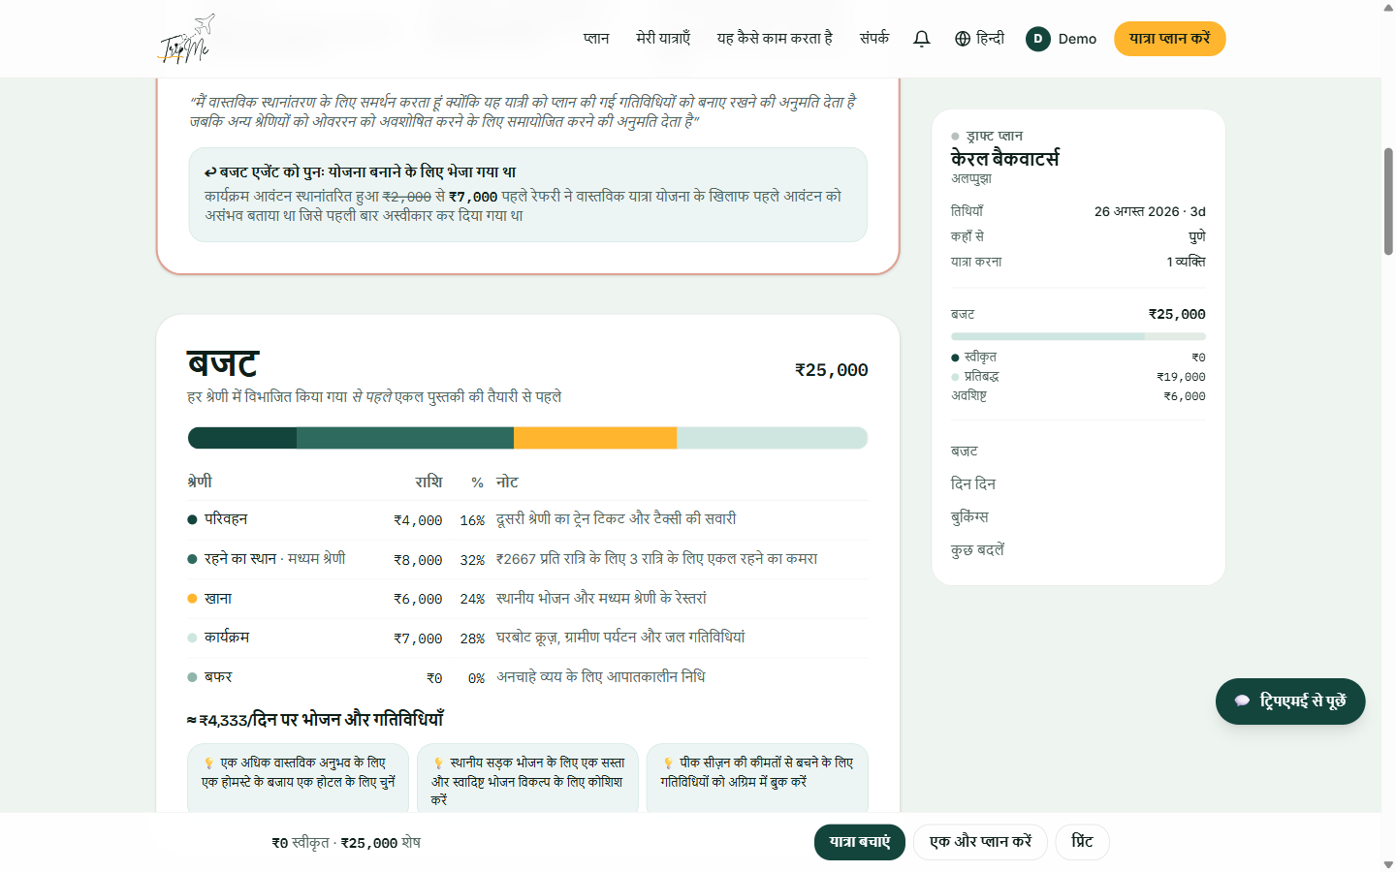
WHAT SHIPPED — AND WHAT WE REFUSE TO FAKE
A complete MVP that tells the truth about itself
Mood-first — no destination field
Approval gates · DEMO labels on every booking
Agent output translated — figures untouched
18 MVP features
six paths · arbitration · override with re-pricing · reminders · settle-up · expense report
Honesty as a feature
bookings labelled simulated · prices marked “est.” · India-only stated and enforced in the pipeline
₹0 infrastructure
three Groq models with per-agent failover · OpenStreetMap & Wikipedia · Vercel — all free tier
Privacy position
trips never leave the browser; an account stores only name, email, picture
TripME · Team DEBUGGERS · tripme-khaki.vercel.app
5

Slide 6
KEY OUTCOMES & IMPACT
What TripME delivers — today, and measured
OUTCOMES — SHIPPED AND VERIFIED
IMPACT — WHAT CHANGES FOR THE TRAVELLER
Complete MVP live — 18 features, all 6 travel paths, 7 languages, on a real URL
4–6 hours → under 60 seconds of agent time — measured and printed on every plan (34–58s)
Arbitration is real — the Referee rejected two agents’ work on a live run and re-planned it (9 calls, 58s)
Survived a provider outage — both original models were retired by Groq; failover absorbed it
One brief replaces 6–8 apps — context entered once, carried end to end
Budget enforced during planning — not reconciled after the money is gone
Groups reach a defensible plan — a published concession matrix; nobody concedes twice
Honesty as shipped UI — simulated labelled, prices marked est., scope stated up front
Validation gates for the beta: >70% plan completion · <60s median agent time · >50% can explain the Referee · >30% override something · >25% confirm · >20% return in 30 days
Try it now — tripme-khaki.vercel.app · wireframes: /wireframes.html
One mood. One budget.
One complete trip.
TripME · Team DEBUGGERS · tripme-khaki.vercel.app
6

Slide 7
Appendix — for Q&A
Architecture & PEAS · tech stack · testing · challenges we actually hit · ethics · prioritisation

Slide 8
APPENDIX A1
Agent architecture — formally specified (PEAS)
Mood & Intent
goal-based
accuracy of captured intent — never invents a preference
Discovery
goal-based
match relevance; India-only; must explain any substitution
Budget
utility-based
spend & split correctness — arithmetic in code, never the model
Itinerary
utility-based
coherence & pacing fit; places from open map data, not memory
Booking
action, gated
simulated bookings; every item above threshold needs explicit approval
Referee
utility + arbitration
conflicts in rupees; fairness floor; can send work backwards
Notification
model-based reflex
time-anchored reminders; opt-in per trip, off by default
Design rule: as much autonomy as the stakes of the decision can safely support — and no more.

Slide 9
APPENDIX A2
Tech: what we built with vs the funded version
ACTUALLY BUILT
FUNDED VERSION — AND WHY NOT NOW
Next.js App Router + TypeScript on Vercel — push-to-deploy
Groq: llama-3.3-70b · gpt-oss-120b · llama-3.1-8b — per-agent failover chains
Failover on 429 / 400 / 413 / 422 / 503 — quota becomes a slowdown, not an outage
OpenStreetMap + Nominatim + Wikipedia — real, keyless, licensed places & photos
Auth.js + Google OAuth + password-less demo user · trips stay in the browser
Total infrastructure cost: ₹0 — every dependency inside a free tier
LangGraph-class runtime — retries, checkpointing, observability at scale
Vector store for cross-trip preference memory; relational store for transactions
FCM/APNs push, SMS & voice gateways — closed-app reminder delivery
Amadeus/Travelport, Uber/Ola, IRCTC behind one adapter — real bookings
Adding these before validation would be infrastructure without a user.

Slide 10
APPENDIX A3
Challenges we actually hit (and what each taught us)
Free-tier quota died mid-build
The real limit was tokens-per-day, visible only in the 429 body. Built three-model per-agent failover; verified with the primary model fully exhausted.
One model 400’d on a nested schema
gpt-oss rejects a schema Llama accepts — took the Pilgrimage path down in production. Failover now covers 400/413/422/503, not just quota.
A few-shot example leaked into output
The Booking prompt said “like Bengaluru → Gokarna…” and got no origin field — so Bengaluru appeared in everyone’s reminders. Fix: origin in the payload, no city named in any prompt. Verified from Guwahati.
Approvals survived price changes
You could approve ₹8,000 and confirm ₹14,000. Now any amount change revokes its approval — consent is to a number, not a line item.
Built features were invisible
Confirm, reminders, email all shipped — behind an unsignposted gate chain. A gate that hides what is behind it looks unbuilt. Fix: the four-step stepper on every plan.

Slide 11
APPENDIX A4
Testing two failure modes · ethics as shipped behaviour
TESTING
ETHICS — LIVE IN THE PRODUCT
Two failure modes: software bugs AND AI failures (hallucination, silent bad money decisions).
Offline regression per agent — fixed input/output suites re-run before any prompt change.
Observability — every agent decision and handoff logged; the raw JSON log is on every trip page.
RAG grounding — places from map data, not model memory.
Human-in-the-loop mandatory above the spend threshold.
Moderated UAT with 5–8 real users before release.
Privacy: trips never leave the device — stated on the sign-in page.
No silent substitution: out-of-scope asks are named and explained.
Money: gates, revocation, code-computed arithmetic.
Reminders: opt-in, time-anchored, never engagement-tuned.
No dark patterns: no fake scarcity, no urgency styling, no forced sign-in before value.
Standing question at every review: could we defend this to a journalist?

Slide 12
APPENDIX A5
Prioritisation: three lenses had to agree
RICE (reach · impact · confidence · effort) ranked every feature → MoSCoW translated it for planning → a Value-vs-Complexity quadrant sanity-checked both.
Rule: every Quick Win went into the MVP, full stop. Everything scoring Strategic Bet, Fill-in or Money Pit was excluded by rule, not by discretion — that is what kept the MVP minimal instead of merely “smaller than the vision”.
Example: Notification reminders scored well on RICE — but for retention, not for the hypothesis. Deliberately pushed to Should-have, Sprint 6.
IF YOU ASK “WHAT WOULD YOU CUT NEXT TIME?”
Nothing from the Must list — but Sprint 7 (traveller control) taught us the real lesson: a plan the traveller cannot change is a demo, not a product. We would plan for override from Sprint 1.
And we would instrument the funnel from day one — you cannot measure a launch retroactively.

