Slide 1
Data cleaning and analysis report week 3 activity 2 – Pearson correlation and outlier detection
Dataset: messy_dataset_Mukesh.csv
Goal: Clean messy data, find correlation, detect outliers( using IQR Interquartile Range)
Presented by : Divya Neupane

Slide 2
Original Data Issues (with exact counts)
Raw Dataset Info
Rows 10
Columns 6
Columns Names ID, Name, Age, Country, Salary, Join Date
Duplicate rows ID =2 appears twice (Bob)
Missing Value 6(Total missing cells before cleaning)

Slide 3
Specific Issuses
Example
Issue Type Example
Missing Value ID – 1, Name – 1, Age - 2, Country – 1 Salary - 2 , Join Date 1 – 6(Total missing cells before cleaning)
Duplicate Row ID =2 appears Twice (Bob)
Text in Numeric Age = “thirty-eight”, salary=“sixty five thousand”
Bad Date Format Invalid month (2019-13-01)

Slide 4
Cleaning Steps Applied
Step Action
Fix Age Converted “Thirty-eight to 38”, non-numeric to number
Fix salary Converted “sixty five thousand to 65000 ” extracted digits
from other strings
Fix ID Made numeric, Merged duplicate ID=2 (kept first non0null values from both rows)
Fix Dates Invalid Dates (month 13 ) NaT
Currency Conversion Created salary_NZD , Australian salaries * 1.08 => NZD

Slide 5
Result after cleaning
Rows 10 -> 9 ( duplicate merged)
Columns : 6 -> 7 (added Salary_NZD) ( diff values for AUD and NZD )
Missing Values : 6 -> 0

Slide 6
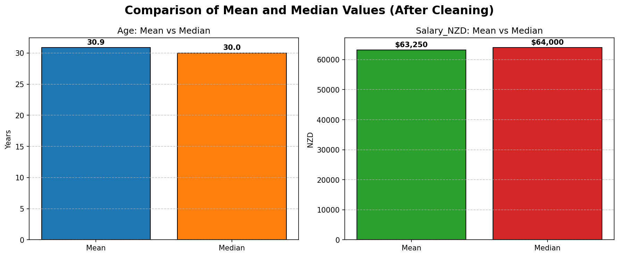
Mean Vs Median Comparison (with Bar Graph)
Here, Age distribution is almost symmetric – mean and median (30 and 30.9) are very close
Salary distribution has a median ( 64000) higher than mean (63,250), indicating a left skew – couples of employees earns less than the typical amount, bringing the average down

Slide 7
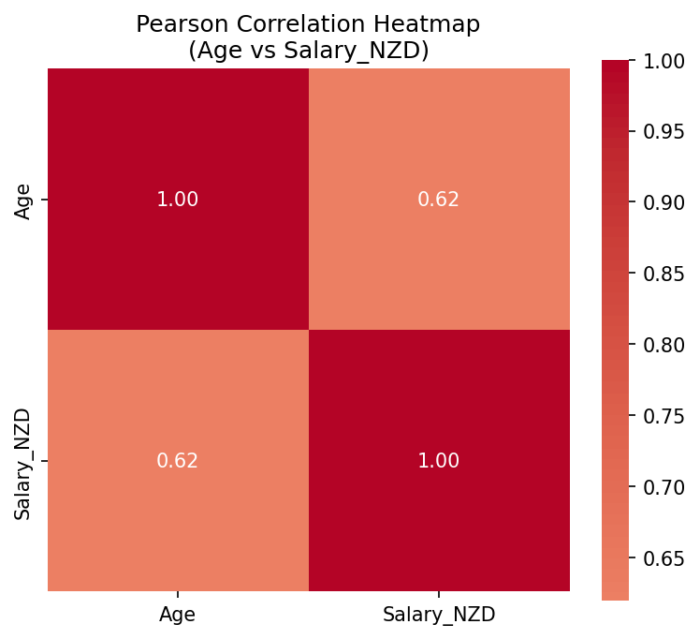
Pearson Correlation Heatmap
The Pearson Correlation coefficient is 0.62, indicating a moderate positive linear relationships between age and salary. As age increases , salary tends to increase, but relationship is not extremely strong

Slide 8
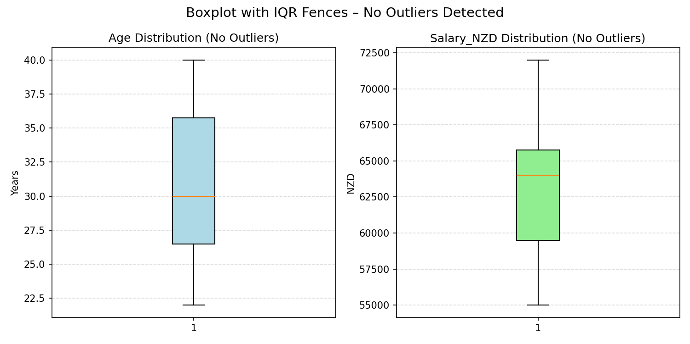
Outliers Reports
The boxplot whiskers show the farthest data points that are still within the IQR fences. Since no points extend beyond the whiskers, we confirm there are no outliers.

Slide 9
Outliers Reports
For Age:
Q1 = 27, Q3 = 38, IQR = 9.2, Lower = 12.6, Upper = 49.6
No Outliers detected
Salary NZD
Q1 = 59500.0, Q3 = 65750.0, IQR = 6250.0, Lower = 50125.0, Upper = 75125.0
No Outliers detected

Slide 10
Thank you !!!!

