Slide 1


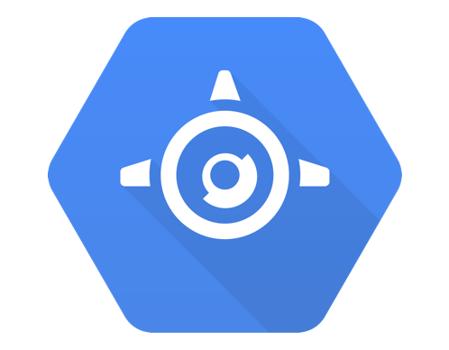
<Title>
Google Cloud Appengine
Using .NET core

Slide 2

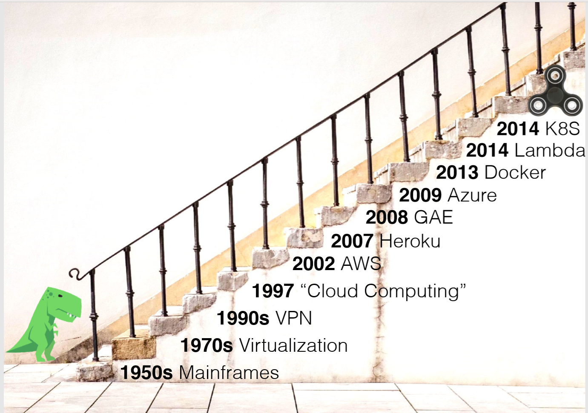
Google AppEngine
What is App-engine?
It is one of the first Google cloud Product
It is PaaS product

Slide 3
Google AppEngine
What is App-engine?
It is one of the first Google cloud Product
It is PaaS product
It is managed service
Scaling is easy

Slide 4
Google AppEngine
What is environment mean in App engine?
It is run-time environment to run your application under App engine
It is classified in two category
Standard Environment
Flexible Environment

Slide 5
Google AppEngine
Standard Environment
It is constrained environment
It runs in sandbox
Problem to use 3party lib
It has faster scale up time
Supported Language
Java 7 ( now Java 8 as well)
Python 2.7
GoLang 1.6 and 1.8
PHP 5.5

Slide 6
Google AppEngine
Flexible Environment
It is Docker base containerize app run in GCP’s VM
Has more access compare to standard environment
User any 3rd party lib
Supported Language
Python
Java
Go
.NET
Practically any language

Slide 7
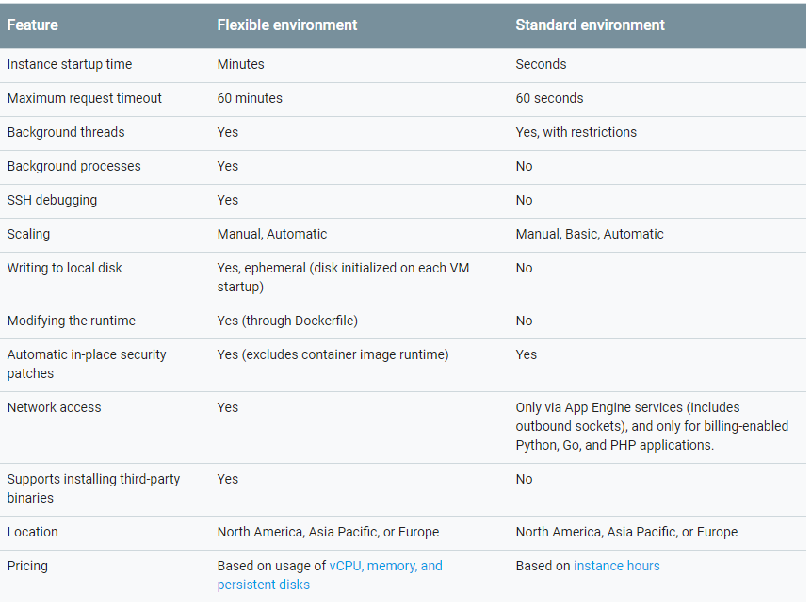

Slide 8
Google AppEngine
Demo for .NET core App-engine
Install gcloud SDK
Acquired local credential
Deploy is visual studio ( it will write app.yaml)
Deploy from command prompt (you need to write app.yaml)

Slide 9
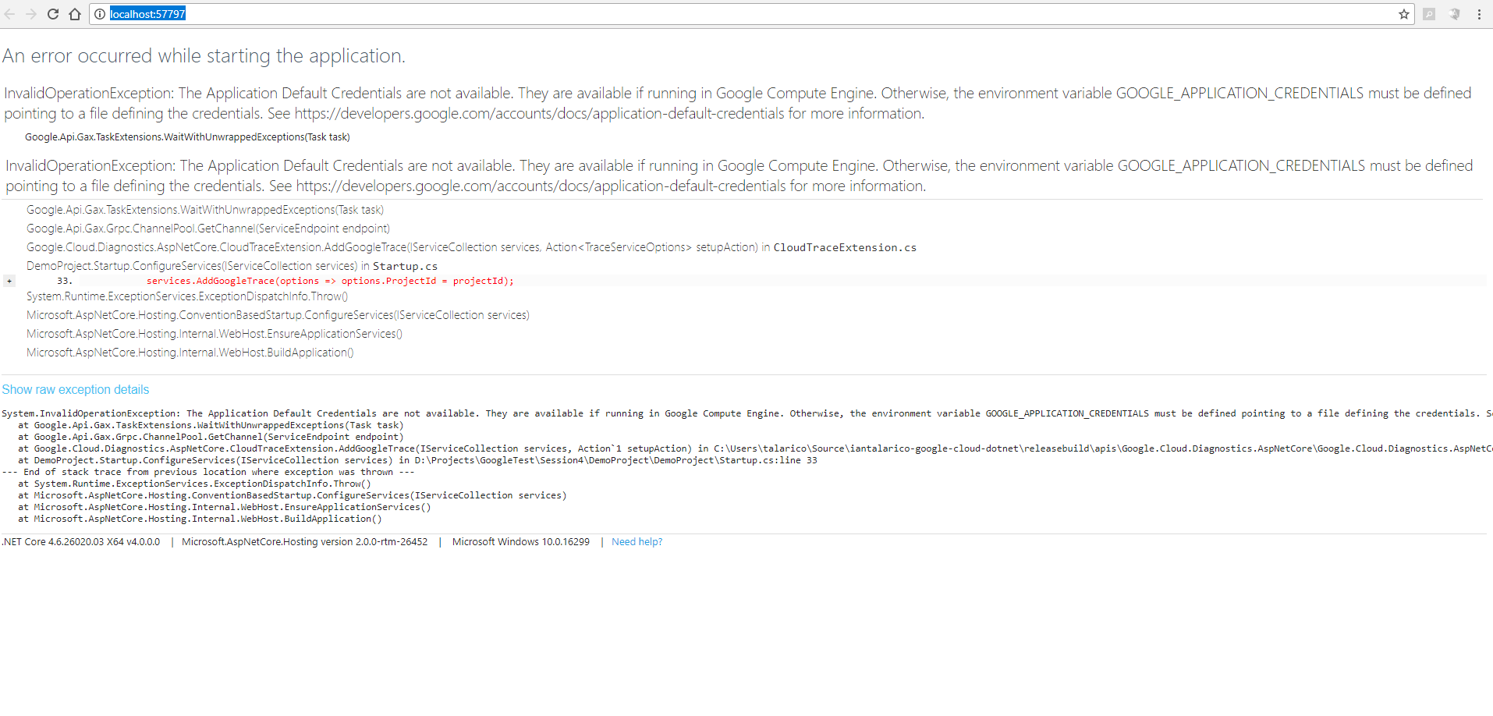
App-Engine

Slide 10
Point to share
Yaml Files in AppEngine
App.Yaml (for app and env configuration)
Cron.Yaml ( to configure Job/Schedule Task)
Dispatch.Yaml(to config routing)

Slide 11
Point to share
App.yaml configuration details
Ref : https://cloud.google.com/appengine/docs/flexible/dotnet/configuring-your-app-with-app-yaml

Slide 12
Point to share
Legacy appengine support Backend and frontend for standard environment
Ref : https://cloud.google.com/appengine/docs/standard/java/backends/

