Slide 1
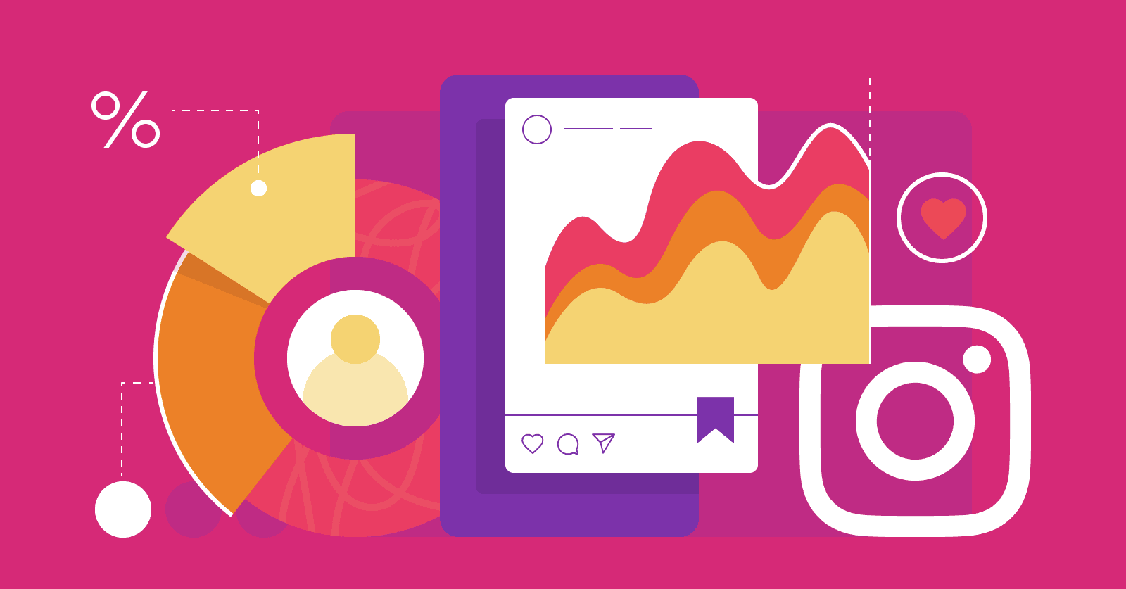
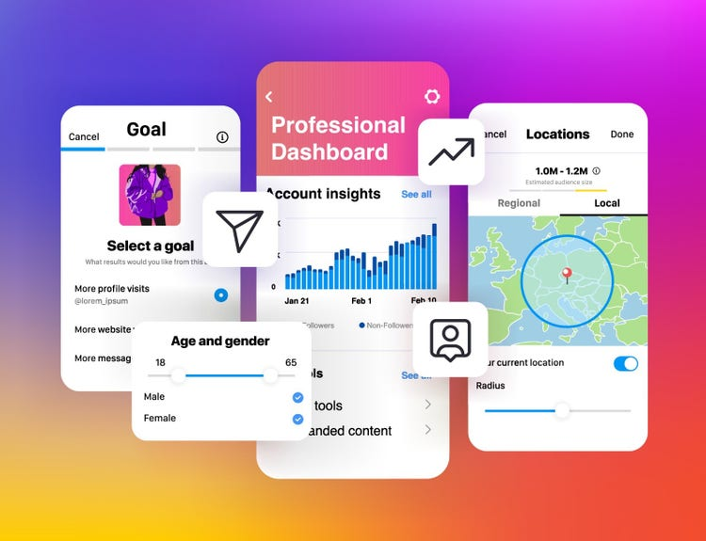

INSTAGRAM USER ANALYTICS
PROJECT DONE BY: DIVYANI SIROHI

Slide 2
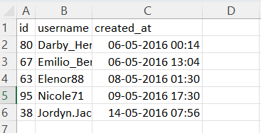
A. Marketing Analysis: 1. Loyal user reward
SQL Query:
SELECT id, username, created_at
FROM users
ORDER BY created _ at ASC
LIMIT 5;

Slide 3
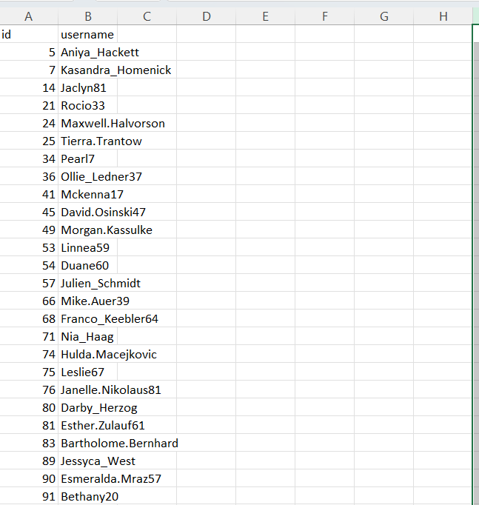
2. Inactive User Engagement:
SQL Query:
SELECT u.id, u. username
FROM users u
LEFT JOIN photos p ON u.id = p.user_id
WHERE p.id IS NULL;

Slide 4

3. Contest Winner Declaration:
SQL Query:
SELECT u.id, u. username, COUNT(l.photo_id) AS total_likes
FROM users u
LEFT JOIN photos p ON u.id = p.user_id
LEFT JOIN likes l ON p.id = l.photo_id
GROUP BY u.id, u.username
ORDER BY total_likes DESC
LIMIT 1;

Slide 5
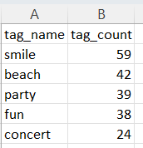
4. Hashtag Research:
SQL Query:
SELECT t.tag_name, COUNT(pt.photo_id) AS tag_count
FROM tags t
JOIN photo_tags pt ON t.id = pt.tag_id
GROUP BY t.tag_name
ORDER BY tag_count DESC
LIMIT 5;
Most commonly used Hashtag:
OUTPUT:

Slide 6
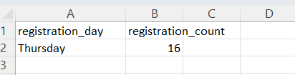
5. Ad Campaign Launch:
SQL Query:
SELECT DAYNAME(created_at) AS registration_day, COUNT(*) AS registration_count
FROM users
GROUP BY registration_day
ORDER BY registration_count DESC
LIMIT 1;

Slide 7

B. Investor Metrics: 1. Users Engagement
SQL Query:
SELECT AVG(post_count) AS average_ posts_ per_ user
FROM (
SELECT COUNT(*) AS post_count
FROM photos
GROUP BY user_id
) AS user_post_counts;
Average Posts per user:
OUTPUT:

Slide 8

Users Engagement:
SQL Query:
SELECT
(SELECT COUNT(*) FROM photos) AS total_ photos,
(SELECT COUNT(*) FROM users) AS total _ users,
(SELECT COUNT(*) FROM photos) / (SELECT COUNT(*) FROM users) AS average _photos_per_ user;
Total Photos Per User:
OUTPUT:

Slide 9
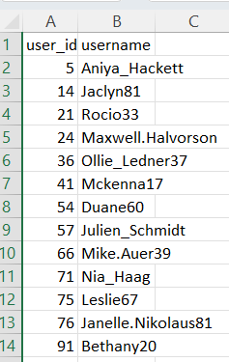
2. Bots & Fake Accounts:
SQL Query:
SELECT user_id
FROM (
SELECT user_id, COUNT(DISTINCT photo_id) AS liked_photos_count
FROM likes
GROUP BY user_id )
AS user_likes
JOIN (
SELECT COUNT(*) AS total_photos
FROM photos )
AS total_photos_count
ON user_likes.liked_photos_count = total_photos_count.total_photos;
Users who liked every single photo on the site:
OUTPUT:

Slide 10
PROJECT OVERVIEW:
The project aims to analyze user interactions and engagement with the Instagram app to provide actionable insights for the product team.
By leveraging SQL and MySQL Workbench, the goal is to extract valuable information from the data, which can inform decisions regarding feature development, user experience improvements, and marketing strategies.

Slide 11
APPROACH:
Data Understanding: Begin by understanding the structure of the Instagram user data, including tables such as user profiles, interactions, posts, comments, likes, etc.
Exploratory Analysis: Conduct exploratory analysis to identify trends, patterns, and outliers in user interactions, engagement metrics, popular content, peak activity times, etc.
Answering Questions: Address specific questions posed by the management team, such as identifying top influencers, determining the most engaging content types, assessing user demographics, and understanding user behavior.
Visualization: Utilize visualization techniques to present key findings in a clear and understandable manner, facilitating decision-making for the product team.

Slide 12
TECH-STACK USED:
Software: MySQL Workbench
Reasoning: MySQL Workbench offers a user-friendly interface for SQL queries, data visualization tools, and database management capabilities, making it suitable for efficiently analyzing Instagram user data.

Slide 13
INSIGHTS:
Top Influencers: Identified top influencers based on the number of followers, likes per post, and engagement rates. This insight can guide influencer marketing strategies and partnerships.
Engagement Patterns: Observed peak activity times and days when users are most active on the platform. This information can optimize the timing of content uploads and promotional campaigns.
Popular Content Types: Determined the most popular content types (e.g., photos, videos, stories) based on user engagement metrics. This insight informs content creation strategies and feature prioritization.
User Demographics: Analyzed user demographics such as age, location, and gender to understand the platform's user base better. This knowledge can tailor content and features to specific audience segments.
User Behavior: Examined user behavior, including browsing habits, interaction preferences, and retention rates. Understanding user behavior helps in enhancing the user experience and driving user retention strategies

Slide 14
RESULT:
Understanding User Behavior: By analyzing user interactions and engagement patterns, we gained a deeper understanding of how users navigate and utilize the Instagram app. This insight allowed us to identify popular features, content types, and user preferences.
Identifying High-Engagement Content: Through analysis, we pinpointed the types of content that attract high levels of engagement from users.
Optimizing Feature Development: By understanding which features are most frequently used and valued by users, we could allocate resources effectively and focus on enhancing the user experience where it matters most.
Informing Marketing Strategies: The analysis provided valuable input for the marketing team in crafting targeted campaigns. Understanding user demographics, preferences, and behaviors allowed for more personalized and effective marketing strategies, ultimately driving user acquisition and retention.
Improving User Experience: By identifying areas for improvement within the app, the analysis contributed to enhancing the overall user experience. Whether it's streamlining navigation, optimizing content discovery, or refining recommendation algorithms, these insights were instrumental in making Instagram more user-friendly.

Slide 15
DRIVE LINK:
Overall, the analysis of Instagram user data provided valuable information that influenced decision-making and drove improvements across the platform. By leveraging SQL and MySQL Workbench, we were able to extract actionable insights that ultimately enhanced user engagement, satisfaction, and the overall success of the Instagram app.

Slide 16
THANK YOU!
PROJECT DONE BY:
DIVYANI SIROHI

