Slide 1
B Tree & B+ Tree
Sagar Rohankar
Notes:
No alog, no pseudo code, no code

Slide 2
Why B Tree?
BST 2^20 for 1 million, B Tree 1000 keys with 2 level
Library Catalog
Database Index
L2 < RAM < Disk
Read in blocks

Slide 3
Rules
For M order tree
Root
Has between 2 and M children
Internal Nodes
Store upto M-1 keys
Have between ceil[M/2] and M children
Leaf Nodes
Store between ceil[(M-1)/2] and M-1 keys
All at same depth

Slide 4
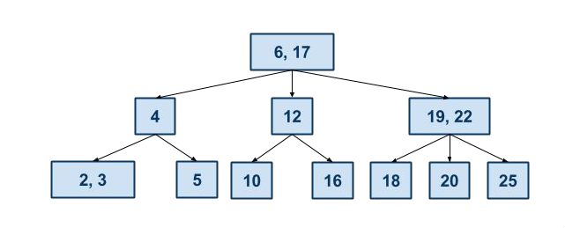
B Tree Search

Slide 5
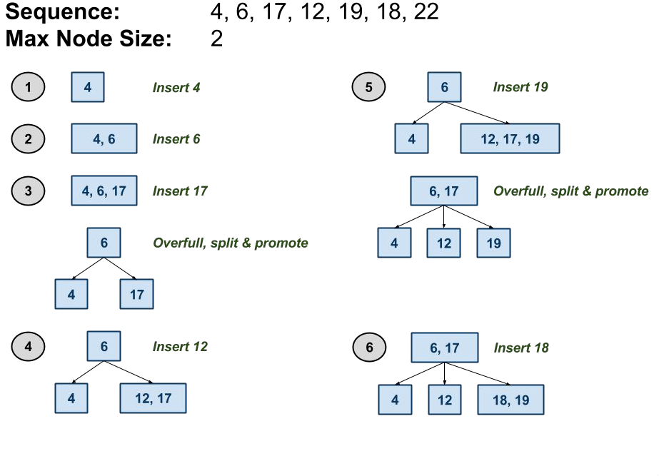
B Tree Insert
Notes:
- order 3 tree M == 3
- tree construction is bottom up as opposed to BST top-down

Slide 6
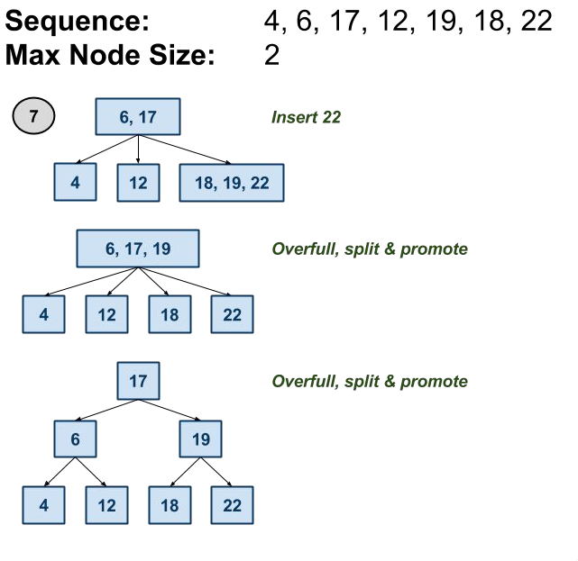
B Tree Insert

Slide 7
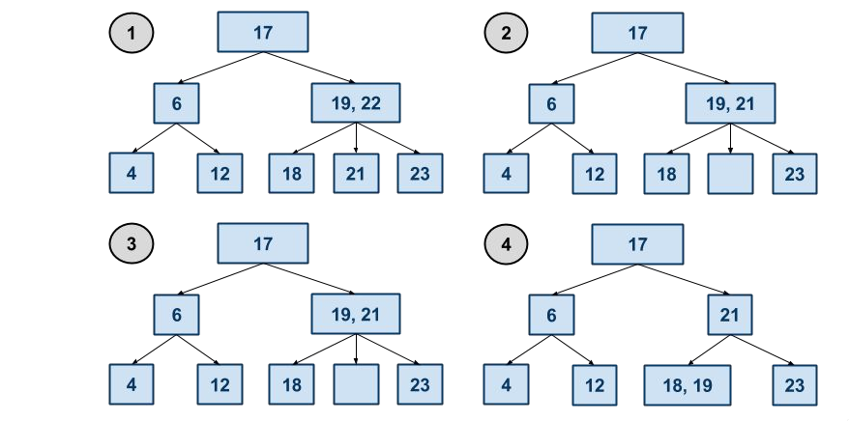
Delete 22

Slide 8
Resources
Time Complexity
O(log N)
Visualization
https://www.cs.usfca.edu/~galles/visualization/BTree.html
Tutorial
https://www.youtube.com/watch?v=TOb1tuEZ2X4

Slide 9
B+ Tree
Extension to B Tree
B+ tree is balanced tree in which every path from root to leaf is same length
All records are stored in leaf, keys stored in internal node
All leaf nodes are interconnected for faster access (useful in sequential scan)
Fill factor 50%

Slide 10
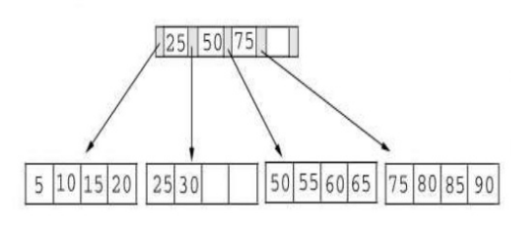
B+ Tree
Internal nodes direct the search, leaf node contain data entries
It contains index pages & data pages. The capacity of leaf has to 50% or more.
If n = 4, then key for each node between 2 to 4
Index page will 4 + 1 = 5

Slide 11
Search
Find 15

Slide 12
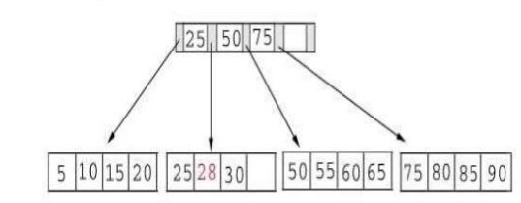
Insert
Insert 28 below tree

Slide 13
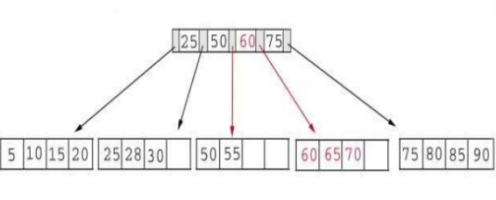
Insert
Insert 70 below tree
Split the tree
Choose middle key 60, place in the index page between 50 7 75

Slide 14
Insert
Insert 95 to tree
Split 75,80,85,90 into 2 pages
Middle key 85 rises to index page
Split the index page creating new root 65

Slide 15
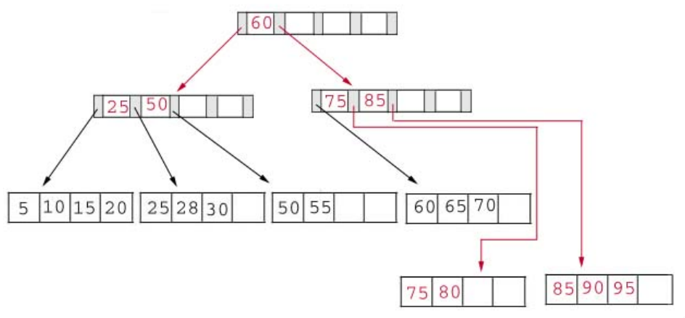
Insert 95 Result

Slide 16
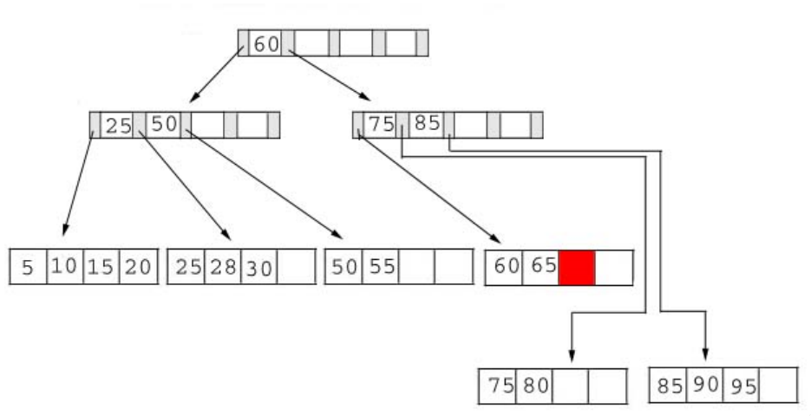
Delete
Delete 70 from tree
Page contain 60, 65 post delete
Satisfied 50% criteria

Slide 17
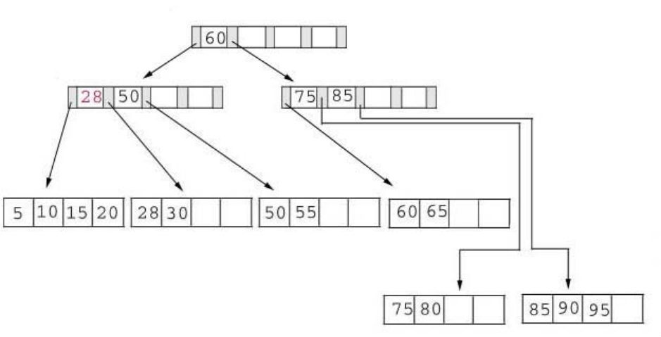
Delete
Delete 25 from tree
25 appears in index page
when we delete 25 we must replace it with 28 in the index page.

Slide 18
Resources
https://www.sci.unich.it/~acciaro/bpiutrees.pdf

