Slide 1
INDEX PAGE
The index page opens to following options:
A user can login (new users can sign up). Such users will be able to access full functionality of the app – like creating quizzes. After login/sign up, user is directed to their home page.
Anonymous users can enter a quiz permalink to take a quiz directly.
The ‘Quiz Builder App’ on the top left is a link that redirects to this page.

Slide 2
HOME PAGE
Once a user is logged in the app displays 2 buttons on the top right (one for home page, other for logging out).
User can enter a quiz permalink to take quiz.
Clicking the ‘Create Quiz’ button allows user to create a quiz.
The page also displays a list of user’s quizzes. They can take a quiz (by clicking the quiz permalink) and can delete them.

Slide 3
CREATE QUIZ PAGE
When creating quiz, user can use the drop-down menu to select number of question (1-10). In each question, user can select number of options (2-5) and single or multiple correct answers using radio buttons.
No required field can be left empty, otherwise quiz is not added.
Once added user is redirected back to home page and is notified the new quiz permalink.

Slide 4
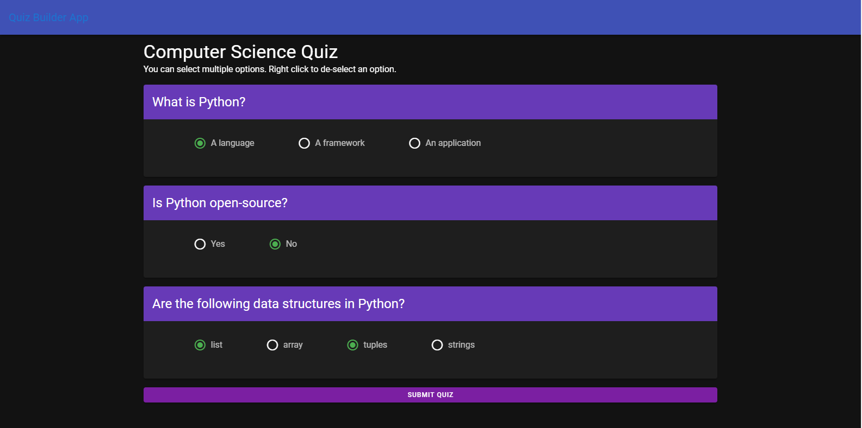
QUIZ PAGE
The quiz page displays the quiz title, along with questions, and options as radio buttons.
A user can select the options of their choice. They can de-select with a right click.
Once submitted, user is taken to home page (index page for unauthenticated user) and notified of their score.

