Slide 1
Question Answering RAG System
Capstone Project Presentation
Deep Learning Summer School
-Divyansh Dhawan (25DLS143)

Slide 2
Problem Statement
Develop a question answering system that leverages Retrieval-Augmented Generation (RAG) to provide accurate and contextually relevant answers to user queries. The system should retrieve the most relevant information from a custom knowledge base or document repository and then generate answers by combining the retrieved content with the user’s question. This approach aims to ensure that responses are grounded in up-to-date, authoritative information beyond what is available in the model’s pre-trained knowledge, improving accuracy and reducing hallucinations.

Slide 3
Motivation & Relevance
Explosion of unstructured data requires smarter QA systems.
RAG combines retrieval and generation, improving answer quality for real-world applications like chatbots, search, and support.
Enables efficient knowledge management and user interaction.

Slide 4
Literature Review
Retrieval-Augmented Generation (RAG): Combines neural retrievers (e.g., dense vector search) with language generators for improved QA.
Key Tools:
FAISS: Efficient similarity search in vector databases.
Sentence Transformers: Semantic text embeddings.
Gradio: Interactive web interfaces.
Related Works: LangChain, Haystack, and OpenAI APIs for advanced RAG implementations.

Slide 5
Dataset Description
Sample Knowledge Base: Few short documents on Deep Learning and related technologies.
Document Examples:
"Convolutional Neural Networks (CNNs) are a class of deep learning models particularly effective at processing spatial and visual..."
"Denoising Diffusion Probabilistic Models (DDPMs), or simply diffusion models, are a type of generative model...".
Custom Data: Users can add their own documents via the interface.

Slide 6
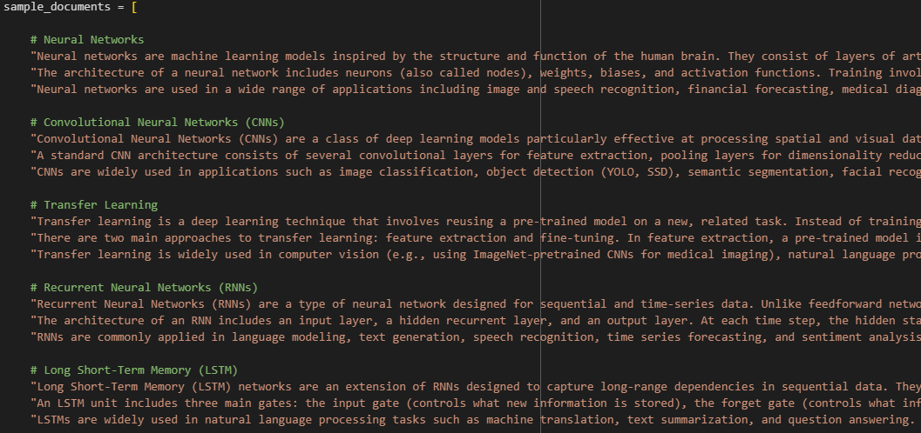
Custom Knowledge Base

Slide 7
Model Architecture
Three Main Components:
Document Store: Stores knowledge base as a list of texts.
Retriever: Uses SentenceTransformer embeddings + FAISS for semantic search.
Generator: Extractive generation using top retrieved documents as context.
Workflow:
Encode documents into vectors.
Retrieve top-k relevant docs for a query.
Generate answer using retrieved context.

Slide 8
Training Strategy & Hyperparameters
Embedding Model: all-MiniLM-L6-v2 (384-dimensional vectors).
Vector Index: FAISS IndexFlatL2 for fast similarity search.
Retrieval: Top-3 documents per query.
No fine-tuning: Uses pre-trained embeddings for simplicity and speed.
Document Addition: Dynamic, supports user uploads.

Slide 9
Results & Evaluation
System Testing:
Successfully answers questions like "What is explainable AI?" and "How does RAG work?" using relevant context.
Metrics:
Similarity scores for retrieved docs.
Qualitative assessment: Answers are contextually relevant and concise.
Interactive Demo: Gradio interface for live testing and feedback.

Slide 10
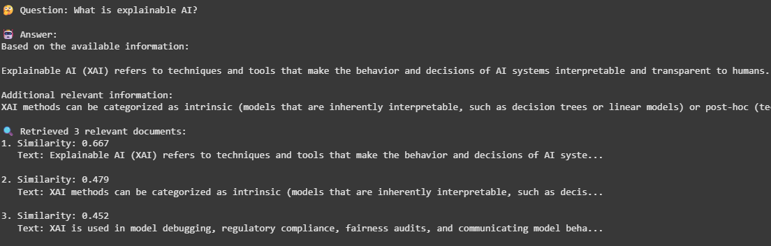
Examples

Slide 11
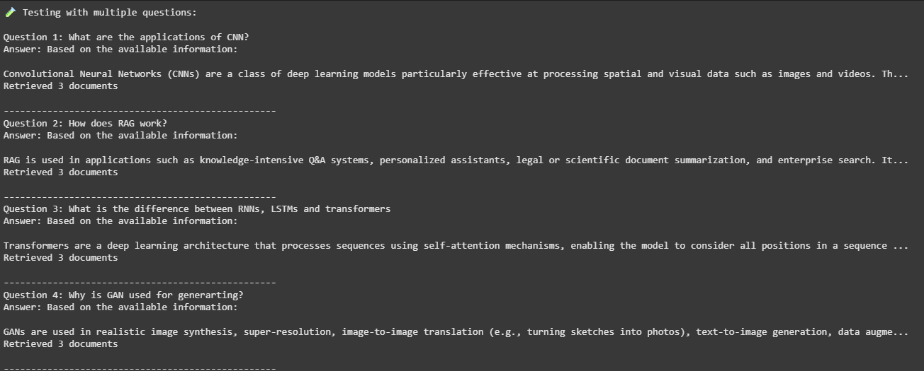
Examples

Slide 12
Challenges Faced
Limited Context: Simple extractive approach may miss nuanced answers.
Small Knowledge Base: Performance depends on document quality and coverage.
No Deep Generation: Does not use large generative models for abstractive answers.
Scalability: FAISS and embedding size limit for very large datasets1.

Slide 13
Conclusion & Future Work
Achievements:
Built a functional RAG QA system with semantic search and answer generation.
Enabled interactive document addition and real-time querying.
Future Enhancements:
Integrate larger language models for better answer generation.
Add metadata and advanced filtering.
Implement re-ranking and chunking for longer documents.
Explore frameworks like LangChain for production-ready solutions.

Slide 14
References
Sentence Transformers Documentation
FAISS Documentation
RAG Paper (arXiv:2005.11401)
LangChain Documentation
YouTube - ChrisMcCormickAI

