Slide 1
DVP MINI-PROJECT · SELF-LEARNING COMPONENT
Air Quality Analysis Dashboard
Seasonal AQI trends, pollutant comparison & interactive visual analytics — built in Python
Course: Data Visualization & Processing (DVP)
Team: Group of 5 · <Member A> · <Member B> · <Member C> · <Member D> · <Member E>
Tools: Python · Tkinter · pandas · NumPy · Seaborn · Matplotlib · Plotly · Excel
Notes:
One-liner: a Python desktop app that turns raw CPCB air-quality CSV data into seasonal AQI insights through an interactive dashboard. Replace the member placeholders with real names.

Slide 2
THE PROBLEM
Why air quality?
Air pollution is one of India's biggest public-health risks — and it is highly seasonal and pollutant-driven. Raw monitoring data is published as large CSV files that are hard to read as-is.
163
avg WINTER AQI (Mumbai)
Which season is worst, and by how much?
Which pollutant actually drives the AQI?
Is the winter peak a one-off or a yearly pattern?
69
avg MONSOON AQI (Mumbai)
Our goal: make that answerable in a few clicks.
02
Notes:
Frame the three questions — our dashboard answers all three. The 163 vs 69 gap is the headline finding, revealed later.

Slide 3
OUR APPROACH
Three layers, cleanly separated
1
Data & compute
2
Visualization
3
GUI dashboard
Load the CSV safely, engineer season/time columns, and compute statistics with pandas + NumPy.
Turn the numbers into charts: Matplotlib, Seaborn heatmaps, an interactive Plotly view, and an Excel report.
A Tkinter desktop app that ties it together — dropdown, buttons, embedded charts, one-click export.
air_analysis.py
visualizations.py
app.py
03
Notes:
Separation of concerns: each file has one job. This also maps directly to how we split the work across 5 people.

Slide 4
THE DATA
Real CPCB monitoring data
Source
Central Pollution Control Board (CPCB), via the public Kaggle dataset — offline CSV, no API
A note on Pune
Pune is not present in this CPCB dataset — Mumbai is the Maharashtra city included, so it is our demo city.
Scope
26 Indian cities · daily records · 2015 – 2020 · ~29,500 rows
Columns
PM2.5, PM10, NO, NO2, NOx, NH3, CO, SO2, O3, Benzene, Toluene, Xylene, AQI, AQI_Bucket
The app is city-agnostic: drop in a Pune CSV (Kaggle station_day or WAQI) and “Pune” appears in the dropdown automatically.
04
Notes:
Be upfront in the viva: we did not fake Pune data. Mumbai is real Maharashtra data; the design swaps to Pune the moment real Pune rows are supplied.

Slide 5
TECH STACK
Libraries & what each one does
T
Tkinter Python's built-in GUI toolkit — the whole desktop dashboard window.
S
Seaborn Statistical charts — correlation heatmap, seasonal boxplots, month×year heatmap.
p
pandas Load the CSV, group by season/month, pivot tables, aggregations.
P
Plotly Interactive time-series that opens in the browser (zoom, hover).
N
NumPy Vectorised math for the CPCB AQI sub-index calculation.
o
openpyxl Writes the multi-sheet Excel report on one click.
M
Matplotlib Core plotting engine; figures embedded inside the Tkinter window.
05
Notes:
Every library maps to a rubric requirement: Tkinter = GUI; pandas/NumPy = computation; Seaborn/Matplotlib/Plotly/Excel = visualization.

Slide 6
UNDER THE HOOD
We compute AQI, not just plot it
Instead of only reading the AQI column, we implemented the official CPCB AQI formula in NumPy. Each pollutant gets a sub-index by linear interpolation inside its concentration band; the overall AQI is the worst sub-index.
CPCB AQI categories
Good
0–50
Satisfactory
51–100
sub-index = (I_hi − I_lo)/(C_hi − C_lo) × (C − C_lo) + I_lo
Moderate
101–200
AQI = max(sub-indices)
Poor
201–300
· requires ≥ 3 pollutants incl. PM2.5 / PM10
Very Poor
301–400
Why it matters: it fills gaps where the AQI column is blank, and it is a strong point to defend in the viva.
Severe
401+
06
Notes:
Walk through: pick the band the concentration falls in, interpolate to get the sub-index, take the max across pollutants. This is the actual government method.

Slide 7
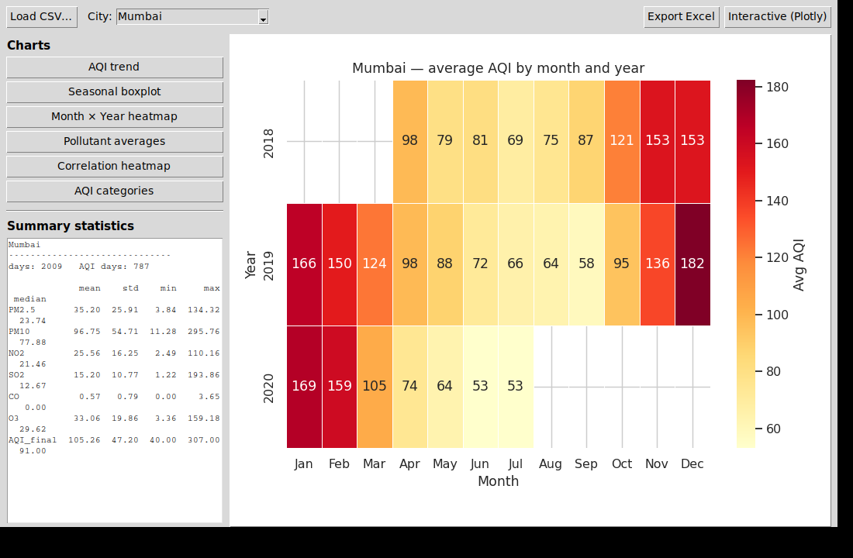
THE APPLICATION
A working desktop dashboard
City dropdown — switch any city instantly
6 chart buttons — each draws inside the window
Live stats panel — mean / std / min / max
Export Excel — multi-sheet report
Interactive — opens a Plotly view
07
Notes:
This is a genuine screenshot of the running app, not a mockup. Demo it live if possible.

Slide 8
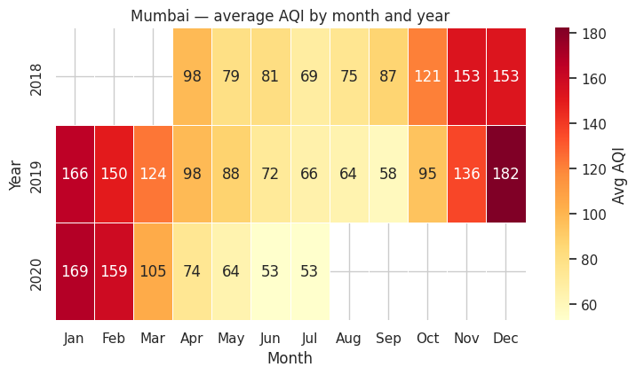
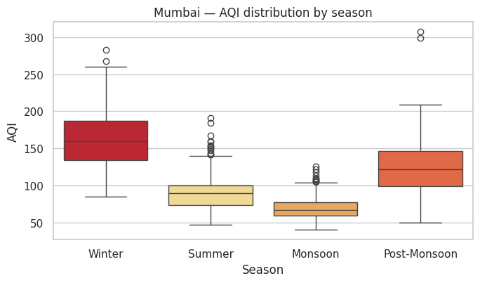
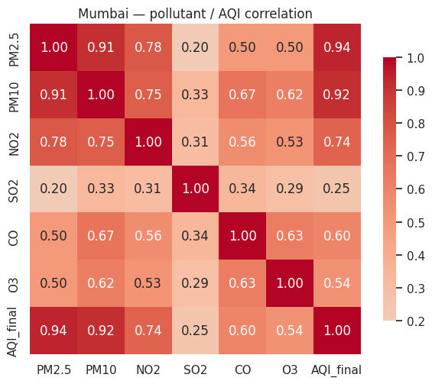
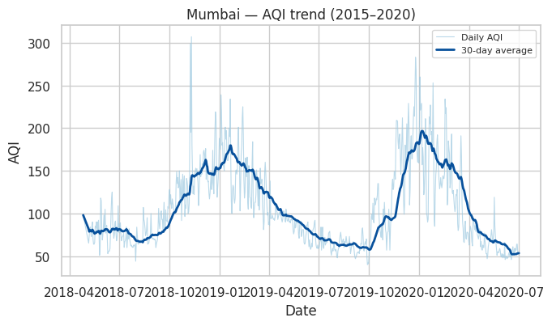
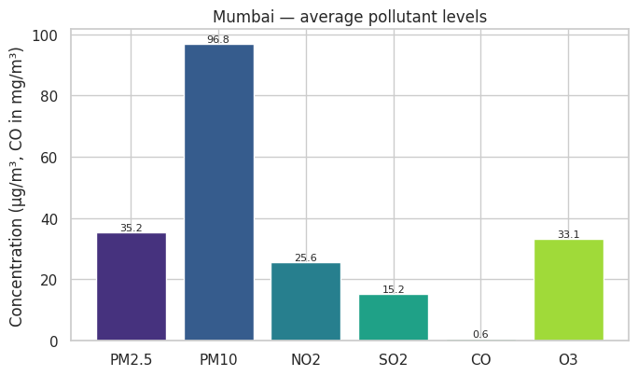
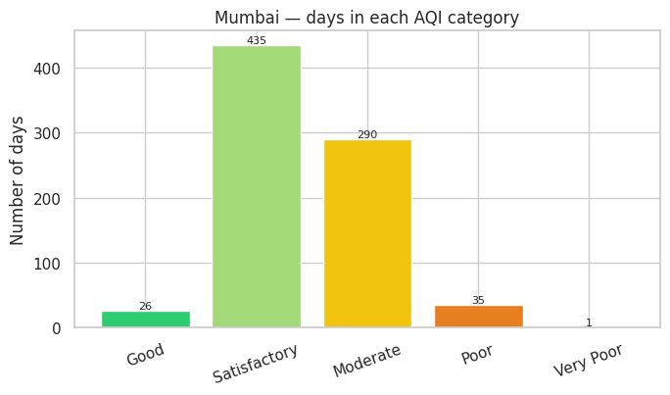
VISUAL ANALYTICS
Six views on the same data
Month × Year heatmap
Seasonal boxplot
Correlation heatmap
AQI trend + rolling avg
Pollutant averages
AQI category counts
08
Notes:
Matplotlib (trend, bars, categories) + Seaborn (heatmaps, boxplot) + a Plotly interactive not shown here. Same dataset, six angles.

Slide 9
FINDINGS
What the data tells us
1
Strong seasonality
Winter AQI (~163) is more than double the monsoon average (~69). Rain clears particulates; winter inversions trap them.
2
PM drives AQI
PM10 has the highest average concentration and correlates most with AQI — it sets the worst days.
3
A repeatable peak
The month×year heatmap shows Jan / Feb / Dec red every year — a consistent winter pattern, not noise.
AQI distribution by season
09
Notes:
Lead with the 163-vs-69 seasonal gap; the boxplot on the right is the evidence.

Slide 10
THE TEAM
How we split the work
A
Data & compute
D
GUI
CSV loading, exception handling, season logic, AQI formula in air_analysis.py
Tkinter layout, dropdown, buttons, embedded canvas in app.py
B
Charts (Matplotlib/Seaborn)
E
Docs & presentation
Trend, bars, heatmaps and the seasonal boxplot in visualizations.py
README, this deck, findings write-up and the demo script
C
Plotly & Excel
Interactive time-series + multi-sheet Excel export
10
Notes:
Replace A–E with names. The split maps 1:1 to the code files, which makes ownership easy to defend.

Slide 11
WRAP-UP
Summary & next steps
A working, city-agnostic air-quality dashboard in pure Python
Real CPCB data → pandas/NumPy compute → Seaborn/Matplotlib/Plotly/Excel output
Clear seasonal story: winter is ~2.4× worse than monsoon
Next steps
Load real Pune data (station_day / WAQI)
Add weather overlay (rain vs AQI)
Multi-city comparison view
Thank you
Questions?
Notes:
Close on the seasonal headline and invite questions. Mention the Pune-data path as the obvious extension.

