Slide 1
SOCIAL MEDIA ANALYTICS
Instagram Clone — SQL-Driven
Engagement & Marketing Insights
13 objective + 10 subjective business questions answered using SQL on the ig_clone dataset
Divyansh Sen
Data Analyst / Data Scientist Aspirant

Slide 2
DATABASE SCHEMA & DATA DESCRIPTION
ig_clone — Tables, Columns & Relationships
users
photos
likes
comments
One row per user (100 users)
Posts uploaded by users
Who liked which photo
Comments written on photos
id (PK)
username
created_at
id (PK)
image_url
user_id (FK → users)
created_dat
user_id (FK → users)
photo_id (FK → photos)
created_at
id (PK)
comment_text
photo_id (FK → photos)
user_id (FK → users)
created_at
follows
tags
photo_tags
How tables connect
Follower → followee links
Hashtag dictionary
Links photos to hashtags
photos belong to users
likes & comments link users ↔ photos
follows link user ↔ user
photo_tags link photos ↔ tags (many-to-many)
follower_id (FK → users)
followee_id (FK → users)
created_at
id (PK)
tag_name
photo_id (FK → photos)
tag_id (FK → tags)

Slide 3
THE DATASET
Project Overview
6 Tables
100 Users
23 Questions
users, photos, likes, comments, follows, tags / photo_tags
Full behavioural footprint per user across posts, likes & comments
13 objective SQL tasks + 10 subjective business-strategy questions
Goal
Clean and validate the data, quantify user activity and engagement, surface the platform's most valuable and most disengaged users, and translate every finding into a marketing or product recommendation.
Data quality check: no NULLs or duplicate records found across all six tables — dataset is analysis-ready.

Slide 4
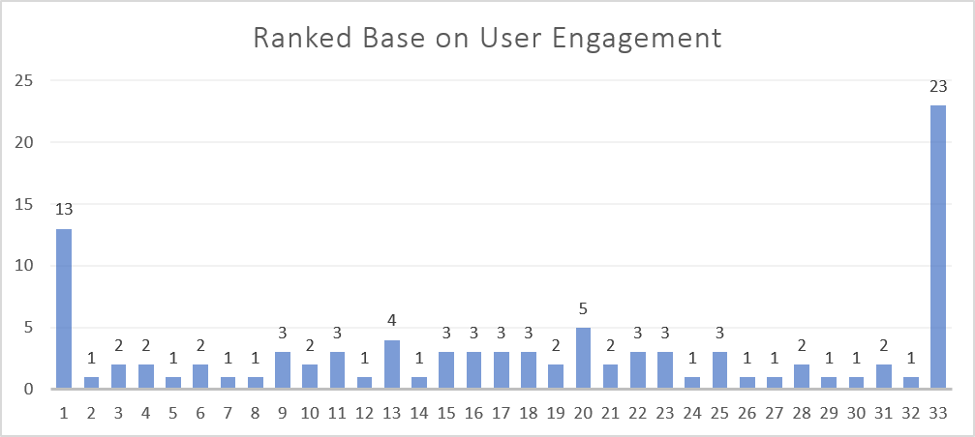
ENGAGEMENT RANKING
Who Are Our Most Valuable Users?
13
top loyal users, ranked by
total likes + comments across
their posts (DENSE_RANK)
Rank 1 users receive the highest combined engagement and are the strongest candidates for loyalty rewards, early-access features, or referral incentives.

Slide 5
CONTENT STRATEGY
Which Hashtags Drive the Most Engagement?
Approach
Likes and comments are aggregated per photo first (avoiding double-counting), joined to hashtags via photo_tags, then ranked with DENSE_RANK on engagement rate per post.
Recommendation
Prioritise content built around delicious, beauty and foodie themes in organic posting and paid campaigns.

Slide 6
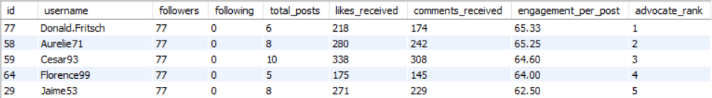
GROWTH PARTNERSHIPS
Influencer & Brand Advocate Candidates
Top 5 by followers + engagement per post (DENSE_RANK)
Use these users for:
Sponsored posts & product seeding
Launch-event ambassadors
Referral / affiliate programs
How the ranking was built
Follower/following counts come from the follows table; likes and comments are aggregated per photo to avoid duplicate counting; engagement per post = (likes + comments) received ÷ total posts. Follower count and engagement per post are combined so reach and genuine interaction both count.

Slide 7
USER LIFECYCLE
Segmentation & Re-engagement
Content-preference segments (based on liked tags)
Inactive users: 26 identified
Beach Interested
Stopped posting, still liking content
Fun Interested
13 users — target with personalised content picks from their preferred tag (e.g. “smile”).
Smile Interested
No Identifiable Preference
No posts, no likes, no comments
Zero behavioural signal — use generic hooks: trending content, onboarding prompts, posting challenges.
Segments turn one-size-fits-all campaigns into targeted content and win-back journeys per user group.

Slide 8
KEY TAKEAWAYS
From SQL Insight to Business Action
1
Clean, duplicate-free dataset gave every downstream metric a reliable base
2
13 top loyal users and top-5 influencer / advocate candidates pinpointed for reward & partnership programs
3
delicious, beauty and foodie content consistently earn the highest engagement rate per post
4
26 inactive users segmented into re-engagement tiers with tailored win-back messaging
Thank you — Divyansh Sen

