Slide 1
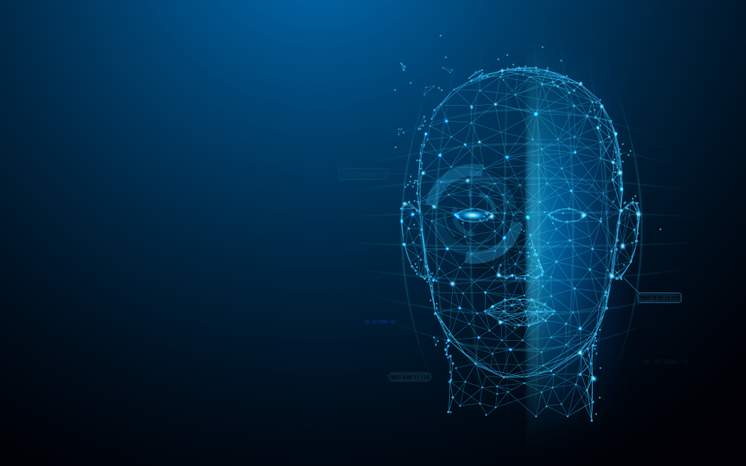
Human Face Recognition Attendance System

Slide 2
IntroDuction
As we are making a system which can recognize face and match with its own database. It will make the attendance system more authentic. Our primary goal is to help the lecturers, improve and organize the process of track and manage student attendance and absenteeism.

Slide 3
What Is Face Detection?
Face detection is a type of computer vision technology that is able to identify people’s faces within digital images. This is very easy for humans, but computers need precise instructions. The images might contain many objects that aren’t human faces, like buildings, cars, animals, and so on.

Slide 4
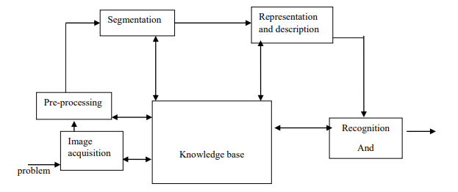
Plan of works

Slide 5
Software Used
Program language: Python 3
Software:
1. pycharm

Slide 6
Advantages
The system stores the faces that are detected and automatically marks attendance.
Ease of use is manipulate and recognize the faces in real time using. Multiple face detection. Multipurpose software Can be used in different places.

Slide 7
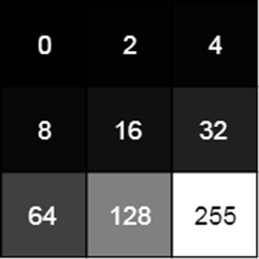
How Do Computers “See” Images?
Since a computer only understand numbers, every pixel is represented by three numbers, corresponding to the amounts of red, green, and blue present in that pixel.
In grayscale (black and white) images, each pixel is a single number, representing the amount of light, or intensity, it carries. In many applications, the range of intensities is from 0 (black) to 255 (white). Everything between 0 and 255 is various shades of gray.
If each grayscale pixel is a number, an image is nothing more than a matrix (or table) of numbers:
In color images, there are three such matrices representing the red, green, and blue channels.

Slide 8
DisAdvantages
The accuracy of the system is not 100% its around 98% +- 1.24%. It can only detect face from a limited distance.

Slide 9
What Are Features?
A feature is a piece of information in an image that is relevant to solving a certain problem. It could be something as simple as a single pixel value, or more complex like edges, corners, and shapes. You can combine multiple simple features into a complex feature.
Applying certain operations to an image produces information that could be considered features as well. Computer vision and image processing have a large collection of useful features and feature extracting operations.
Basically, any inherent or derived property of an image could be used as a feature to solve tasks.

