Slide 1
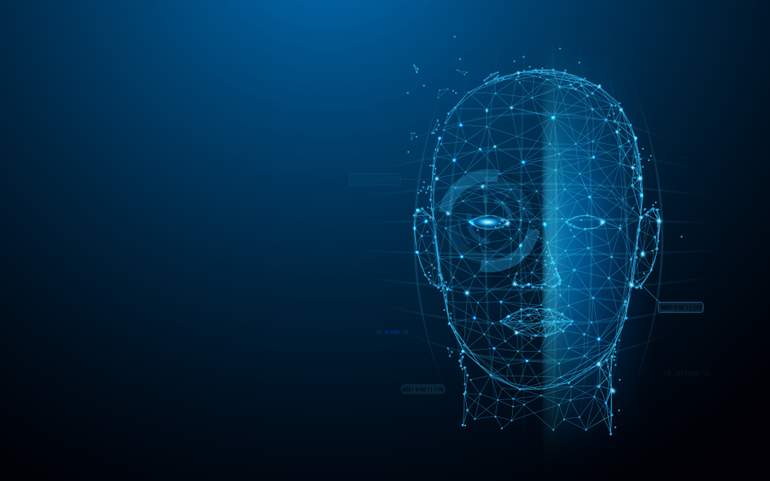
Human Face Recognition Attendance System

Slide 2
What is OpenCV ?
OpenCV is a cross-platform library using which we can develop real-time computer vision applications. It mainly focuses on image processing, video capture and analysis including features like face detection and object detection.
OpenCV uses machine learning algorithms to search for faces within a picture. Because faces are so complicated, there isn’t one simple test that will tell you if it found a face or not. Instead, there are thousands of small patterns and features that must be matched. The algorithms break the task of identifying the face into thousands of smaller, bite-sized tasks, each of which is easy to solve. These tasks are also called classifiers.

Slide 3
Features of OpenCV Library
Using OpenCV library, you can −
Read and write images
Capture and save videos
Process images (filter, transform)
Perform feature detection
Detect specific objects such as faces, eyes, cars, in the videos or images.
Analyze the video, i.e., estimate the motion in it, subtract the background, and track objects in it.

Slide 4
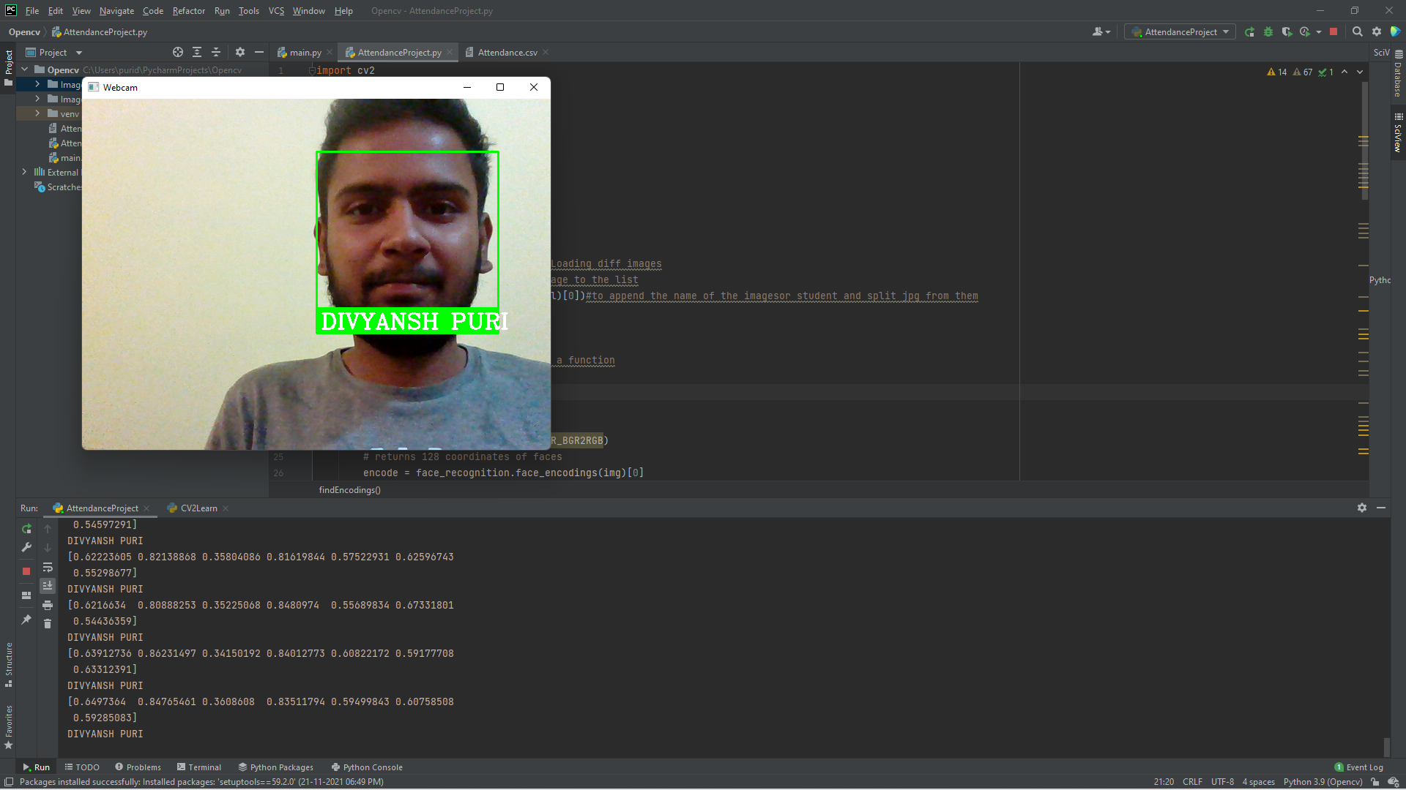
Face recognition demo program:

Slide 5
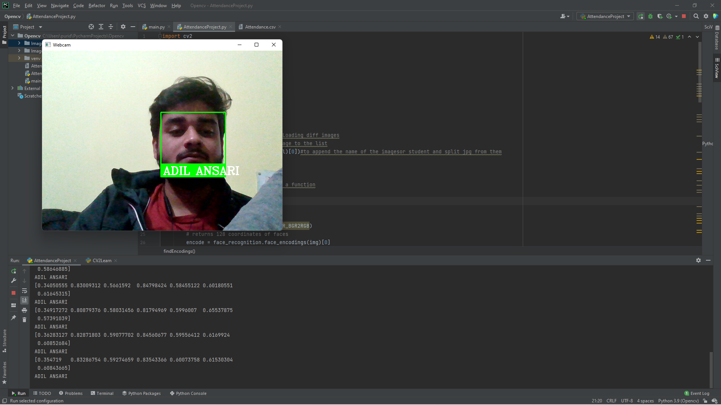
Face recognition demo program:

Slide 6
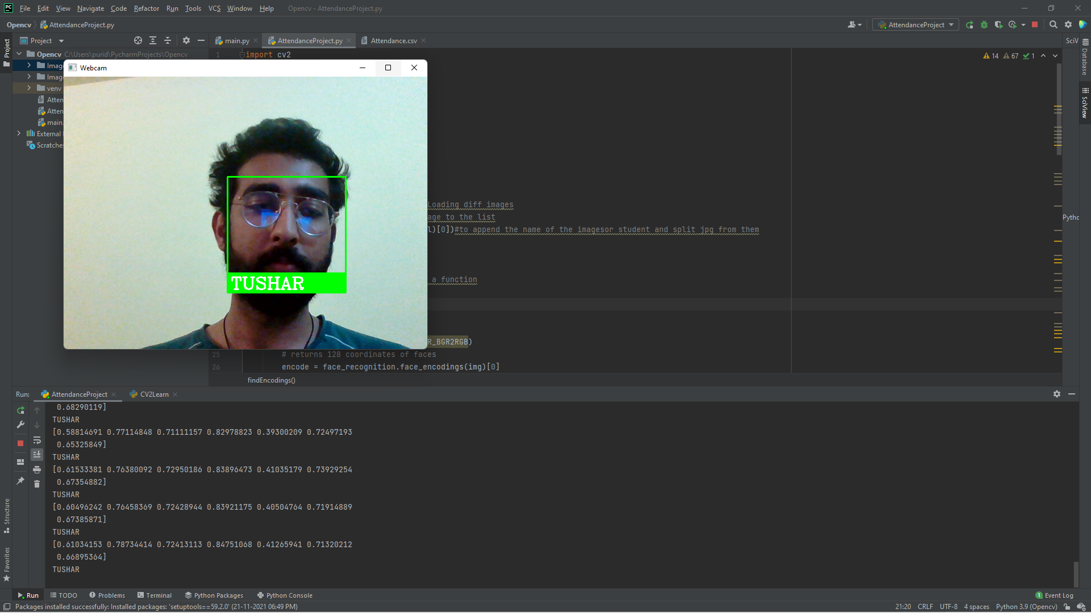
Face recognition demo program:

Slide 7
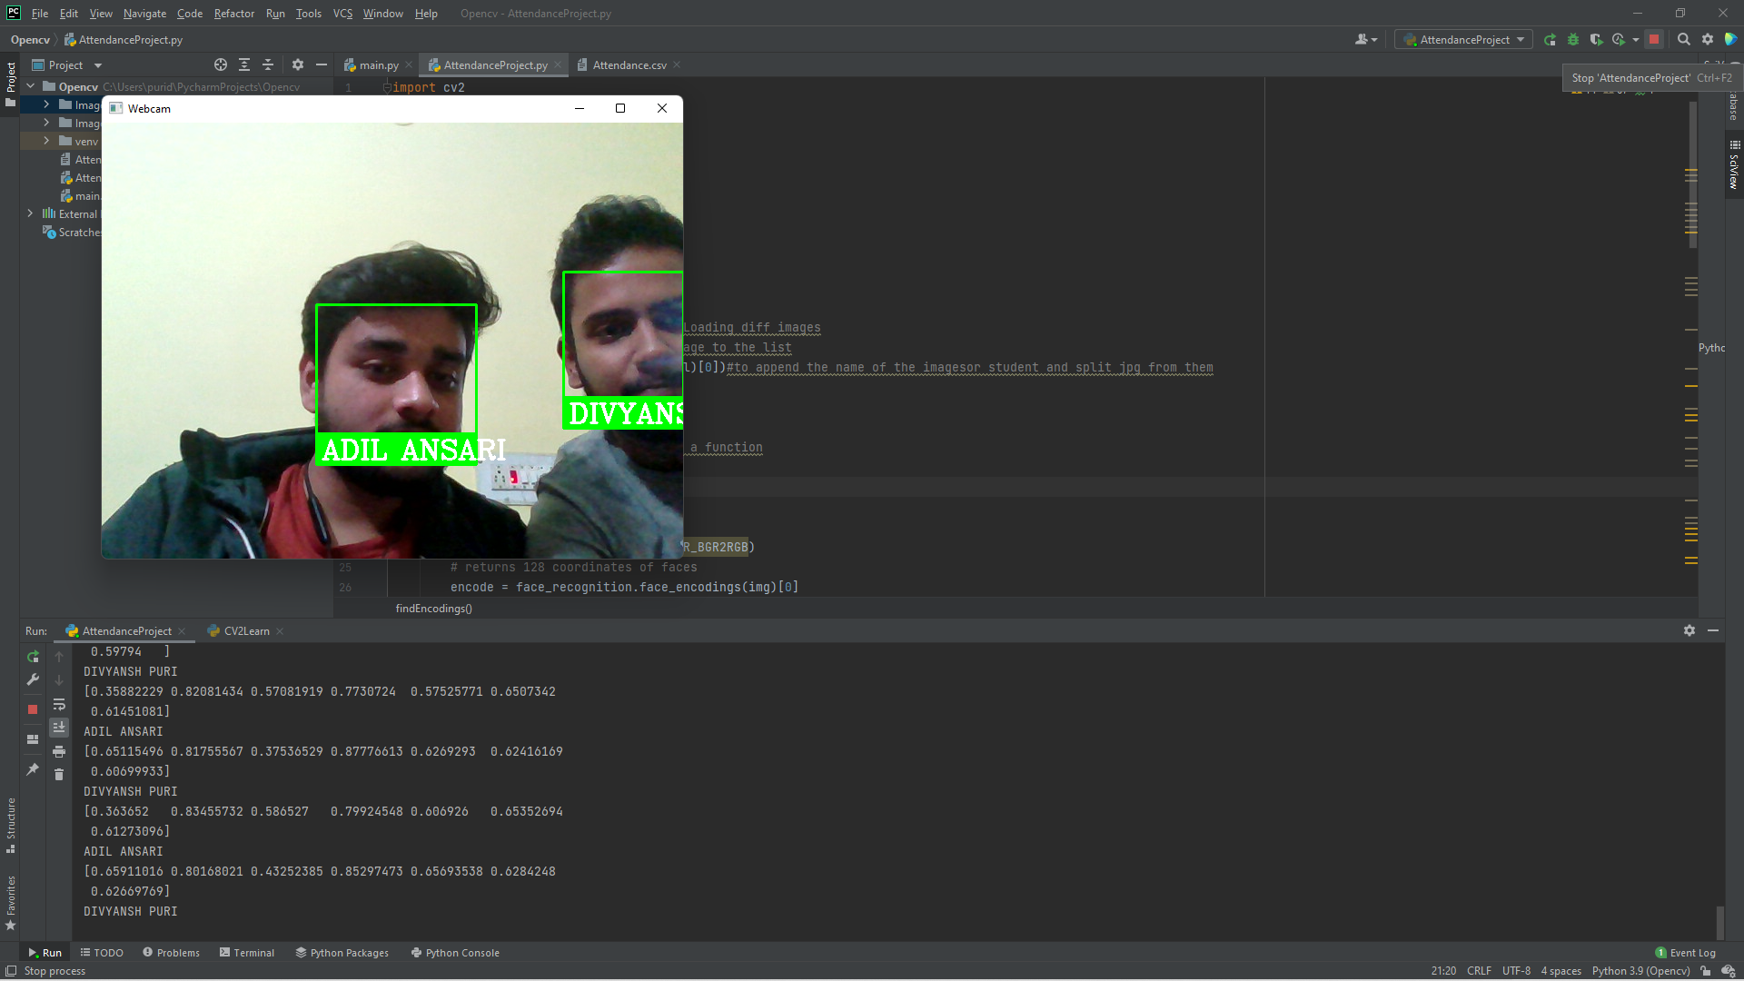
Face recognition demo program:

Slide 8
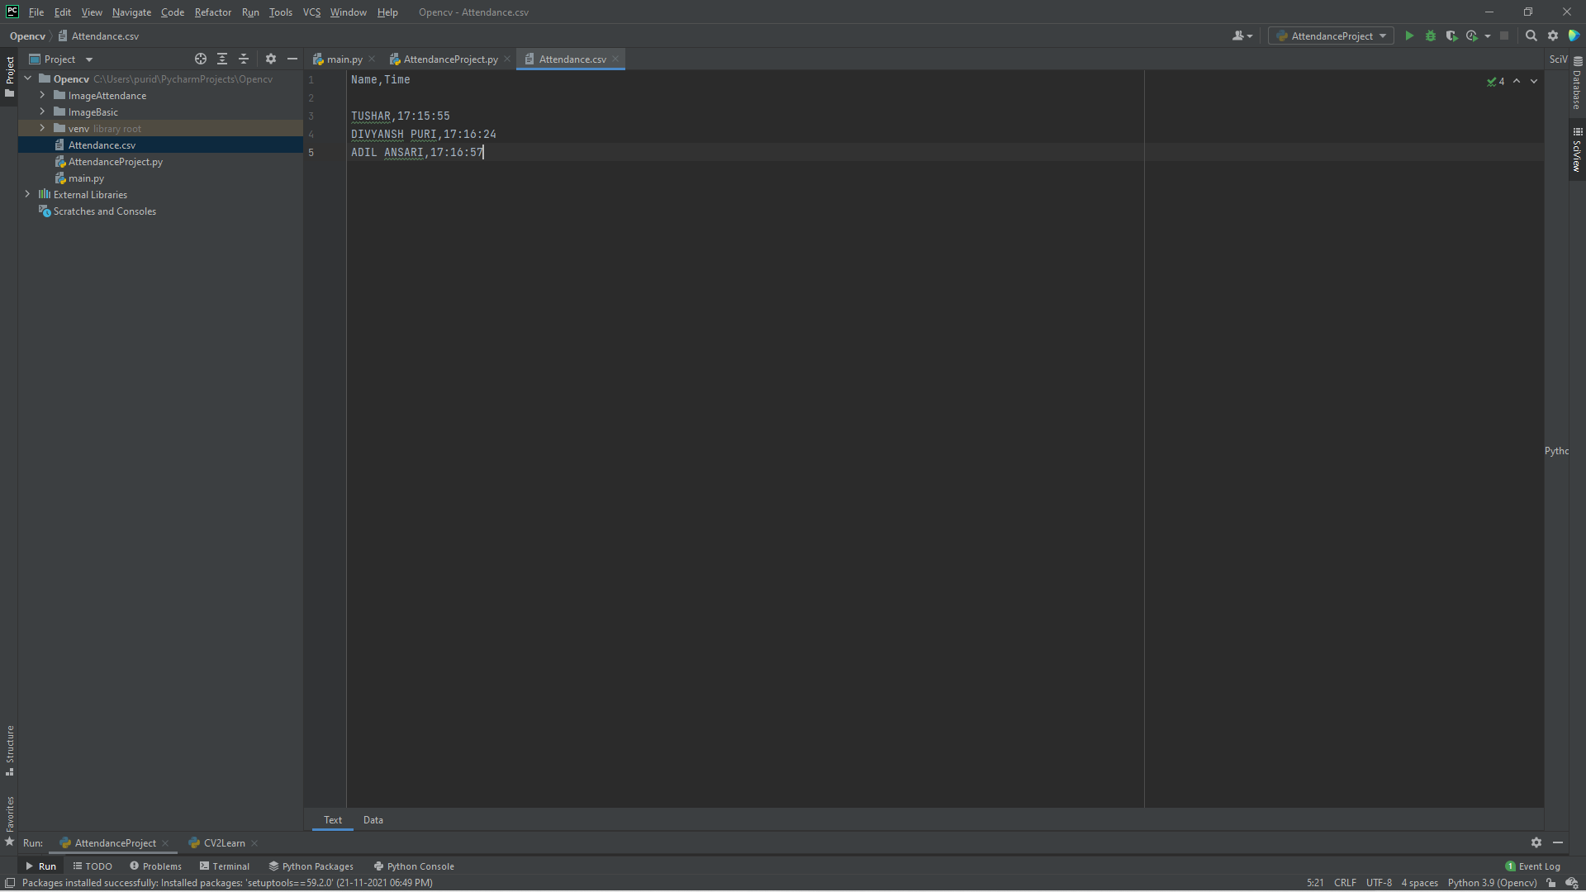
Face recognition demo program MARKED ATTENDANCE WITH TIME OF ENTRY:

Slide 9
References
Face Recognition with open cv:
https://www.pyimagesearch.com/2018/06/18/face-recognition-with-opencv-python-and-deep-learning/
https://pypi.org/project/face_recognition/
https://towardsdatascience.com/a-guide-to-face-detection-in-python-3eab0f6b9fc1

