Slide 1


Test Your Quantitative Skills
Divyansh Singh(2002900100057 / CSE / A)
Divyansh Dubey(2002900100056 / CSE / A)

Slide 2


Objective
Assess and Improve Aptitude Skills
Engage and Motivate Users
Personalized Learning Experience
Track Progress and Provide Insights
Foster Competition and Social Interaction

Slide 3
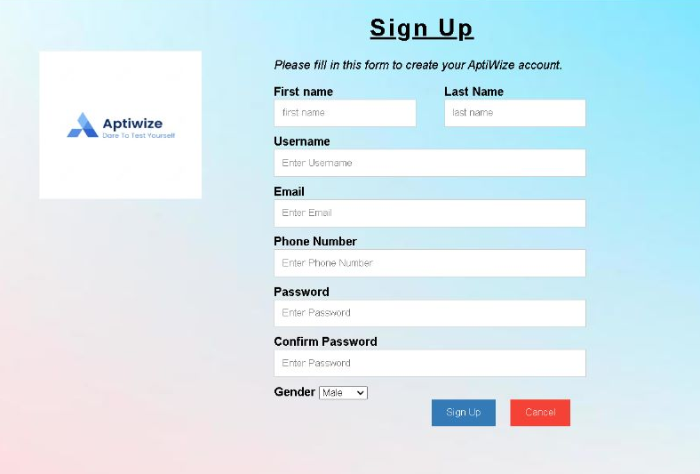
Layout of Sign-up page

Slide 4
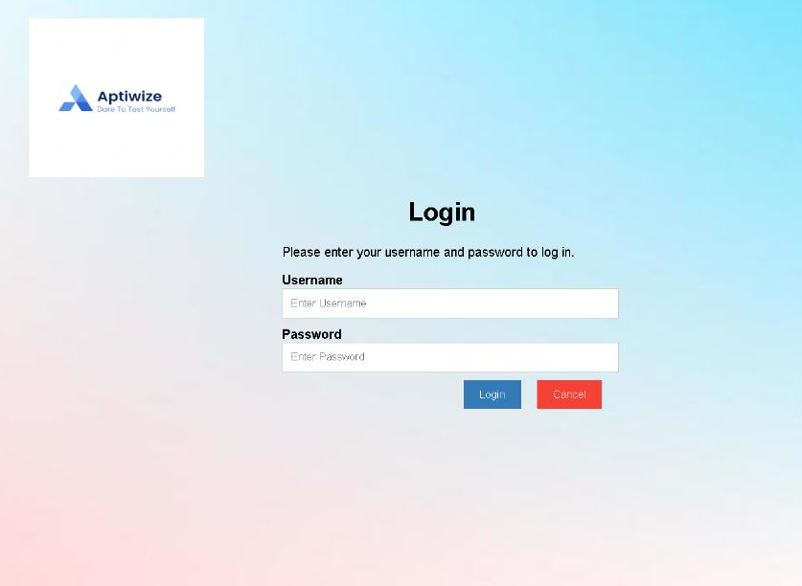
Layout of a login page

Slide 5
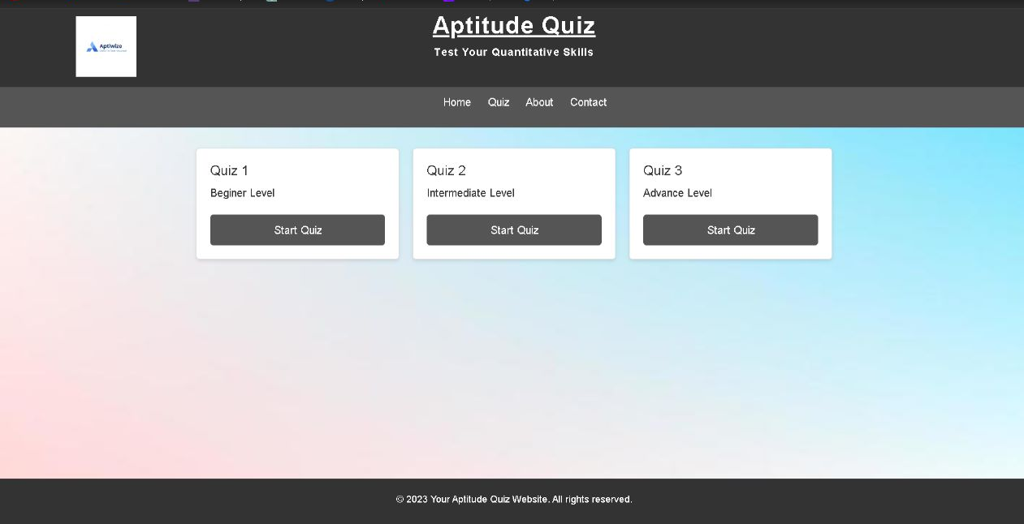
HOMEPAGE

Slide 6
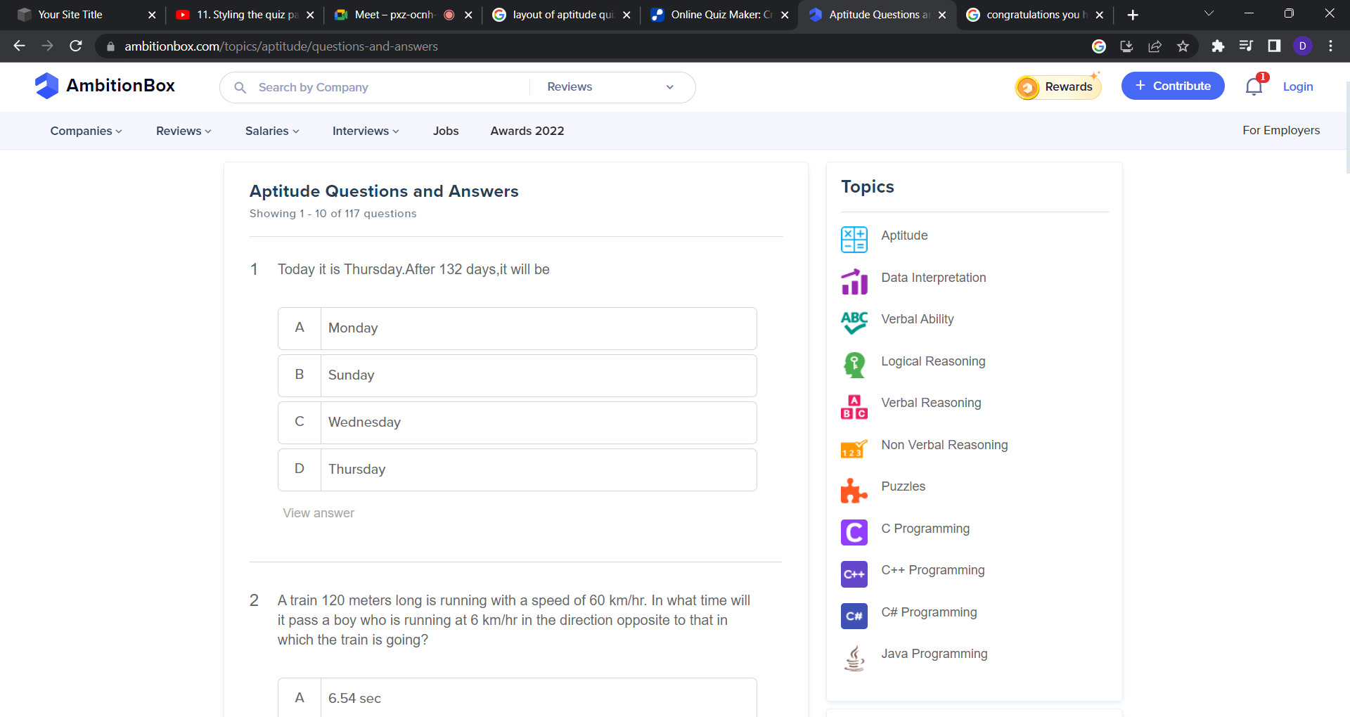
Topics covered

Slide 7
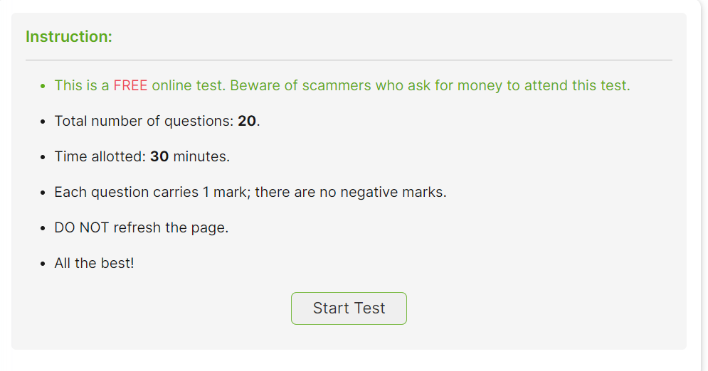
Layout of start/instructions of test

Slide 8
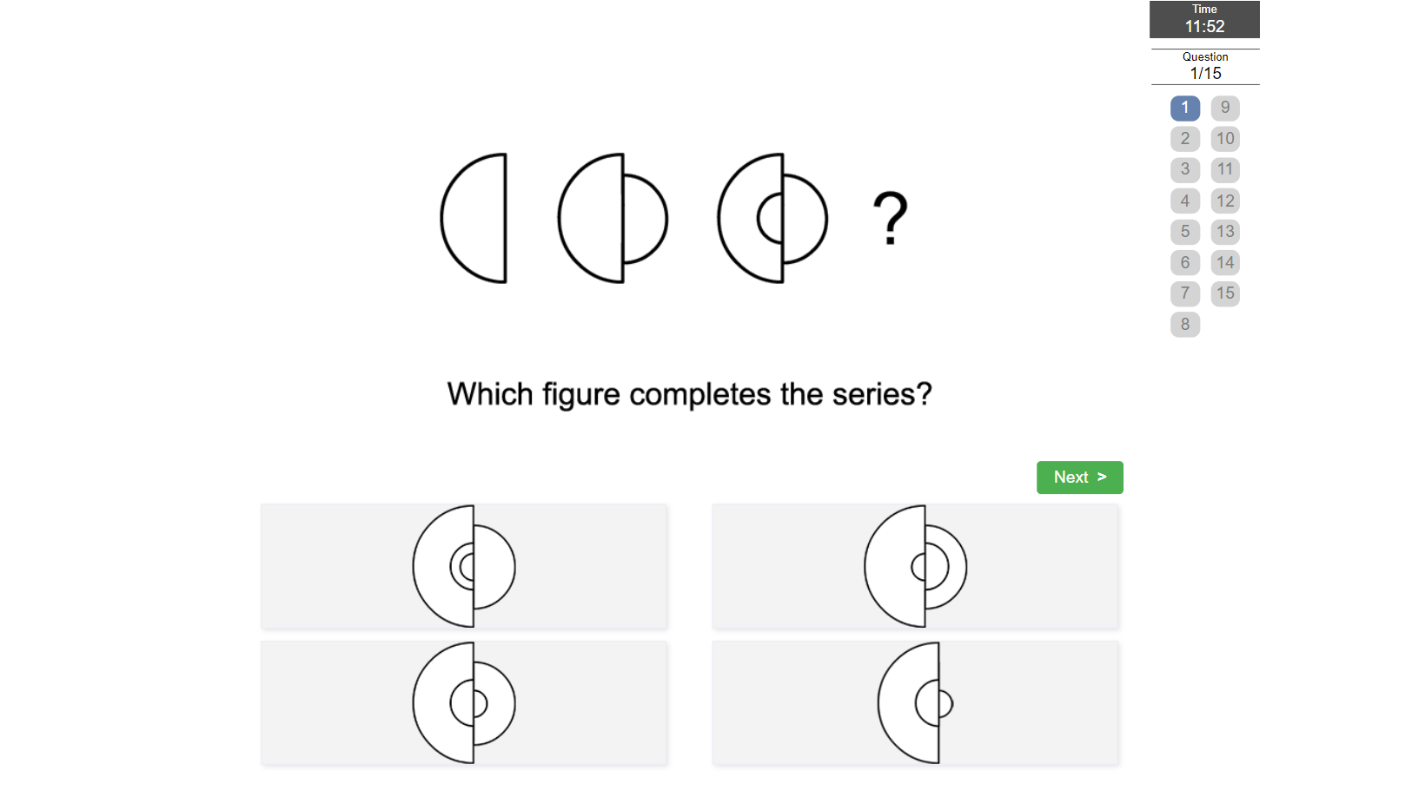
About Components
Time
Question no.
Q1)
question
Next question
options
A)
B)
C)
D)

Slide 9
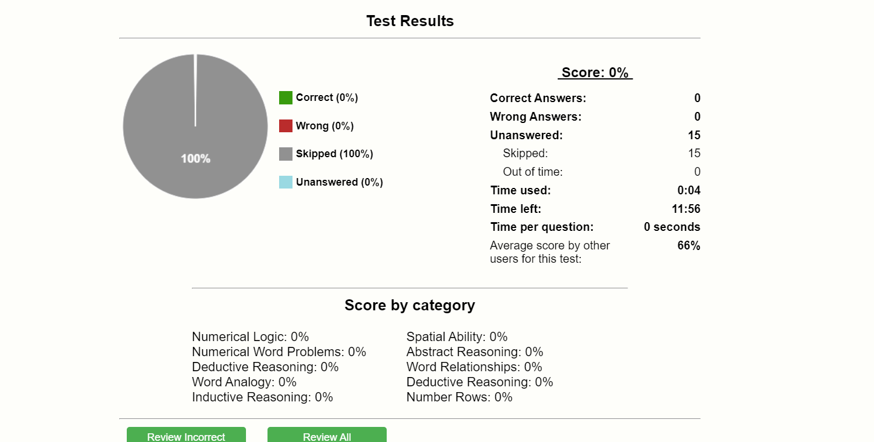
Details about end page

Slide 10
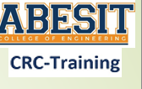

Thank
you
Please Ask easy questions…….

