Slide 1
JAVA

Slide 2
What is Java?
Java is a programming language and a platform.
Platform Any hardware or software environment in which a program runs, known as a platform. Since Java has its own Runtime Environment (JRE) and API, it is called platform.

Slide 3

History of Java
Java history is interesting to know. The history of java starts from Green Team. Java team members (also known as Green Team), initiated a revolutionary task to develop a language for digital devices such as set-top boxes, televisions etc.
Currently, Java is used in internet programming, mobile devices, games, e-business solutions etc. There are given the major points that describes the history of java.
1) James Gosling, Mike Sheridan, and Patrick Naughton initiated the Java language project in June 1991. The small team of sun engineers called Green Team.
james gosling

Slide 4

2) Originally designed for small, embedded systems in electronic appliances like set-top boxes.
3) Firstly, it was called "Greentalk" by James Gosling and file extension was .
4) After that, it was called Oak and was developed as a part of the Green project.

Slide 5
Why Java name for java language?
7) Why they choosed java name for java language? The team gathered to choose a new name. The suggested words were "dynamic", "revolutionary", "Silk", "jolt", "DNA" etc.
8) Java is an island of Indonesia where first coffee was produced (called java coffee).
9) Originally developed by James Gosling at Sun Microsystems (which is now a subsidiary of Oracle Corporation) and released in 1995.
11) In 1995, Time magazine called Java one of the Ten Best Products of 1995.
12) JDK 1.0 released in(January 23, 1996).

Slide 6
Java Version History
There are many java versions that has been released.
JDK Alpha and Beta (1995)
JDK 1.0 (23rd Jan, 1996)
JDK 1.1 (19th Feb, 1997)
J2SE 1.2 (8th Dec, 1998)
J2SE 1.3 (8th May, 2000)
J2SE 1.4 (6th Feb, 2002)
J2SE 5.0 (30th Sep, 2004)
Java SE 6 (11th Dec, 2006)
Java SE 7 (28th July, 2011)
Java SE 8 (March 18, 2014)

Slide 7
Types of Java Applications
1) Standalone Application
It is also known as desktop application or window-based application. An application that we need to install on every machine such as media player, antivirus etc. AWT and Swing are used in java for creating standalone applications.
2) Web Application
An application that runs on the server side and creates dynamic page, is called web application. Currently, servlet, jsp, struts, jsf etc. technologies are used for creating web applications in java.
3) Enterprise Application
An application that is distributed in nature, such as banking applications etc. It has the advantage of high level security, load balancing and clustering. In java, EJB is used for creating enterprise applications.
4) Mobile Application
An application that is created for mobile devices. Currently Android and Java ME are used for creating mobile applications.

Slide 8
JVM
JVM (Java Virtual Machine) is an abstract machine. It is a specification that provides runtime environment in which java bytecode can be executed.
JVMs are available for many hardware and software platforms. JVM, JRE and JDK are platform dependent because configuration of each OS differs. But, Java is platform independent.
The JVM performs following main tasks:
Loads code
Verifies code
Executes code
Provides runtime environment

Slide 9
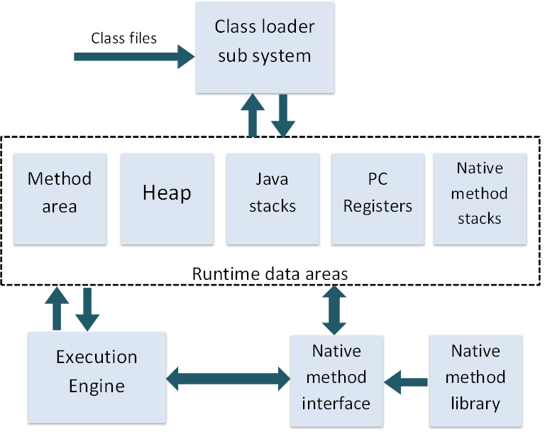

Slide 10
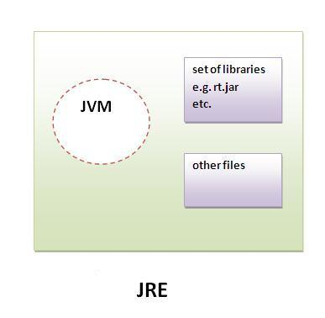
JRE
It is used to provide runtime environment . It is the implementation of JVM . It physically exists . It contains set of libraries + other files that JVM uses at runtime.

Slide 11
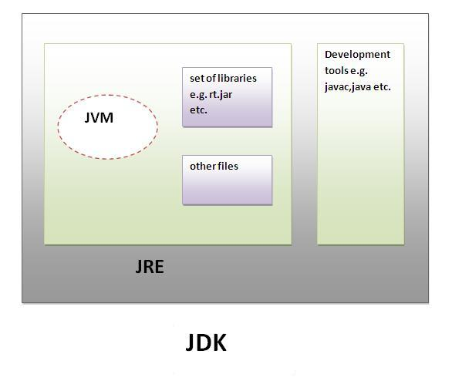

Slide 12
Object-Oriented
Java supports the object-oriented approach to develop programs. It supports various features of an object oriented language, such as abstraction, encapsulation, inheritance, and polymorphism.
To implement the object oriented language, the entire code of the program must be written within a class.
The Java language does not support stand-alone statements. Even the most basic program in Java must be within a class.

Slide 13
Data Types
The data stored in the memory of the computer can be of many types. For example, a person’s age is stored as a numeric value and an address is stored as alphanumeric characters. Data types are used to define the operations that are possible on the variables and the storage method.
Java is a strictly typed language, which means that Java gives importance to type checking. Expressions and variables in Java can be of different types, such as int,
char, or String. Type checking is one of the important steps in the compilation of a program. The data stored in the memory of a computer can be of different types.
Types of Data type.
1) primitive data types
2) non-primitive data types
Java is Strongly Typed Programming language

Slide 14
Primitive Data Types
The built-in data types in Java are known as the primitive or the simple data types. There are eight primitive data types in Java, which are further grouped in the following categories:

Slide 15
non-primitive data types
Non-primitive data types are not defined by the programming language, but are instead created by the programmer. They are sometimes called “reference variables” or “object references”; since they reference a memory location, which stores the data. In the Java programming language, non-primitive data types are simply called “objects”; because they are created, rather than predefined. While an object may contain any type of data, the information referenced by the object may still be stored as a primitive data type.
Array
2) String
3) enum
etc..

Slide 16
Keywords
Keywords are the reserved words for a language, which express the language features. Keywords cannot be used to name variables, constants, or classes.
Java is a case-sensitive language and the keywords should be written in lowercase only. The keywords with all or some letters in uppercase can be treated as a variable name
but that should be avoided.

Slide 18
Defining Variables
A variable is used to store and manipulate data or values in programs. A variable is the name that refers to a memory location where some data value is stored. You can assign
different values to a variable during program execution.
Java allocates memory to each variable that you use in your program. If the name or number is used to refer to an area in the memory where a value is stored, number is a
variable.
Each variable that is used in a program must be declared.
For example, if the variable number is to be used for storing an integer value, the variable, number, must be declared and it should be of the type int.
Naming Conventions for Variables
A program refers to a variable by using its name. Certain
rules and conventions govern the naming of variables. These rules are enforced by a programming language. A program does not compile if you have not followed the

Slide 19
Rules of the language. Conventions help to improve the readability of the program, but following them is not
mandatory. The naming conventions for a variable in Java are:
1. The name of a variable needs to be meaningful, short, and without any embedded space or symbol, such as ?, !, #, @, %, &, {}, [], :, ;, “, and /.
2. A variable name must be unique.
3. A variable name must begin with a letter, an underscore (_), or the dollar symbol ($), which
can be followed by a sequence of letters or digits (0 to 9), ‘$’, or ‘_’.
4. A variable name should not start with a digit.
5. A variable name should not contain embedded white spaces. You can use an underscore for
spacing purpose.
6. A variable name should not consist of a keyword.
7. A variable name in Java is case-sensitive. There is a difference between uppercase and lowercase names. For example, age is not same as Age.

Slide 20
Declaring Variables
The declaration of a variable informs the compiler about the variable name, data type, and the scope of a variable. A variable has to be declared before you access it. The following code snippet shows how to declare a variable:
<type> <variablename>; // Single variable of given type.
<type><variable1name,variable2name.....variable_n_name> // Multiple variables of given type .
In the preceding syntax, you need to initialize variables before you use them. The Java compiler initializes the class data variables to default values when an object is created. You can assign values to a variable during declaration or after declaration of the variable, before first use of the variable. For example, you can use the
int num1, num2; // Declaration of variables.
num1 = 5; // Assigning values to the variables.
num2 =10;

Slide 21
Types of Variables
There are three types of variables in java
local variable
instance variable
static variable
1. Local variables: Are declared inside a method. Their scope is within the block of code in which
they are defined. They are local to the block of code and are not accessible outside the method.
2. Instance Variable: A variable that is declared inside the class but outside the method is called instance variable . It is not declared as static.
3. Static variable: A variable that is declared as static is called static variable. It cannot be local.
class Demo{
int a=50;//instance variable
static int b=100;//static variable
void method(){
int c=90;//local variable
}
}//end of class

Slide 22
final variable
If you make any variable as final, you cannot change the value of final variable(It will be constant).
class Demo
{
final int TopSpeed=40;//final variable
public static void main(String ar[])
{
TopSpeed=90;
}
}

Slide 23
Manipulating Variables
Assignment Operator
You use the assignment operator (=) to assign a value to a variable. The following syntax is used for the assignment operator:
op1 = op2;
Arithmetic Operators
Arithmetic operators are used to compute mathematical expressions.
+ Adds two operands
Subtracts one operand from another
* Multiplies two operands
/ Divides two operands
% Calculates the modulus

Slide 24
Logical Operator
Conditional operators, like their relational counterparts, are also mostly used in if statements, while loops, and for loops.
Symbol | Condition
&& | AND
|| | OR
! | NOT

Slide 25
Relational Operators
Symbol Condition
== is equal to
!= is not equal to
> is greater than
< is less than
>= is greater than or equal to
<= is less than or equal to
Unary Operator
++ increment
-- decrement

Slide 26
Ternary Operator
Work like if else
Bitwise Operators:
Java defines several bitwise operators, which can be applied to the integer types, long, int, short, char, and byte.
Bitwise operator works on bits and performs bit-by-bit operation. Assume if a = 60; and b = 13; now in binary format they will be as follows:
a = 0011 1100
b = 0000 1101
-----------------
a&b = 0000 1100
a|b = 0011 1101
a^b = 0011 0001
~a = 1100 0011
(a < b) ? a : b;

Slide 27
Operator Description Example
& Binary AND Operator copies a bit to the result if it
exists in both operands. (A & B) will give 12 which is 0000 1100
| Binary OR Operator copies a bit if it exists in either
operand. (A | B) will give 61 which is 0011 1101
^ Binary XOR Operator copies the bit if it is set in one
operand but not both. (A ^ B) will give 49 which is 0011 0001
~ Binary Ones Complement Operator is unary and has
the effect of 'flipping' bits. (~A ) will give -61 which is 1100 0011 in 2's complement form due to a signed binary number.
<< Binary Left Shift Operator. The left operands value is
moved left by the number of bits specified by the right operand.
A << 2 will give 240 which is 1111 0000
>> Binary Right Shift Operator. The left operands value is
moved right by the number of bits specified by the right operand.
A >> 2 will give 15 which is 1111

Slide 28
Casting and Conversion
Consider a scenario where you need to create an application to perform arithmetic operations on two integer values. The resultant of the arithmetic operation is a floating-point. In such a situation, the program should be compatible to handle the resultant data type.
To resolve such issues, Java provides a mechanism called casting. Casting allows converting a variable of one data type to another.
Java programming language supports the following types of conversions:
Implicit Conversion
Implicit conversion refers to an automatic conversion of one data type to another. It occurs if both the data types are compatible with each other. For example, you can
assign a value of int type to a variable of long data type.

Slide 29
Explicit Conversion
Explicit conversion occurs when one data type cannot be implicitly converted to another data type. In an explicit
conversion, you must convert the data type to the compatible type.
For example, the int type is large enough to store a byte value. Therefore, it does not require any explicit
conversion. However, assigning an int value to a byte type would require explicit conversion as the range of the byte type is smaller as compared to the int type.
class TypeCast
{
public static void main(String arr[])
{
byte b; int i = 25; double d = 35.55;
b = (byte) i;
System.out.println(“Value of int to byte conversion” + b); b = (byte) d;
System.out.println(“Value of double to byte conversion” + b); i = (int) d;
System.out.println(“Value of double to int conversion” + i);}}

Slide 30
Using Conditional Statements
Conditional statements allow selective execution of a set of statements depending on the value of expressions associated with them. Conditional statements are also known as decision-making statements. You make decisions in your daily life, such as which ice cream to have or which movie to watch. The same decision-making is also incorporated in programs by using conditional statements. You can control the flow of a program by using conditional statements. The two types of conditional statements in Java are:
The if-else statement
The switch statement
Using the if-else Statement
if(boolean expression){
statement(s)
}
else {
statement(s)
}

Slide 31
The switch Statement
The switch statement successively tests the value of an expression or a variable against a list of case labels with integer or character constants. When a match is found in one of the case labels, the statements associated with that case label get executed. The switch keyword in the
switch statement contains the variable or the expression whose value is evaluated to select a case label. The case keyword is followed by a constant and a colon. The data
type of a case constant should match the data type of the switch variable.
switch(expression or variable name){
case Expr1:
statements;
break;
case Expr2:
statements;
break;
default:
statements; }

Slide 32
Using Looping Statements
A looping statement causes a section of a program to be executed a certain number of times. The repetition continues while the condition set in the looping statement remains true. When the condition becomes false, the loop ends and the control passes to the statement following the
loop.
The for Loop

Slide 33
The while Loop
while(boolean expression)
{
statements;
}
The do-while Loop
In the while loop, the condition is evaluated at the beginning of the loop. If the condition is false, the body of the loop is not executed. If the body of the loop needs to
be executed at least once, then the do-while loop should be used. The do-while construct places the test condition at the end of the loop.

Slide 34
The break Statement
The break statement causes the program flow to exit from the body of the switch statement. Control goes to the first statement following the end of the statement. If the break
statement is not used inside a case construct, the control passes to the next case statement and the remaining statements, in the switch statement, are executed.
The continue Statement
It skips the statements following the continue statement in the loop body.

Slide 35
Using Arrays
You may come across a situation where you need to store similar type of values for a large number of data items. For example, to store the marks of all the students of a
university, you need to declare thousands of variables. In addition, each variable name needs to be unique, as per the variable naming rules. It is practically impossible for a person to remember the name of each variable. To avoid such situations, you can use arrays. An array is a group of
variables of the same data type and referred to by a common name.
An array is a contiguous block of memory locations referred by a common name. For example, to store the marks of 5000 students, you can declare an array, marks, of size 5000 and can store the marks of as many students.

Slide 36
The various types of arrays in Java are:
One-dimensional arrays
Multidimensional arrays
one-dimensional Array
type arr[]=new type[size];
int arr[]=new int[5];
Multidimensional Arrays
In java 2D array not implemented matrix style sun people followed array of array approach for multidimensional array creation.
The main advantage of this approach is memory utilization will be improved.
In addition to one-dimensional arrays, you can create multidimensional arrays. To declare multidimensional arrays, you need to specify multiple square brackets after
the array name. For example, the following code snippet creates a two-dimensional array:
int a[][]=new int[2][2];

Slide 37
Creating Classes and Objects
A class defines user-defined objects and their characteristics. Any concept that you need to implement in a Java program is encapsulated within a class. A class defines the attributes and methods of objects of the same type sharing common characteristics. For example, when you create an online shopping site for books, each book is
an instance of the Books class. All books have attributes, such as the number of pages, type of binding, and title. In
addition, the books have various common methods, such as being selected, being bought, and being sold. The state
of each book is independent of the state of another book. The main components of a class are:
Data members (attributes)
Methods
Classes contain statements that include the declaration of data members, which specify the type of data to be stored. Methods of a class contain a set of executable statements that gives a desired output. Methods define the action to be carried out on the data members of the class. The class block or the class body is included within a set of braces, {}, which indicate the start and end of the class.

Slide 38
class ClassName
{
//Declaration of data members
//Declaration of methods
}
class Employee
{
String employeeName;
int employeeID;
String employeeDesignation;
}
Employee e1 =new Employee();

Slide 39
Naming convention
Java naming convention is a rule to follow as you decide what to name your identifiers such as class, package, variable, constant, method etc.
But, it is not forced to follow. So, it is known as convention not rule.
All the classes, interfaces, packages, methods and fields of java programming language are given according to java naming convention.
Advantage of naming conventions in java
By using standard Java naming conventions, you make your code easier to read for yourself and for other programmers. Readability of Java program is very important. It indicates that less time is spent to figure out what the code does.

Slide 40
Name | Convention
class name | should start with uppercase letter e.g. String, Color, Button, System, Thread etc.
interface name | should start with uppercase letter e.g. Runnable, Remote, ActionListener etc.
method name | should start with lowercase letter e.g. actionPerformed(), main(), print(), println() etc.
variable name | should start with lowercase letter e.g. firstName, orderNumber etc.
package name | should be in lowercase letter e.g. java, lang, sql, util etc.
constants name | should be in uppercase letter. e.g. RED, YELLOW, MAX_PRIORITY etc.

Slide 41
Adding Methods to a Class
In a program, referring to multiple data members of a class can be a tedious task. In addition, accessing data members directly overrules the concept of encapsulation. You can
create a method that can be used to access the data members. Using methods in a Java program provides the following advantages:
Reusability: Enables you to reuse the whole code or a part of it. A function or a task is encapsulated in a method that can be accessed from anywhere in the program. The practice of reusing a method is also called “write once, use many”.
Reduce Complexity: Reduces complexity in a code having hundreds of lines. A large and
complex code is divided into procedures, which are implemented as methods.
Data Hiding: Hides the implementation details of an object. When you call a method from another location in the code, you do not need to know how that method is being executed. The
programmer can access the data members of the class by executing methods.

Slide 42
void sum(){
int s;
s = 10 + 20;
System.out.println(“The sum is:” +s); }
Defining Parameterized Methods
A parameterized method is a method that uses parameters to process the data and generate an output. The output of a parameterized method is not static and depends on the
value of the parameters passed. Parameters in a parameterized method allow the method to be generalized.
void sum(int num1, int num2){
int s;
s = num1 + num2;
System.out.println(“The sum is:” +s);
}

Slide 43
Method That Returns a Value
You can define a method that can return a value instead of just computing results and displaying them. The return type of a method is specified to the Java compiler in the method declaration statement. The return type of a method can be of any primitive data type or abstract data type. The value is returned from a method by using the return keyword followed by the value to be returned. The methods that do not return any value have a return type void. The following code snippet shows the syntax of any method that returns a value:
<return_type> method_name (parameter_list)
{
statements;
return value;
}

Slide 44
Constructor in Java
Constructor is a special type of method that is used to initialize the object.
Constructor is invoked at the time of object creation. It constructs the values i.e. provides data for the object that is why it is known as constructor.
Rules for creating constructor:
There are basically two rules defined for the constructor.
Constructor name must be same as its class name.
Constructor must have no explicit return type
There are two types of constructors:
default constructor (no-arg constructor)
parameterized constructor

Slide 45
class Student{
int id;
String name;
Student(){id=101;name=“DFD”;}
public static void main(String args[]){
Student3 s1=new Student3();
Student3 s2=new Student3();
s1.display();
s2.display();
}
}

Slide 46
Difference between constructor and method in java
Java Constructor | Java Method
Constructor is used to initialize the state of an object. | Method is used to expose behaviour of an object.
Constructor must not have return type. | Method must have return type.
Constructor is invoked implicitly. | Method is invoked explicitly.
The java compiler provides a default constructor if you don't have any constructor. | Method is not provided by compiler in any case.
Constructor name must be same as the class name. | Method name may or may not be same as class name

Slide 47
Access Specifier & Modifiers
In old language like C++ public, private, protected, default are considered as Access Specifier. Except this the remaining (like static) are considered as Access Modifiers.
But in java there is no terminology like specifier. all are by default considered as modifiers only.

Slide 48
Access Modifiers
Classes enable an object to access data variables or methods of another class. For example, in a banking application you might need to hide information, such as customer balance, from unauthorized access by other classes of the application. Within the Account class, the
methods access the information, but outside the class you need to restrict access to this information.
Java provides access Modifiers to decide which part of the class, such as data members and methods, will be accessible to other classes or objects and how the data members are used in other classes and objects.
Access Modifiers
An access Modifiers controls the access of class members and variables by other objects. The various types of access Modifiers in Java are:
public
private
protected

Slide 49
Types of Permitted Modifiers
The various modifiers permitted in Java are:
static
final
abstract
native
synchronized

Slide 50
static
The static keyword is used with methods, variables, and inner classes. The static keyword is used to define
class variables and methods that belong to a class and not to any particular instance of the class.
final
The final keyword is used with methods, variables, and classes. The final keyword indicates that the data member cannot be modified.
The final keyword does not allow the class to be inherited or modified.
abstract
The abstract keyword is used to declare classes that only define common properties and behavior of other classes. A class declared as abstract cannot be instantiated.
The abstract class contains the declaration of methods. These methods are known as abstract methods. The abstract method is defined in the subclass instead of being defined in the abstract class.

Slide 51
native
The native keyword is used only with methods. It is used to inform the compiler that the method has been coded in a programming language other than Java, such as C or C++. The native keyword with a method indicates that the method lies outside the Java Runtime
Environment (JRE).
The following code snippet shows how to declare a native modifier:
public native void nativeMethod(var1, var2, . . .) ;
The native method makes a program platform dependent.
synchronized
The synchronized keyword is used for methods. The synchronized keyword controls the access to a block of code in a multithreaded programming environment. A thread is a unit of execution within a process. Java supports multithreaded programming and each thread defines a separate path of execution.
In a multithreaded program, you need to synchronize various threads. As a result of synchronization, only one thread can access a shared resource when two or more threads need access to the resource at the same time. For example, if multiple threads need to print a document, only one thread can access the printer as the result of synchronization.

Slide 52
Java Package
A java package is a group of similar types of classes, interfaces and sub-packages.
Package in java can be categorized in two form, built-in package and user-defined package.
There are many built-in packages such as java, lang, awt, javax, swing, net, io, util, sql etc.
Access Modifiers
There are 4 types of java access modifiers:
private
default
protected
public

Slide 53
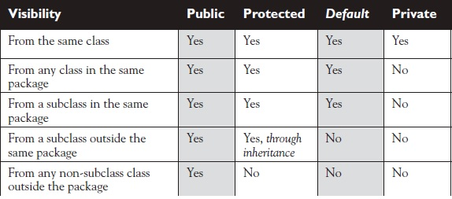

Slide 54
instanceof Operator
In addition to the arithmetic operators, Java supports the instanceof operator. The instanceof operator is used to test whether an object is an instance of a specific class at run time. The left-hand operand can be an object variable or an array element. The right-hand operand of
the instanceof operator can be a class or array type.
The syntax of the instanceof operator is:
op1 instanceof op2

Slide 55
Polymorphism in Java
Polymorphism in java is a concept by which we can perform a single action by different ways. Polymorphism is derived from 2 greek words: poly and morphs.
The word "poly" means many and "morphs" means forms. So polymorphism means many forms.
There are two types of polymorphism in java: compile time polymorphism and runtime polymorphism. We can perform polymorphism in java by method overloading and method overriding.

Slide 56
Overloading Methods
Method overloading is defined as the functionality that enables you to define two or more methods with the same name but with different signatures within the class. The methods that share the same name, but have different signatures are called overloaded methods. The signature of a method consists of:
The name of the method.
The number of arguments it takes.
The data type of the arguments.
The order of the arguments.
When an overloaded method is invoked, the Java compiler uses the type or the number of arguments to determine which copy of overloaded method to invoke. Therefore,
overloaded methods must differ in the type or the number of parameters. The return types of overloaded methods can be different.
public void multiply(int a, int b) //Multiply two integers
public void multiply(float a, floatb) //Multiply two floats

Slide 57
Runtime Polymorphism in Java
Runtime polymorphism or Dynamic Method Dispatch is a process in which a call to an overridden method is resolved at runtime rather than compile-time.
If subclass (child class) has the same method as declared in the parent class, it is known as method overriding in java.
class employee {
public void salary()
{ S.o.p("Employee");}
}
class regularEmp extends employee {
public void salary()
{ S.o.p("regular Emp"); }
}
class guestEmp extends employee { public void salary() { S.o.p("guest Emp"); } }
class mainclass { p.s.v.m(String a[]) {
guestEmp g=new guestEmp();
g.salary(); }}

Slide 58
Abstract class in Java
A class that is declared with abstract keyword, is known as abstract class in java. It can have abstract and non-abstract methods (method with body).
Abstraction is a process of hiding the implementation details and showing only functionality to the user.
Another way, it shows only important things to the user and hides the internal details
Ways to achieve Abstaction
There are two ways to achieve abstraction in java
Abstract class (0 to 100%)
Interface (100%)
A class that is declared as abstract is known as abstract class. It needs to be extended and its method implemented. It cannot be instantiated.

Slide 59
abstract class salary
{
abstract void PF();
void income() {
System.out.println("salary in abstract class");
}
}
public class abstraction extends salary{
public static void main(String[] args)
{
abstraction a=new abstraction();
a.PF();
}
@Override
void PF() {
System.out.println("Salary in child class");
}
}

Slide 60
Interface in Java
An interface in java is a blueprint of a class. It has static constants and abstract methods only.
The interface in java is a mechanism to achieve fully abstraction. There can be only abstract methods in the java interface not method body. It is used to achieve fully abstraction and multiple inheritance in Java.
interface salary {
void PF();
}
public class abstraction implements salary{
public void PF() {
System.out.println("salary with interface");
}
public static void main(String[] args)
{
abstraction a=new abstraction();
a.PF();
} }

Slide 61
Default Interface Methods
A default method lets you define a default implementation for an interface method. In other words, by use of a default method, it is now possible for an interface method to provide a body,
rather than being abstract.
public interface MyIF {
// This is a "normal" interface method declaration.
// It does NOT define a default implementation.
int getNumber();
// This is a default method. Notice that it provides
// a default implementation.
default String getString() {
return "Default String";
}
}

Slide 62
static Methods in an Interface
Like static methods in a class, a static method defined by an interface can be called independently of any object. Thus, no implementation of the interface is necessary, and no instance of the interface is required, in order to call a static method. Instead, a static method is called by specifying the interface name, followed by a period, followed by the method name.
static interface methods are not inherited by either an implementing class or a subinterface.

Slide 63
Inner Class
Java inner class or nested class is a class i.e. declared inside the class or interface.
We use inner classes to logically group classes and interfaces in one place so that it can be more readable and maintainable.
Additionally, it can access all the members of outer class including private data members and methods.
Advantage of java inner classes
There are basically three advantages of inner classes in java. They are as follows:
1) Nested classes represent a special type of relationship that is it can access all the members (data members and methods) of outer class including private.
2) Nested classes are used to develop more readable and maintainable code because it logically group classes and interfaces in one place only.
3) Code Optimization: It requires less code to write.

Slide 64
Difference between nested class and inner class in Java
Inner class is a part of nested class. Non-static nested classes are known as inner classes.
Types of Nested classes
Type | Description
Member Inner Class | A class created within class and outside method.
Annonymous Inner Class | A class created for implementing interface or extending class. Its name is decided by the java compiler.
Local Inner Class | A class created within method.
Static Nested Class | A static class created within class.
Nested Interface | An interface created within class or interface.

Slide 65
Member inner class
A class that is declared inside a class but outside a method is known as member inner class.
Invocation of Member Inner class
From within the class
From outside the class
class TestMemberOuter1{
private int data=30;
class Inner{
void msg(){System.out.println("data is "+data);}
}
void display(){
Inner in=new Inner();
in.msg(); }
public static void main(String args[]){
TestMemberOuter1 obj=new TestMemberOuter1();
obj.display();
} }

Slide 66
Anonymous inner class
A class that have no name is known as anonymous inner class.
Anonymous class can be created by:
Class (may be abstract class also).
Interface.
abstract class Person{
abstract void eat();
}
class TestAnnonymousInner{
public static void main(String args[]){
Person p=new Person(){
void eat(){System.out.println("nice fruits");}
};
p.eat();
}
}

Slide 67
Local inner class
A class that is created inside a method is known as local inner class. If you want to invoke the methods of local inner class, you must instantiate this class inside the method.
public class localInner1{
private int data=30;//instance variable
void display(){
class Local{
void msg(){System.out.println(data);}
}
Local l=new Local();
l.msg();
}
public static void main(String args[]){
localInner1 obj=new localInner1();
obj.display();
}
}

Slide 68
static nested class static nested class static nested class static nested class static nested class
A static class that is created inside a class is known as static nested class. It cannot access the non-static members.
It can access static data members of outer class including private.
static nested class cannot access non-static (instance) data member or method.
class TestOuter1{
static int data=30;
static class Inner{
void msg(){System.out.println("data is "+data);}
}
public static void main(String args[]){
TestOuter1.Inner obj=new TestOuter1.Inner();
obj.msg();
}
}

Slide 69
Nested Interface
An interface i.e. declared within another interface or class is known as nested interface. The nested interfaces are used to group related interfaces so that they can be easy to maintain. The nested interface must be referred by the outer interface or class. It can't be accessed directly.
interface Showable{
void show();
interface Message{
void msg();
}
}
class TestNestedInterface1 implements Showable.Message{
public void msg(){System.out.println("Hello nested interface");}
public static void main(String args[]){
Showable.Message message=new TestNestedInterface1();
message.msg();
} }

Slide 70
Command Line Arguments
The java command-line argument is an argument i.e. passed at the time of running the java program.
The arguments passed from the console can be received in the java program and it can be used as an input.
class A{
public static void main(String args[]){
for(int i=0;i<args.length;i++)
System.out.println(args[i]);
}
}

Slide 71
static
The static keyword in java is used for memory management mainly. We can apply java static keyword with variables, methods, blocks and nested class. The static keyword belongs to the class than instance of the class.
The static can be
variable (also known as class variable)
method (also known as class method)
block
nested class

Slide 72
static variable
If you declare any variable as static, it is known static variable.
The static variable can be used to refer the common property of all objects (that is not unique for each object) e.g. company name of employees, college name of students etc.
The static variable gets memory only once in class area at the time of class loading.
Advantage of static variable
It makes your program memory efficient (i.e it saves memory).
class Student{
int rollno;
String name;
String college="ITS"; }
Suppose there are 500 students in my college, now all instance data members will get memory each time when object is created.All student have its unique rollno and name so instance data member is good.Here, college refers to the common property of all objects. If we make it static,this field will get memory only once.
Java static property is shared to all objects.

Slide 73
static method
If you apply static keyword with any method, it is known as static method.
A static method belongs to the class rather than object of a class.
A static method can be invoked without the need for creating an instance of a class.
They can only directly call other static methods.
They can only directly access static data.

Slide 74
static block
Is used to initialize the static data member.
It is executed before main method at the time of classloading.

Slide 75
Wrapper Class
Wrapper class in java provides the mechanism to convert primitive into object and object into primitive.
Since J2SE 5.0, autoboxing and unboxing feature converts primitive into object and object into primitive automatically. The automatic conversion of primitive into object is known and autoboxing and object to primitive unboxing.
One of the eight classes of java.lang package are known as wrapper class in java.

Slide 76
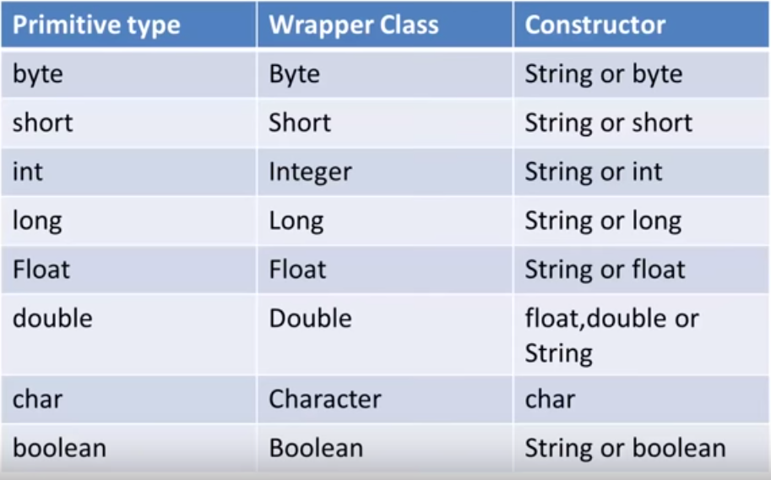

Slide 77
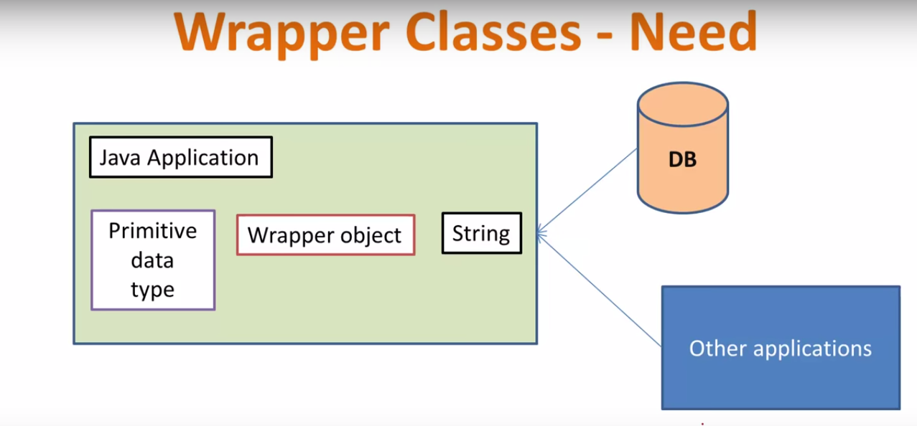
The data that arrives from other applications or DB comes as text and It can be converted to objects or primitive data types using Wrapper classes.

Slide 78
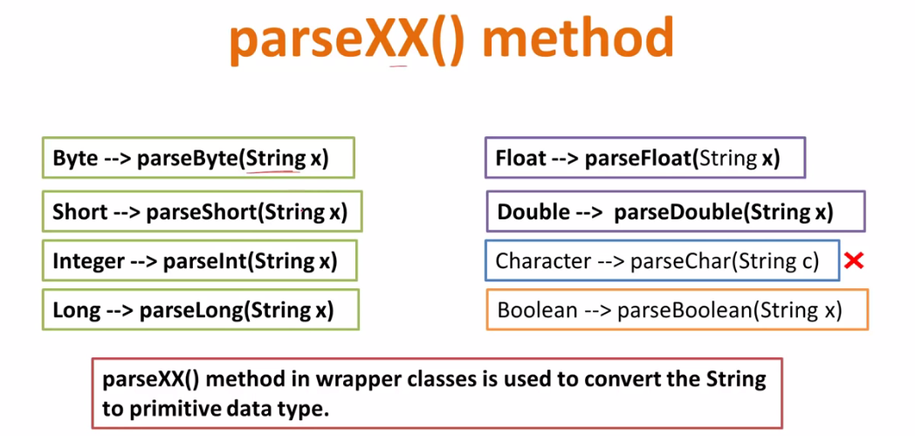
int x = 25;
Integer y = new Integer(33);
The first statement declares an int variable named x and initializes it with the value 25. The second statement instantiates an Integer object. The object is initialized with the value 33 and a reference to the object is assigned to the object variable y.

Slide 79
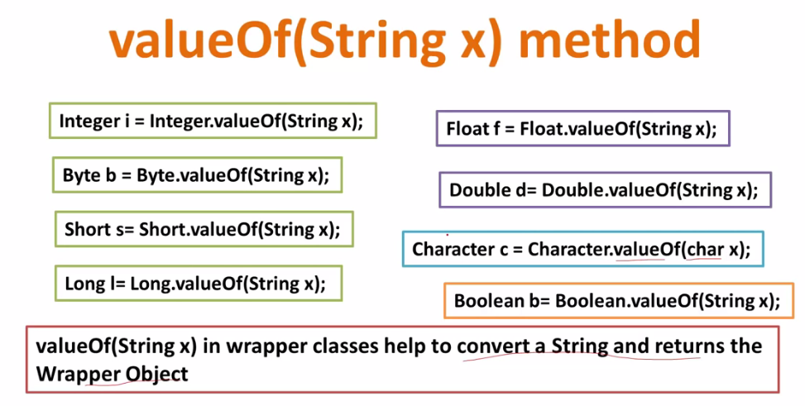

Slide 80
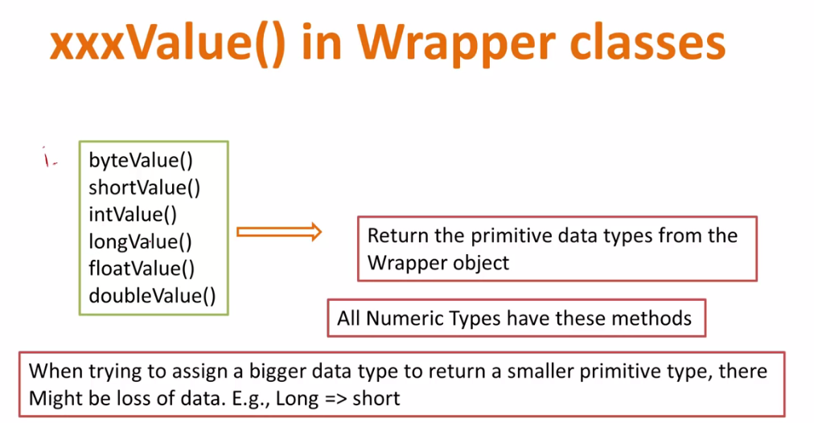

Slide 81
Primitive to Wrapper
public class WrapperExample1{
public static void main(String args[]){
//Converting int into Integer
int a=20;
Integer i=Integer.valueOf(a);//converting int into Integer
Integer j=a;//autoboxing, now compiler will write Integer.valueOf(a) internally
System.out.println(a+" "+i+" "+j);
}}

Slide 82
Wrapper to Primitive
public class WrapperExample2{
public static void main(String args[]){
//Converting Integer to int
Integer a=new Integer(3);
int i=a.intValue();//converting Integer to int
int j=a;//unboxing, now compiler will write a.intValue() internally
System.out.println(a+" "+i+" "+j);
}}

Slide 83
Variable Argument (Varargs)
The varargs allows the method to accept zero or multiple arguments. Before varargs either we use overloaded method or take an array as the method parameter but it was not considered good because it leads to the maintenance problem. If we don't know how many argument we will have to pass in the method, varargs is the better approach.
Advantage of Varargs:
We don't have to provide overloaded methods so less code.
class VarargsExample{
static void display(String... values){
System.out.println("display method invoked ");
for(String s:values){
System.out.println(s);
} }
public static void main(String args[]){
display();//zero argument
display("hello");//one argument
display("my","name","is","varargs");//four arguments
} }

Slide 84
Static Import:
The static import feature of Java facilitate the java programmer to access any static member of a class directly. There is no need to qualify it by the class name.
Advantage of static import:
Less coding is required if you have access any static member of a class oftenly.
Disadvantage of static import:
If you overuse the static import feature, it makes the program unreadable and unmaintainable.
import static java.lang.System.*;
class StaticImportExample{
public static void main(String args[]){
out.println("Hello");//Now no need of System.out
out.println("Java");
}
}

Slide 85
String
The java String is immutable i.e. it cannot be changed but a new instance is created. For mutable class, you can use StringBuffer and StringBuilder class.
There are two ways to create String object:
By string literal
By new keyword
literal
String s1="Welcome";
String s2="Welcome";//will not create new instance
new keyword
String s1=new String(“Welcome”);
String s2=new String("Welcome");//creates two objects

Slide 86
Immutable String
string objects are immutable. Immutable simply means unmodifiable or unchangeable.
Once string object is created its data or state can't be changed but a new string object is created.
class dem {
public static void main(String aa[])
{ String s1="Hello";
String s2=“everyone";
s1.concat(s2);
System.out.println(s1);
} }
Is the given example only “Hello” will be printed. Because s1 is String and string is immutable it can’t change.

Slide 87
String comparison
1.equals()
2. ==
equals() method is used to compare value of the string..
class demo
{ public static void main(String aa[])
{
String s1="Hello";
String s2="Hello";
String s3=“hello”;
System.out.println(s1.equals(s2));
System.out.println(s1.equals(s3));
} }
Output:
true
false

Slide 88
==
== is used to compare reference of the string
class demo {
public static void main(String aa[])
{
String s1="Hello";
String s2="Hello";
String s3=new String("Hello");
String s4=new String("Hello");
System.out.println(s1==s2);
System.out.println(s3==s4);
} }

Slide 89
Difference b/t String & StringBuffer
String s=new String(“hello");
s.concat(“everyone");
s.o.p(s);//hello
StringBuffer ss=new StringBuffer(“hello");
ss.concat(“everyone");
s.o.p(ss);//helloeveryone
1. once we create a String object we can't perform any changes in the existing object. if we are trying to perform any changes with those changes a new object will be created. this non changeable nature is nothing but immutability of the string object.
2. once we create a StringBuffer object we can perform any type of changes in the existing object. this changeable is nothing but mutability of the StringBuffer object.

Slide 90
StringBuffer class:
The StringBuffer class is used to created mutable (modifiable) string. The StringBuffer class is same as String except it is mutable i.e. it can be changed.
StringBuffer class is thread-safe i.e. multiple threads cannot access it simultaneously .So it is safe and will result in an order.
class DFD{
public static void main(String args[]){
StringBuffer sb=new StringBuffer("Hello ");
sb.append("Java");
System.out.println(sb);
}
}

Slide 91
StringBuilder class:
The StringBuilder class is used to create mutable (modifiable) string. The StringBuilder class is same as StringBuffer class except that it is non-synchronized.
class DFD{
public static void main(String args[]){
StringBuilder sb=new StringBuilder("Hello ");
sb.append("Java");
System.out.println(sb);
}
}

Slide 92
Differences between StringBuffer & StringBuilder
StringBuffer
1. Every method present in StringBuffer is synchronized.
2. At a time only one threads are allow to operate on StringBuffer object and hence StringBuffer object is Thread safe.
3. It increase waiting time of threads and hence relatively performance is low.
4. Introduced in 1.0 version
StringBuilder
1. No method present in StringBuilder is synchronized.
2. At a time multiple threads are allow to operate on StringBuilder object and hence StringBuilder object is not Thread safe.
3. Threads are not required to wait to operate on StringBuilder object and hence relatively performance is high.
4. Introduced in 1.5 version.

Slide 93
Exception Handling in Java
An exception is an abnormal condition that arises in a code sequence at run time. In other words, an exception is a runtime error.
The exception handling in java is one of the powerful mechanism to handle the runtime errors so that normal flow of the application can be maintained.
exception is an event that disrupts the normal flow of the program. It is an object which is thrown at runtime.
There are mainly two types of exceptions: checked and uncheckedException.
1) Checked Exception
The classes that extend Throwable class except RuntimeException. Checked exceptions are checked at compile-time.
2) Unchecked Exception
The classes that extend RuntimeException are known as unchecked exceptions e.g. ArithmeticException, NullPointerException, ArrayIndexOutOfBoundsException etc. Unchecked exceptions are not checked at compile-time rather they are checked at runtime.

Slide 94
Throwable is at the top of the exception class hierarchy. Immediately below Throwable are two subclasses that partition exceptions into two distinct branches. One branch is headed by Exception. This class is used for exceptional conditions that user programs should catch.
Exceptions of type Error are used by the Java run-time system. Stack overflow is an example of such an error.

Slide 95
try block
Enclose the code that catch block
Catch block is used to handle the Exception. It must be used after the try block.might throw an exception in try block.
finally block
The finally block is a block that is always executed. It is mainly used to perform some important tasks such as closing connection

Slide 96
throw keyword
throw is a keyword in java which is used to throw an exception manually. Using throw keyword, you can throw an exception from any method or block. But, that exception must be of type java.lang.Throwable class or it’s sub classes.
import java.util.Scanner;
class age extends Exception
{
age(String s) { } }
class userDefinedException {
public void accept() {
try{ int a;
Scanner sc=new Scanner(System.in);
System.out.println("Plz Enter your age");
a=sc.nextInt();
if(a<18) { throw new age("Invalid age"); }
else { System.out.println("Welcome");
}}
catch(age e){System.out.println("Exception handled::"+e);} }
public static void main(String ss[]) throws age {
userDefinedException u=new userDefinedException();
u.accept(); } }

Slide 97
throws keyword
throws is also a keyword in java which is used in the method signature to indicate that this method may throw mentioned exceptions. The caller to such methods must handle the mentioned exceptions either using try-catch blocks or using throws keyword.

Slide 98
Difference b/t Exception and Error
Throwable class acts as root for java exception hierarchy.
Exception are caused by our program and this is recoverable.
Example:
For Example if our program requirement is to read data from D:\\demo.txt file at runtime if the D:\\demo.txt file is not available the we get FileNotFoundException.
If FileNotFoundException occurs then we can read another file and rest of the program will be continued normally.
Error are not caused by our program these are due to lack of system resources.
error are non recoverable.
Example:
For Example if OutOfMemory error occurs being a programmer we can't do anything and the program will be terminated abnormally.
System admin or server admin is responsible to increase heap memory.

Slide 99
Difference b/t fully checked and partially checked exception.
A checked exception is said to be fully checked exception if and only if its child classes also checked.
EX:
IOException
InteruptedException
A checked exception is said to be partially checked exception if and only if some of its child classes are Unchecked.
The only possible partially checked exception in java are.
EX:
Exception
Throwable

Slide 100
Actual java program execution
1.JVM starts
2. JVM will create MainThread and Runtime Stack for it[Main-Thread].
3. Main-Thread locate the .class file and loads it into memory.
4. Now main() execution starts.
5. Later main execution end.
6. JVM destroy the runtime stack created for a particular order.
7. Main Thread goes into the dead state.
8. JVM goes to shut down

Slide 101
Thread
A thread is a lightweight sub process, a smallest unit of processing. It is a separate path of execution.
Threads are independent, if there occurs exception in one thread, it doesn't affect other threads. It shares a common memory area.
According to sun, there is only 4 states in thread life cycle in java new, runnable, non-runnable and terminated.
new : when new thread created .
Runnable : when we start thread with the help of start() .
Non-runnable : when we sleep thread for particular time period .
Terminated : when thread dead.

Slide 102
When a Java program starts up, one thread begins running immediately. This is usually
called the main thread of your program, because it is the one that is executed when your
program begins.
There are two ways to create a thread:
By extending Thread class
By implementing Runnable interface.

Slide 103
Implementing Runnable
The easiest way to create a thread is to create a class that implements the Runnable
interface. To implement Runnable, a class need only implement a single method called run( ), which is declared like this:
public void run( )
Inside run( ), you will define the code that constitutes the new thread. It is important to
understand that run( ) can call other methods, use other classes, and declare variables, just like
the main thread can. The only difference is that run( ) establishes the entry point for another,
concurrent thread of execution within your program. This thread will end when run( )
returns.
After you create a class that implements Runnable, you will instantiate an object of type
Thread from within that class. Thread defines several constructors.

Slide 104
Extending Thread
The second way to create a thread is to create a new class that extends Thread, and then to
create an instance of that class. The extending class must override the run( ) method, which
is the entry point for the new thread. It must also call start( ) to begin execution of the new
thread.

Slide 105
MultiThreading in Java
Multithreading in java is a process of executing multiple threads simultaneously.
Thread is basically a lightweight sub-process, a smallest unit of processing. Multiprocessing and multithreading, both are used to achieve multitasking.
But we use multithreading than multiprocessing because threads share a common memory area. They don't allocate separate memory area so saves memory, and context-switching between the threads takes less time than process.
Java Multithreading is mostly used in games, animation etc.

Slide 106
The join() method
In order to make a particular Thread to wait until completing other(only one Thread) Thread execution.
if t1 has to wait until t2 Thread execution completes.
then t1 Thread should call join() on t2 Thread reference.
class joinclass extends Thread {
public void run()
{ int i;
for(i=1;i<5;i++) {
System.out.println(i); try
{ Thread.sleep(500); }
catch(Exception e)
{ } } }
public static void main(String s[]) throws Exception {
joinclass j1=new joinclass();
joinclass j2=new joinclass();
joinclass j3=new joinclass();
joinclass j4=new joinclass();
j1.start(); j1.join(); j2.start(); j3.start(); j4.start(); } }

Slide 107
Daemon
It provides services to user threads for background supporting tasks.
Its life depends on non-Daemon thread when non-daemon thread goes in dead state, Daemon thread also goes in dead state.
Note: If you want to make a user thread as Daemon, it must not be started before otherwise it will throw IllegalThreadStateException.
Naming a thread
public String getName(): is used to return the name of a thread.
public void setName(String name): is used to change the name of a thread.

Slide 108
Thread Priority
Each thread have a priority. Priorities are represented by a number between 1 and 10. In most cases, thread scheduler schedules the threads according to their priority. But it is not guaranteed because it depends on JVM specification that which scheduling it chooses.
3 constants defined in Thread class:
public static int MIN_PRIORITY
public static int NORM_PRIORITY
public static int MAX_PRIORITY
Default priority of a thread is 5 (NORM_PRIORITY). The value of MIN_PRIORITY is 1 and the value of MAX_PRIORITY is 10.

Slide 109
Synchronization in Java
Synchronized keyword applicable only for methods
Synchronization in java is the capability of control the access of multiple threads to any shared resource.
Java Synchronization is better option where we want to allow only one thread to access the shared resource.
If you declare any method as synchronized, it is known as synchronized method.
Synchronized method is used to lock an object for any shared resource.
When a thread invokes a synchronized method, it automatically acquires the lock for that object and releases it when the thread completes its task.
Synchronized block in java
Synchronized block can be used to perform synchronization on any specific resource of the method.
Suppose you have 50 lines of code in your method, but you want to synchronize only 5 lines, you can use synchronized block.
If you put all the codes of the method in the synchronized block, it will work same as the synchronized method.

Slide 110
Input and Output in Java
Input and Output (I/O) is used to process the input and produce the output based on the input. Java uses the concept of stream to make I/O operations fast. java.io package contains all the classes required for input and output operations.
Stream
A stream is a sequence of data. In Java a stream is composed of bytes. It's called a stream because it's like a stream of water that continues to flow.
Three streams are created for us automatically:
1) System.out: standard output stream
2) System.in: standard input stream
3) System.err: standard error

Slide 111
Byte Streams and Character Streams
Java defines two types of streams: byte and character. Byte streams provide a convenient
means for handling input and output of bytes. Byte streams are used, for example, when
reading or writing binary data. Character streams provide a convenient means for handling
input and output of characters.
The Byte Stream Classes
Byte streams are defined by using two class hierarchies. At the top are two abstract classes:
InputStream and OutputStream.

Slide 112
import java.io.FileNotFoundException;
import java.io.FileOutputStream;
import java.io.IOException;
import java.util.Scanner;
public class FileOutputStreamProgram {
public static void main(String[] args) throws IOException {
FileOutputStream out=new FileOutputStream("D:\\DFD DATA\\program\\writeFile.txt");
System.out.println("Enter some Text");
Scanner s=new Scanner(System.in);
String str;
str=s.nextLine();
System.out.println(str);
byte[] b=str.getBytes();
out.write(b);
}
}

Slide 113
import java.io.FileInputStream;
import java.io.FileNotFoundException;
import java.io.IOException;
public class FileInputStreamProgram {
public static void main(String[] args) throws IOException {
FileInputStream fin=new FileInputStream("D:\\DFD DATA\\program\\writeFile.txt");
int i;
while((i=fin.read())!=-1)
{
System.out.print((char)i);
}
}
}

Slide 114
The Character Stream Classes
Character streams are defined by using two class hierarchies. At the top are two abstract
classes: Reader and Writer.
FileWriter class:
FileWriter class is used to write character-oriented data to the file. Sun Microsystem has suggested not to use the FileInputStream and FileOutputStream classes if you have to read and write the textual information.

Slide 115
import java.io.FileWriter;
import java.io.IOException;
import java.util.Scanner;
public class FileWriterProgram {
public static void main(String[] args) throws IOException {
FileWriter fw=new FileWriter("D:\\DFD DATA\\program\\write.txt");
Scanner s=new Scanner(System.in);
System.out.println("Enter some text");
String str;
str=s.nextLine();
fw.write(str);
fw.close();
}
}

Slide 116
import java.io.FileNotFoundException;
import java.io.FileReader;
import java.io.IOException;
public class FileReaderProgram {
public static void main(String[] args) throws IOException {
// TODO Auto-generated method stub
FileReader fr=new FileReader("D:\\DFD DATA\\program\\write.txt");
int i;
while((i=fr.read())!=-1)
{
System.out.print((char)i);
}
}
}

