Slide 1

Consult360 AI
Intelligent Pre-Consultation Clinical Copilot
HEALTH-A-THON 2026

Slide 2

The Problem
Doctors spend 5–10 minutes per consultation searching through fragmented patient data
EMR Systems
Lab Reports
Imaging
PDFs & Scans
Referral Letters
Result: Information overload, missed investigations, fragmented care.

Slide 3

Why This Matters
For Doctors
For Hospitals
For Patients
Cognitive overload, reduced consultation quality, administrative burden
Inefficient workflows, longer appointment times, rising operational costs
Rushed consultations, missed clinical insights, poor continuity of care
Every minute spent searching is a minute not spent caring.

Slide 4
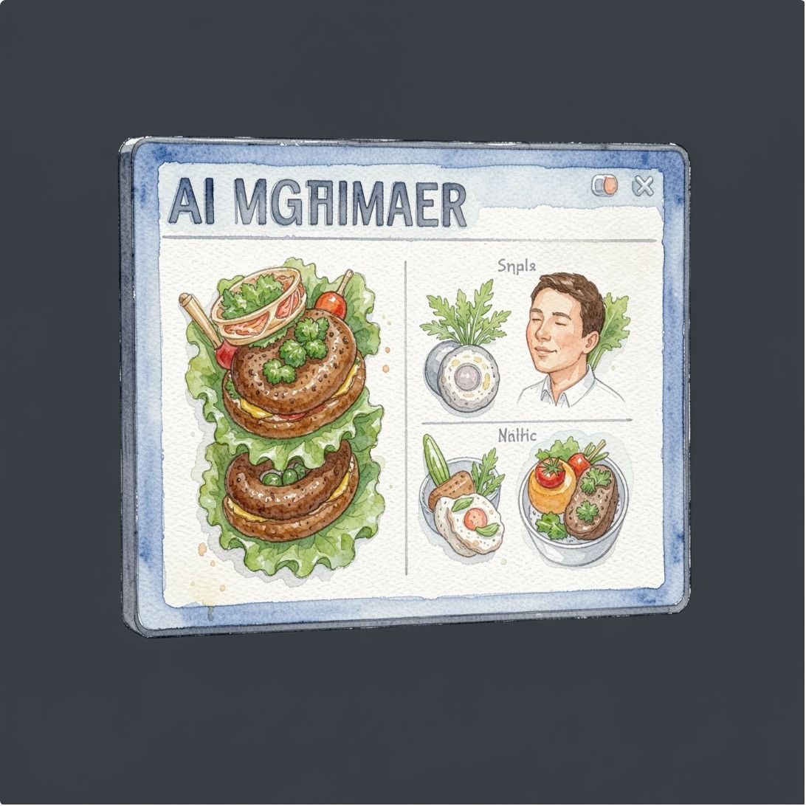

Our Solution
Automatically prepare doctors before every consultation
Reads and understands all patient reports
Extracts clinical entities and medical history
Detects clinical changes and trends
Builds intelligent patient timeline
Generates actionable consultation brief
Highlights pending investigations and risks
One-click preparation. Complete clinical context. Ready to consult.

Slide 5

System Architecture
From fragmented reports to actionable intelligence
Data Ingestion
Provider Delivery
Clinical Intelligence

Slide 6






AI Capabilities
OCR & PDF Understanding
Medical Entity Extraction
Extract text from any document format
Diagnoses, medications, allergies, lab values
Clinical Timeline
Clinical Change Detection
Chronological patient history with key events
Spot trends, improvements, deteriorations
Risk Detection
Explainable AI
Flag critical findings and contraindications
Show reasoning behind every recommendation

Slide 7

Doctor Dashboard
Intuitive interface for instant patient context
Patient Overview
Demographics, chief complaint, allergies at a glance
Report Upload
Drag-and-drop any document
Risk Cards
Highlighted alerts and pending investigations
Action Items
Doctor-specific recommendations

Slide 8



AI Consultation Brief
Premium patient summary — everything a doctor needs, in seconds
1
2
1
2
Chief Complaint & History
Active Diagnoses
Clinical Changes
Pending Investigations
3
4
3
4
Risk Flags
Doctor Action Items
Medication History
Allergies & Contraindications
5
5
One-Line Summary
Recent Lab Results

Slide 9
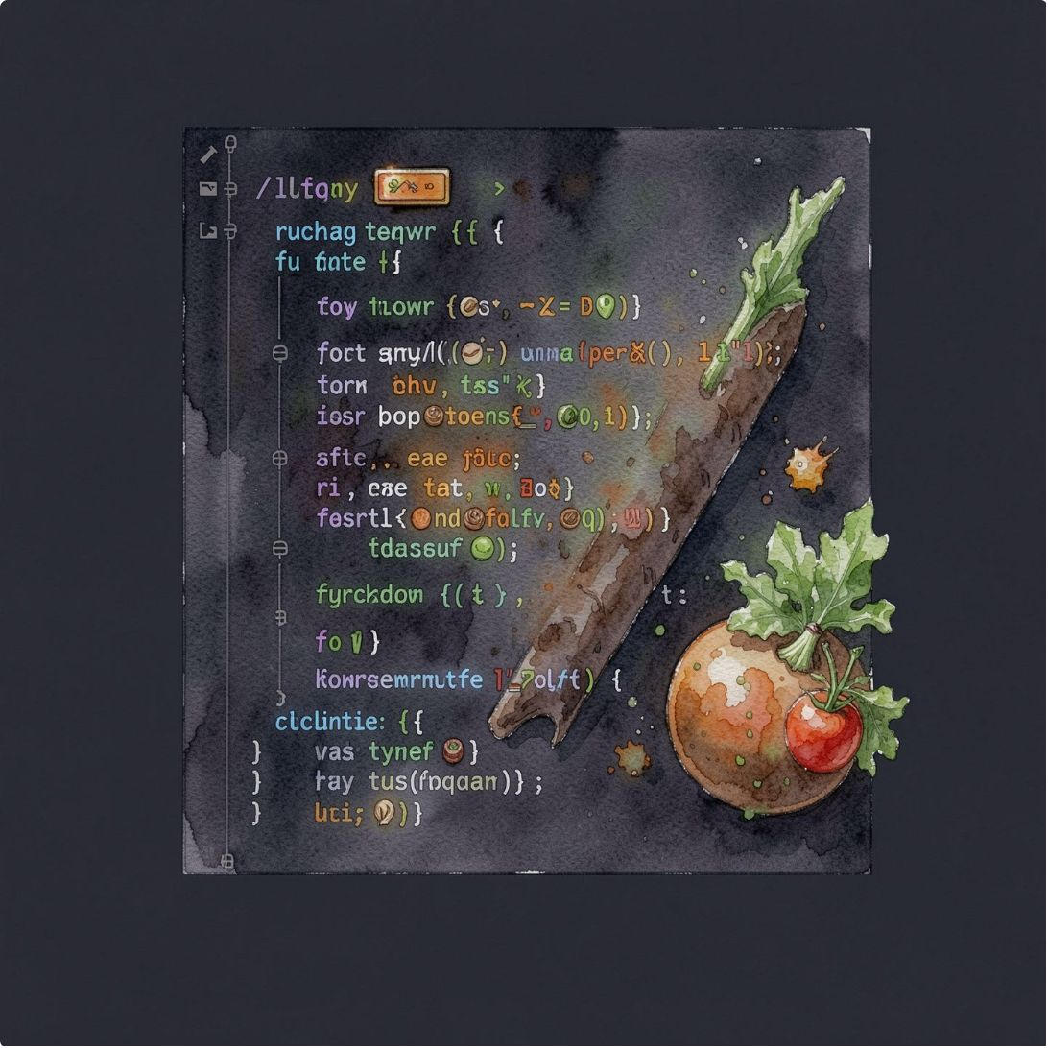


Technology Stack
Frontend
AI Engine
Storage
HTML, CSS, JavaScript — Clean, responsive UI
Google Gemini API, PDF.js, OCR — Intelligent processing
LocalStorage (demo), PostgreSQL (production)
Backend
Deployment
Spring Boot (future) — Scalable architecture
Vercel — Fast, reliable hosting
Built for healthcare. Designed for scale.

Slide 10
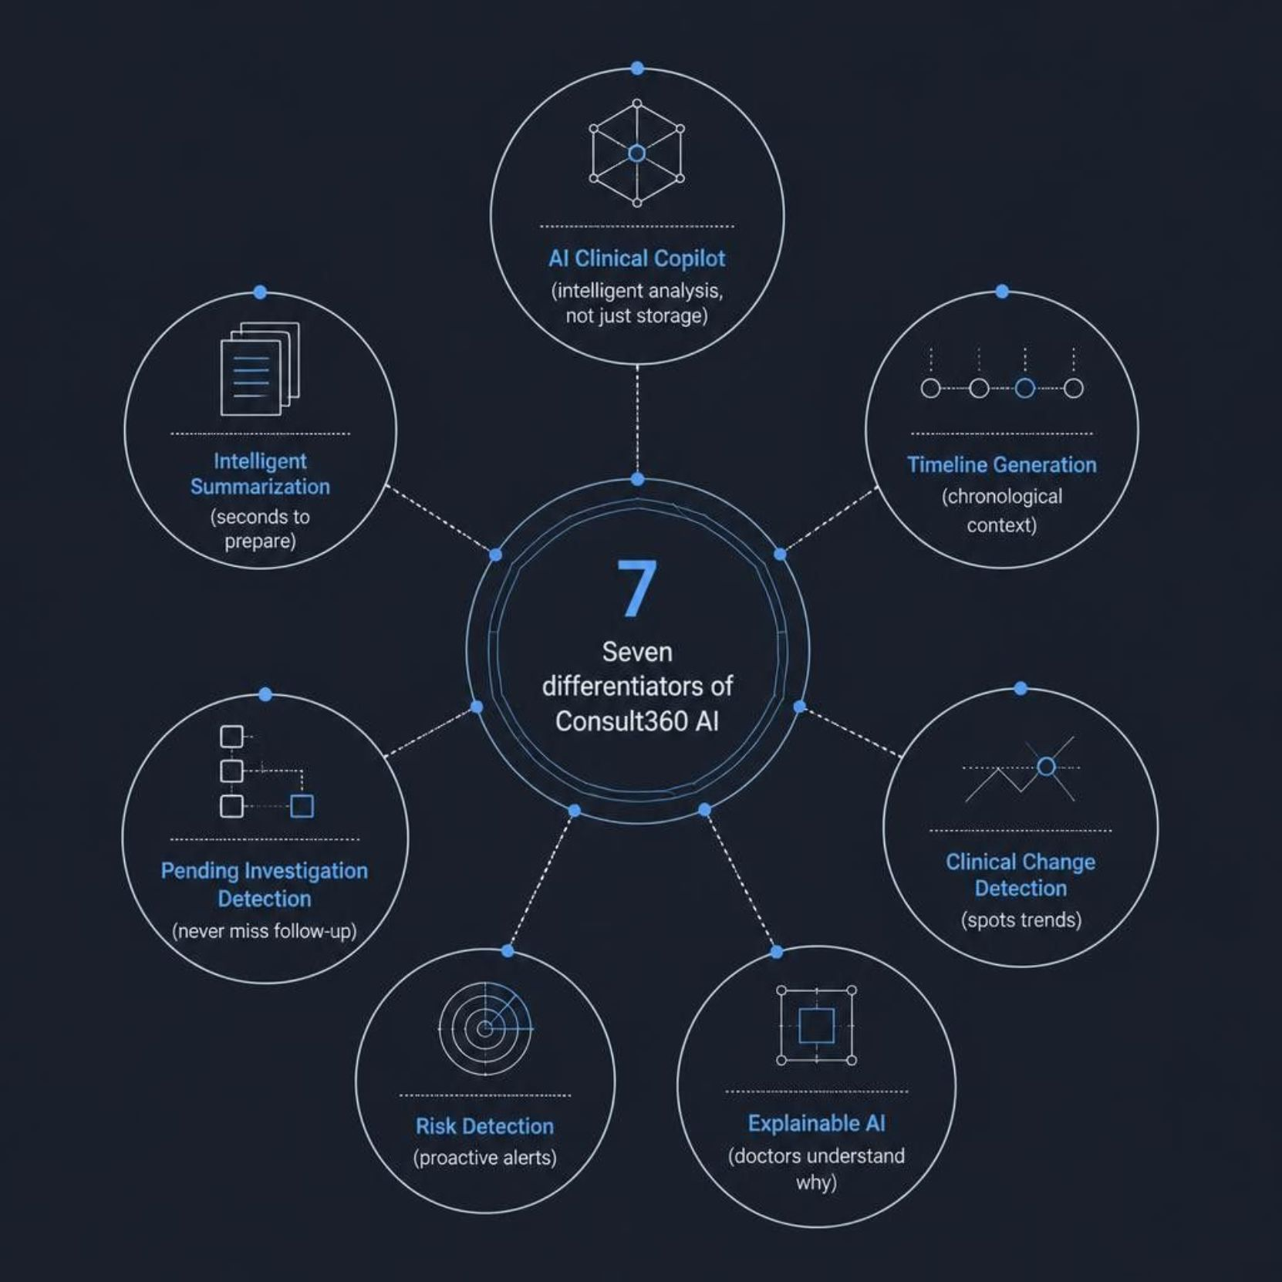

What Makes Us Different
AI Clinical Copilot
Explainable AI
Intelligent analysis, not just data storage
Doctors understand why, not just what
Intelligent Summarization
Seconds to prepare, not minutes

Slide 11

Impact
For Doctors
For Hospitals
Save 5–10 minutes per consultation. Reduce cognitive load. Focus on patient care.
Improved workflow efficiency, better appointment utilization, reduced admin time.
For Patients
Better consultations, improved continuity of care, fewer missed diagnoses.
Measurable outcomes. Real impact. Better healthcare.

