Slide 1
ENPM808A
Introduction to Machine Learning
Final Project Presentation
By:
Divyansh Agrawal

Slide 2
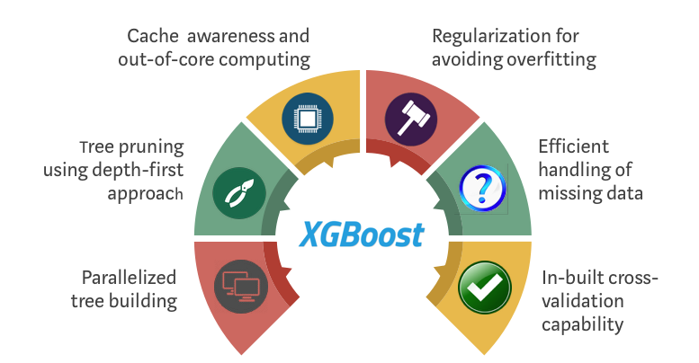
Delivered Model
XGBoost stands for Extreme Gradient Boosting. It uses more accurate approximations to find the best tree model. I am changing the max-depth hyper parameter. This is responsible for how deep each tree will grow during any boosting round.
Why XGBoost?
In broad terms, it’s the efficiency, accuracy, and feasibility of this algorithm.
It has both linear model solver and tree learning algorithms. So, what makes it fast is its capacity to do parallel computation on a single machine.
It also has additional features for doing cross-validation and finding important variables.

Slide 3
Various Models Considered
Linear regression - Ridge regularization
SVM
XGBoost

Slide 4
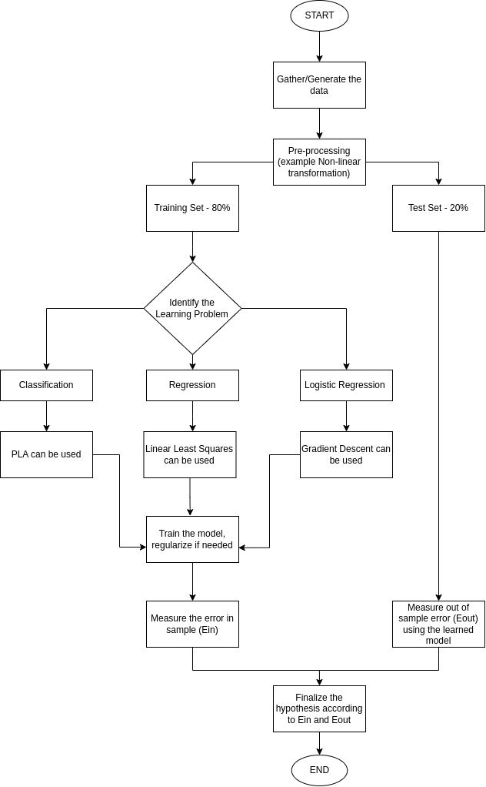
Generalized Pipeline

Slide 5
Features Used
Distance between current position and local goal
Distance between current position and final goal
Distance between local goal and final goal
Angle of line-of-sight (LOS) joining current position and final goal with the x axis
Angle of line-of-sight (LOS) joining current position and local goal with the x axis
Distance in front of the bot (540th value in the laser range)

Slide 6
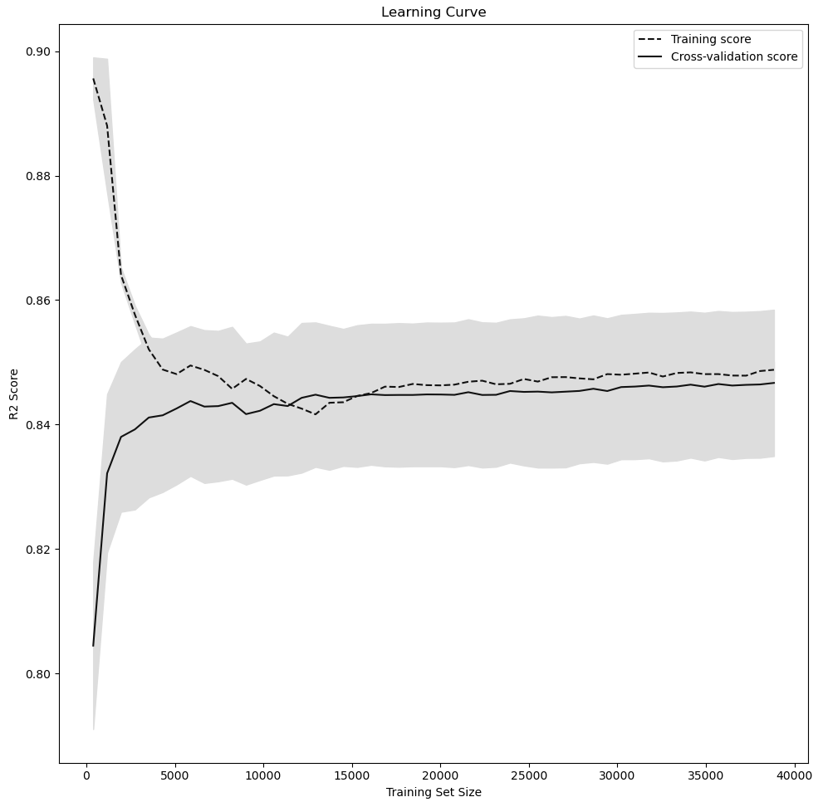
Learning Curves for XGBoost
Dataset: Openbox
Command Action: Translational Velocity
R2 score on the test data: 0.7565059895450211

Slide 7
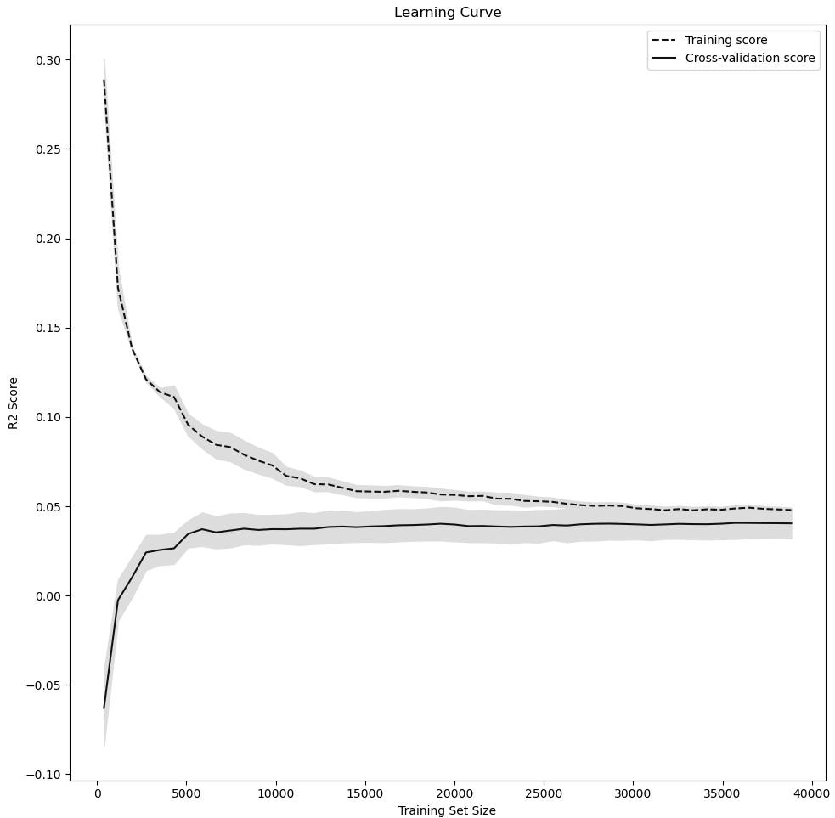
Learning Curves for XGBoost
Dataset: Openbox
Command Action: Rotational Velocity
R2 score on the test data: -0.2594334449890192

Slide 8
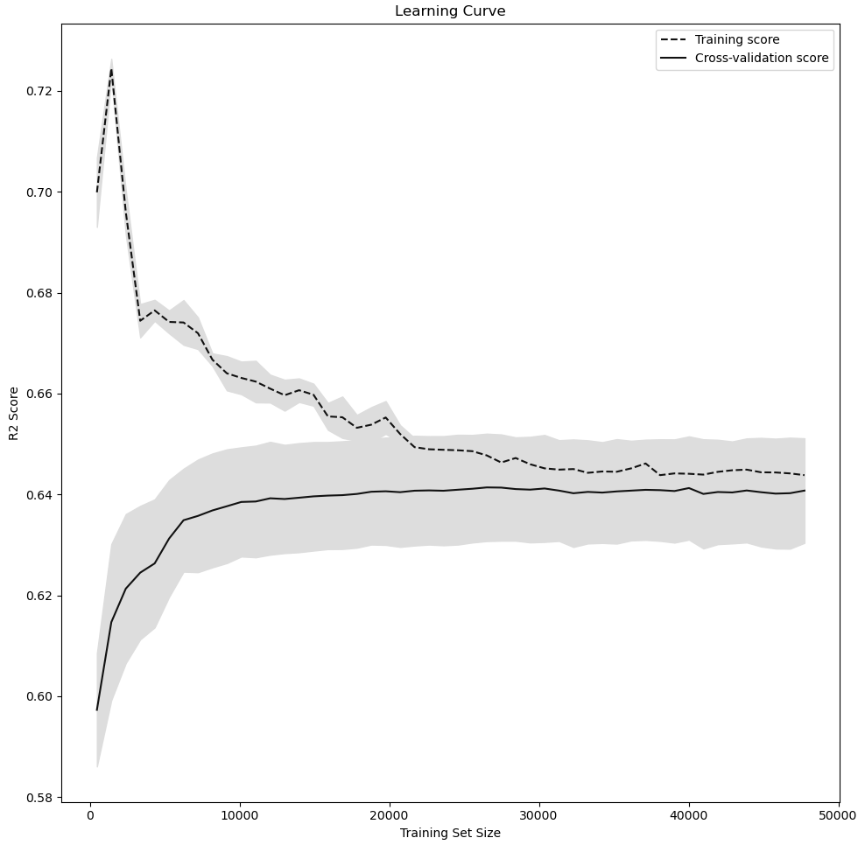
Learning Curves for XGBoost
Dataset: Corridor
Command Action: Translational Velocity
R2 score on the test data: 0.4131266087420681

Slide 9
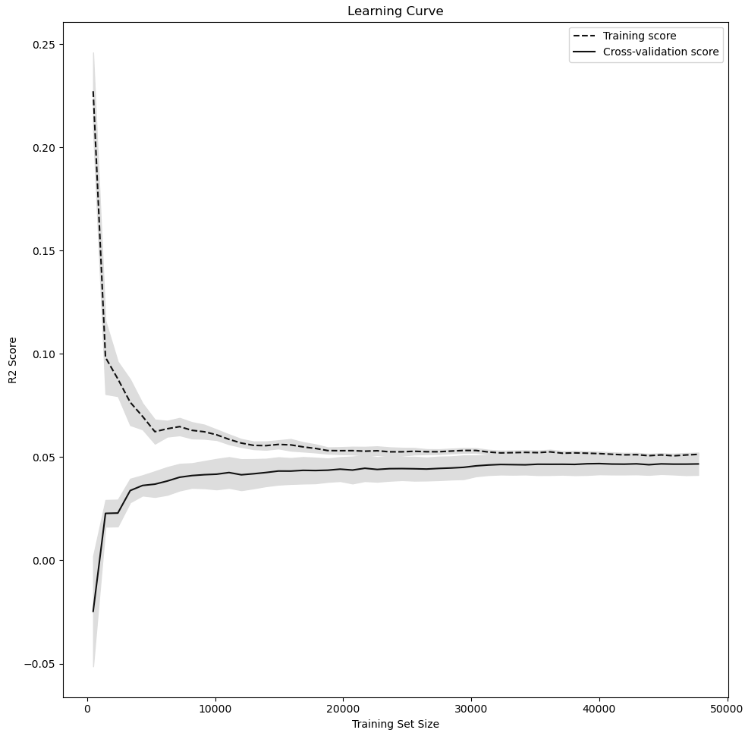
Learning Curves for XGBoost
Dataset: Corridor
Command Action: Rotational Velocity
R2 score on the test data: -0.6349991005113047

Slide 10
Conclusion
The best model according to me is the XGBoost. The reason being that it gives a better performance as compared to the other 2. Also, it does not take a long time when the number of datapoints are high in the training.
All the models performed better when predicting the translational velocity (represented by cmd_vel_v in the document) as compared to the rotational velocity (represented by cmd_vel_w). The reason for this might be that the features selected by me do not contribute much to calculating the rotational component of the velocity.
Also, in some cases the R2 score for rotational velocity is negative which means that the model is predicting worse than the mean of the target values.
NOTE: I have trained separate models for OpenBox and Corridor dataset. Since it was told in the class that testing and training should be performed on similar datasets. OpenBox and Corridor are different environments so training on one and testing on the other does not make any sense. Also, due to limited computational resources, I have used only a few files for training and testing.

