Slide 1
IBM
Coursera Capstone Project
DIVYANSH AGAWRAL
28 April 2020

Slide 2
Business Problem
Finding any similarity or dissimilarity between the cities of Toronto and New York City.

Slide 3
Data
Collecting the Data for New York City and Toronto,
Processing it,
And Preparing.

Slide 4
Data for Toronto
Collecting Data from WikiPedia.
Removing the Nan values and processing the data.
Merging and finalizing the dataframe.
Step 1
Step 2
Step 3
Step 4
Step 5
Converting it to a pandas Dataframe using Beautiful Soup
Using the Client Id and Client secret to get the information from the FourSquare Website

Slide 5
Data for New York City
Collecting Data from URL.
Cleaning the DataFrame and finalizing.
Merging and finalizing the dataframe.
Step 1
Step 2
Step 3
Step 4
Step 5
Converting it to a pandas Dataframe using JSON;
Using the Client Id and Client secret to get the information from the FourSquare Website

Slide 6
Analysis

Slide 7
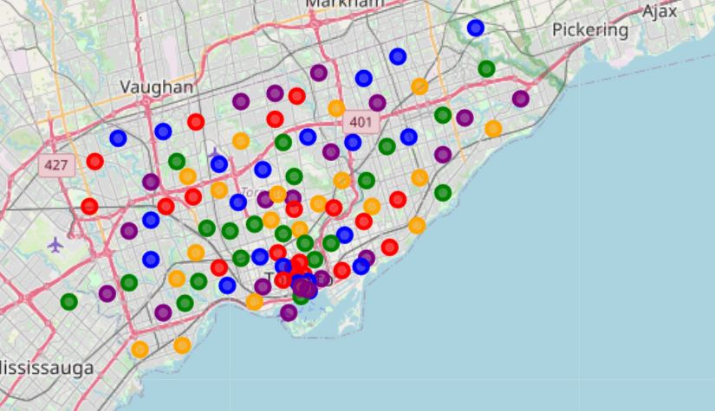
Toronto
5 Clusrters, are spread thorugh out the city with various colors showing the sparsity in Toronto city.

Slide 8
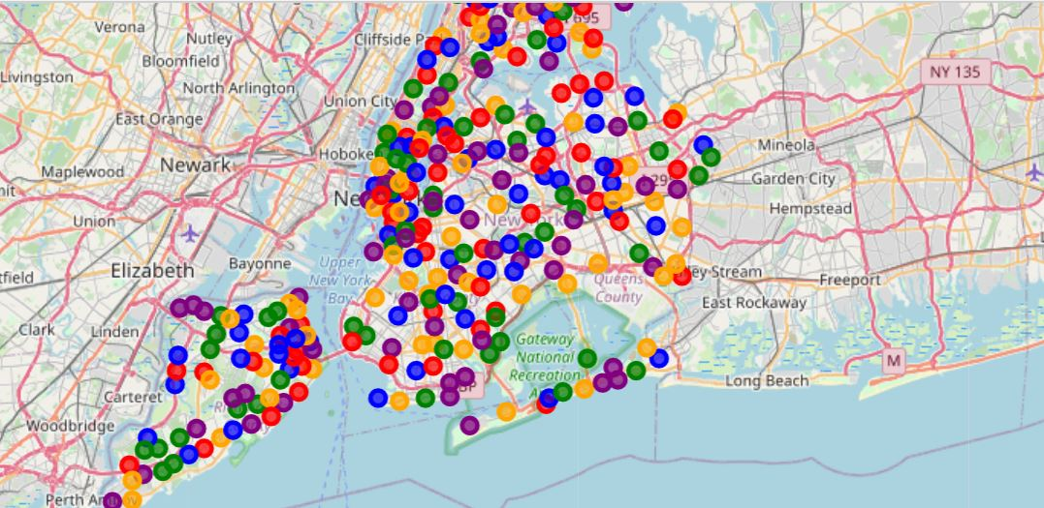
New York City
5 Clusters are showing the dense population of neighborhoods in the New York City

Slide 9
Analysis
New York City is has a high competition in any kind of business and also high variety of people.
Toronto has low competition and sparse population and hence can be suitable for a steady and slow business.
Both the cities are unique of themselves with no similarity whatsoever.

