Slide 1

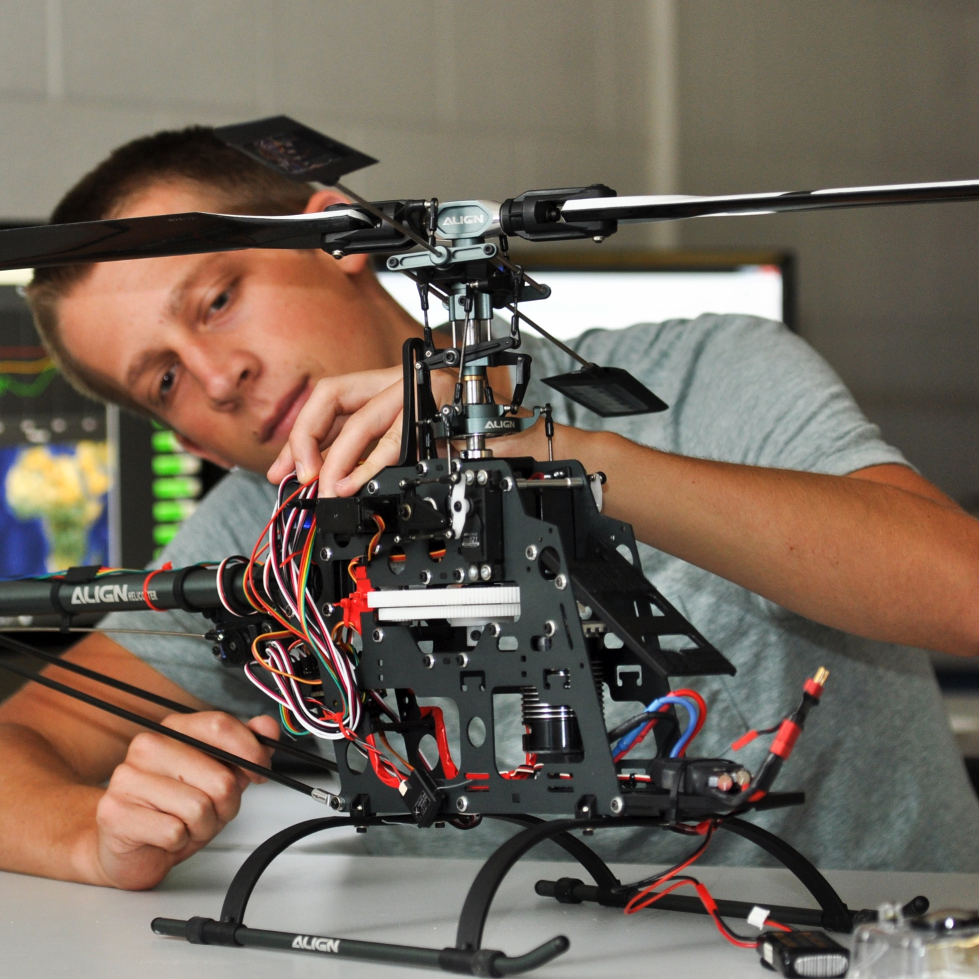

Anisotropic Diffusion Filter :
Analysis and Performance
Ping-Chung & Divyansh

Slide 2

Outline
Problem Statement
Anisotropic Filter - Analysis
Anisotropic Filter - Performance comparison
Some more results

Slide 3
Problem Statement
MRI images are inherently susceptible to noise from the acquiring devices.
The task is to remove noise effectively i.e. without losing details(edges) from the image.
We consider AWGN in this presentation.

Slide 4
Solution
A quick solution to the problem can be to pick a FD LPF or a median/moving average filter.
Problem with these are that they don't do a good job preserving the edges in the images
Is there a way to remove noise and preserve details?
Yes! - Anisotropic Diffusion Filter

Slide 5
Anisotropic Diffusion
A PDE approach to solve the problem. It is a numerical approach and doesn't have a closed form.
The underlying principle is to stop the diffusion process when you encounter a high gradient(edge) in the image.
Stop diffusion

Slide 6


AD (cont.) - How?
Modified heat equation.
Use the following iteration process :
Where c(r,t) is a monotonically decreasing function of the image gradient magnitude.
"t" is the iteration step.

Slide 7
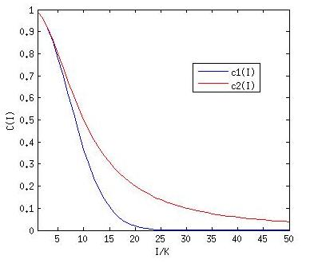

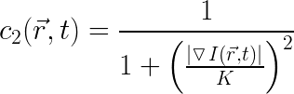
AD (cont.) - The function C
In this presentation we use two c functions given by Perona-Malik

Slide 8
AD (cont.)
The gradient is calculated taking in to account the nearest 8 neighbours i.e. N S E W NE NW SE SW.
Parameter "K" has to be chosen such that you get best result for your image.
  A small value of K results in better noise removal but blurry edges.
  A big value of results in good edge preservation but not good noise removal. This means you need more iteration of your equation, which is time consuming.

Slide 9
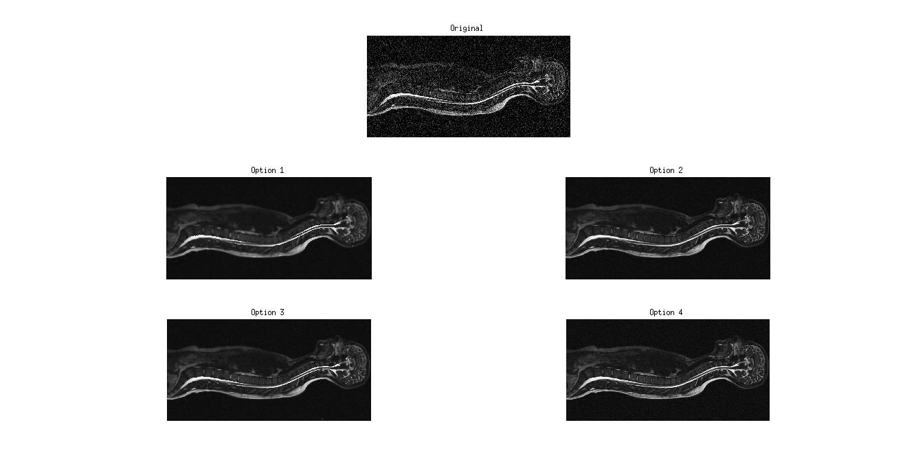
Results

Slide 10
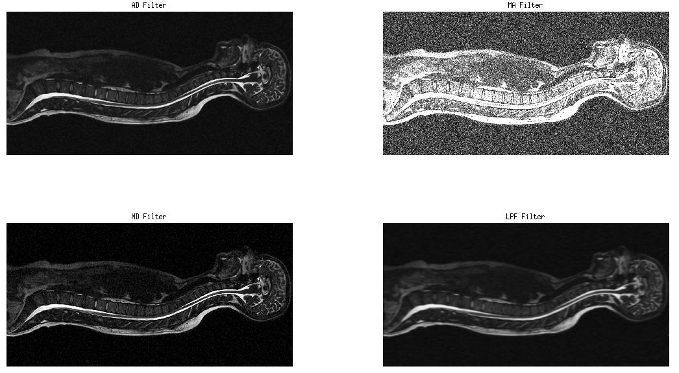
Comparison

Slide 11
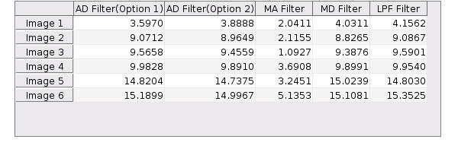
PSNR Comparison

Slide 12
References
Wikipedia
Jinshan Tang; Qingling Sun; Jun Liu; Yongyan Cao, "An Adaptive Anisotropic Diffusion Filter for Noise Reduction in MR Images," Mechatronics and Automation, 2007. ICMA 2007. International Conference on , vol., no., pp.1299,1304, 5-8 Aug. 2007
Rafael C. Gonzalez and Richard E. Woods. 1992. Digital Image Processing (2nd ed.). Addison-Wesley Longman Publishing Co., Inc., Boston, MA, USA.

Slide 13

THANK YOU

