Slide 1
IMAGINATION FORGE HACKATHON 2026
TITLE PAGE
Problem Statement Title
The Real-Time DICOM Anonymizer
Theme
Healthcare • AI • Cybersecurity • Medical Data Privacy
PS Category
Software
Team Name (Registered on portal)
Your Team Name
THE CORE IDEA
A local-first DICOM privacy gate that detects PHI in metadata and pixels, preserves clinical information, validates the output independently, and blocks release when safety cannot be proven.
“We do not just anonymize the DICOM — we challenge the output, verify it, and refuse to release what we cannot prove is safe.”

Slide 2
SENTINELDICOM VEILGUARD
Your Team Name
THE REAL PROBLEM
PHI may exist in standard tags, private/vendor tags, nested sequences, free text, burned-in pixels, UIDs and other visual/embedded content.
PROPOSED SOLUTION
Automatically discover, classify, transform and verify PHI at both metadata and image levels using a policy-driven desktop pipeline.
THE DIFFERENTIATOR
Three-Truth Release Gate: Privacy Truth + Pixel/Integrity Truth + DICOM Structural Truth.
DETECT → CLASSIFY → TRANSFORM → ATTACK → VERIFY → RELEASE / REVIEW / QUARANTINE
Metadata PHI
PS3.15 policy • private tags • nested SQ • dates • UIDs
Pixel PHI
Text detection • OCR • visual/barcode risk
Context Sieve
Identity removed • clinical markers preserved
Independent Validation
PHI re-scan • pixel diff • DICOM checks
Release Gate
APPROVED • REVIEW • BLOCK
Real-world outcome: the research team receives a clinically useful DICOM only after the system independently verifies privacy, pixel integrity and DICOM structure. Uncertain or failed cases never bypass the gate.

Slide 3
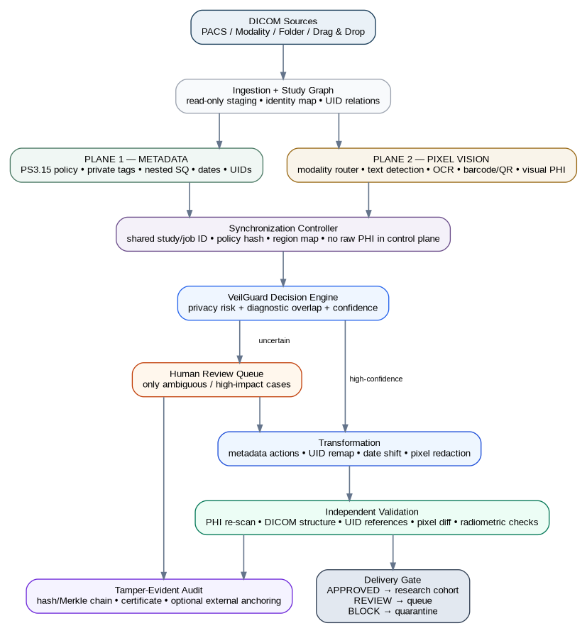
TECHNICAL APPROACH
Your Team Name
CORE DICOM
Python • pydicom • PS3.15 policy engine • recursive SQ traversal
OCR • text detection • regex/NER • metadata-to-pixel correlation • modality router
OCR • text detection • regex/NER • metadata↔pixel correlation • modality router
SECURITY + AUDIT
HMAC-SHA256 UID mapping • encrypted vault • hash/Merkle-chain audit • fail-closed states
MVP SCOPE
CT • Ultrasound • X-ray / Secondary Capture • desktop batch/folder watch
OCR • text detection • regex/NER • metadata-to-pixel correlation • modality router

Slide 4
FEASIBILITY AND VIABILITY
Your Team Name
FEASIBILITY
• Python + PySide6 keeps the prototype practical.
• Start with CT, US and X-ray/SC.
• Synthetic PHI DICOMs enable safe testing.
• 6-week MVP: 4 focused phases.
CHALLENGES / RISKS
• OCR can miss low-contrast or rotated text.
• Over-redaction can remove clinical markers.
• Unsupported codecs or malformed DICOM.
• 3D facial identity risk in head/neck CT/MR.
MITIGATION
• Risk-adaptive OCR + fallback detector.
• Context sieve + human review for anatomy overlap.
• Unsupported/failed files → quarantine.
• Visual-identity router + conservative defacing policy.
FAIL-CLOSED RULE
Uncertain → Review
Validation failure → Quarantine
No silent bypass.
THREE-TRUTH GATE
Privacy + Pixel/Integrity + DICOM structure must all pass before export.
SCALE-UP PATH
Future: PACS, more modalities, advanced payload/QI analysis, enterprise deployment.

Slide 5
IMPACT AND BENEFITS
Your Team Name
HOSPITALS / DATA CUSTODIANS
Safer release workflow • local-first processing • auditable transformations • quarantine for uncertainty.
AI / RESEARCH TEAMS
Cleaner cohorts • longitudinal linkage • preserved clinical structure • reproducible de-identification.
PATIENTS / PUBLIC TRUST
Reduces accidental identity exposure when imaging is reused for research, AI training or collaboration.
VALUE CREATED BY THE RELEASE-GATE MODEL
UTILITY PRESERVED
Policy-driven retention protects orientation markers, scales, technical parameters and research timelines instead of blindly deleting information.
PROOF, NOT CLAIMS
Independent re-scan, pixel-difference analysis, UID closure and DICOM validation produce evidence of the result.
SCALABLE FOUNDATION
Desktop MVP → folder watch → enterprise/PACS extensions while retaining the same fail-safe release philosophy.
Signature outcome: a research DICOM is released only after the system actively searches for residual identity and proves approved image regions, structure and relationships remain intact.

Slide 6
RESEARCH AND REFERENCES
Your Team Name
DICOM PS 3.5 — Data Structures & UID Rules
https://dicom.nema.org/medical/dicom/current/output/html/part05.html
DICOM PS 3.15 — Security / De-identification Profiles
https://dicom.nema.org/medical/dicom/current/output/html/part15.html
HHS — Guidance on De-identification of PHI
https://www.hhs.gov/hipaa/for-professionals/special-topics/de-identification/index.html
Project Research Base
SentinelDICOM + DICOM VeilGuard blueprints, hardening reviews and technical edge-case analysis.
DESIGN PRINCIPLES CARRIED INTO THE PROTOTYPE
DICOM PS3.15 policy baseline + configurable private-tag handling.
Metadata-to-pixel correlation + modality-gated vision for burned-in PHI.
Three-Truth Release Gate + human review + fail-closed quarantine.
No blanket legal-compliance claim: output is processed under a selected policy and validated against configured gates.
Core message: Privacy + Diagnostic Integrity + Structural Validity must agree before release.

