Slide 1
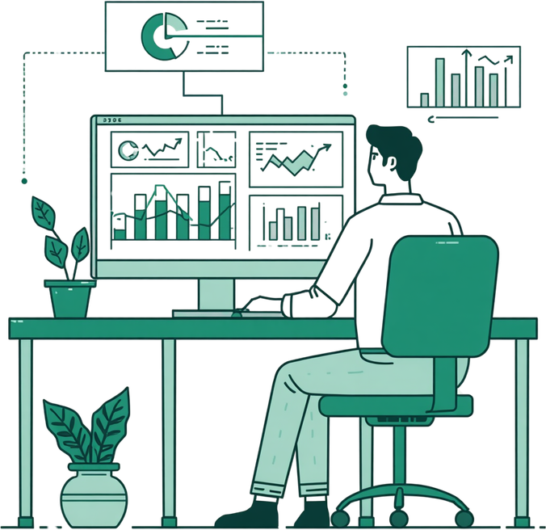
Bluestock Fintech
Mutual Fund Analytics & Interactive Dashboard Development
Bluestock Fintech Internship – June 2026
Presented By
Divyansh Dave

Slide 2



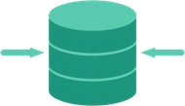

Project Overview & Objectives
ETL Pipeline & Data Infrastructure
EDA & Risk Metrics
Power BI Dashboard & Recommendations
Build an end-to-end ETL pipeline to extract raw CSV data, clean duplicates, standardize dates, handle missing values, and load processed data into SQLite for structured analysis.
Perform exploratory data analysis and calculate advanced risk metrics including VaR, CVaR, Sharpe Ratio, CAGR, and volatility to evaluate fund performance and investor behavior.
Develop an interactive Power BI dashboard visualizing fund performance, investor demographics, and SIP trends, plus a fund recommendation system ranked by Sharpe Ratio.

Slide 3





Datasets Used
fund_master.csv
nav_history.csv & investor_transactions.csv
performance.csv
Contains mutual fund scheme details including fund names, categories, sub-categories, and AMFI codes. Serves as the master reference for all fund-level analysis.
Historical NAV data tracks daily fund prices over time. Investor transactions capture SIPs, lumpsum investments, and redemptions with dates and amounts.
Stores computed metrics including returns, CAGR, Sharpe Ratio, volatility measures, and risk grades. Enables fund comparison and risk-adjusted performance analysis.

Slide 4

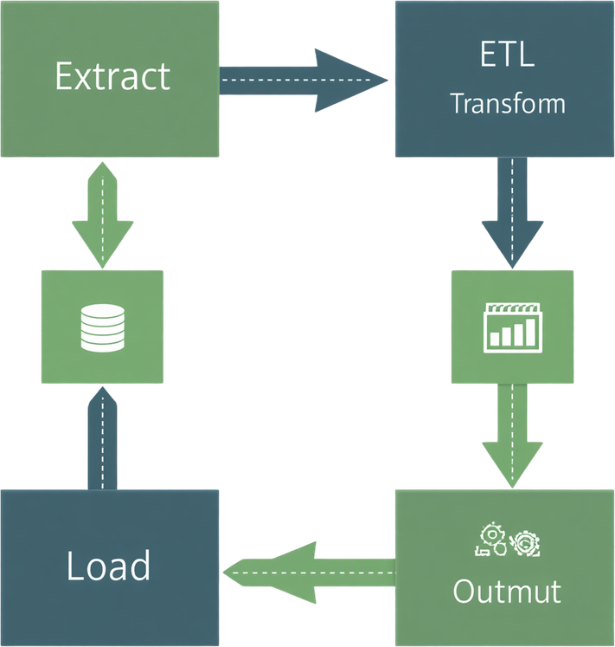





ETL Pipeline
Overview
Transform & Clean
Remove duplicates, standardize dates, handle missing values, validate transaction amounts, and engineer new features for analysis.
Extract Raw Data
Import raw CSV files including fund_master, nav_history, investor_transactions, and performance data into the pipeline for processing.
Analysis-Ready Output
Deliver structured, validated datasets ready for EDA, risk metric calculations, Power BI dashboards, and fund recommendations.
Load to Storage
Store processed data in SQLite database and export clean files to the data/processed/ folder for downstream analysis.

Slide 5




Exploratory Data Analysis – Key Insights
Fund & Transaction Distribution
Investor Demographics
Risk vs. Return & SIP Growth
Equity mutual funds dominate the dataset. SIPs constitute 58.4% of all transactions, followed by Lumpsum (35.34%) and Redemptions (6.17%), reflecting strong systematic investment preference.
66.54% Male vs 33.46% Female investors. The largest age group is 26–35 years (41%), indicating strong participation among young working professionals.
Higher-risk funds yield significantly higher average returns (~22% vs ~6%). Monthly SIP inflows show a steady upward growth trend, signaling rising investor confidence.

Slide 6


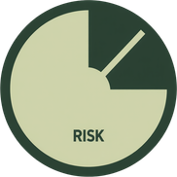

Advanced Risk Metrics
VaR & CVaR Analysis
Historical VaR
(95% Confidence)
Conditional VaR
(CVaR / ES)
Risk Management
Application
Quantifies the maximum potential loss over a given period at a 95% confidence level. Helps set risk thresholds across fund categories.
Estimates the expected loss in worst-case scenarios beyond the VaR threshold. Provides a more conservative and complete risk picture.
VaR and CVaR are compared across fund categories and risk grades to identify high-exposure funds and guide portfolio risk decisions.

Slide 7



Rolling Sharpe Ratio Analysis
90-Day Rolling Methodology
Track Performance Fluctuations
Identify Consistent Outperformers
Sharpe Ratio is computed on a rolling 90-day window to capture dynamic risk-adjusted returns, smoothing short-term noise while reflecting evolving fund performance.
Rolling analysis reveals how fund efficiency shifts over time, highlighting periods of outperformance and drawdown relative to risk taken by the fund manager.
Funds maintaining a stable, high rolling Sharpe Ratio across market cycles are flagged as consistent outperformers and prioritized in the recommendation system.

Slide 8



Investor Cohort & SIP Continuity Analysis
Cohort Analysis by First Investment Year
SIP Continuity Flagging
At-Risk Investor Detection
Investors grouped by year of first investment to track retention, behavioral patterns, and long-term loyalty trends across cohorts.
SIPs with gaps exceeding 35 days are automatically flagged as at-risk, enabling proactive intervention to prevent lapse and improve continuity rates.
Identifies investors at risk of SIP lapse, quantifies loyalty metrics, and supports targeted retention strategies to reduce churn and improve AUM stability.

Slide 9

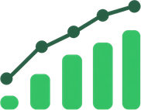
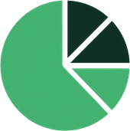
Power BI Dashboard – Fund Performance (Page 1)
Key Performance Metrics
NAV Trends & Risk vs Return
Gender & Investor Distribution
Total Funds: 40 | Total AUM: 1 Million | Avg 3-Year Return: 14.09% | Avg Sharpe Ratio: 1.36. These headline KPIs provide an at-a-glance summary of the mutual fund portfolio's overall health and performance.
Interactive NAV trend line chart tracks historical fund performance over time. Risk vs Return scatter plot maps each fund's annualized return against its volatility, enabling quick identification of high-performing, risk-efficient funds.
Gender distribution pie chart reveals 66.54% Male and 33.46% Female investors. Age cohort breakdown highlights the 26–35 segment as the dominant group at 41%, guiding targeted fund recommendations and communication strategies.

Slide 10



Power BI Dashboard –
Industry Overview (Page 2)
Risk Grade Distribution
Top 10 Funds by 3-Year Return
Fund Distribution by Category
Moderate: 40%, High: 20%, Low: 15%, Very High: 15%, Moderately High: 10%. Higher-risk funds average 3Y return ~22% vs lower-risk ~6%.
Ranked bar chart highlighting top-performing mutual funds. Leading funds deliver 3-year returns exceeding 22%, driven by equity mid-cap and small-cap categories.
Equity funds: 39K transactions, Debt funds: 7K. Age group and state-wise investment breakdowns reveal regional preferences and demographic trends.

Slide 11



Power BI Dashboard
Investor Analytics (Page 3)
Transaction Type Distribution
State & Age Group Analysis
Gender & City Tier Breakdown
SIP: 58.4% of all transactions. Lumpsum: 35.34%. Redemption: 6.17%. SIPs dominate, reflecting strong systematic investment behavior among investors.
Investment volumes mapped by state and age group. Largest investor segment: 26–35 years (41%). Geographic spread reveals top contributing states and regional trends.
66.54% Male, 33.46% Female investors. City tier analysis compares Top 30 vs Bottom 30 cities, highlighting urban concentration and growth potential in Tier-2 markets.

Slide 12



Power BI Dashboard –
SIP Market Trends (Page 4)
Monthly SIP
Inflow Trends
Risk Grade &
Category Breakdown
Avg 3-Year Return
by Fund House
Line chart tracks monthly SIP inflows showing steady growth over time, highlighting seasonal patterns and acceleration in retail investor participation across fund categories.
Bar charts display risk grade distribution and investment by fund category — Equity leads at 39K, followed by Debt at 7K, with Moderate risk grade at 40% of total funds.
Ranked bar chart compares average 3-year returns across fund houses. High-risk fund houses average ~22% returns vs ~6% for lower-risk peers, guiding investor allocation decisions.

Slide 13
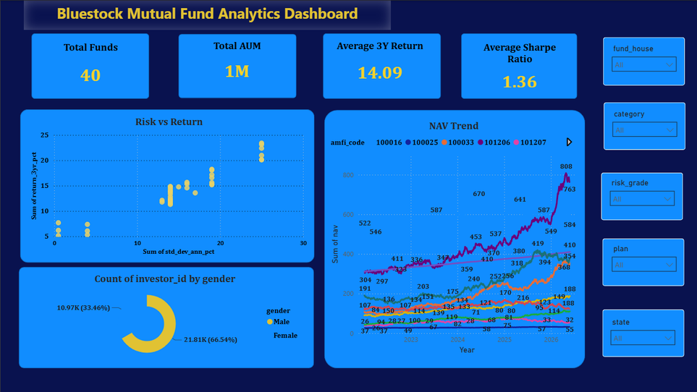
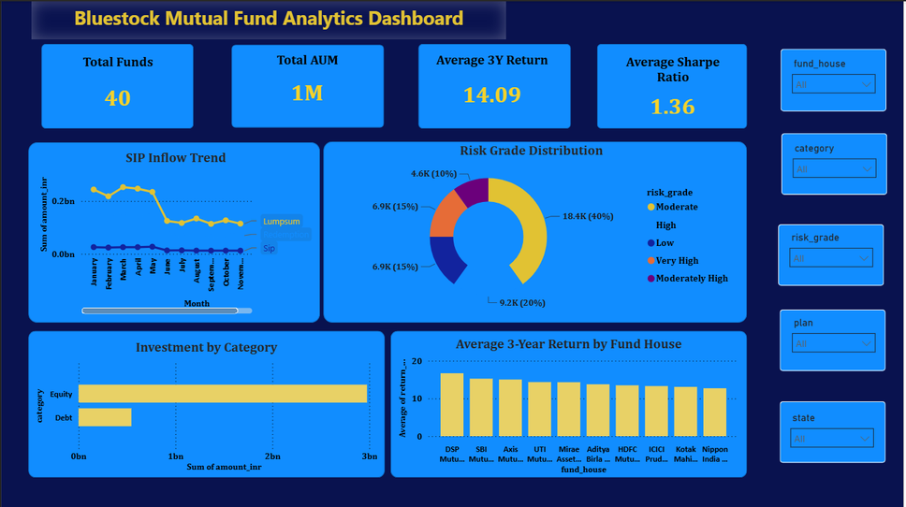
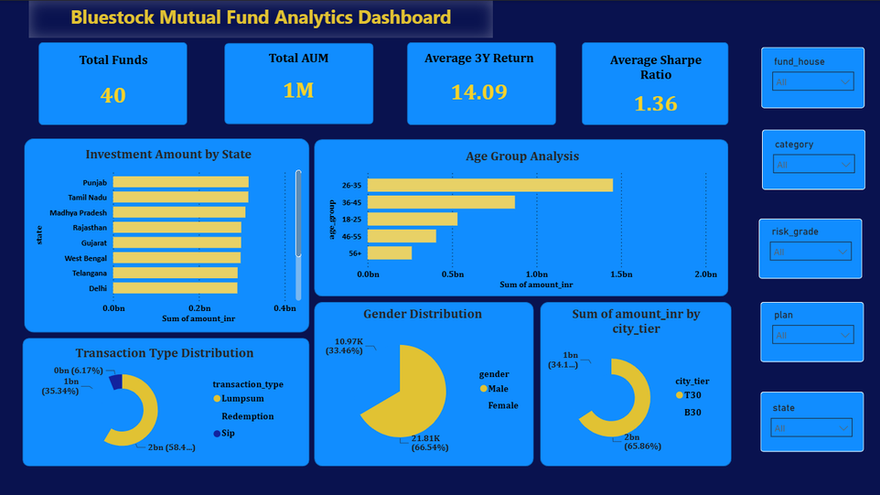
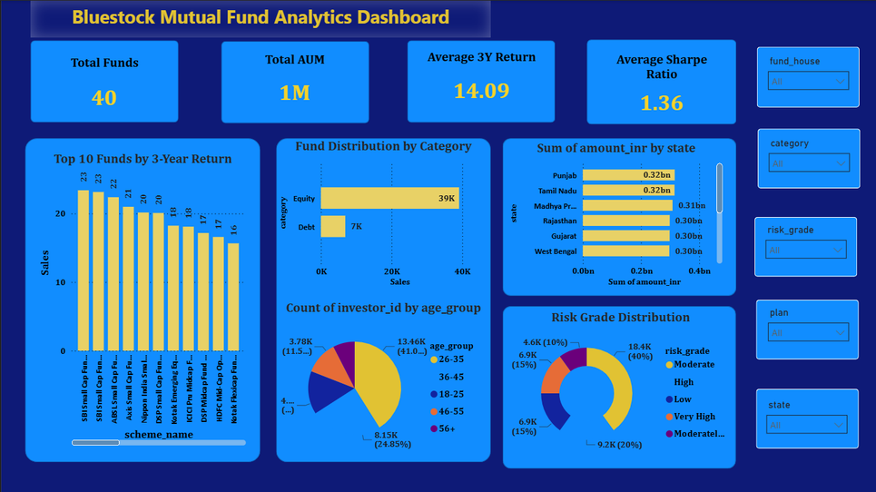
Fund Performance Overview (Page 1)
Industry & Category Analysis (Page 2)
Investor Analytics (Page 3)
SIP Market Trends (Page 4)

Slide 14


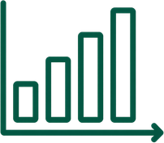


Key Metrics & Risk Analysis Summary
Investor Demographics
Risk Grade Distribution
Top Sharpe Ratio Performers
Total Investors: 32,780
• Male: 21,810 (66.54%)
• Female: 10,970 (33.46%)
Transactions:
• SIP: 58.4%
• Lumpsum: 35.34%
• Redemption: 6.17%
• Moderate: 40%
• High: 20%
• Low: 15%
• Very High: 15%
• Moderately High: 10%
Higher-risk funds avg 3Y return ~22% vs lower-risk ~6%
Best risk-adjusted returns:
ICICI Pru Liquid Fund
Kotak Liquid Fund
ABSL Liquid Fund
Avg Portfolio Sharpe Ratio: 1.36

Slide 15



Mutual Fund Recommendation System
Step 1: Filter by Risk Appetite
Step 2: Rank by Sharpe Ratio
Step 3: Top 3 Recommendations
Funds are filtered based on the investor's risk grade preference (Low, Moderate, High, Very High) to ensure suitability.
Within each risk category, funds are ranked by Sharpe Ratio to identify the best risk-adjusted return performers.
High Risk Example:
• Kotak Emerging Equity (0.96)
• ICICI Pru Midcap (0.95)
• DSP Midcap Fund (0.90)

Slide 16






Future Enhancements
Live NAV data integration via APIs, ML models for return prediction, and personalized recommendations using collaborative filtering.
Real-Time Deployment & Automation
Real-time Power BI dashboard deployment with automated data refresh pipelines for continuous, up-to-date fund analytics.
Thank You for Your Attention
Future Scope & Closing
Open for questions and discussion. Presented by Divyansh Dave – Bluestock Fintech Internship, June 2026.

