Slide 1
THE EFFECTS OF GROWTH , FOREIGN AID AND FINANCIAL DEVELOPMENT ON POVERTY
DIVYANSH GUPTA(200351)

Slide 2
Introduction
Over the last two decades, global poverty has decreased significantly (1981-2010), East Asia and the Pacific have seen the sharpest declines in both the number of poor and the poverty rate whereas Sub-Saharan Africa has seen a significant increase in the number of poor over the same period.
Poverty reduction will be a major challenge in the future due to the disparities in experience across regions. Numerous cross-country research and case studies, discover a one-to one relationship between the poorest quintile’s income and average income.
Current empirical studies suggest that growth-promoting policies such as financial system development, trade openness, and remittances may have a systemic impact on the poor.
This study answers the following two questions, First: how does growth and policies that promote development affect poverty-reduction? Second, is the effect of each of these explanatory variables nonlinear in terms of poverty? Because the sequencing of reforms for effective and expedited poverty eradication may change in response to growth and policy.

Slide 3
Literature Review
Both cross-country and case studies have shown the importance of continuous economic development as a significant component in poverty eradication (see Ravallion & Chen, 1997; Dollar & Kraay, 2002:2004: Besley & Burgess, 2003; Kraay, 2006).
According to Dollar and Kraay (2002), there is a one-to-one relationship average income and income of the poorest quantile and conventional growth factors such as trade policy have little effect on low income.
Tsai and Huang (2007) had results similar to Dollar and Kray but contrary to them, they also showed openness to international commerce has a large poverty-reducing impact.
However, Ravallion (2006), using micro and macro data, concludes that trade has a substantially smaller poverty-reduction impact.
According to Tsai and Huang (2007), FDI inflows have no substantial influence on poor income.

Slide 4
Literature Review
Chambers et al. (2008) using panel data from 1986 to 2000 discovered an inverted-U shaped relationship between income and poverty, i.e., short-run economic growth enhances poverty while long-run growth decreases poverty.
Adams and Page (2005) discovered that foreign remittances have significant poverty-reduction impacts in the area while examining development of poverty, inequality, and growth in selected Middle East and North African nations from 1980 to 2000.
Beck et al. (2007) discovered that financial growth not only benefits the lowest quintile's income but also decreases income disparity. These two findings, together with the growth-enhancing impacts of financial development, demonstrate the critical role that financial development plays in poverty alleviation.
Clemens et al. (2012) discovered that foreign help had a moderate positive impact on growth, Alvi and Aberra(2014) found that growth in average income and other growth enhancing policies have heterogenous impact on poverty, especially the marginal effect of growth and growth enhancing policies decreases at higher levels of poverty.

Slide 5
Objective
The purpose of this paper is to revisit the relationship between average income and other determinants of growth on poverty using Non Parametric Analysis. If the true impact is nonlinear, the findings of prior studies' least squares calculation, which offer a point estimate of the average influence of growth and development-enhancing measures on poverty, may be deceptive. Contrary to least squares estimation, Non Parametric Analysis does not assume any prior function or relationship between poverty and other determinants of growth, thus it is perfect to depict the non-linear relationship between average income and other determinants of growth on poverty and the varying effects of growth enhancing policies on poverty. We can therefore show where the impact of growth and growth enhancing policies on reducing poverty is the highest and the lowest, (whether the higher levels of poverty are affected by the growth and financial aid more or whether we need different policies for different poverty levels.)

Slide 6
Data Source and Coverage
Time-series data for India from 1977 to 2019 make up our sample. The PovcalNet poverty and inequality dataset from the World Bank contains information on poverty and the Gini coefficient, a measure of income inequality. Real GDP per capita, trade, foreign assistance, financial development, inflation, age dependence ratio, foreign direct investment flows, and international remittances are some of the other factors we utilise. These data are obtained from the World Bank, World Development Indicators. We use the international poverty line of "$2.15 a day" in 2017 PPP . Variable definitions and sources of data are available below.
The explanatory factors are assessed as averages over three years since the dependent variable, which measures poverty, is accessible every three years. The amount of foreign help, for instance, that corresponds to the year 1990 is the average of the aid flows from 1988 to 1990.

Slide 7
Model Specification
To examine the relative impact of growth and income distribution for poverty reduction, I will employ the Kernel Regression using Nadaraya-Watson Estimator .To test the effect of growth-enhancing policies on poverty, we expand the basic specification to include factors identified in the literature as determinants of growth, such as openness to international trade, financial development, government consumption, institutional quality, and international capital flows-foreign aid, FDI inflows, and international remittances. There is no specified relationship between poverty and growth as we are using non parametric analysis and the whole estimation of relationship depends on data.
Dependent Variable:- Poverty Gap(Log of the average income shortfall as share of poverty line)
Independent Variable:- Real GDP per Capita, Aid, Openness to Trade, Finance, Age dependency Ratio, Mean Household Income, Foreign Direct Investment, Remittances

Slide 8
Data Source and Coverage
VARIABLE DEFINTIONS AND SOURCES
Variables Variable Definitions Source
Real GDP per capita Log GDP per capita, PPP(2017) World Development Indicator
Aid Aid % of Gross National Income (GNI) World Development Indicator
Openness Log of the sum of exports and imports of goods and World Development Indicator
services as share of Gross Domestic Product (GDP)
Finance Log of domestic credit to private sector as share of GDP same as above
Age Dependency ratio The ratio of dependents to working-age population same as above
Headcount Index Log of proportion of people living below the poverty line PovcalNet
Poverty Gap Index Log of the average income shortfall as share of poverty line PovcalNet
Mean Household Income Log of the mean annual household income in 1993 PPP PovcalNet
Foreign direct investment Foreign direct investment, net inflows (% of GDP) World Development indicator
Remittances Workers' remittances and compensation of employees, World Development indicator
received (% of GDP)

Slide 9
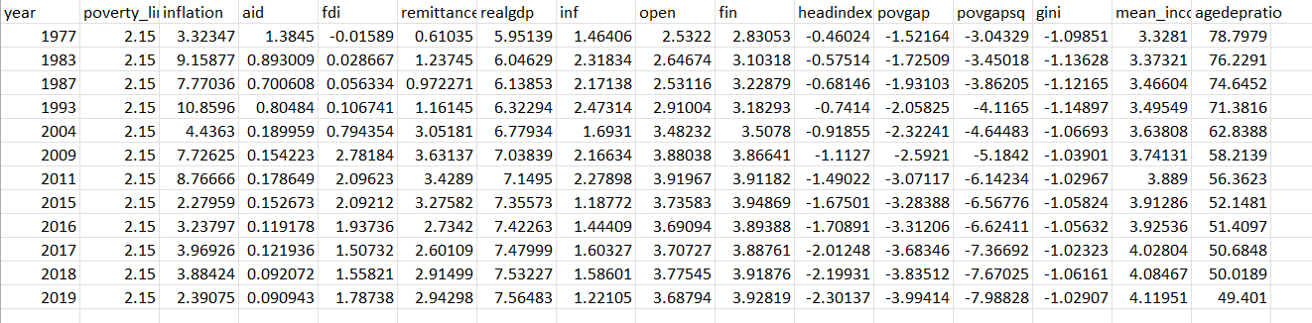
Data

Slide 10
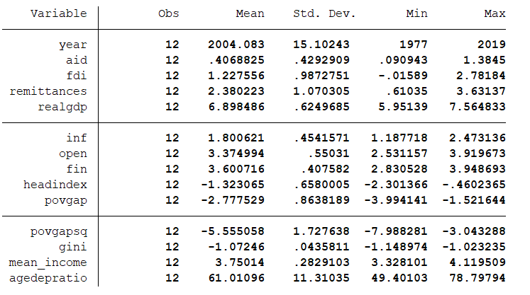
Summary Statistics

Slide 11
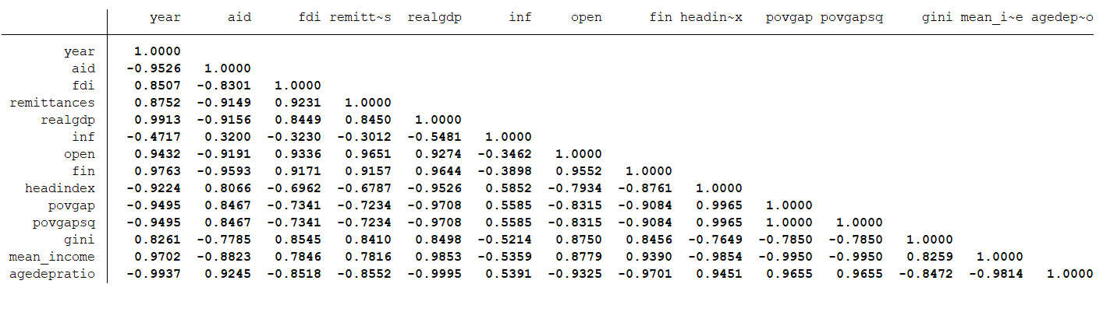
Correlation Map

Slide 12
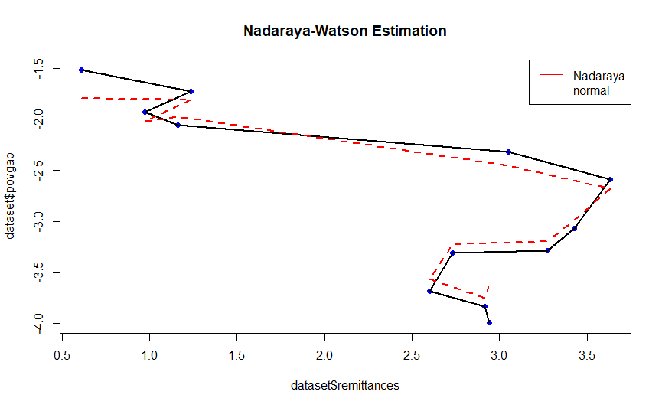
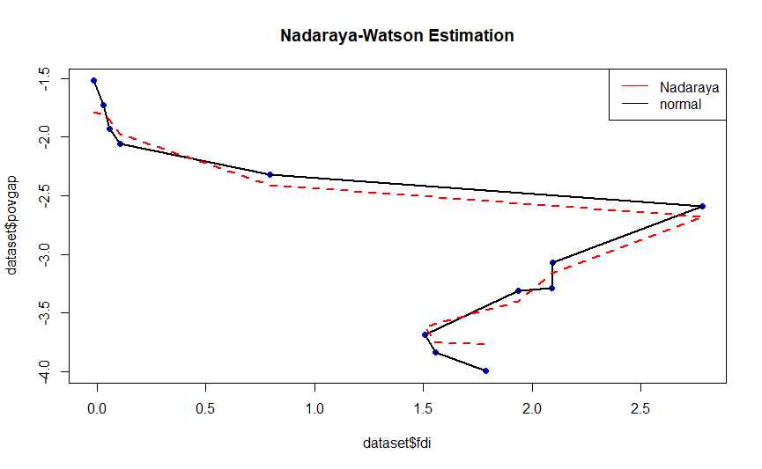
Real GDP appears to be strongly positively correlated with many of the other variables, such as aid, FDI, and remittances, suggesting that these factors may contribute to economic growth.
Openness and financial development are strongly positively correlated with each other, suggesting that a more open economy may be associated with greater financial development, thus reducing the Poverty.

Slide 13
Hypothesis
Based on the above conclusions made by different authors, the hypothesis of my study would be:
There exists a negative relation between the growth in average Income and the average Poverty gap.
Openness to Trade and Foreign Direct Investment have a large poverty-reducing effect.
Financial Development plays a critical role in alleviation of poverty.
There is a negative relation between the mean annual household income and poverty gap.
Age Dependency Ratio is positively correlated with the Poverty Gap.

Slide 14
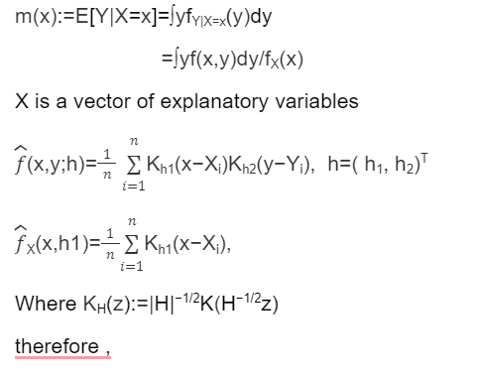
Econometric Methodology
We use Kernel Regression for non-parametric analysis using a time series data on India’s variables. We will be using one of the kernel regression methods called Nadaraya-Watson Estimator for estimating poverty.
The Kernel Density Function K(z) used is Gaussian. K(z)= exp(-z²/2) Y is the dependent Variable

Slide 15
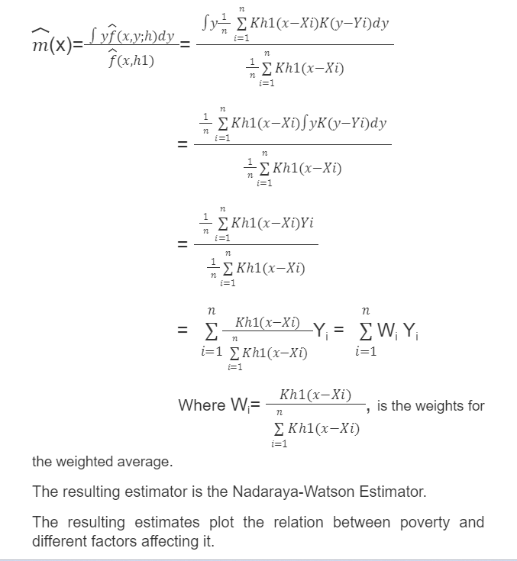
Econometric Methodology

Slide 16
Results and conclusions

Slide 17
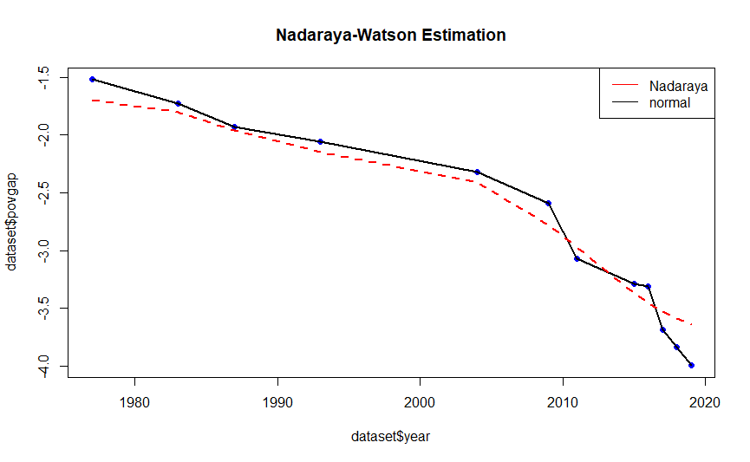
Changes in Poverty over Time
Poverty has decreased over time due to several other factors which we will see in the upcoming slides.

Slide 18
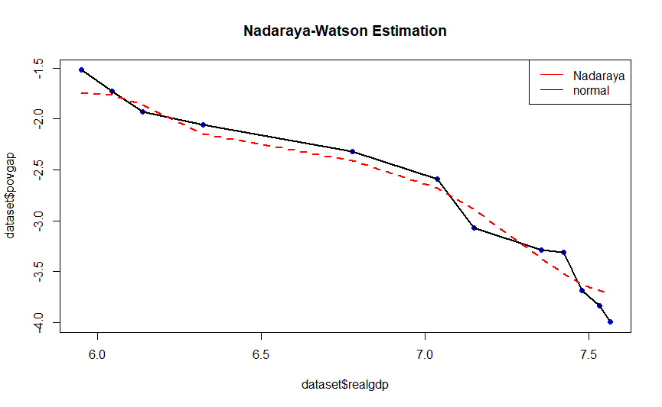
Relationship Between GDP and Poverty

Slide 19
As we can see there is constant decrease of poverty gap in the India Economy with respect to GDP growth which is expected as income growth promotes employment and reduces poverty among the people.

Slide 20
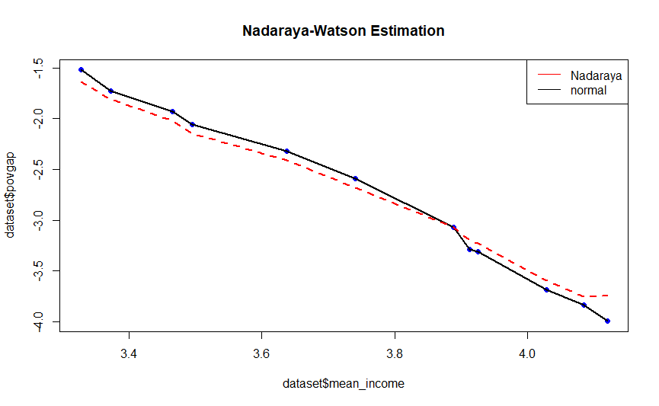
Relationship Between Mean Annual Income and Poverty

Slide 21
As we can see there is constant decrease of poverty gap in the India Economy with respect to income growth which is expected as income growth promotes employment and reduces poverty among the people.

Slide 22
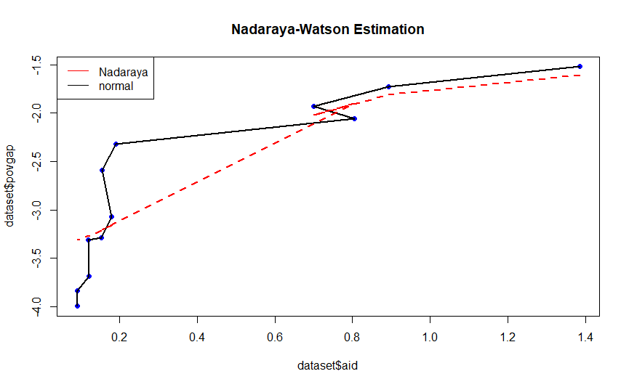
Relationship Between Financial Aid and Poverty
2004-2019
1991-1993

Slide 23
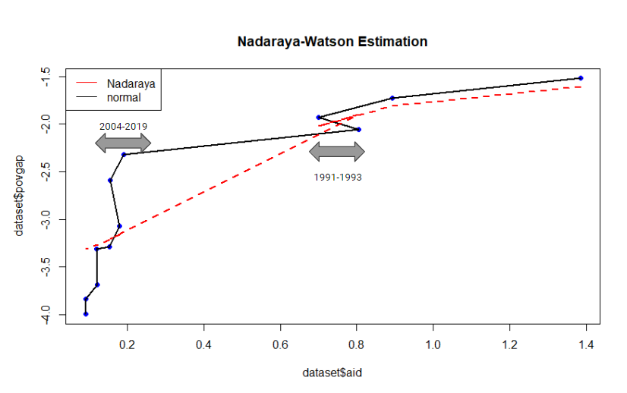
As we can see during years 1991-1992 , there was a sudden increase in financial Aid, due to the Economic Crisis of 1991, which caused the rate at which poverty was declining to decrease, and as the economy progressed we can see that during recent years of 2004-2019, there is a steep decrease in poverty with respect to Aid.
As we can see , there is continuous decrease in poverty as financial Aid to the country decreased, because due to financial development the Aid was no longer needed and the development also decreased poverty.

Slide 24
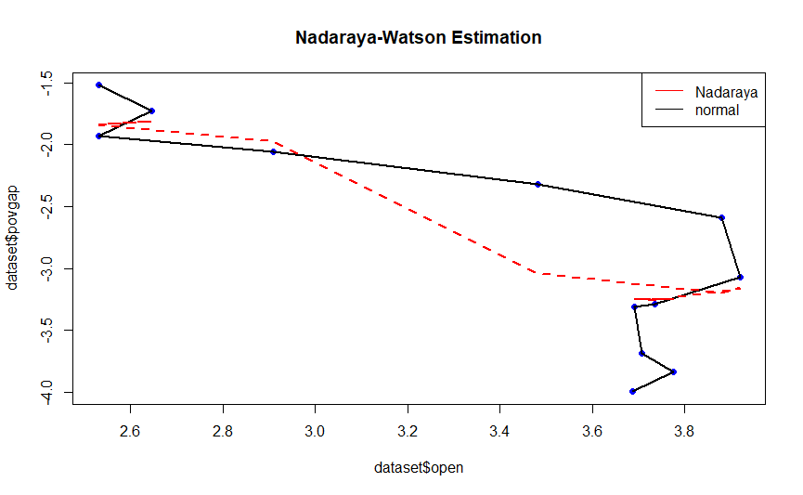
Relationship Between Openness to Trade and Poverty

Slide 25
There was a large jump in exports and imports of India(i.e. Openness to trade increased a lot) due to the new Economic Policy Reforms of 1991 which caused a steep decline in poverty in India. And as can be seen from the general trend removing the restrictions on trade has always reduced poverty in the long run.

Slide 26
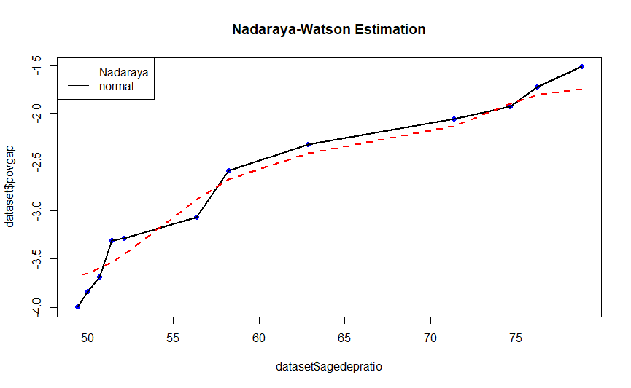
Relationship Between Age Dependency Ratio and Poverty

Slide 27
The increase in the Youth Age-Dependency Ratio negatively affects the mental force of the Working-age population due to the education expenditure pressure which causes an immense load on the financials, thus increasing the income shortfall below poverty line and thus increasing the poverty.
The above graph supports this Hypothesis.

Slide 28
Relationship Between Foreign Direct Investment and Poverty
2009

Slide 29
2009
As we can see from the graph, as FDI increases, the poverty sees a downflow due to money being injected into the economy to promote growth.
In 2009, due to great economic depression, FDI inflow decreased a lot in the country, but still poverty continued to decrease because of the other factors into play.

Slide 30
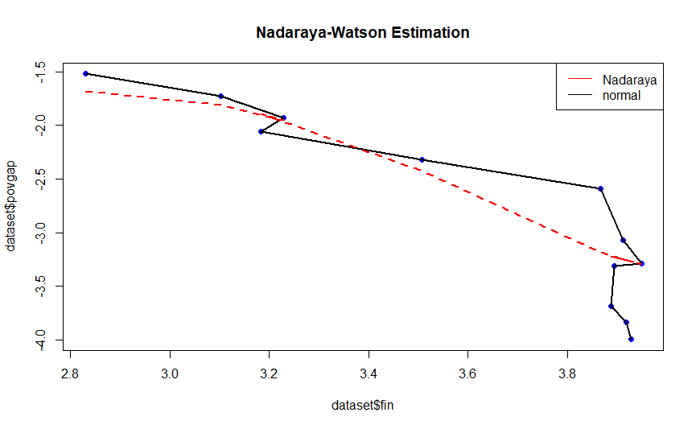
Relationship Between Financial Credit and Poverty

Slide 31
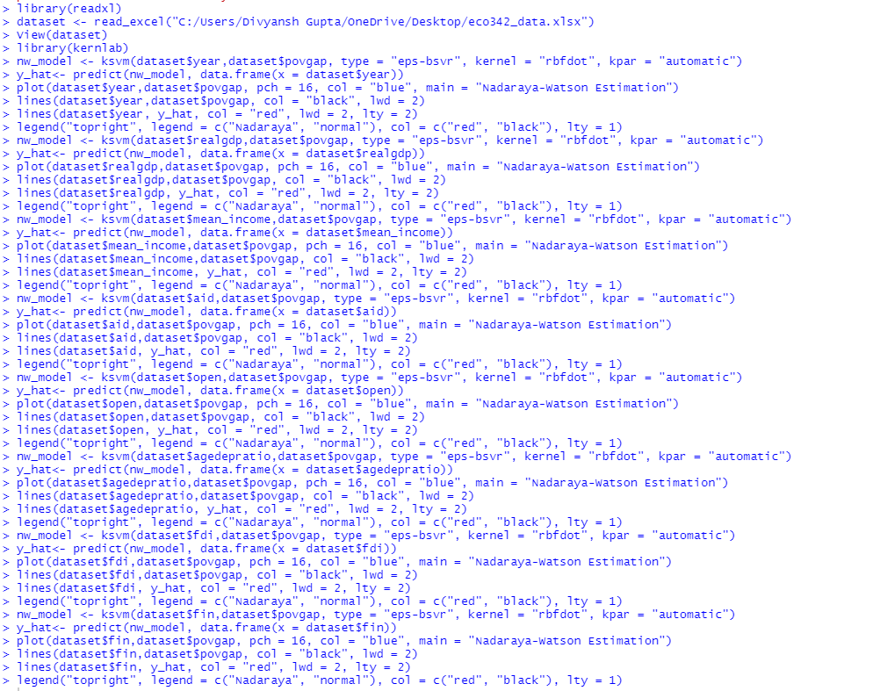
R and STATA Codes

Slide 32
References
Base Paper
“Foreign Aid, Growth and Poverty Relation: A Quantile Regression Approach”, The Journal of Developing Areas, Summer 2014, Vol. 48, No.3(Summer 2014), pp. 381-403
Reference Paper
"Do international migration and remittances reduce poverty in developing countries?”, World Development, 2005, Vol. 33, No. 10, pp 1645-1669.
“Does Foreign Aid reduce Poverty?”, Journal of International Development, 2012, Vol. 24, Issue 8, pp. 955-976.
“Aid, growth and development: Have we come full circle?”, Journal of Globalization and Development, 2010, Vol. 1, Issue 2, pp. 1-29
“Halving Global Poverty”, The Journal of Economic Perspectives, 2003, Vol. 17, No. 3, pp. 3-22.

